Slide 1

How Content Promotion Changed Inbound Marketing Forever
Chad Pollitt
VP of Audience & Co-Founder
Relevance

Slide 2

CHAD POLLITT
@chadpollitt
VP of Audience, Co-founder
Notes:
Bio slide 2

Slide 3
AGENDA
The Content Explosion
Broken Promises
Content Promotion
Success Stories
How it’s Done
How to Budget

Slide 4
1
The Content Explosion

Slide 5

Every Minute of Every Day

Slide 6

Every Minute of Every Day
- Mashable

Slide 7
Every Minute of Every Day
571 websites are launched
- Mashable

Slide 8
Every Minute of Every Day
571 websites are launched
350,000 tweets are tweeted
- Mashable

Slide 9
Every Minute of Every Day
571 websites are launched
350,000 tweets are tweeted
48 hours of YouTube videos are uploaded
- Mashable

Slide 10
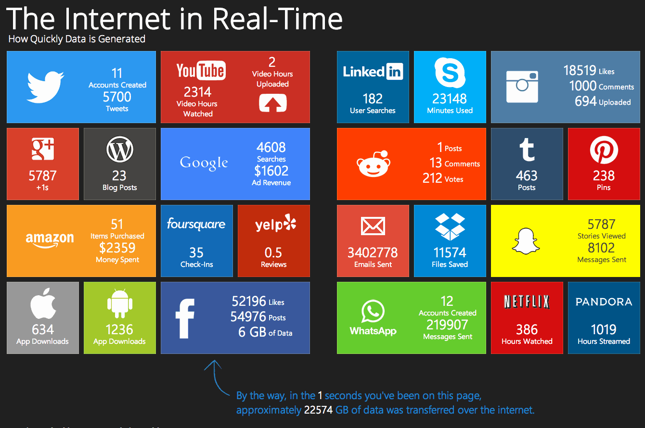

Slide 11
Over
2.73 million
blog posts are written and published daily
The Content Promotion Manifesto

Slide 12
Many Verticals are Oversaturated with Content Already

Slide 13
Great Content Goes Unread Every Day

Slide 14
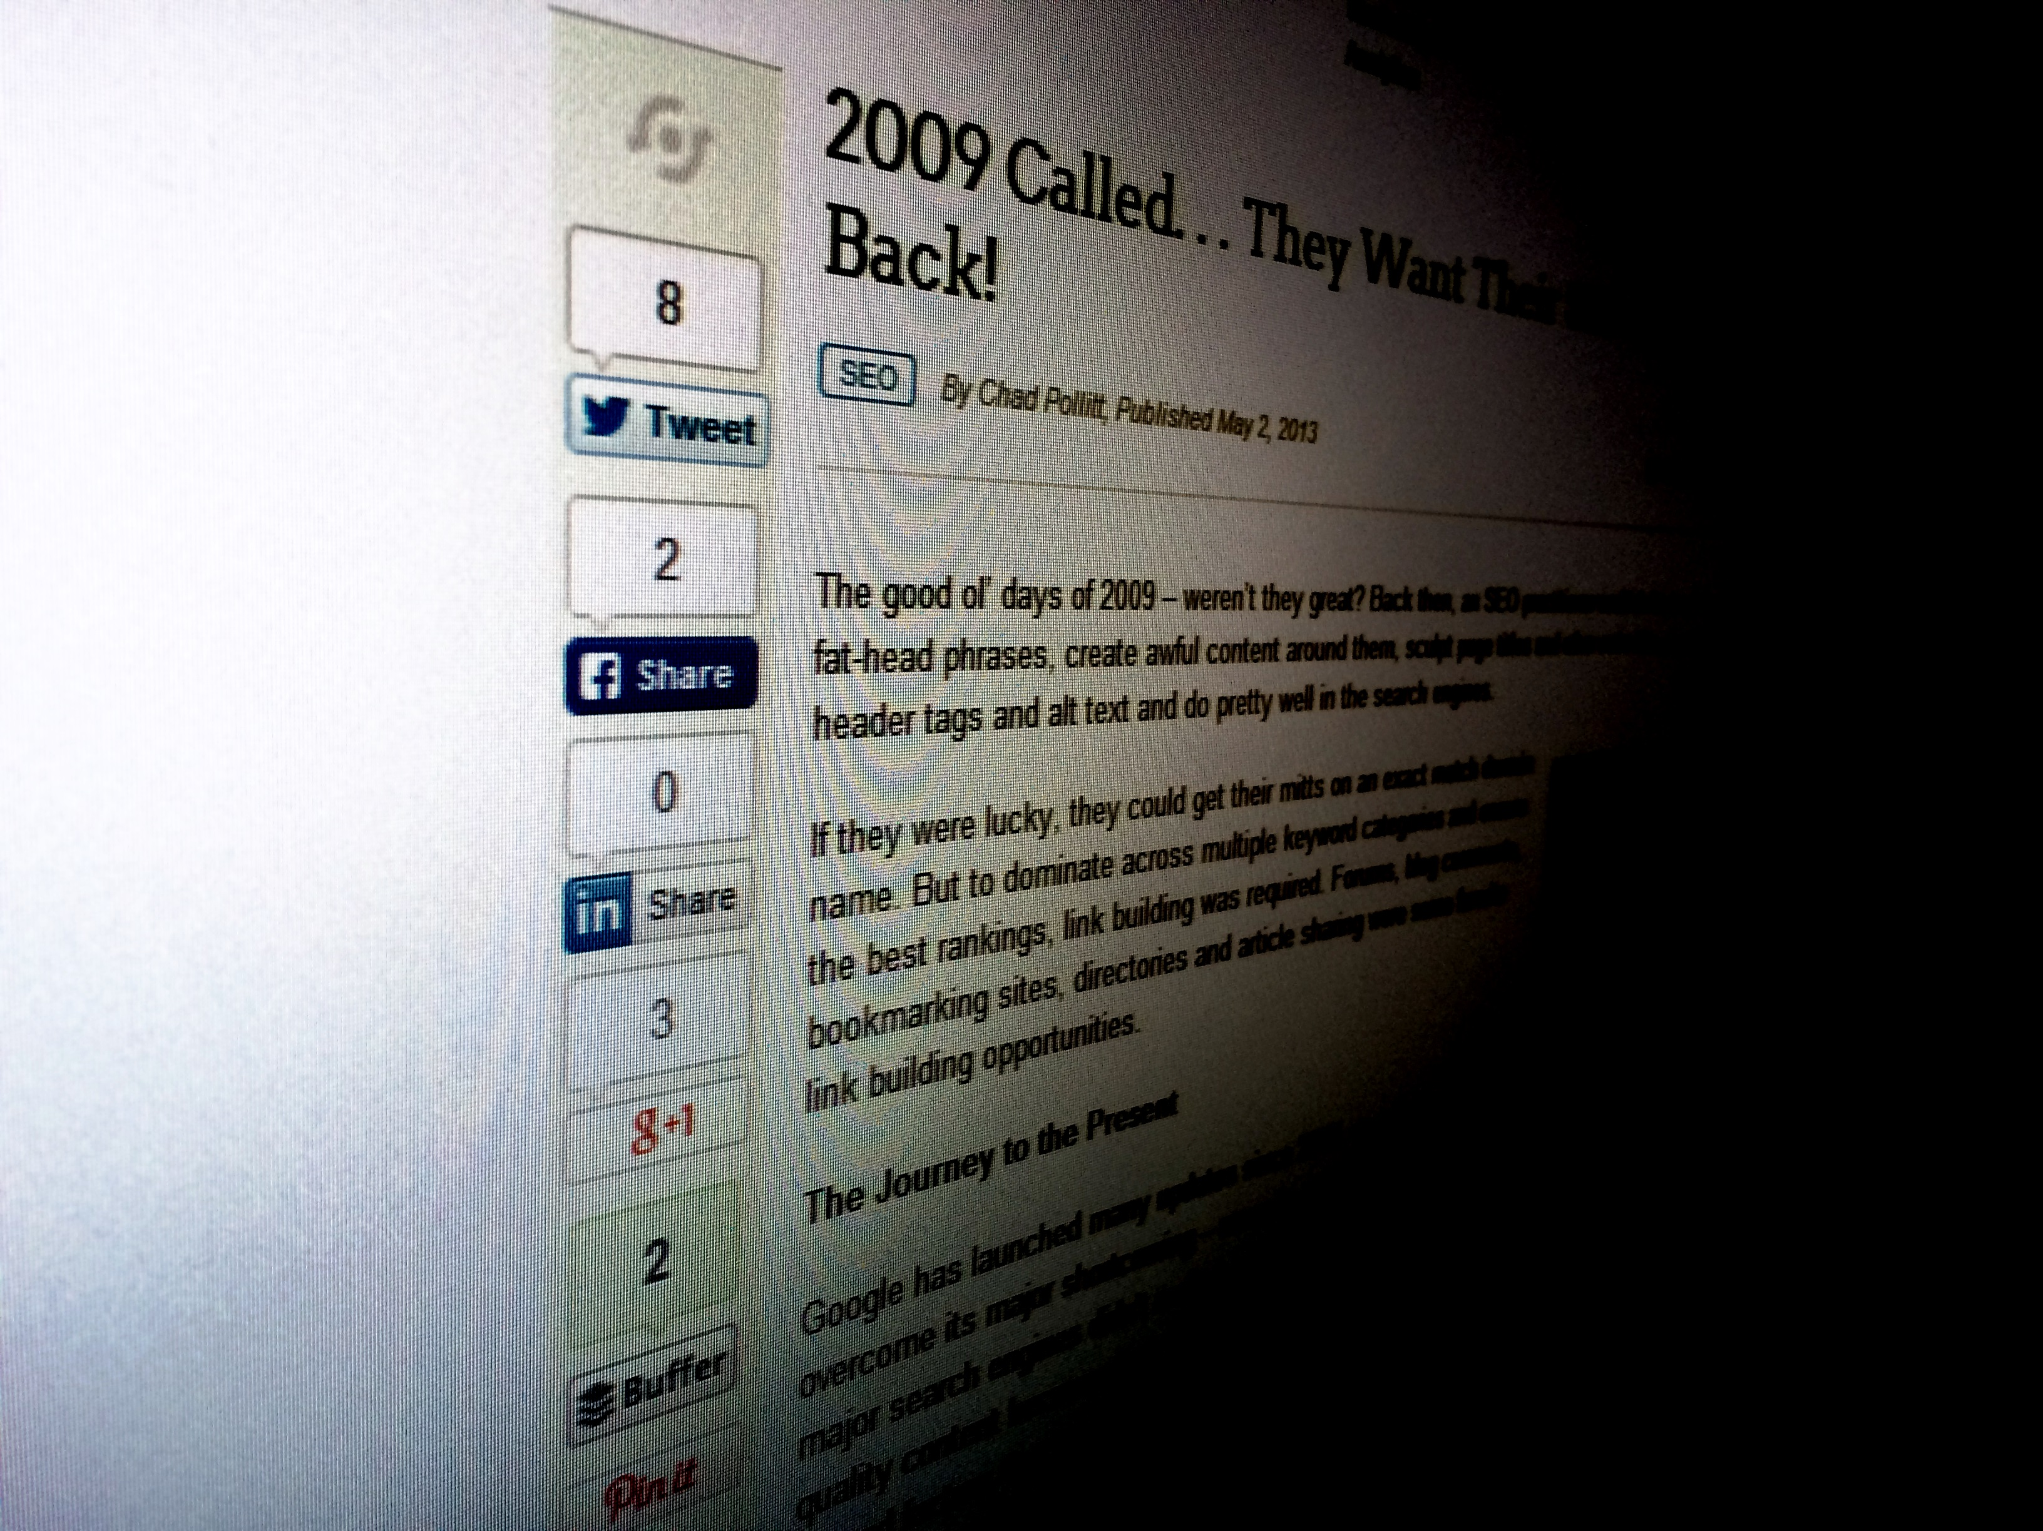
Only 13 Unique
Views

Slide 15
by 2020, the amount of information on the Internet will grow by
500%
Mark Schaefer, The Content Code

Slide 16
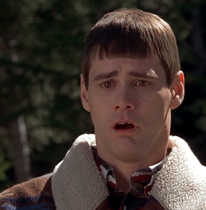
How Does That Make You Feel?

Slide 17
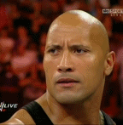
…Or Maybe Like This?

Slide 18
Only
37%
of marketers believe they’re using their content effectively
CMI

Slide 19
This isn’t a CONTENT PROBLEM

Slide 20
It’s an AUDIENCE PROBLEM

Slide 21
“
Brands can actually step down content production and step up distribution [promotion] to get better results
Ryan Skinner, Forrester

Slide 22
“
Better distribution [promotion] improves content’s quality, as the feedback cycle accelerates
Ryan Skinner, Forrester

Slide 23
2
Broken Promises

Slide 24
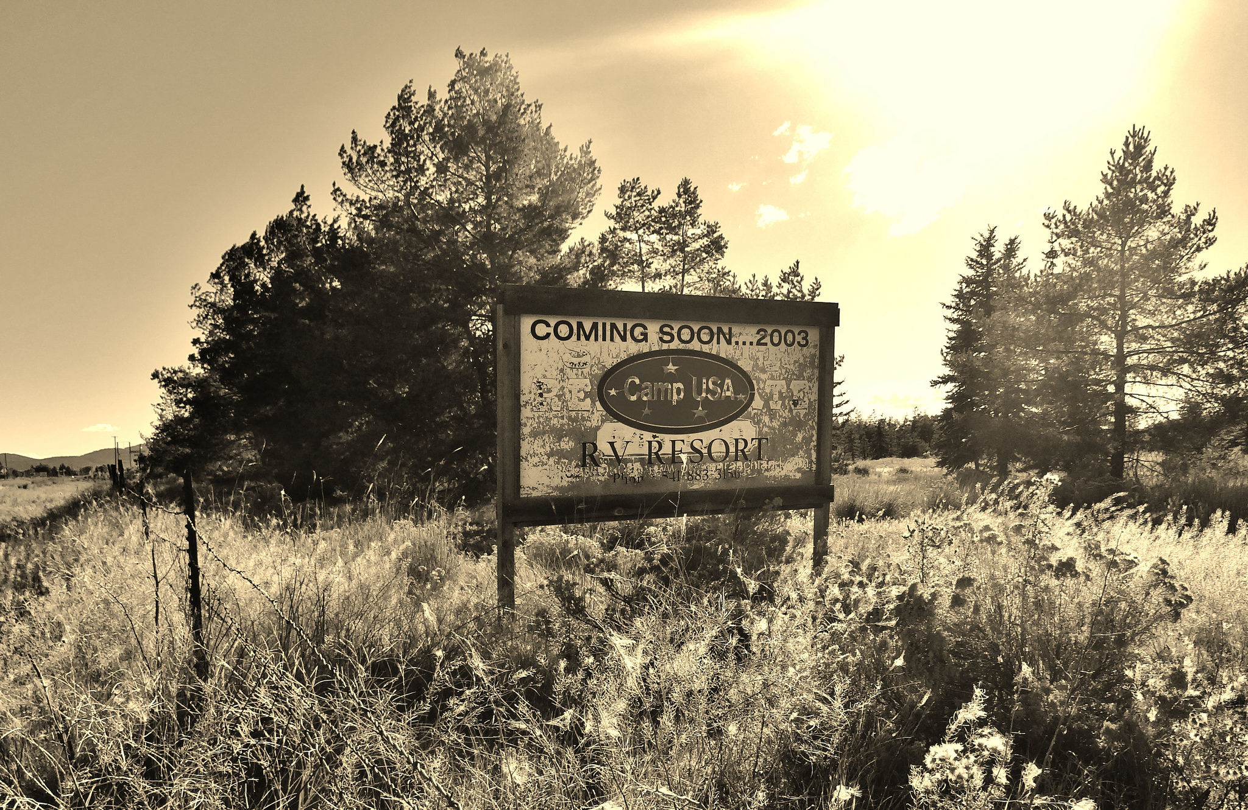
Social media and search engines are breaking their promise to us…

Slide 25

From their inception they’ve been the main content distribution channels of the Internet

Slide 26

They were the gatekeepers of the content delivered and consumed online

Slide 27

Facebook’s organic reach is at 2% and dropping
- International Business Times

Slide 28
With other networks following suit

Slide 29
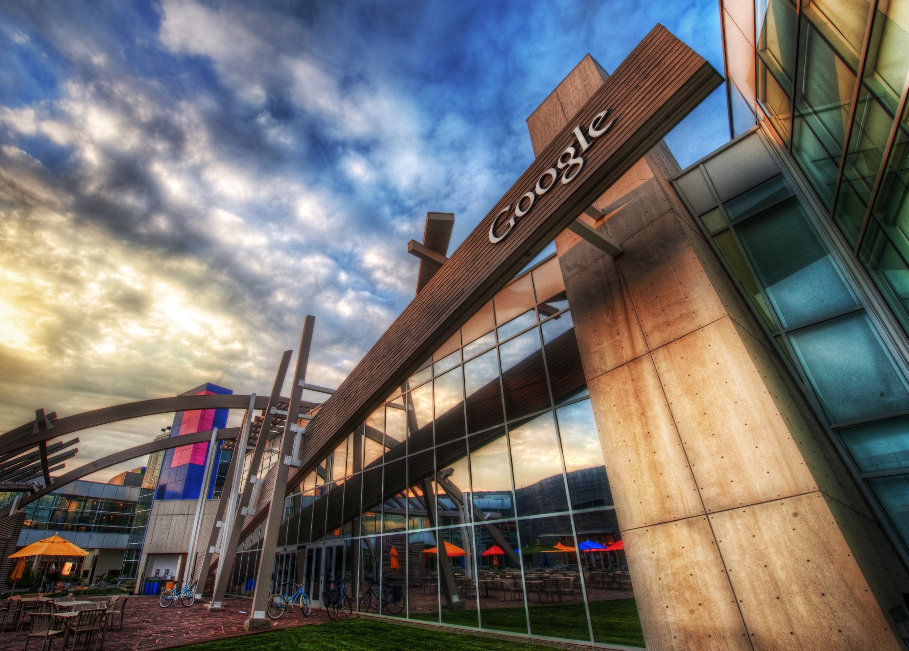
Year over year search query growth is on the decline
- ComScore

Slide 30
There are only 10 organic positions in most search engine results pages

Slide 31
SEO is not something you do anymore, it’s what happens when you do everything else right

Slide 32

Search engines aren’t built to serve up tomorrow’s volume of content

Slide 33
They’re barely built to serve up today’s volume of content

Slide 34

How will we get our content seen?

Slide 35
3
Content Promotion

Slide 36
“
It has been found that the less an advertisement looks like an advertisement and the more it looks like an editorial, the more readers stop, look and read
David Ogilvy, the “Father of Advertising”

Slide 37
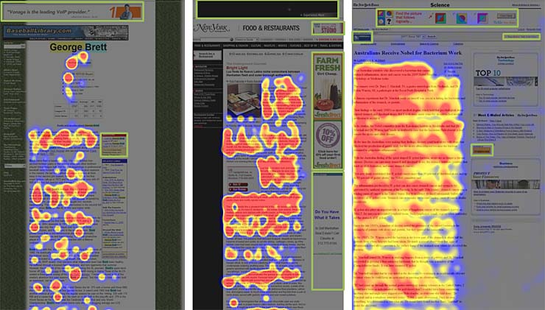

Slide 38
“
You’re more likely to survive a plane crash than click on a banner ad
Solve Media

Slide 39
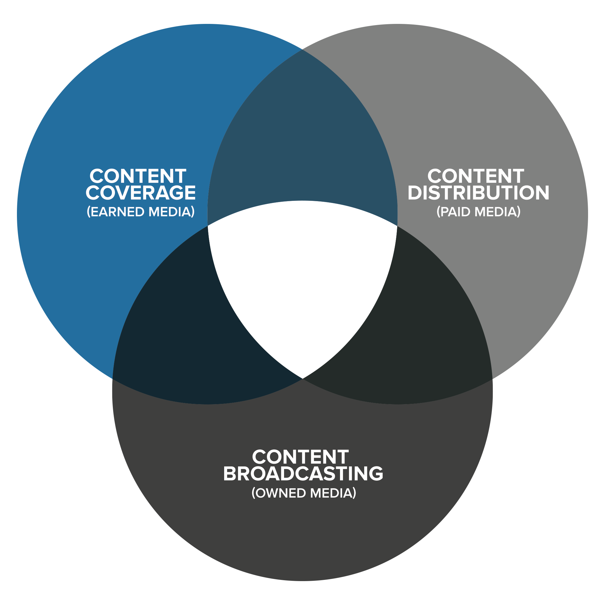

Slide 40
Media Relations
Influencer Outreach
Bylined Articles
Syndication

Slide 41
Media Relations
Native Newsletter
Influencer Outreach
Native Advertising
Bylined Articles
Native Social
Syndication
Advertorials
Press Releases

Slide 42
Media Relations
Native Newsletter
Influencer Outreach
Native Advertising
Bylined Articles
Native Social
Syndication
Advertorials
Press Releases
Social Media
Email

Slide 43
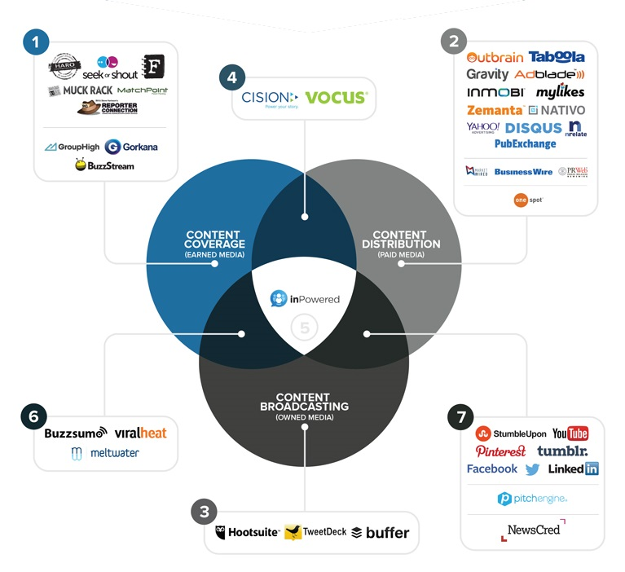
Content Promotion Tools
bit.ly/promotion-ecosystem

Slide 44


Sponsored Content
Everything a media buyer or publisher would need to know!
bit.ly/guide-to-sponsored-content

Slide 45
4
Success Stories

Slide 46
The Greatest Hoodie Ever Made

Slide 47


American Giant
Earned coverage from Slate.com and Esquire

Slide 48
forced a
15 to 20x
increase in production and still barely met demand.
Inc.com

Slide 49
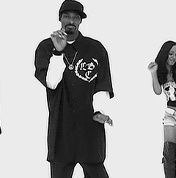
American Giant
Very difficult to get media coverage for a product, but Bayard Winthrop pulled it off

Slide 50

Great product and story with purposeful promotion

Slide 51
How Rodon Beats Chinese Pricing

Slide 52
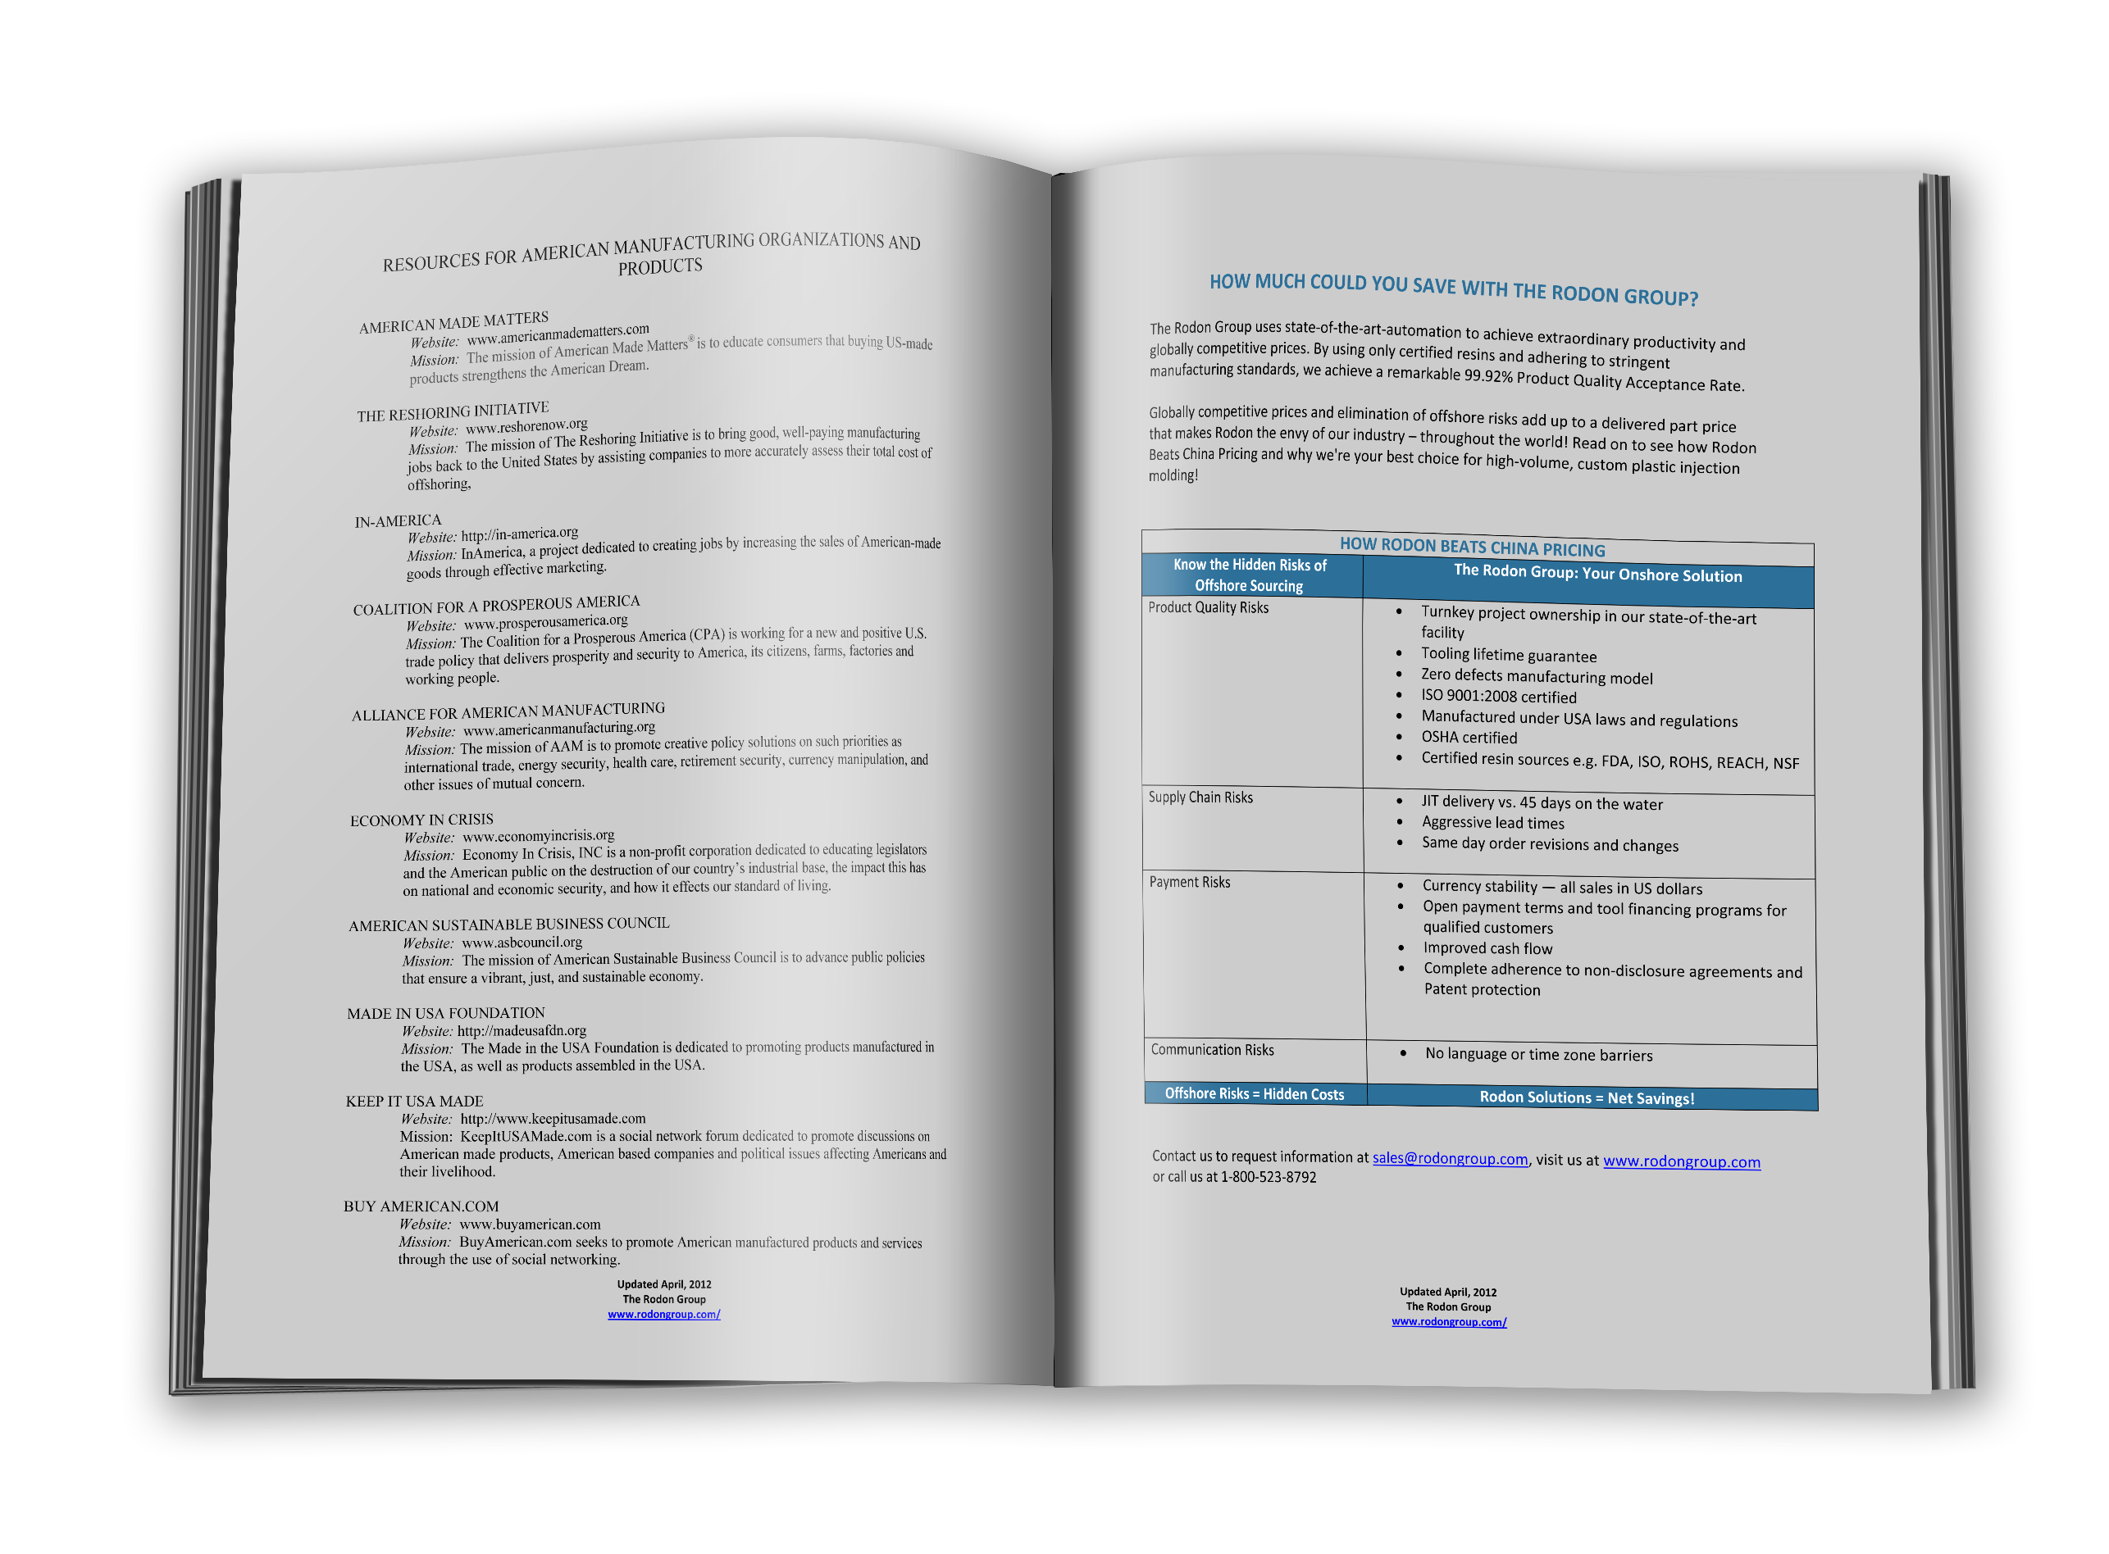
“Cheaper than China” Ebook
The Rodon Group
Earned coverage from virtually every major media outlet

Slide 53
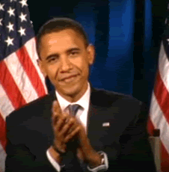
The Rodon Group
…BECAUSE of an in-person endorsement from the POTUS

Slide 54
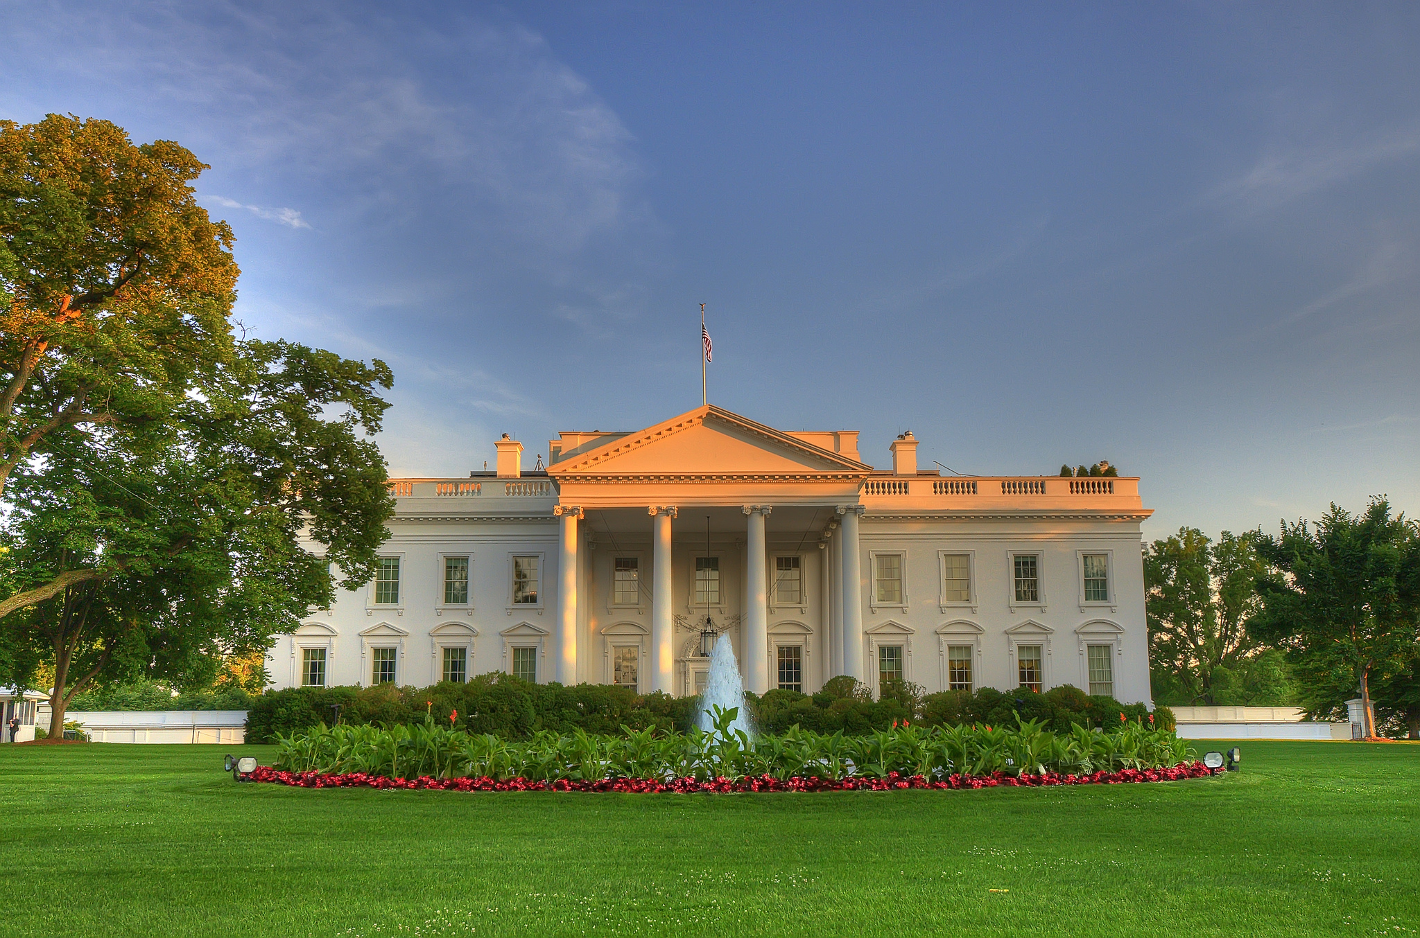
Great content with purposeful promotion

Slide 55
Content that Advanced an Industry

Slide 56
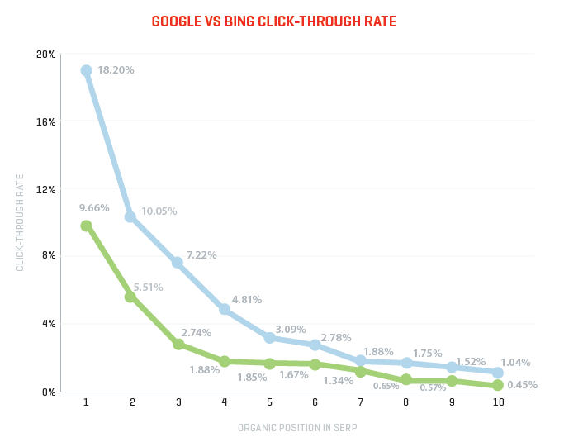
Slingshot SEO
Earned coverage from academia, media outlets and industry influencers around the world

Slide 57
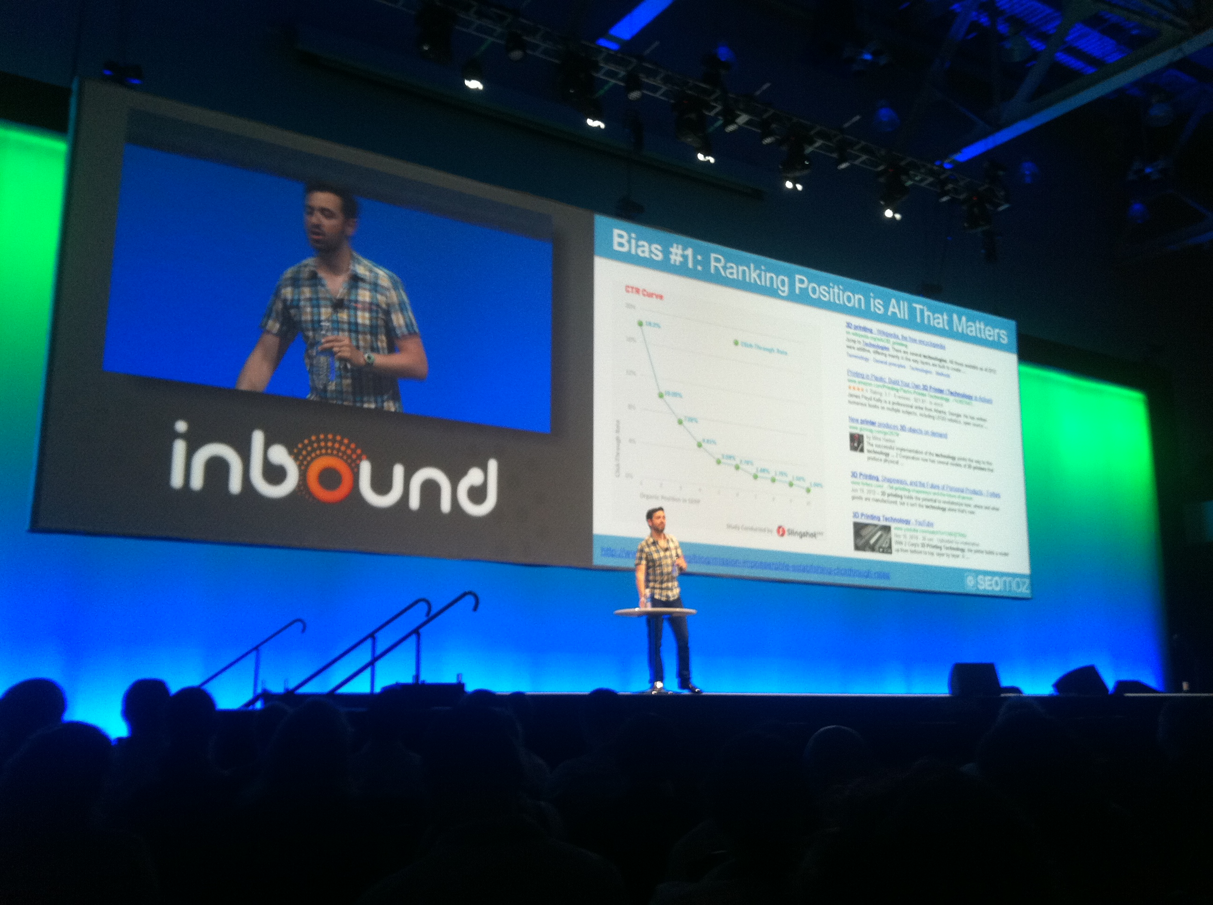
Even an onstage endorsement from Rand Fishkin at INBOUND 2012

Slide 58
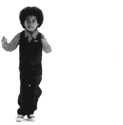
Slingshot SEO
Research and media relations enabled the study to advance an industry

Slide 59
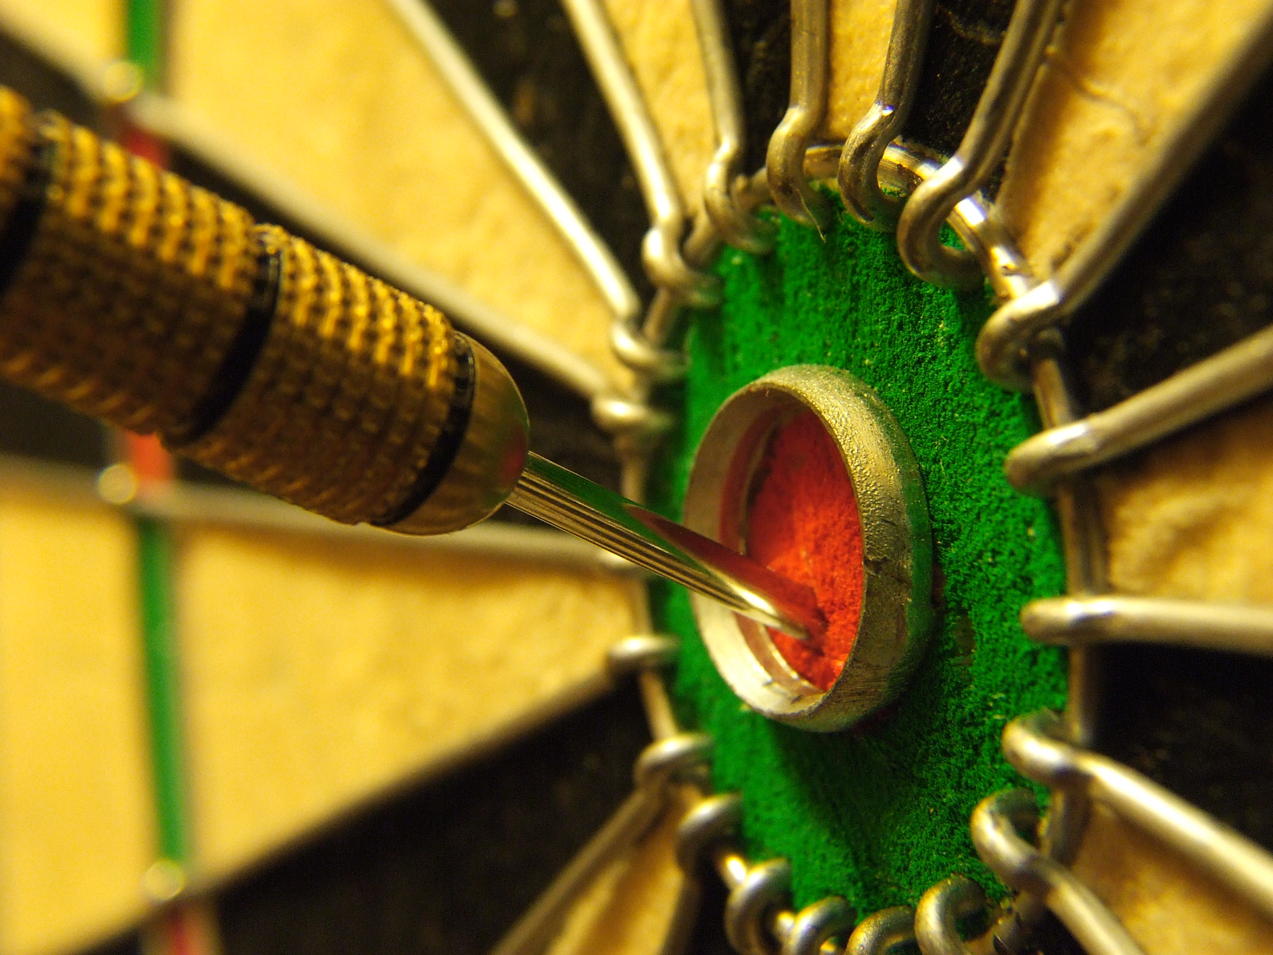
Great content and research with purposeful promotion

Slide 60
Content promotion that drove eight-digits of incremental revenue

Slide 61
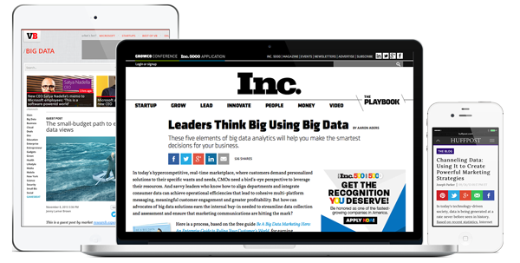
“Big Data Marketing Hero” Ebook
Teradata
Earned coverage from 46 media outlets and trade publications

Slide 62

Over 3 million media impressions
25% landing page conversion rate
30 global brand prospect meetings

Slide 63
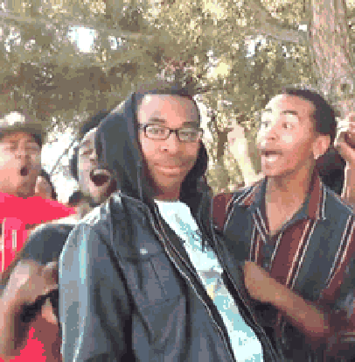
Teradata
A full-on owned, paid and earned media blitz drove 36x return on investment

Slide 64
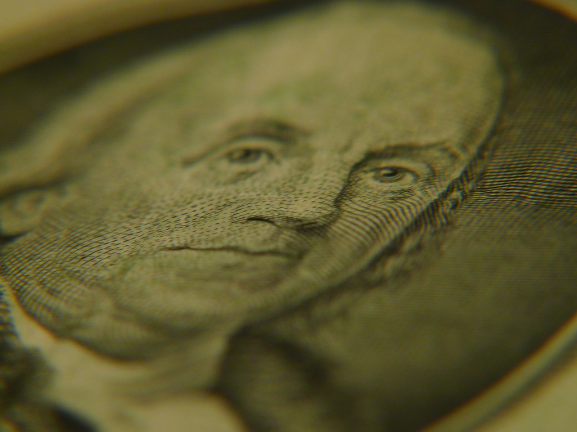
Great content and promotion on all three media channels

Slide 65
The Bottom Line for You?

Slide 66
Start with Research, Create Great Content and Promote It

Slide 67
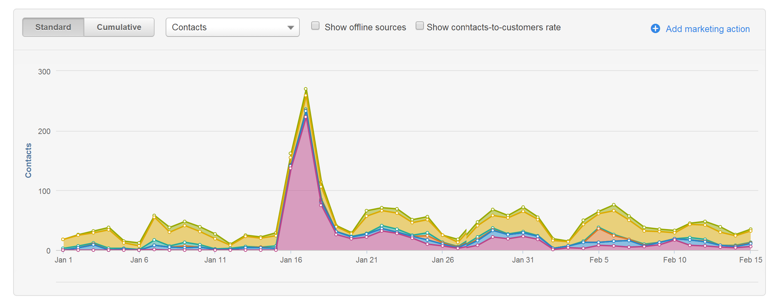
800+ incremental leads in 14 days from one mention on Inc.com

Slide 68
5
How it’s Done

Slide 69

Research

Slide 70
Define Personas
Media Assessment
Audience Assessment
Content Assessment
Influencer Identification
Research

Slide 71
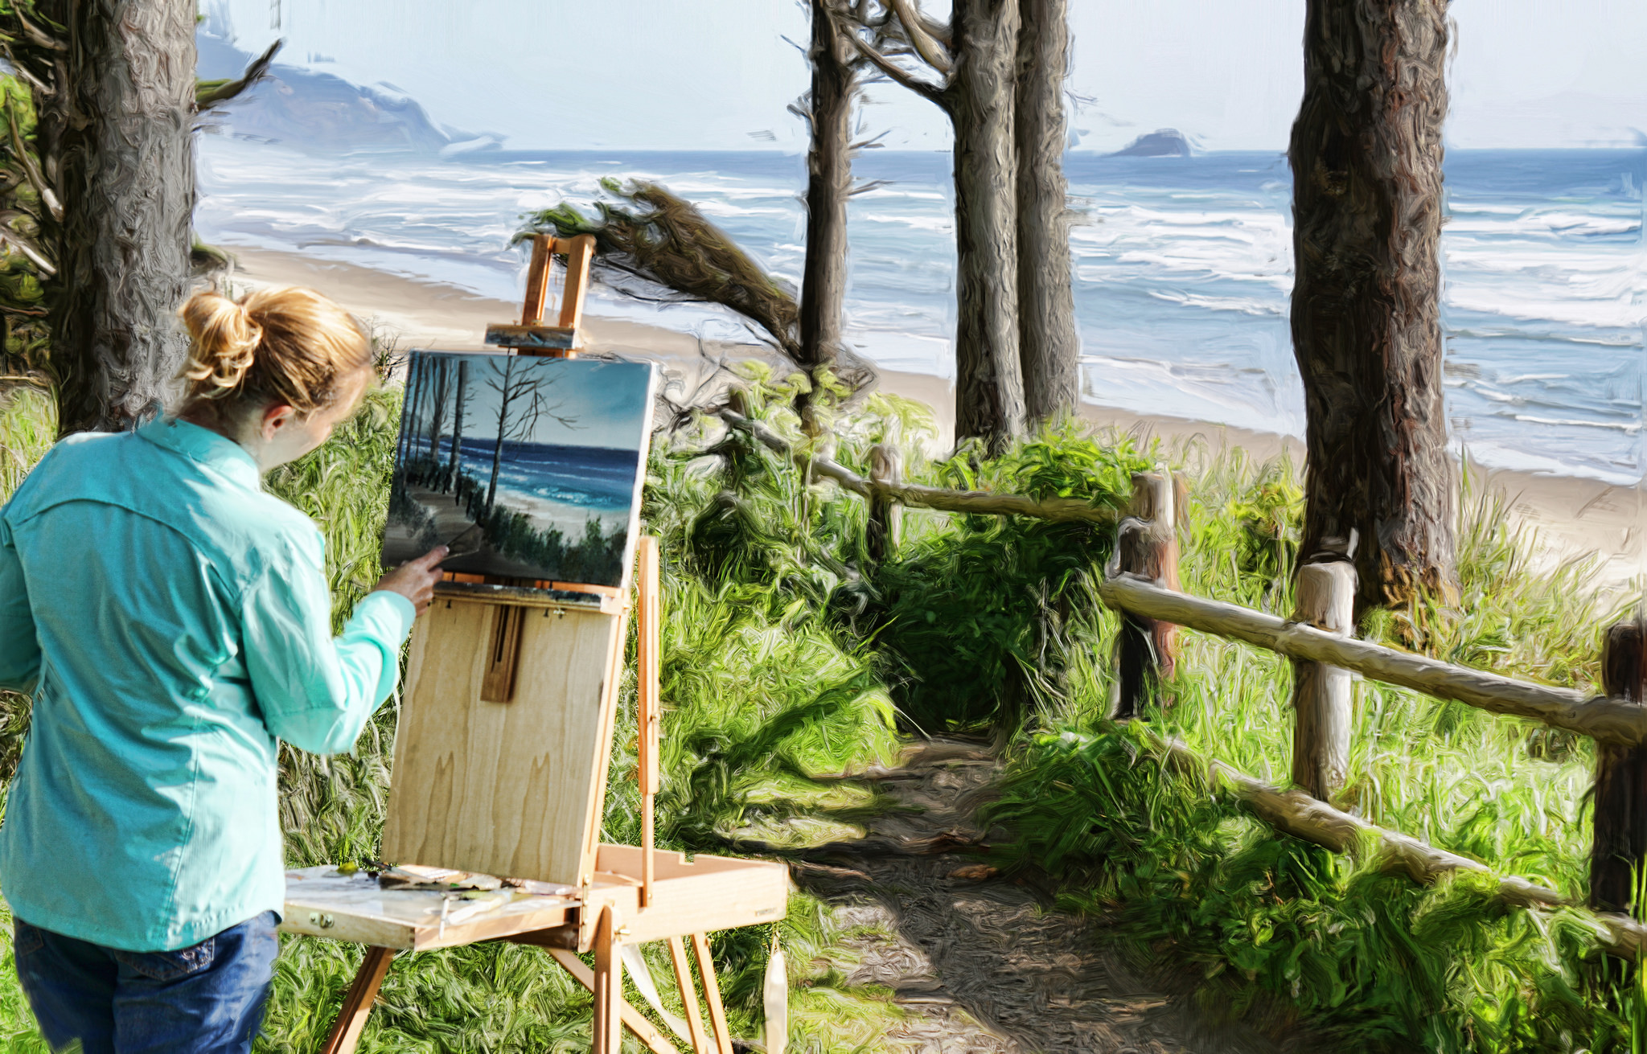
Creative

Slide 72
Creative
Create content and all supporting assets

Slide 73
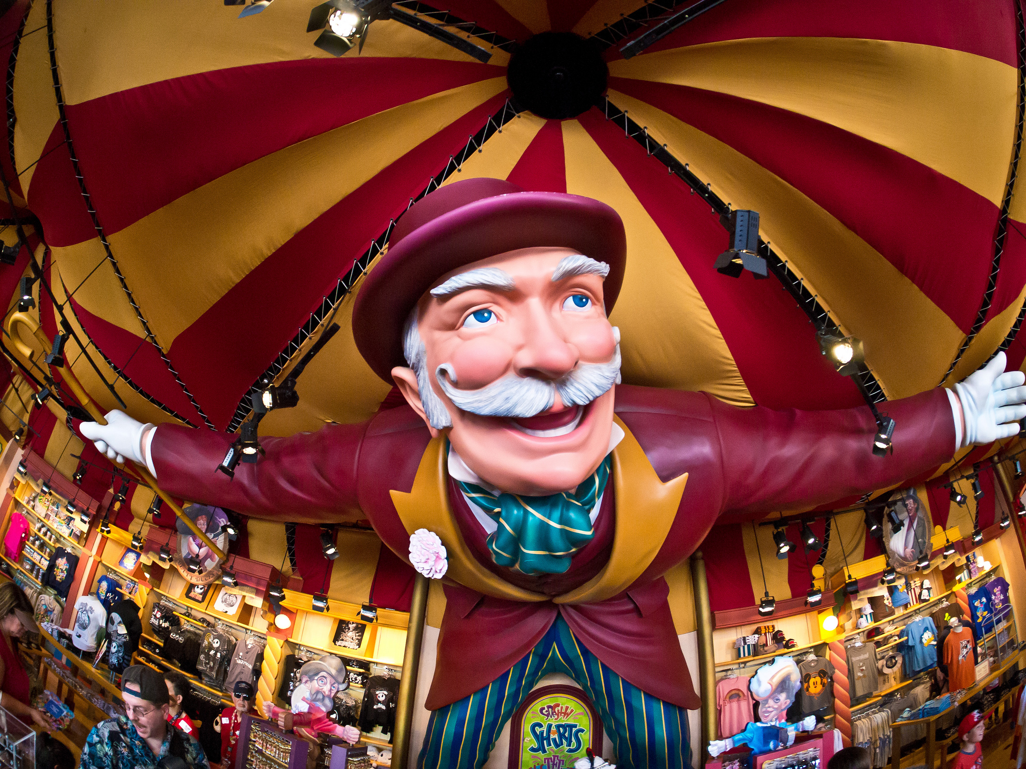
Promotion

Slide 74
Finalize Pitch Angles
Editorial Outreach
Influencer Outreach
Paid Media
Email
Social Media
Promotion

Slide 75
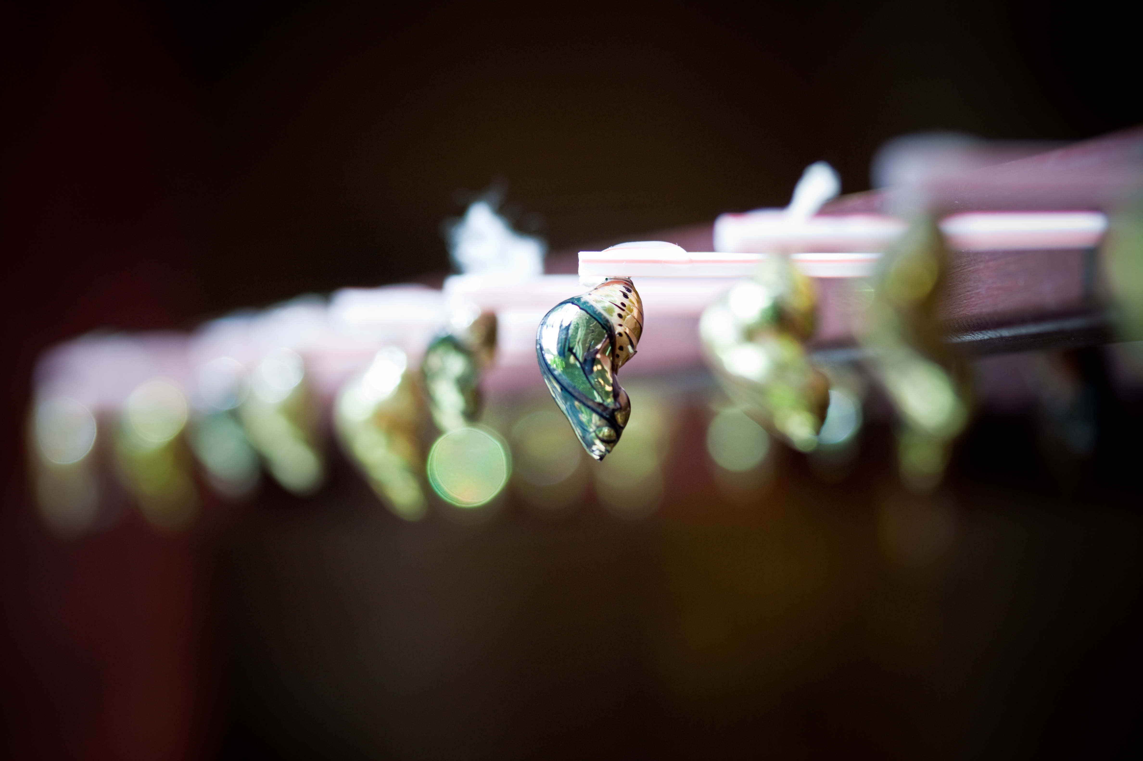
Conversion

Slide 76
A/B Testing
Retargeting
Marketing Automation
Conversion

Slide 77
6
How to Budget for Content Promotion

Slide 78
“
Half the money I spend on advertising is wasted; the trouble is I don’t know which half
John Wanamaker, the “Father of the Modern Department Store”

Slide 79
63%
of marketers believe they’re NOT using their content effectively
CMI

Slide 80

2013 Spending on Content Promotion

Slide 81
2013 Spending on Content Promotion
On average,
brands spent at least…

Slide 82
15.2%
of content marketing budgets on promotion
Content Promotion Manifesto

Slide 83
This is a Recipe for FAILURE

Slide 84

Relevance Agency Clients Spent

Slide 85
Relevance Agency Clients Spent
40% of their content marketing budgets on promotion

Slide 86
This is a Recipe for SUCCESS

Slide 87
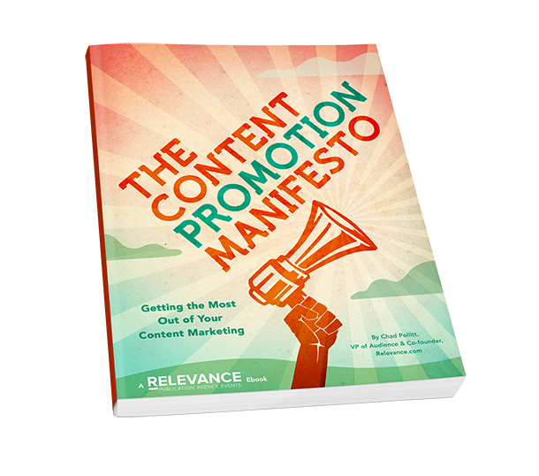
SPECIAL OFFER
Get your copy for FREE now before it hits Amazon!
bit.ly/content-promotion-manifesto

