Slide 1


Slide 2
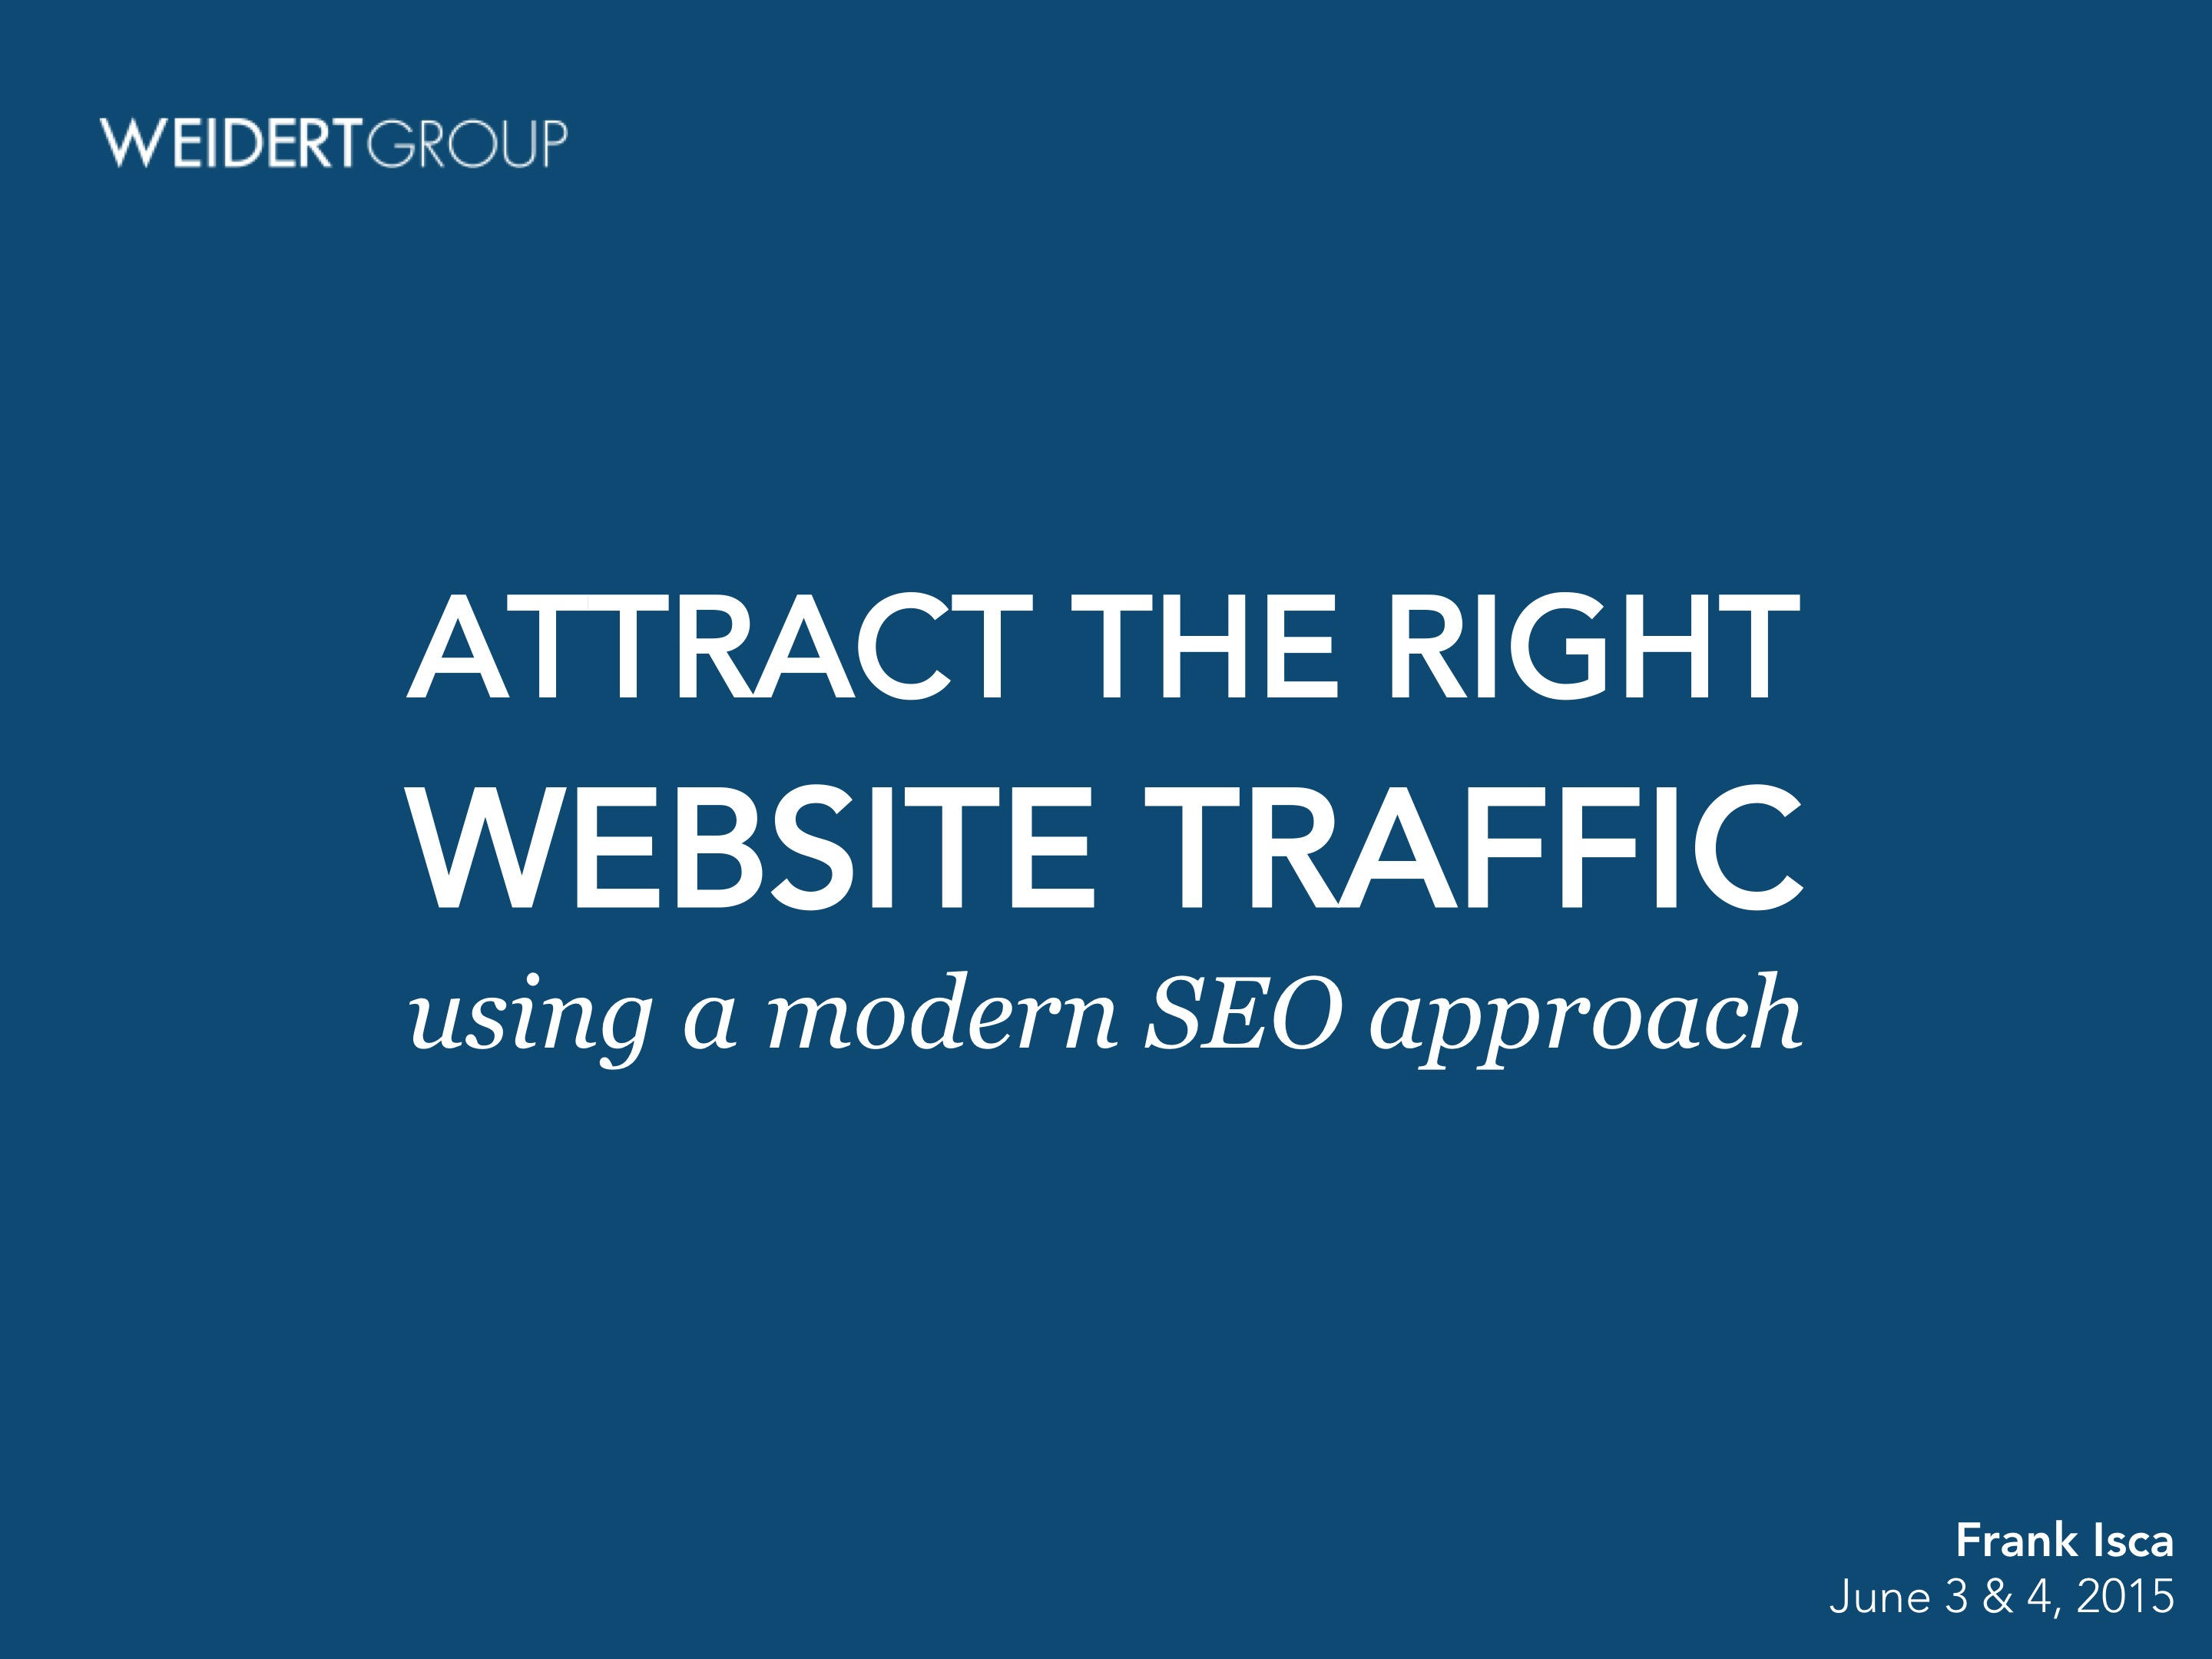

ATTRACT THE RIGHT
WEBSITE TRAFFIC
using a modern SEO approach
Frank Isca
June 3 & 4, 2015

Slide 3
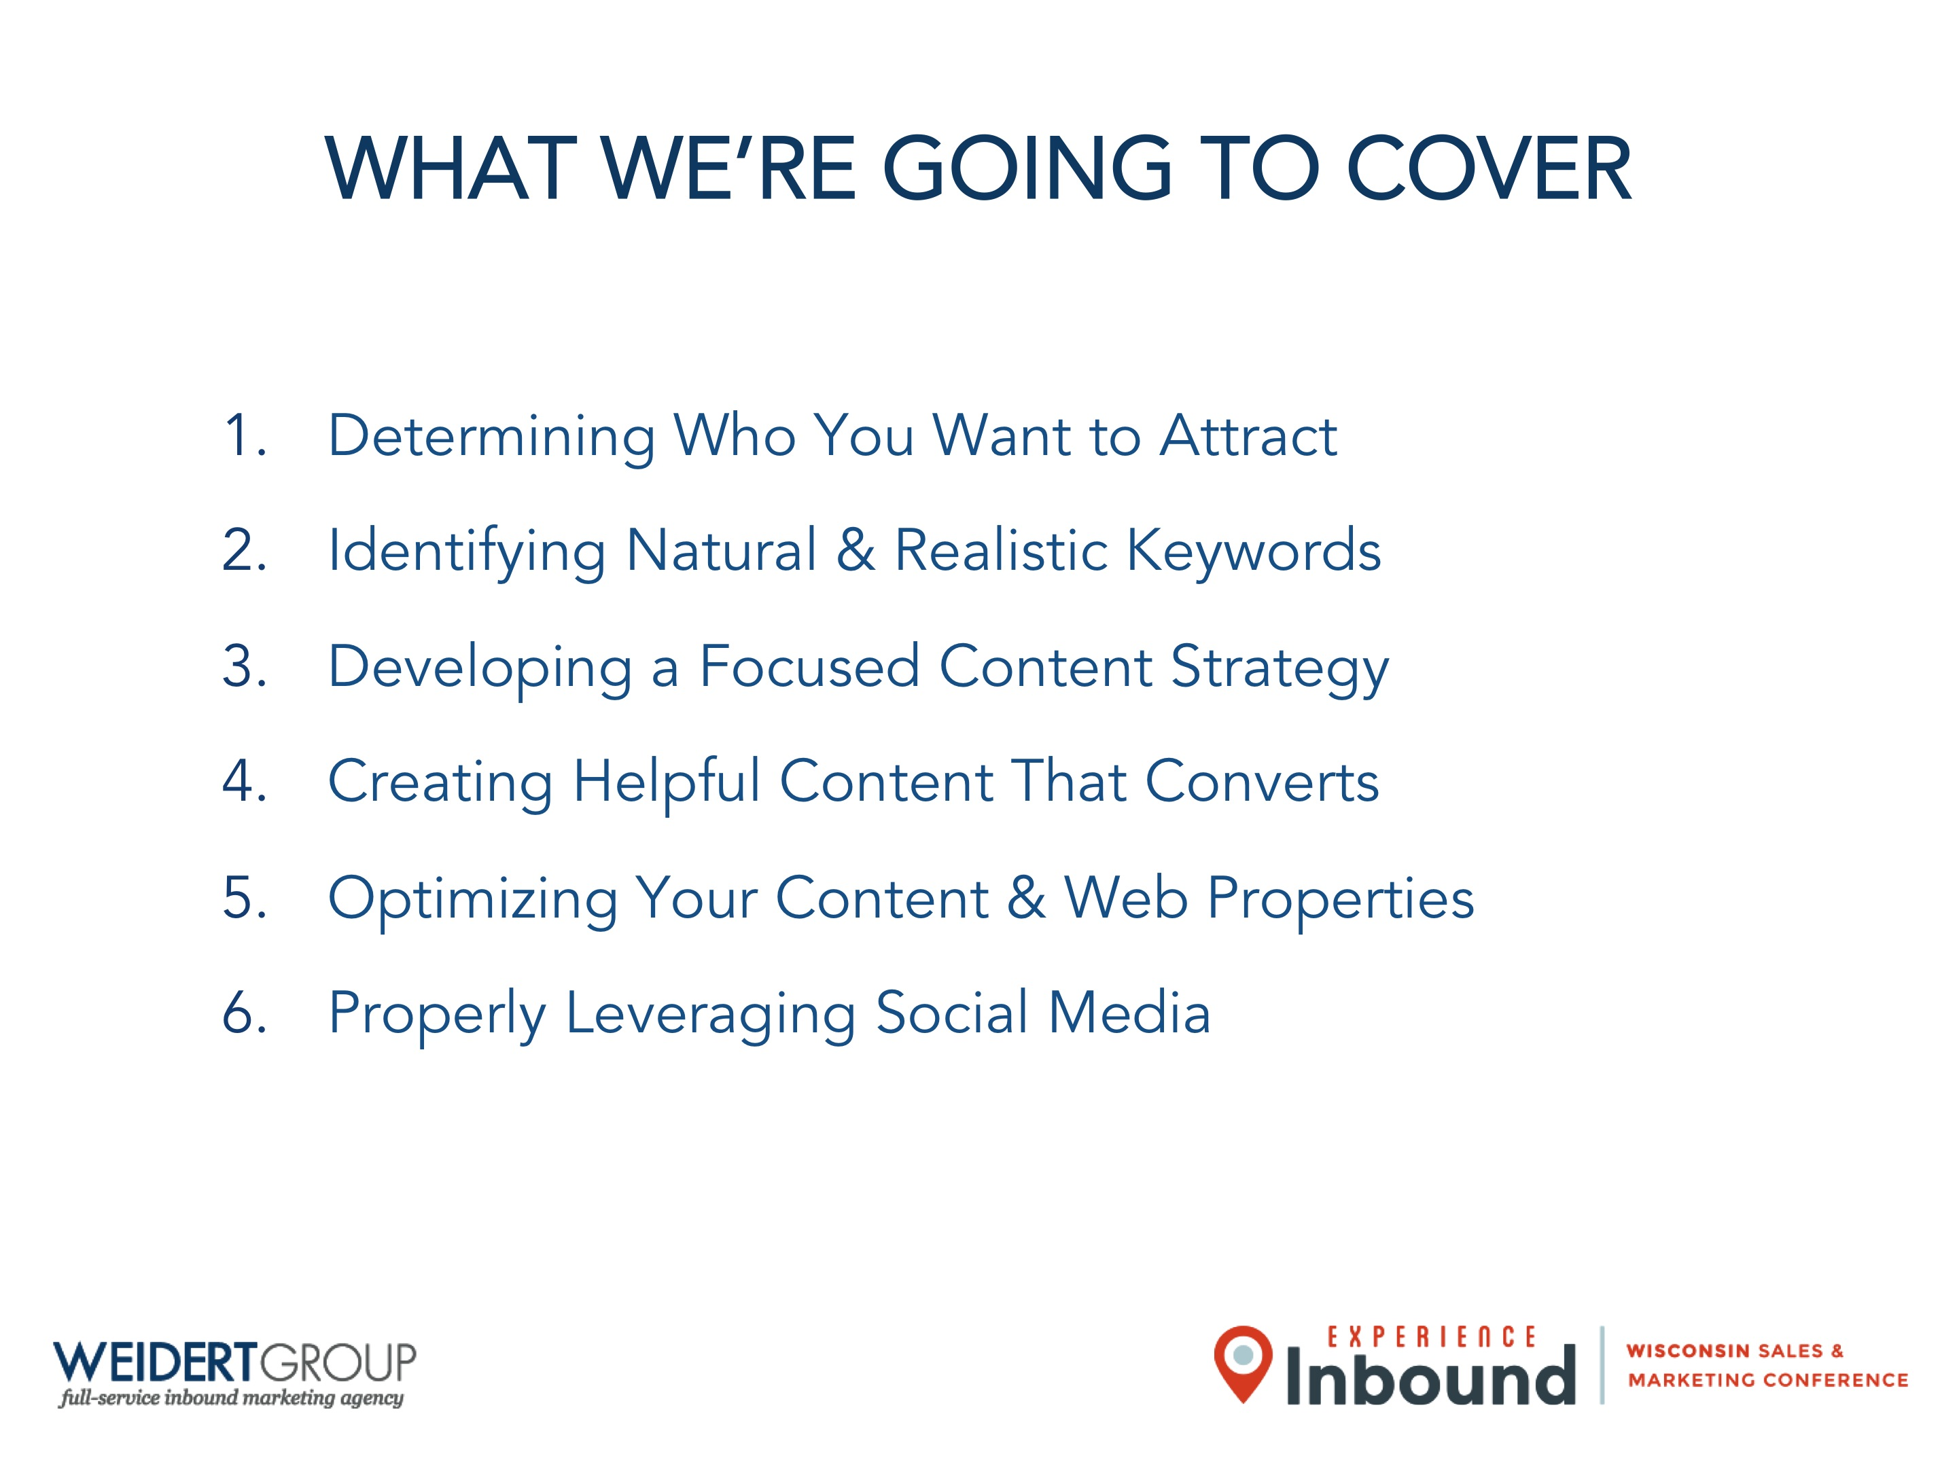


WHAT WE’RE GOING TO COVER
Determining Who You Want to Attract
Identifying Natural & Realistic Keywords
Developing a Focused Content Strategy
Creating Helpful Content That Converts
Optimizing Your Content & Web Properties
Properly Leveraging Social Media

Slide 4
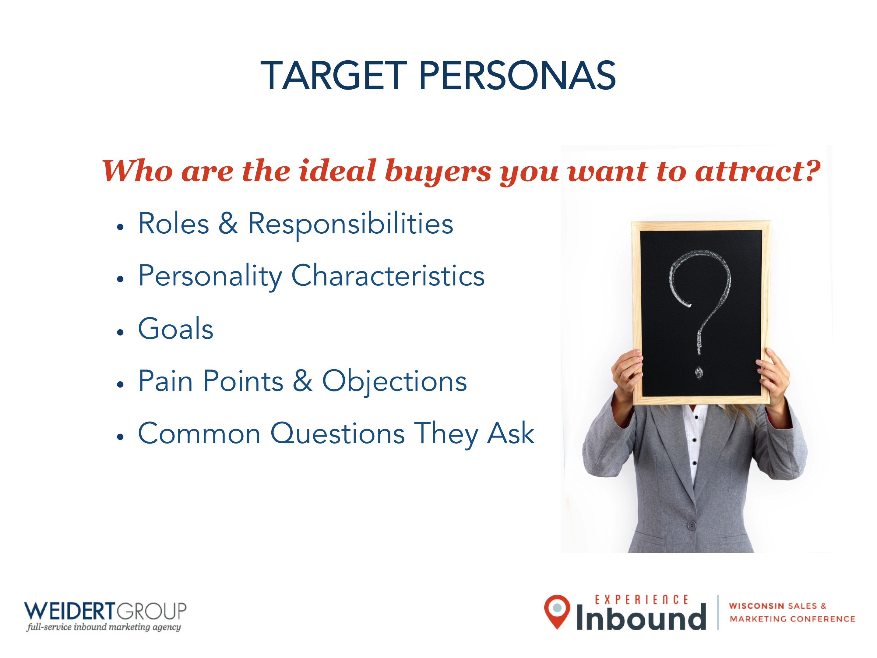

TARGET PERSONAS
Who are the ideal buyers you want to attract?
Roles & Responsibilities
Personality Characteristics
Goals
Pain Points & Objections
Common Questions They Ask

Slide 5

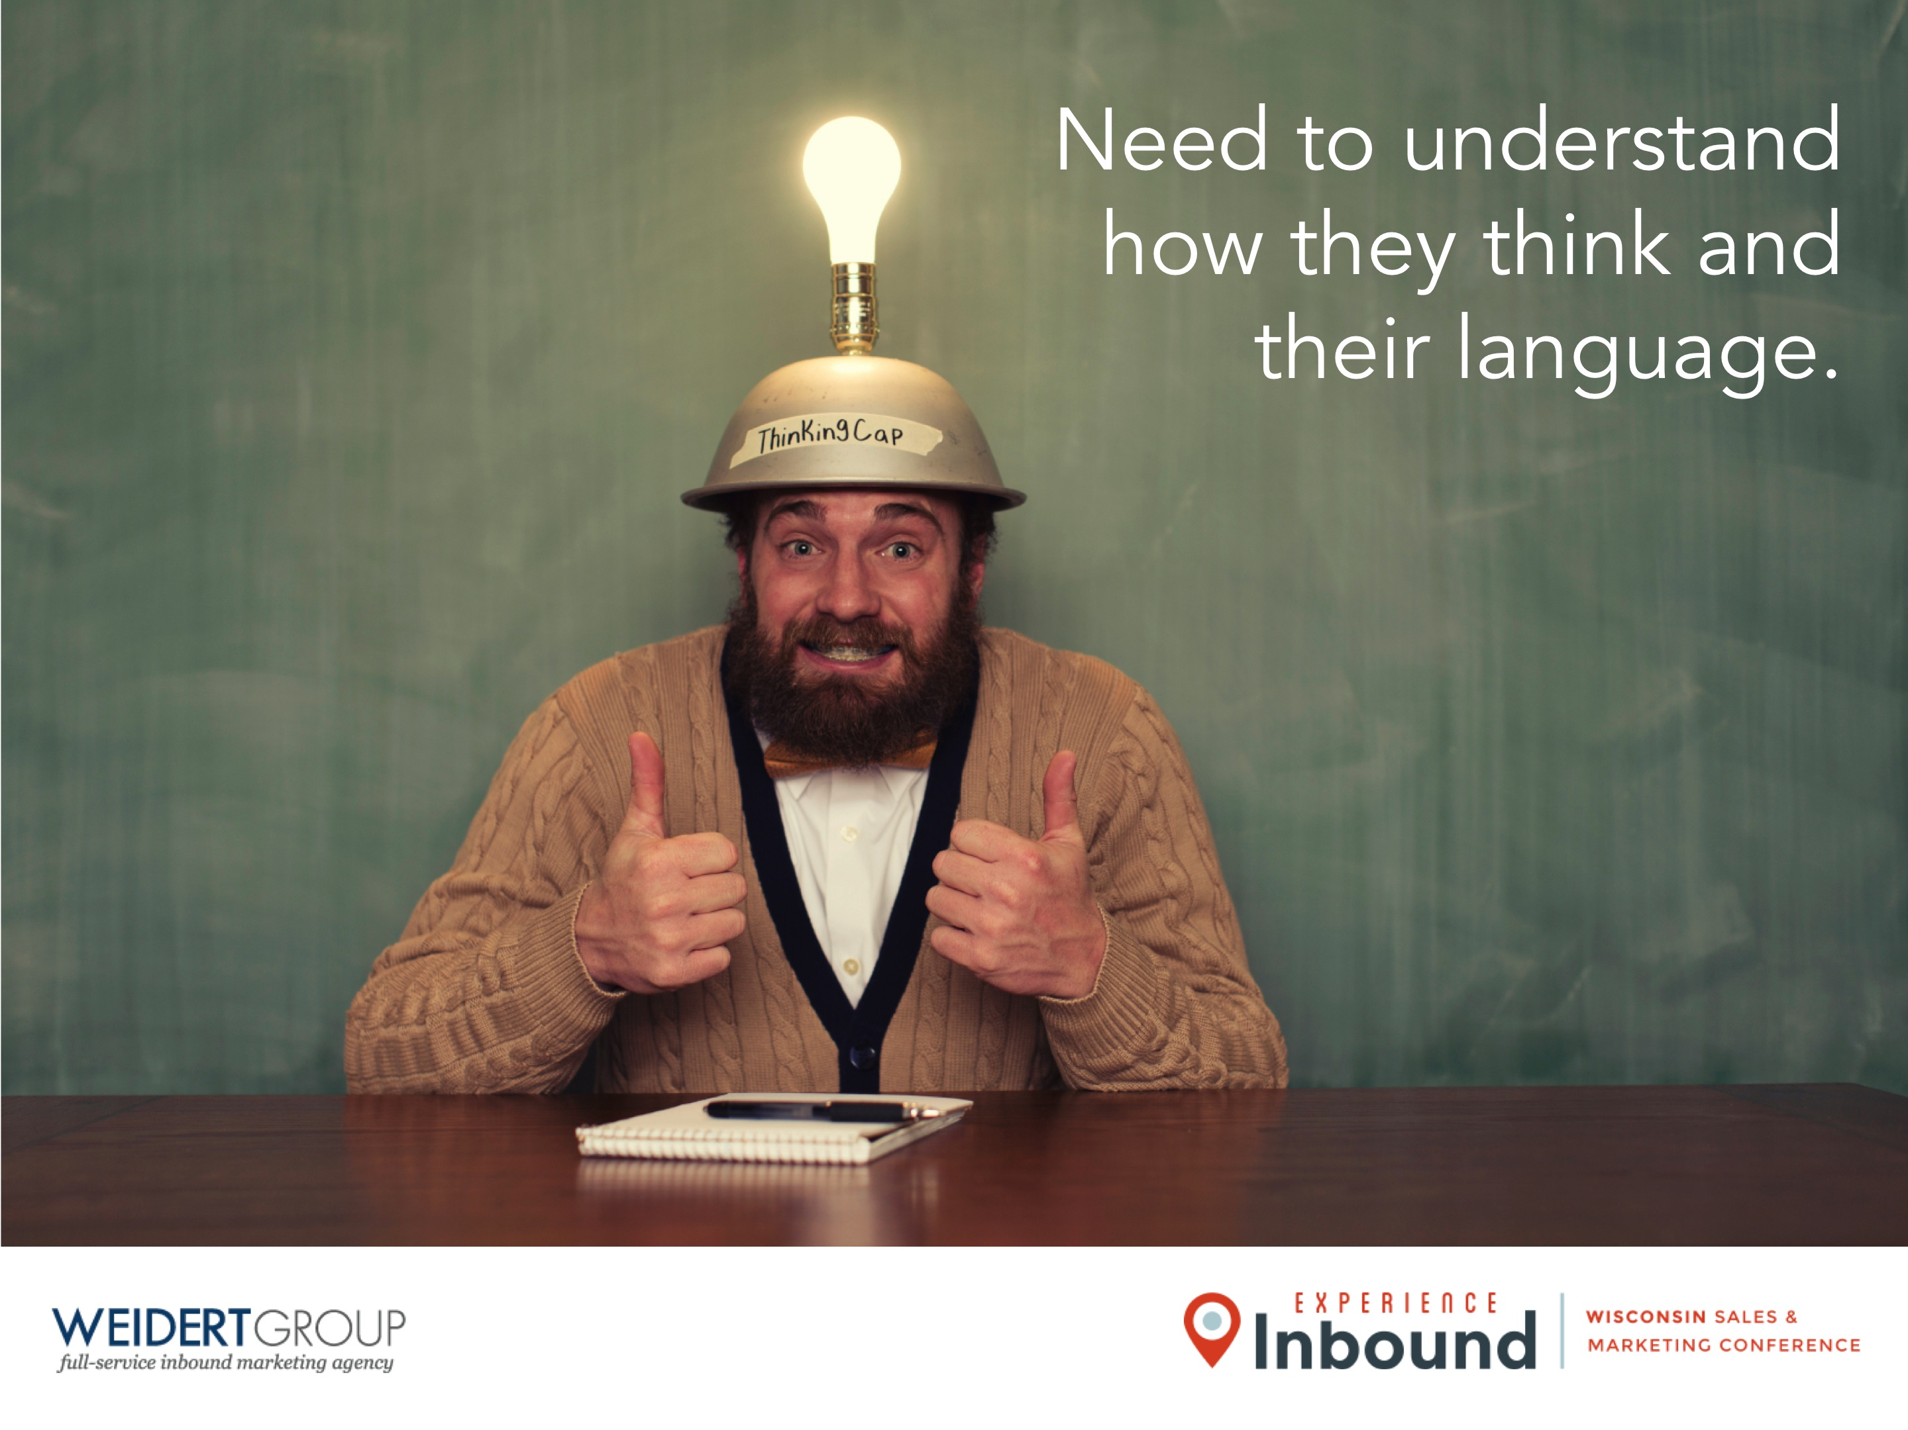
Need to understand how they think and their language.

Slide 6
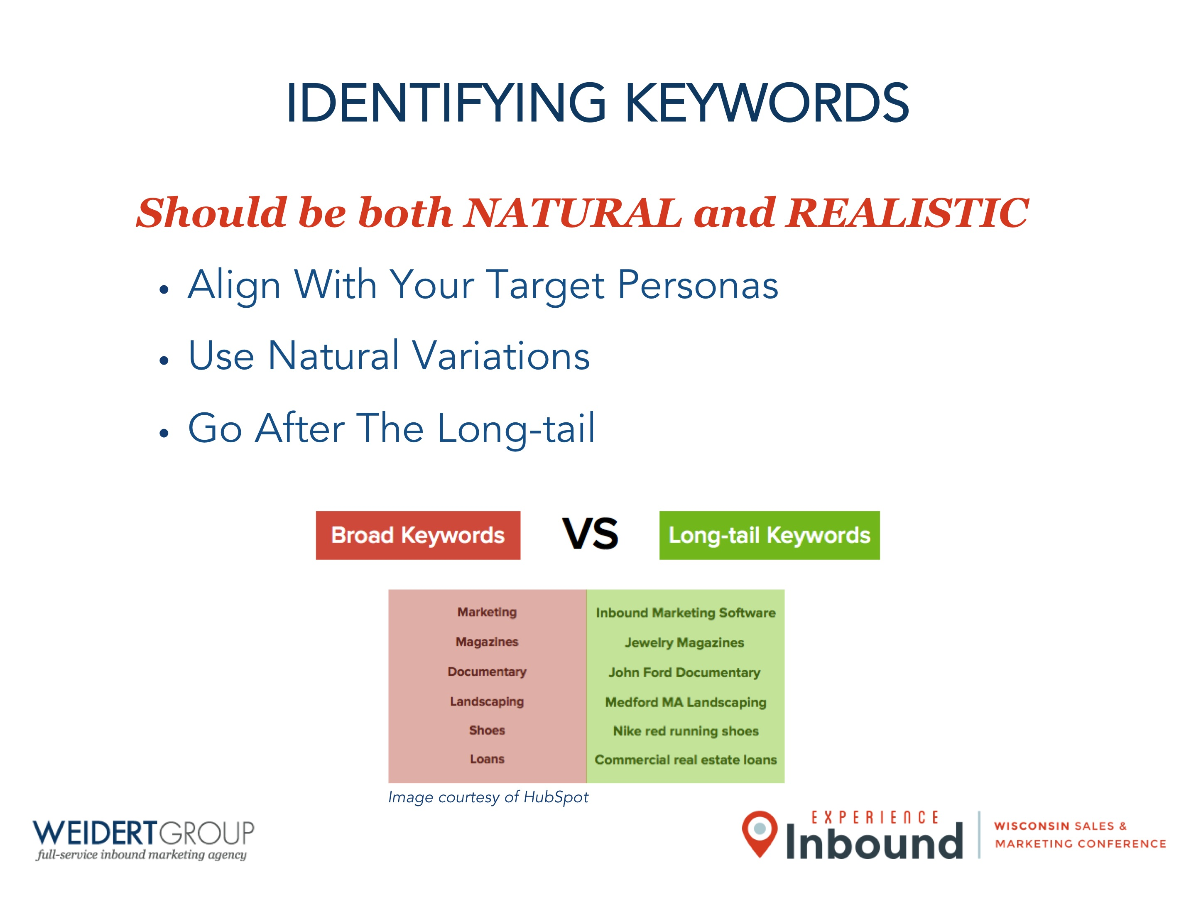
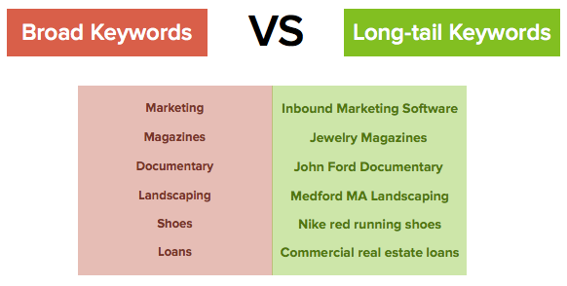
IDENTIFYING KEYWORDS
Should be both NATURAL and REALISTIC
Align With Your Target Personas
Use Natural Variations
Go After The Long-tail
Image courtesy of HubSpot

Slide 7
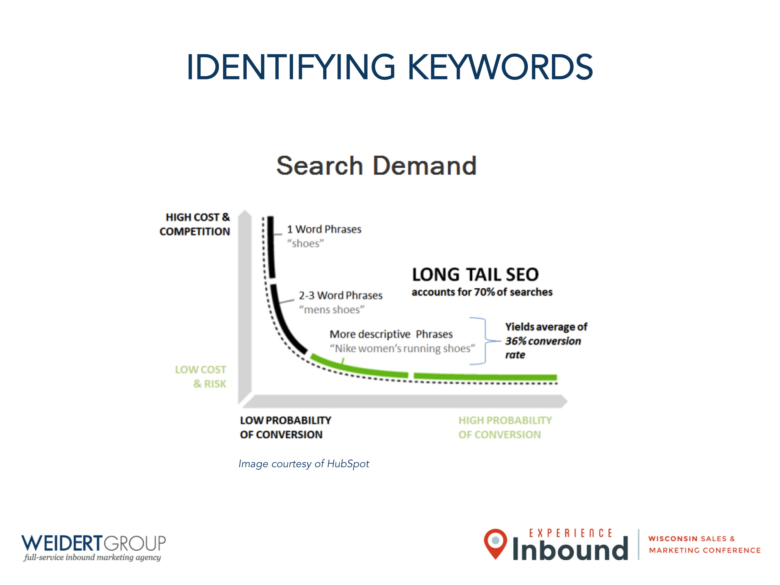
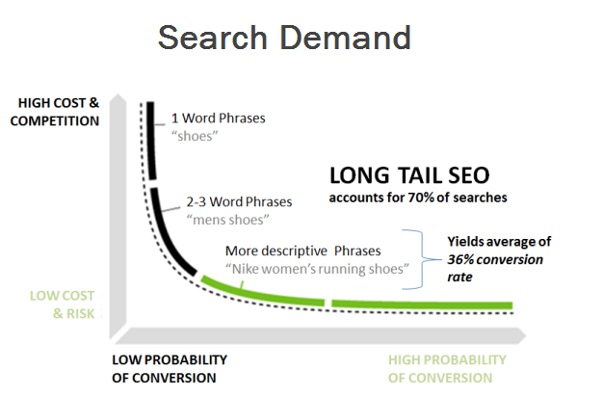
IDENTIFYING KEYWORDS
Image courtesy of HubSpot

Slide 8
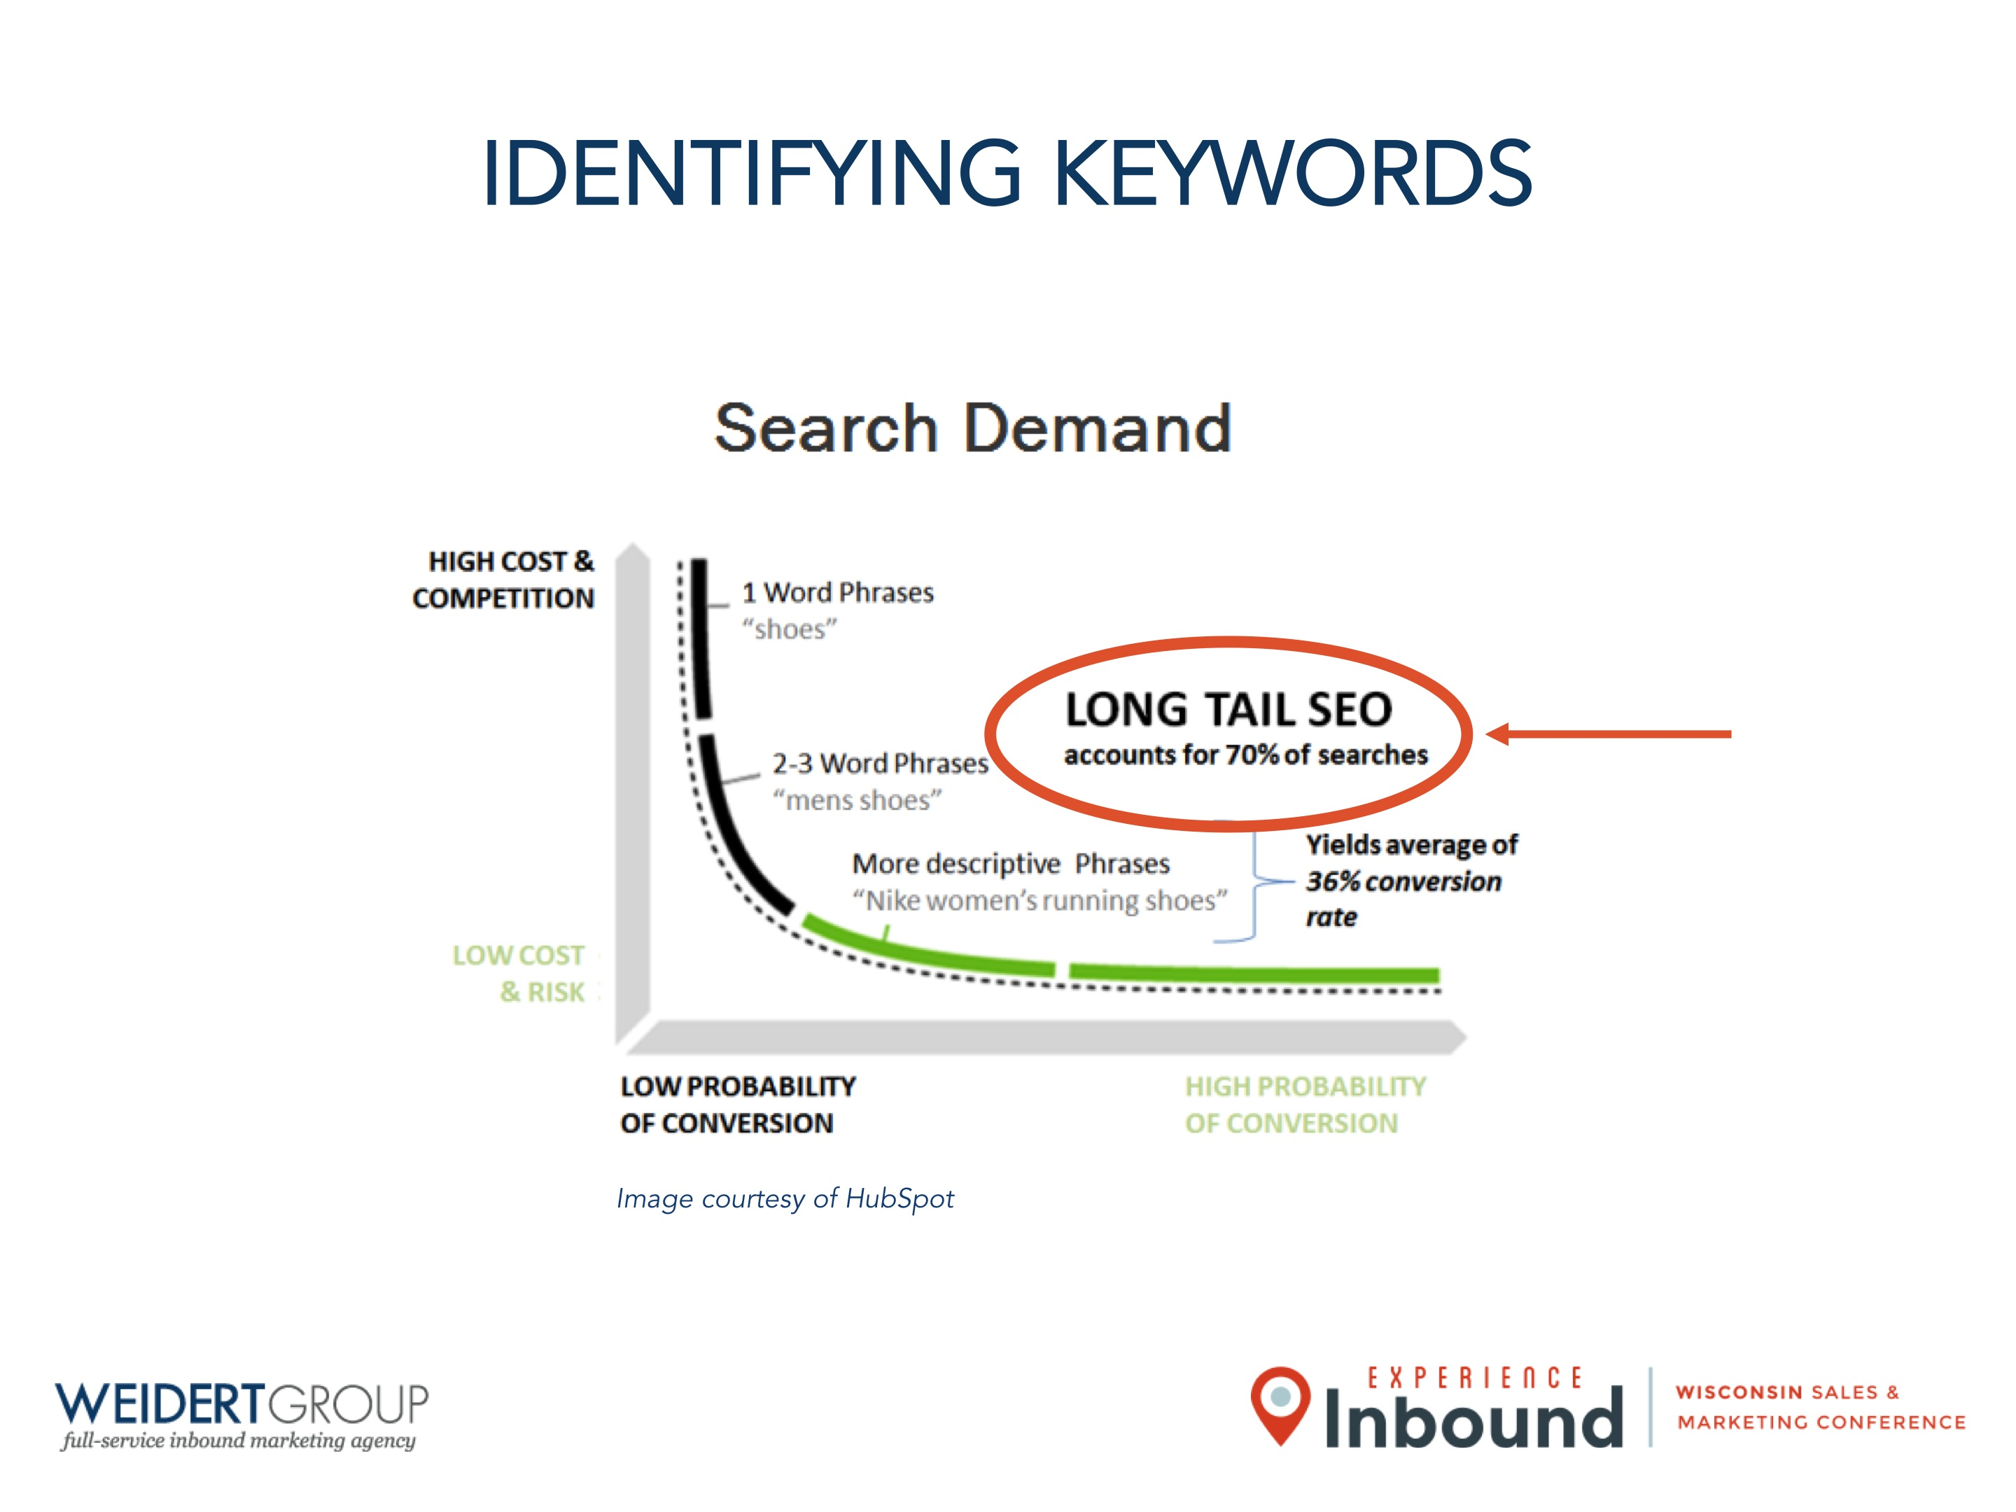
IDENTIFYING KEYWORDS
Image courtesy of HubSpot

Slide 9

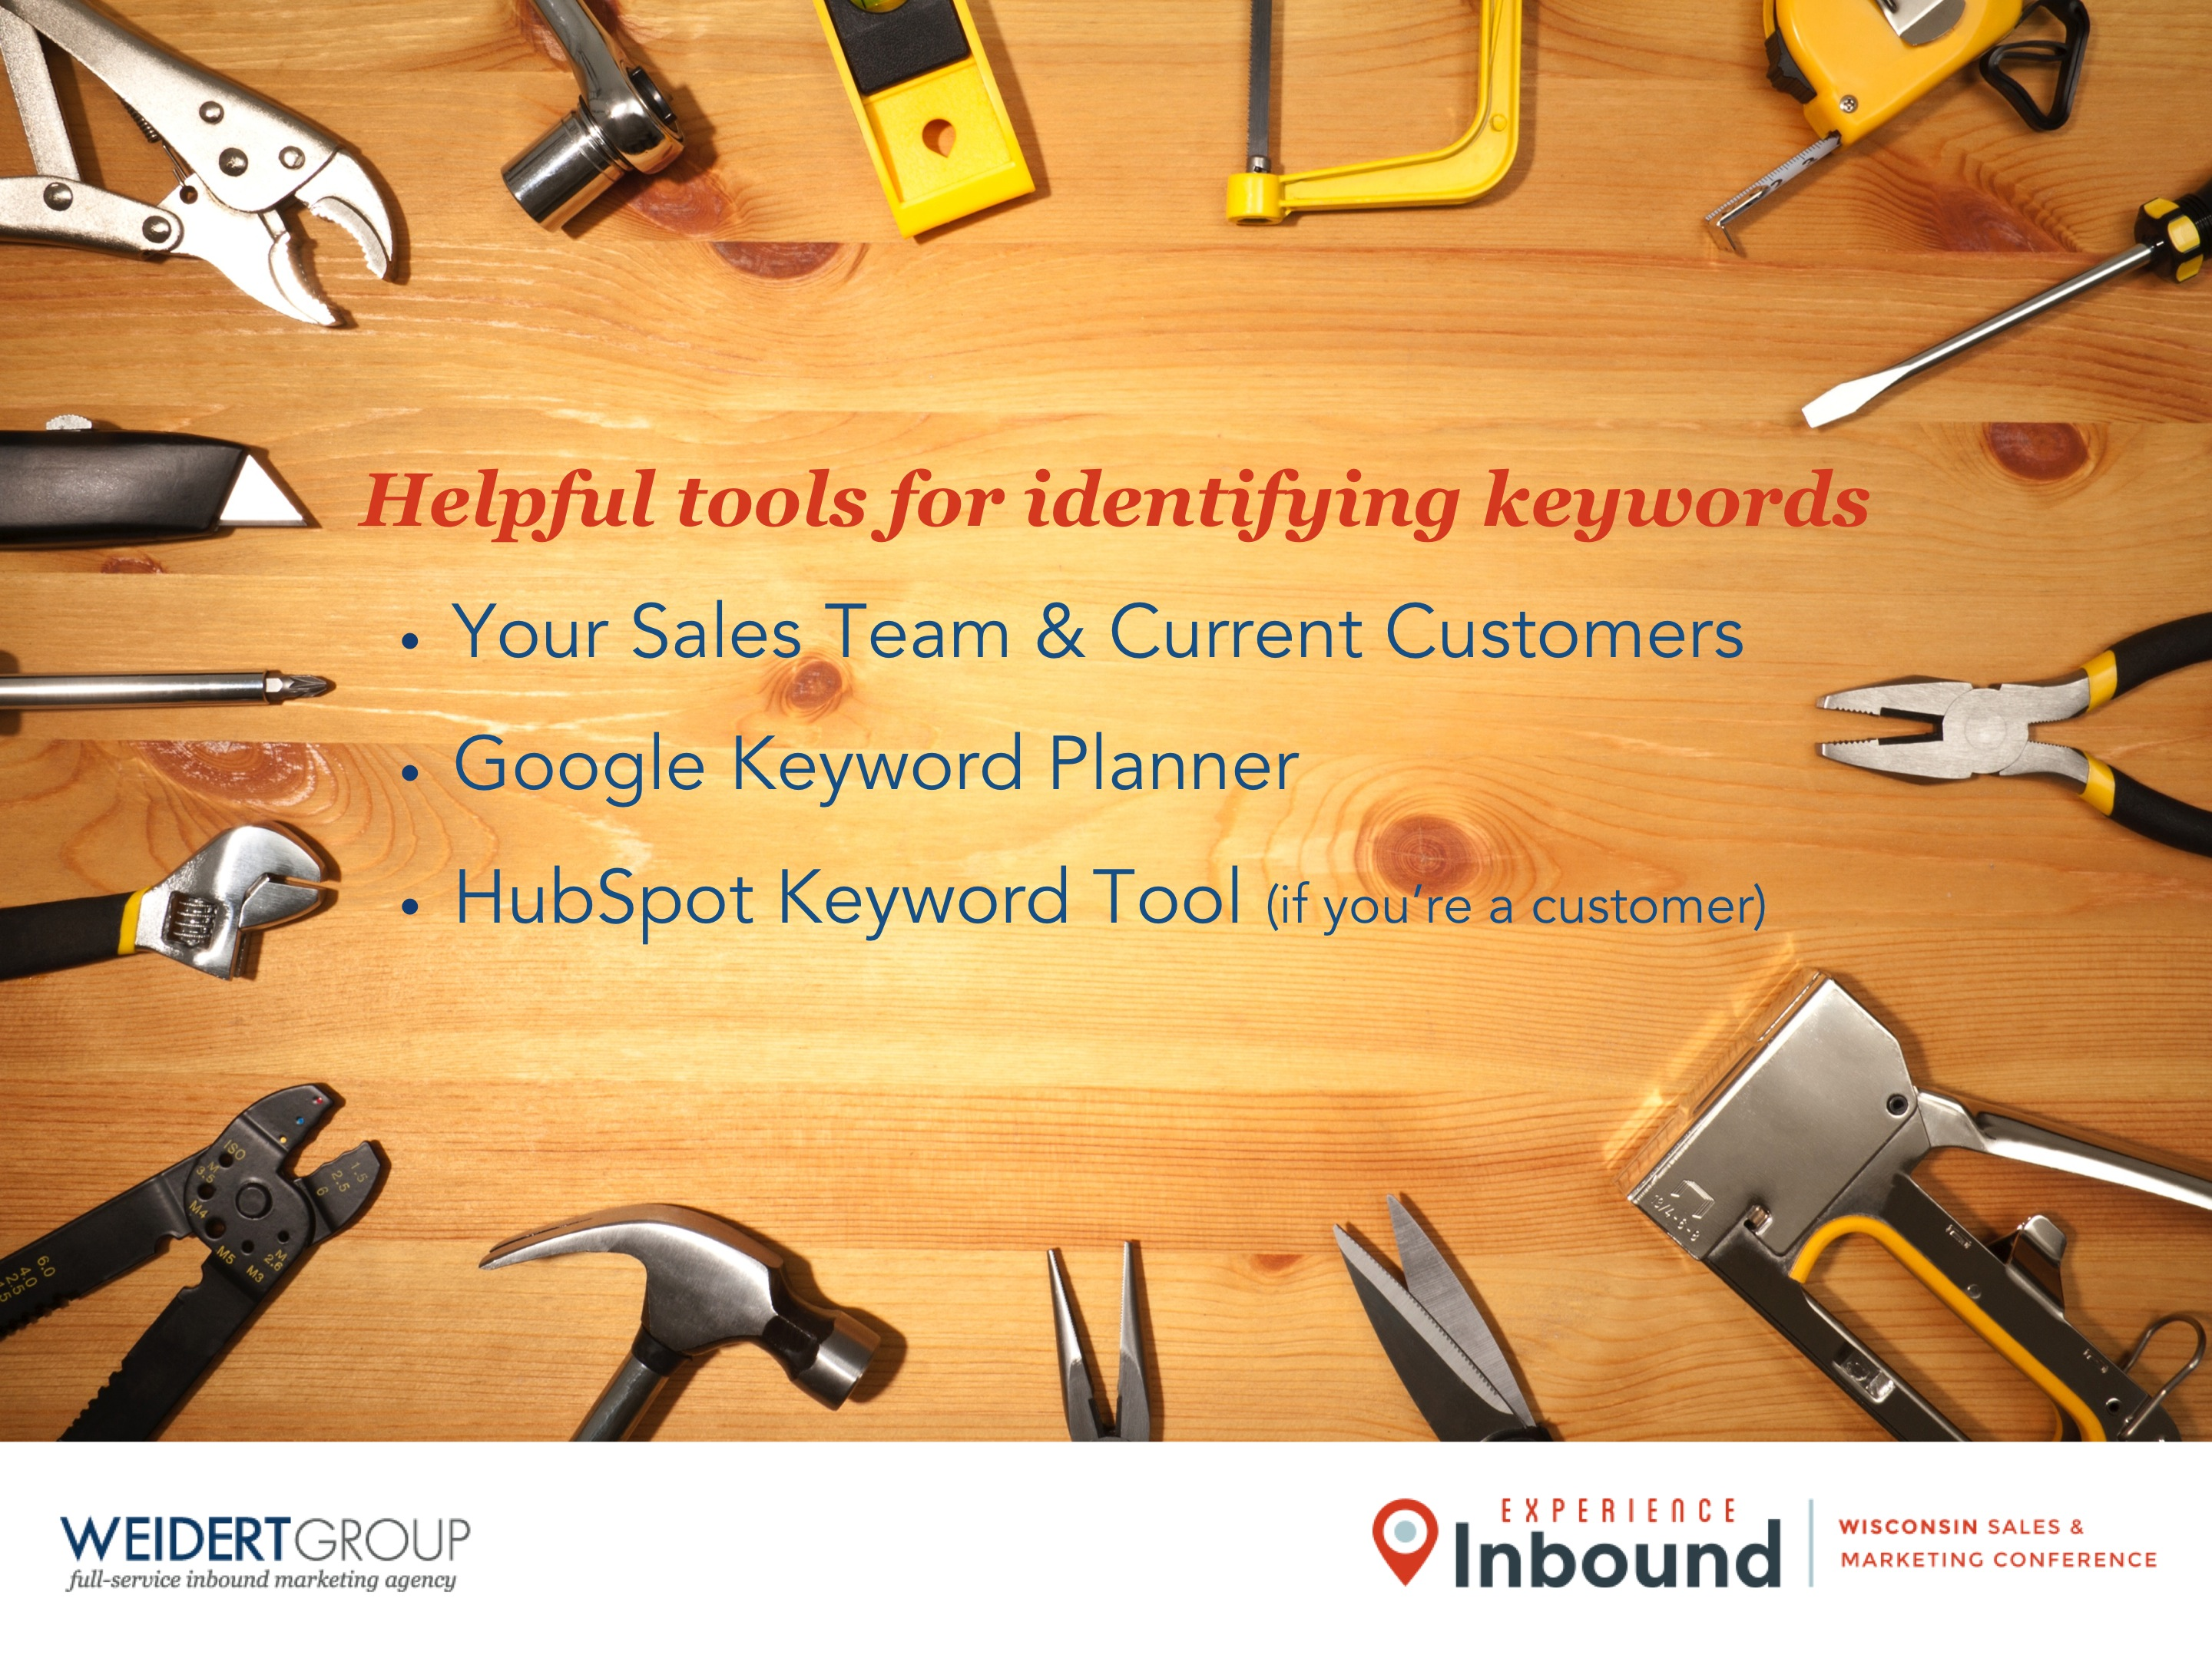
Helpful tools for identifying keywords
Your Sales Team & Current Customers
Google Keyword Planner
HubSpot Keyword Tool (if you’re a customer)

Slide 10
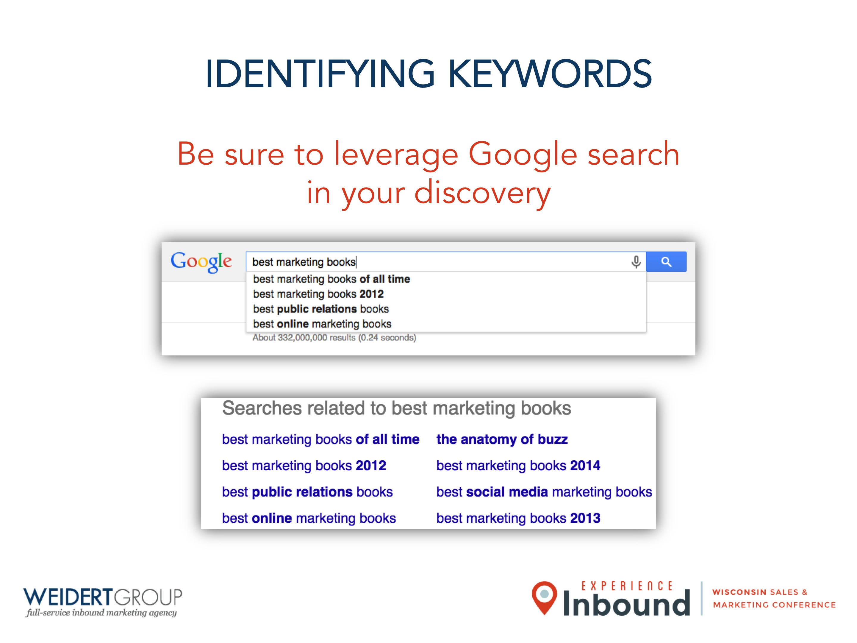
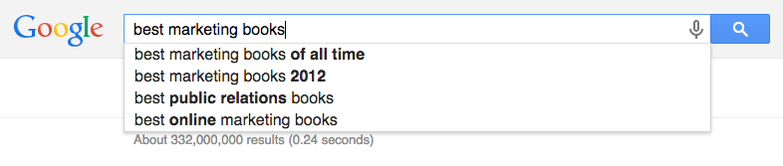
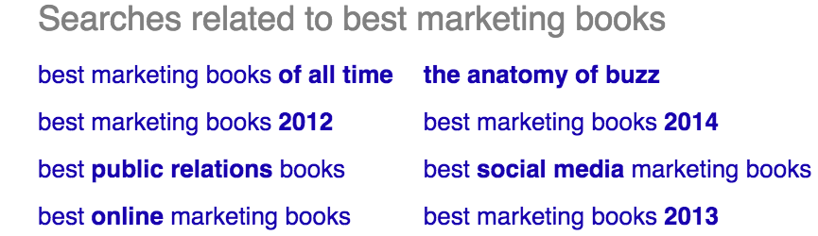
IDENTIFYING KEYWORDS
Be sure to leverage Google search in your discovery

Slide 11
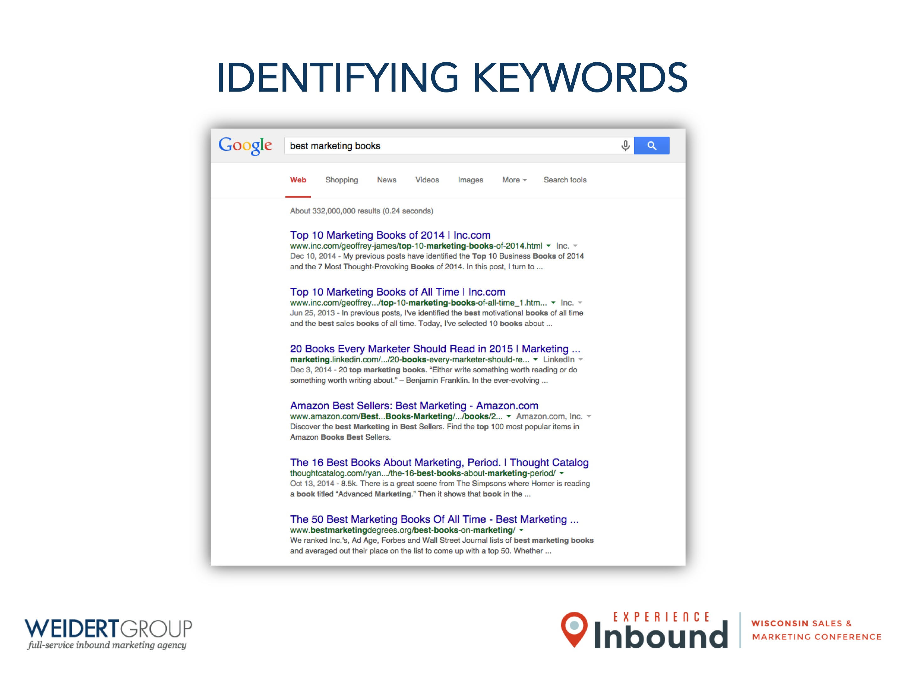
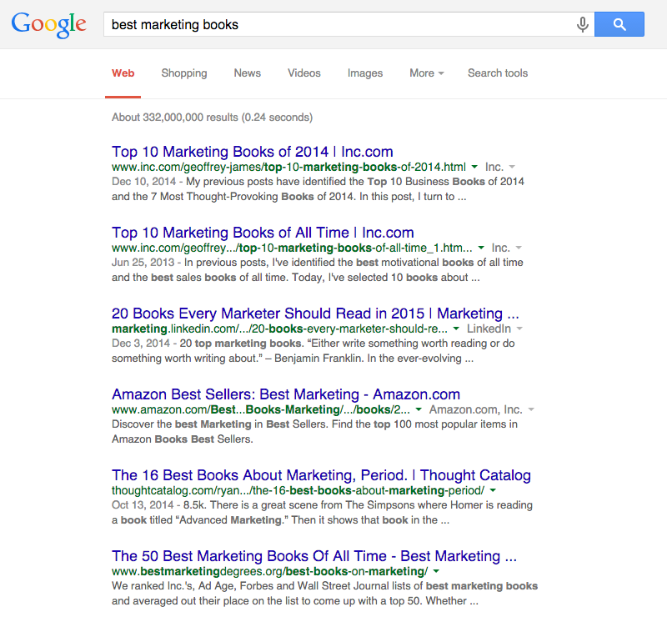
IDENTIFYING KEYWORDS

Slide 12
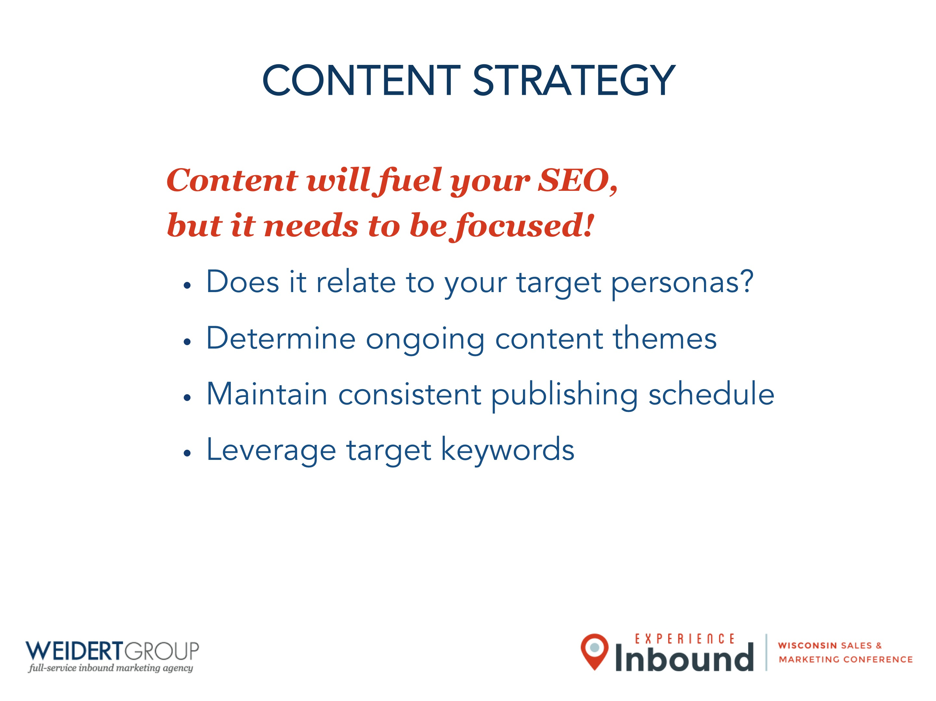
CONTENT STRATEGY
Content will fuel your SEO,
but it needs to be focused!
Does it relate to your target personas?
Determine ongoing content themes
Maintain consistent publishing schedule
Leverage target keywords

Slide 13
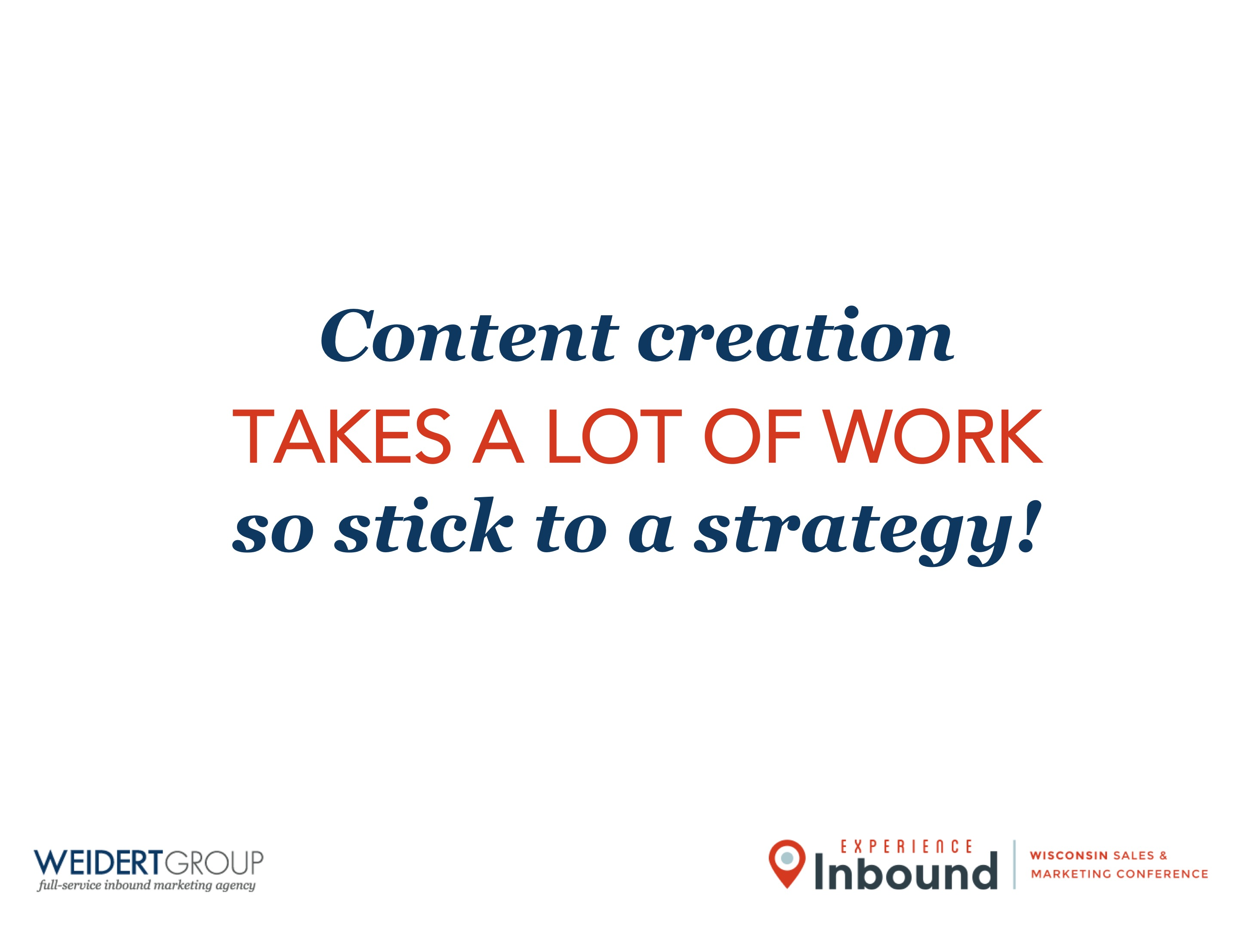
Content creation
TAKES A LOT OF WORK
so stick to a strategy!

Slide 14
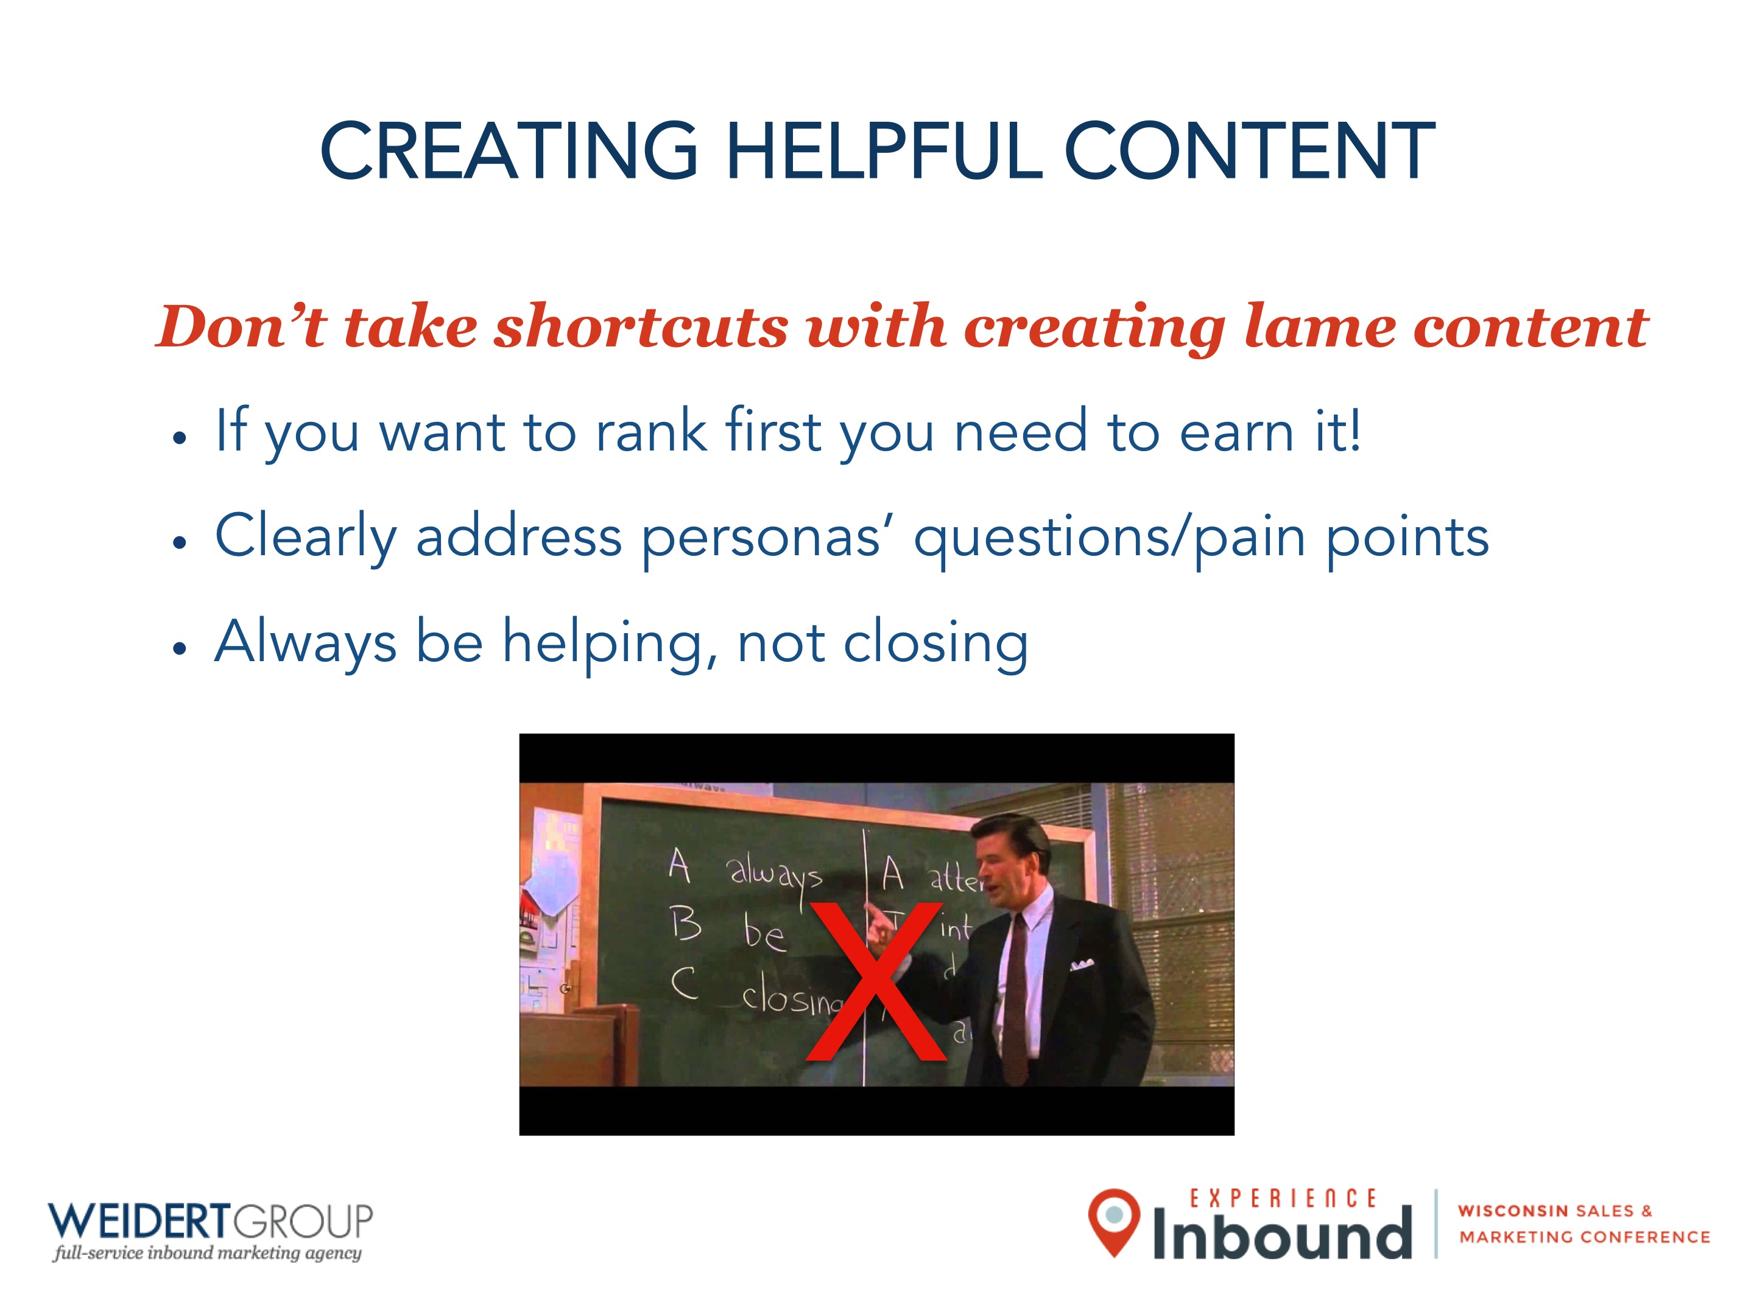
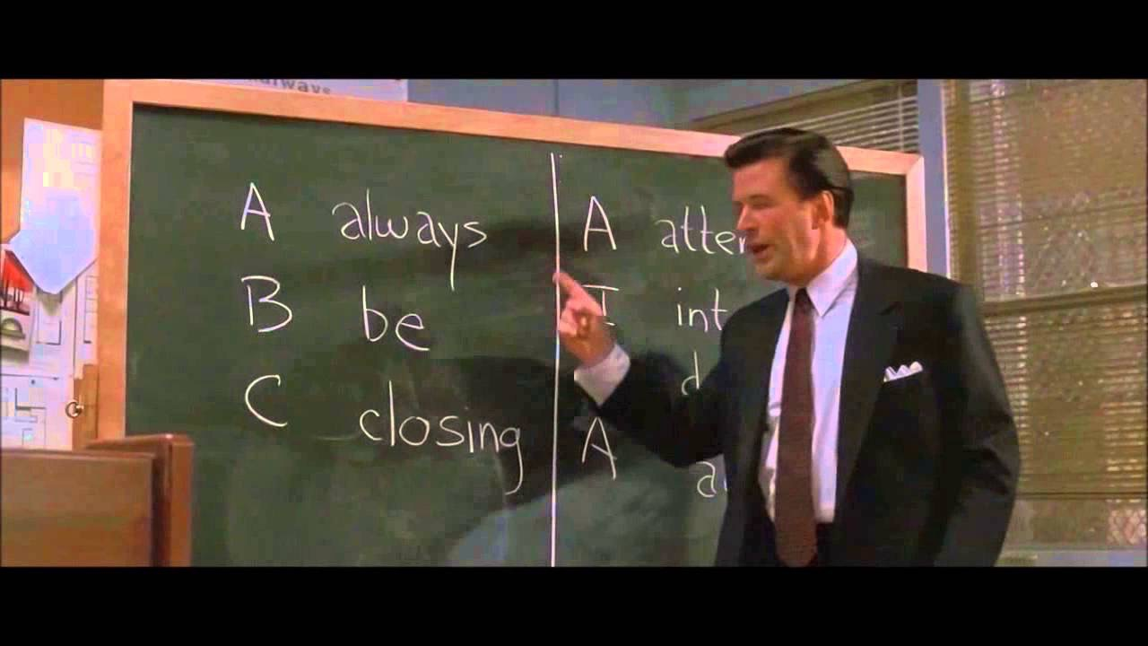
CREATING HELPFUL CONTENT
Don’t take shortcuts with creating lame content
If you want to rank first you need to earn it!
Clearly address personas’ questions/pain points
Always be helping, not closing
X

Slide 15
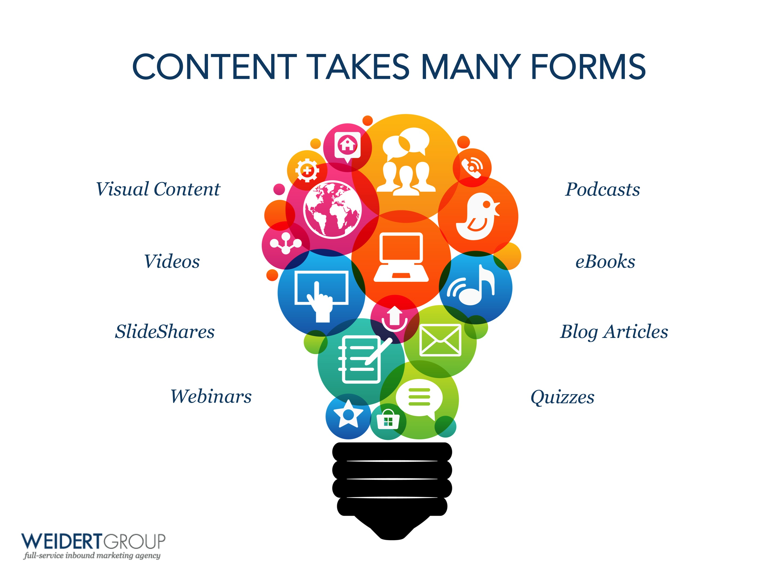

CONTENT TAKES MANY FORMS
Visual Content
Podcasts
Videos
eBooks
SlideShares
Blog Articles
Webinars
Quizzes

Slide 16


Forgetting to optimize content is a failure to launch!

Slide 17
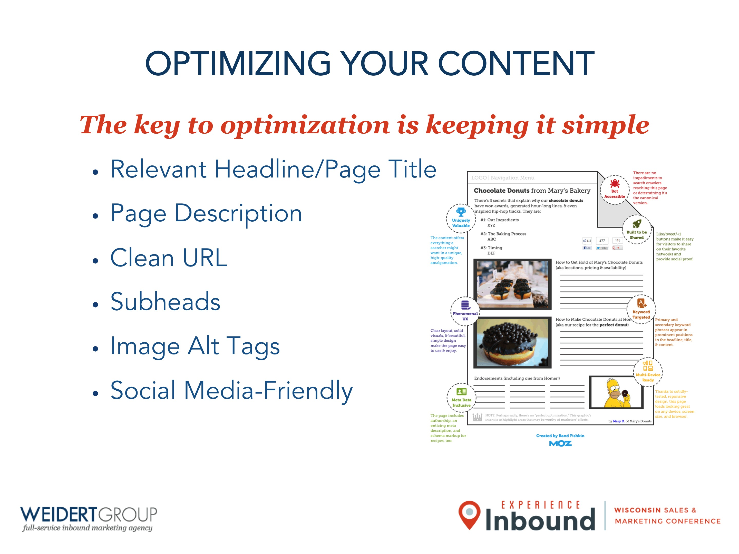
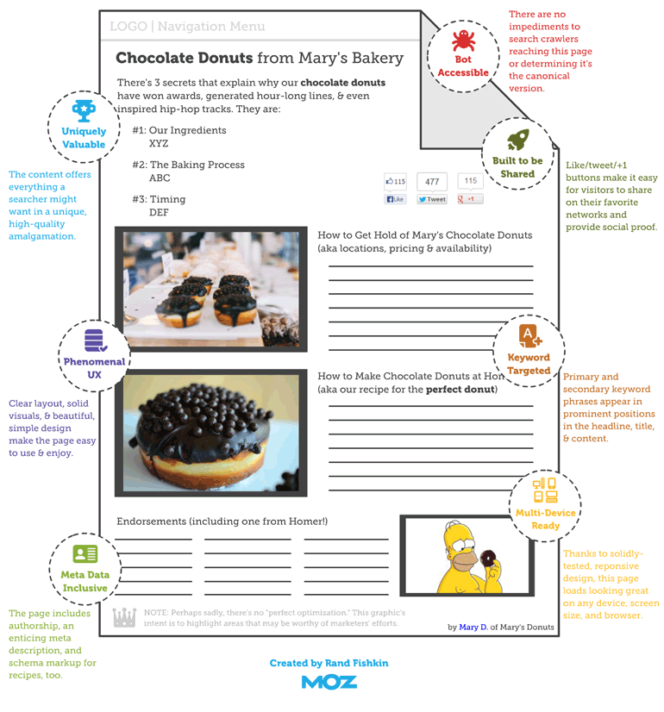
OPTIMIZING YOUR CONTENT
The key to optimization is keeping it simple
Relevant Headline/Page Title
Page Description
Clean URL
Subheads
Image Alt Tags
Social Media-Friendly

Slide 18
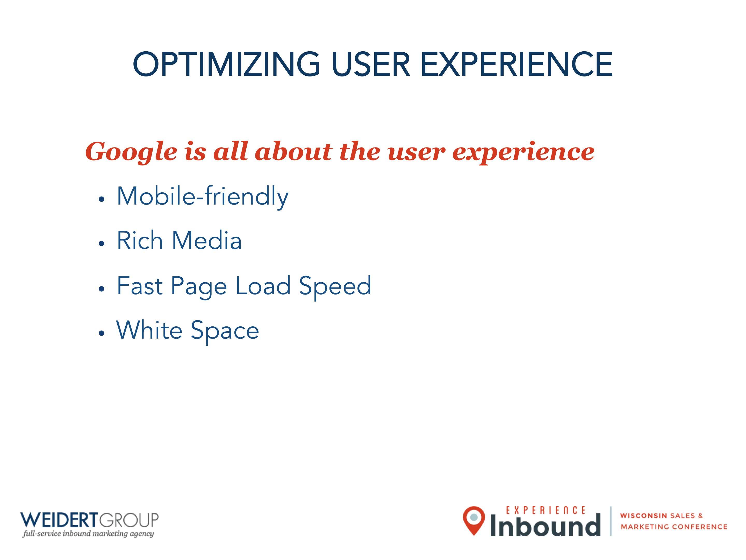
OPTIMIZING USER EXPERIENCE
Google is all about the user experience
Mobile-friendly
Rich Media
Fast Page Load Speed
White Space

Slide 19

Amplify your content
WITH SOCIAL MEDIA

Slide 20
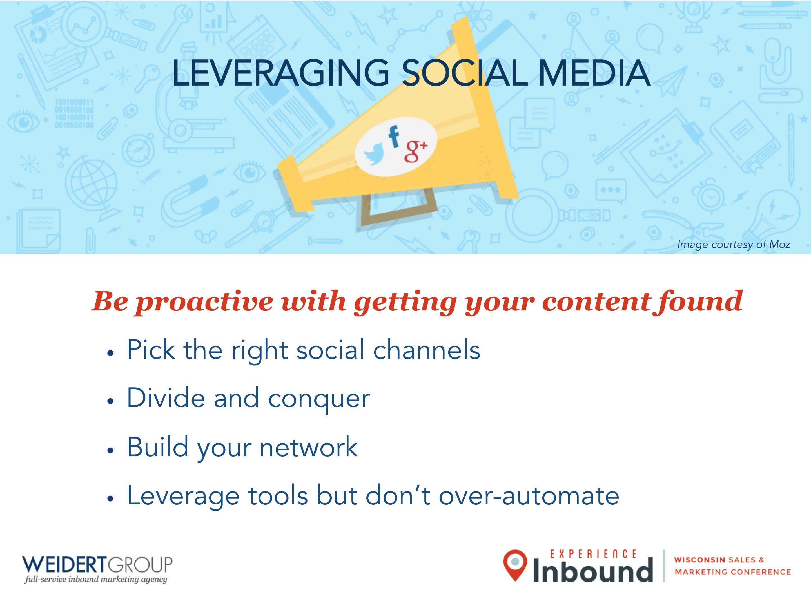

LEVERAGING SOCIAL MEDIA
Image courtesy of Moz
Be proactive with getting your content found
Pick the right social channels
Divide and conquer
Build your network
Leverage tools but don’t over-automate

Slide 21

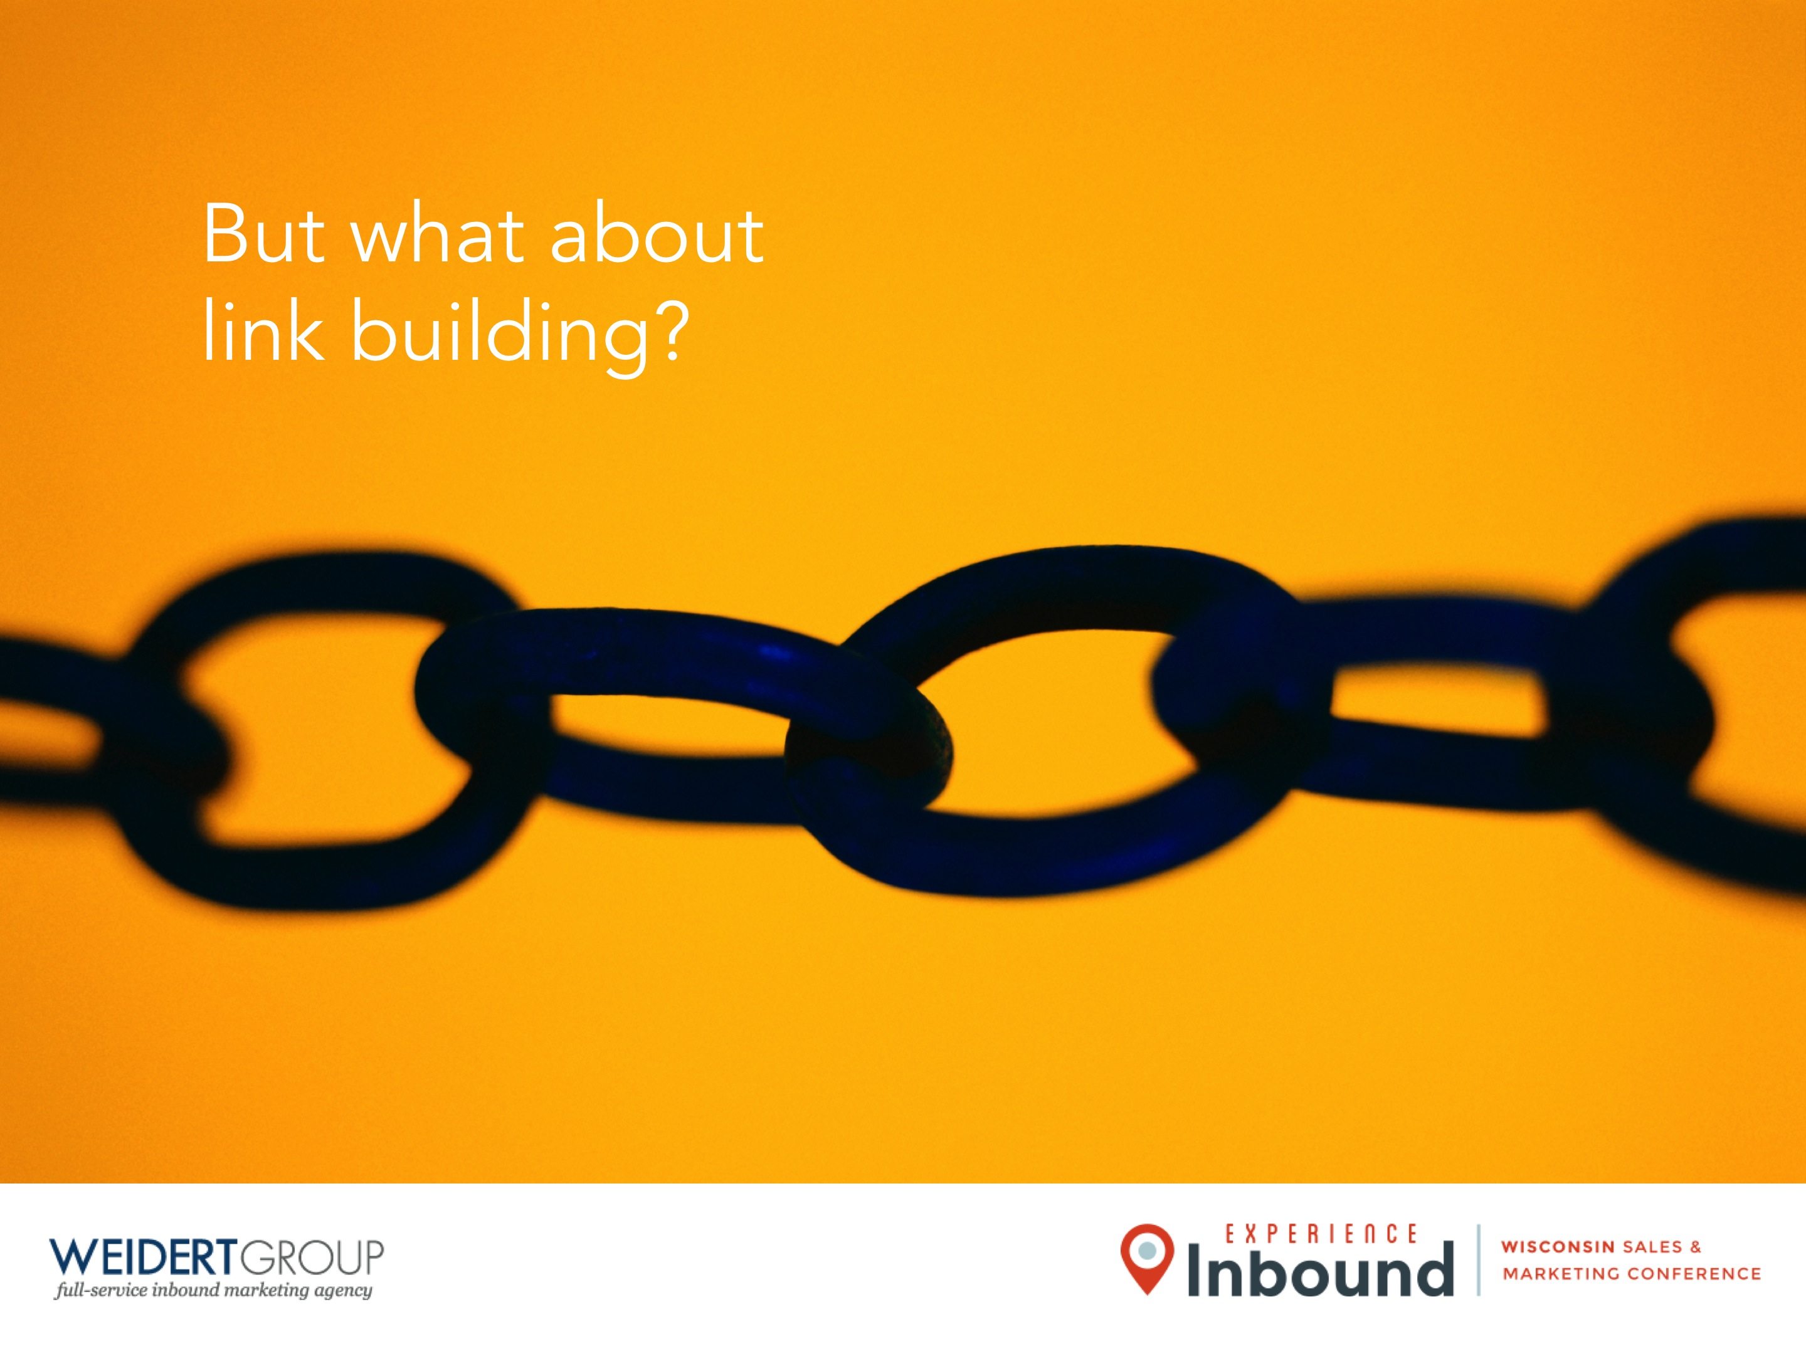
But what about link building?

Slide 22

Does this all
REALLY WORK?

Slide 23
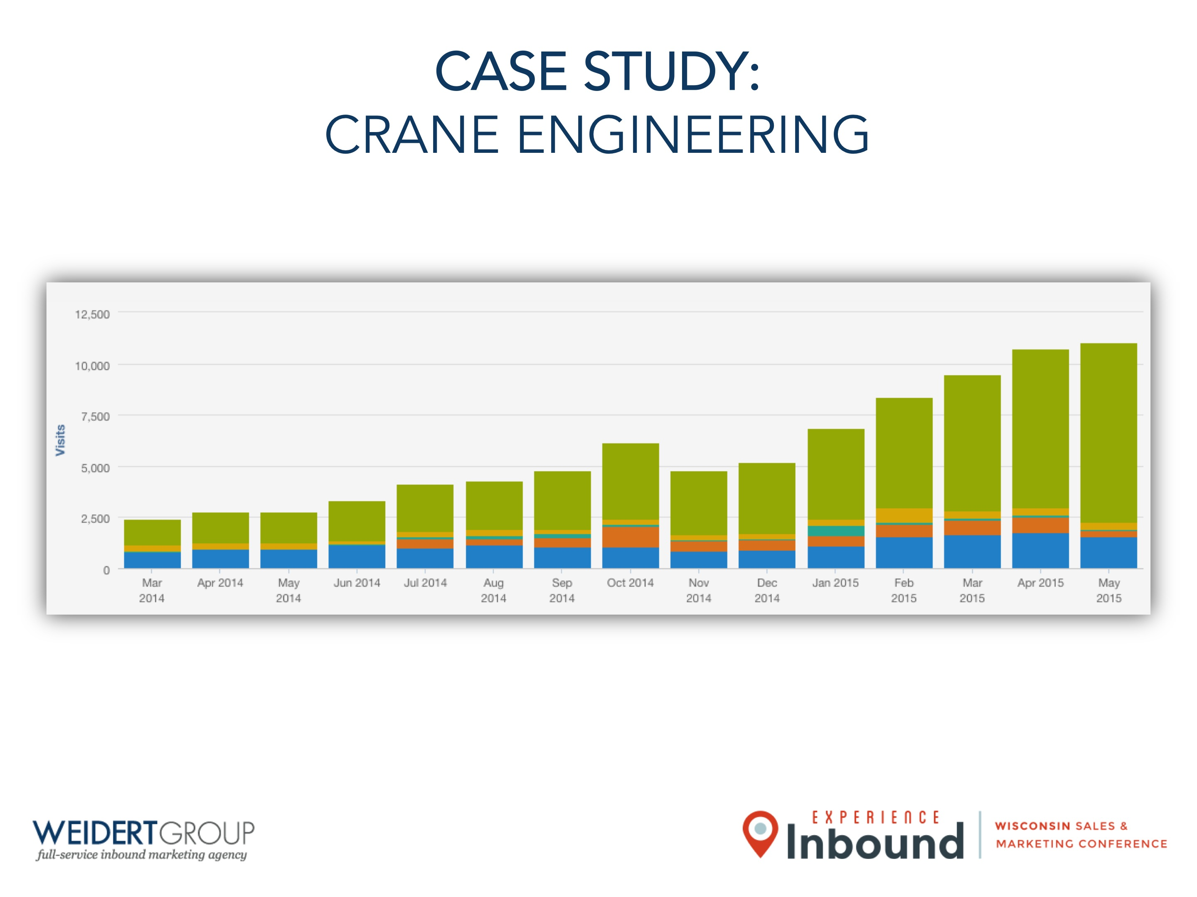
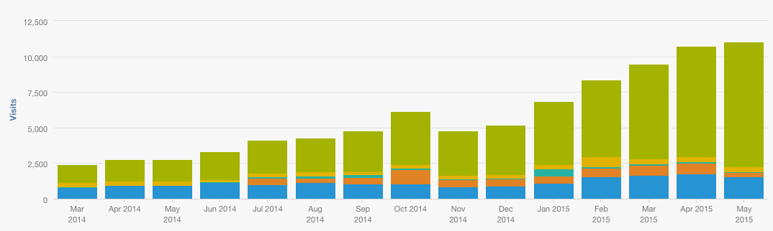
CASE STUDY:
CRANE ENGINEERING

Slide 24
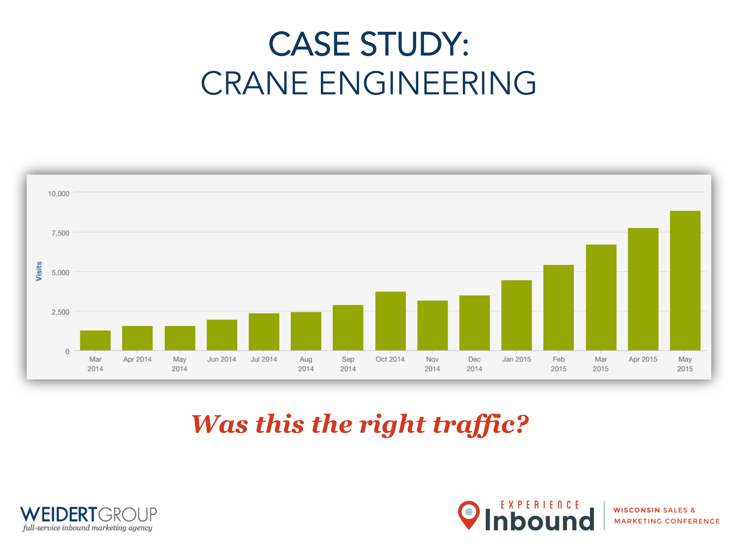
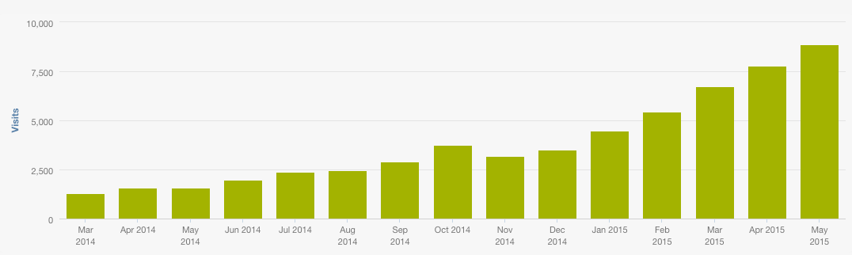
CASE STUDY:
CRANE ENGINEERING
Was this the right traffic?

Slide 25
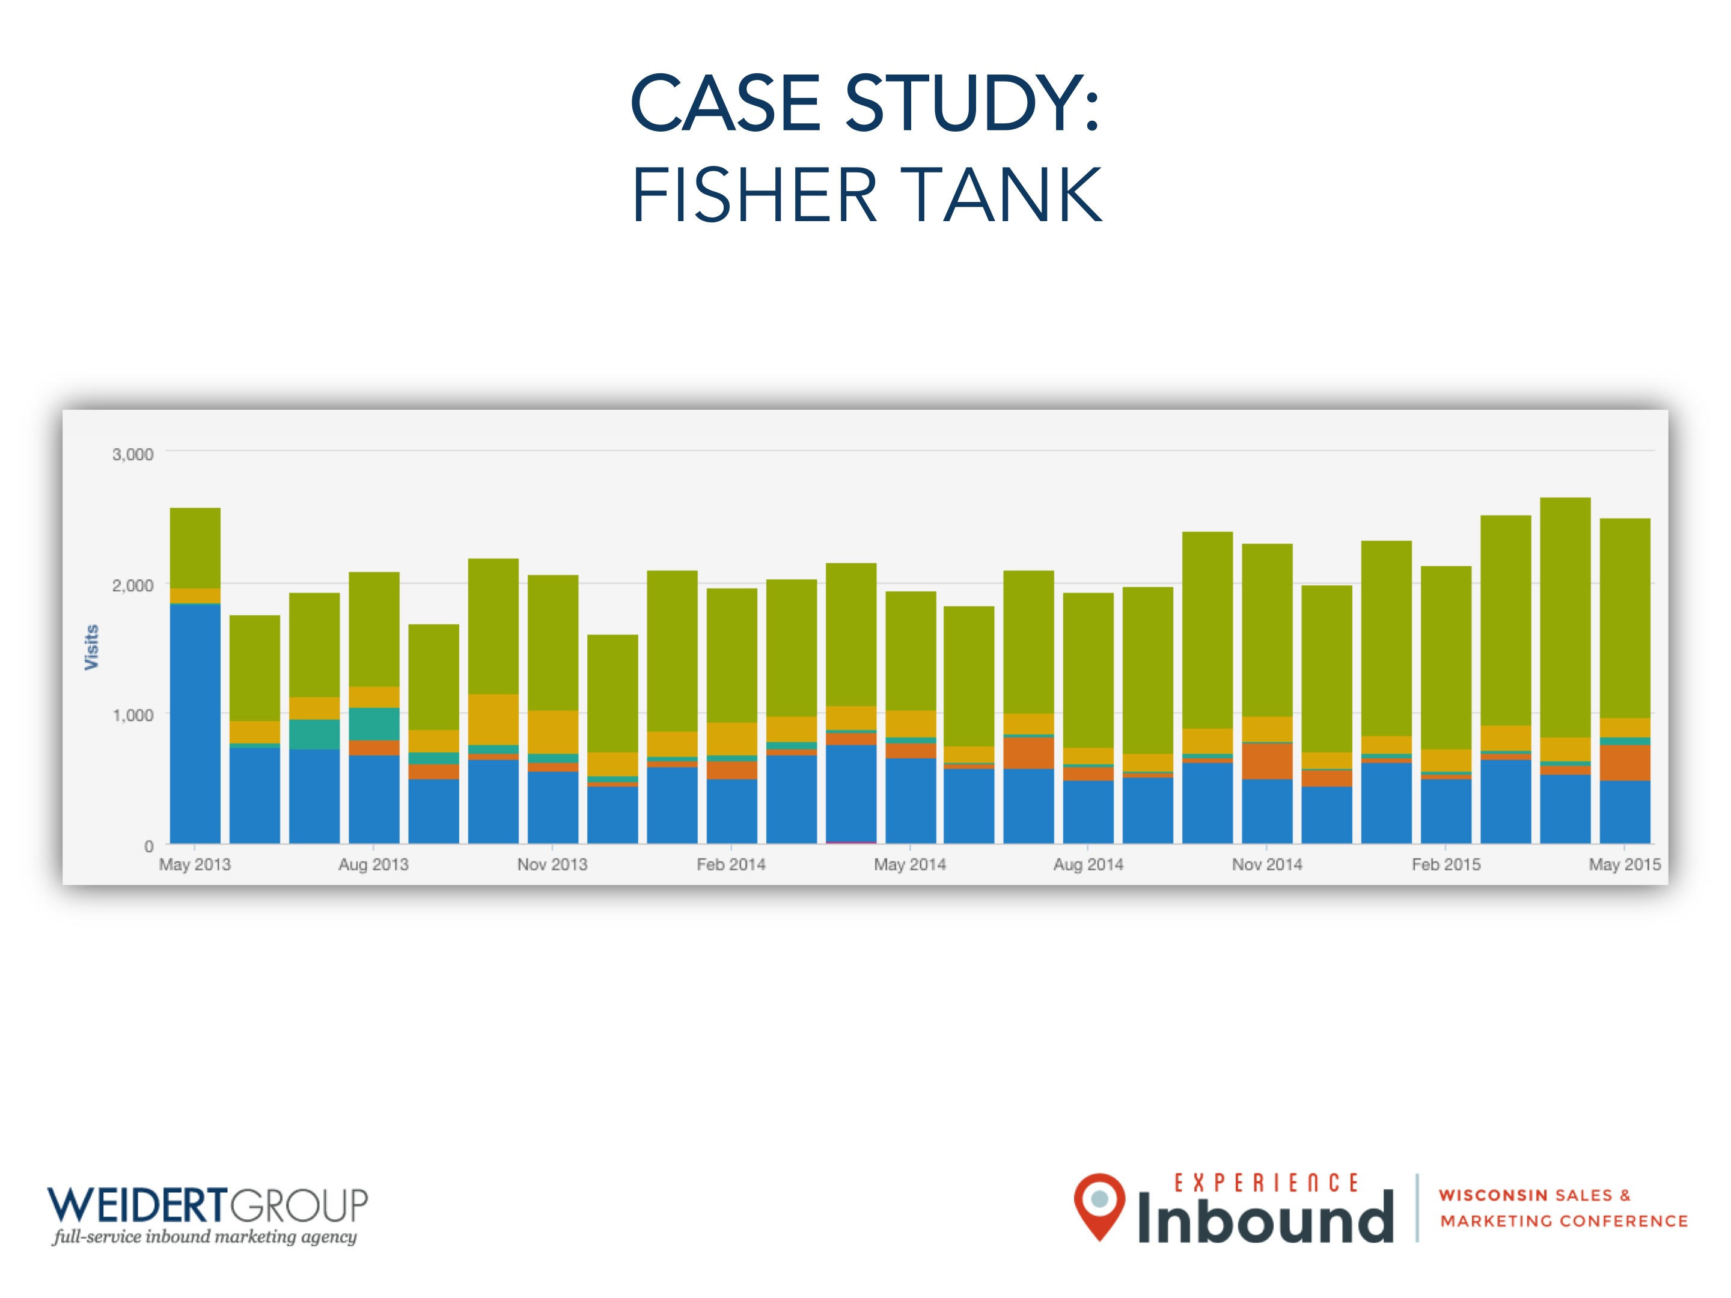
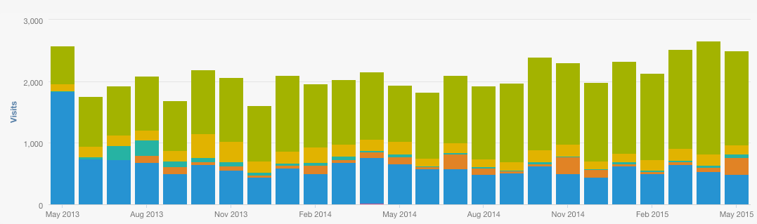
CASE STUDY:
FISHER TANK

Slide 26
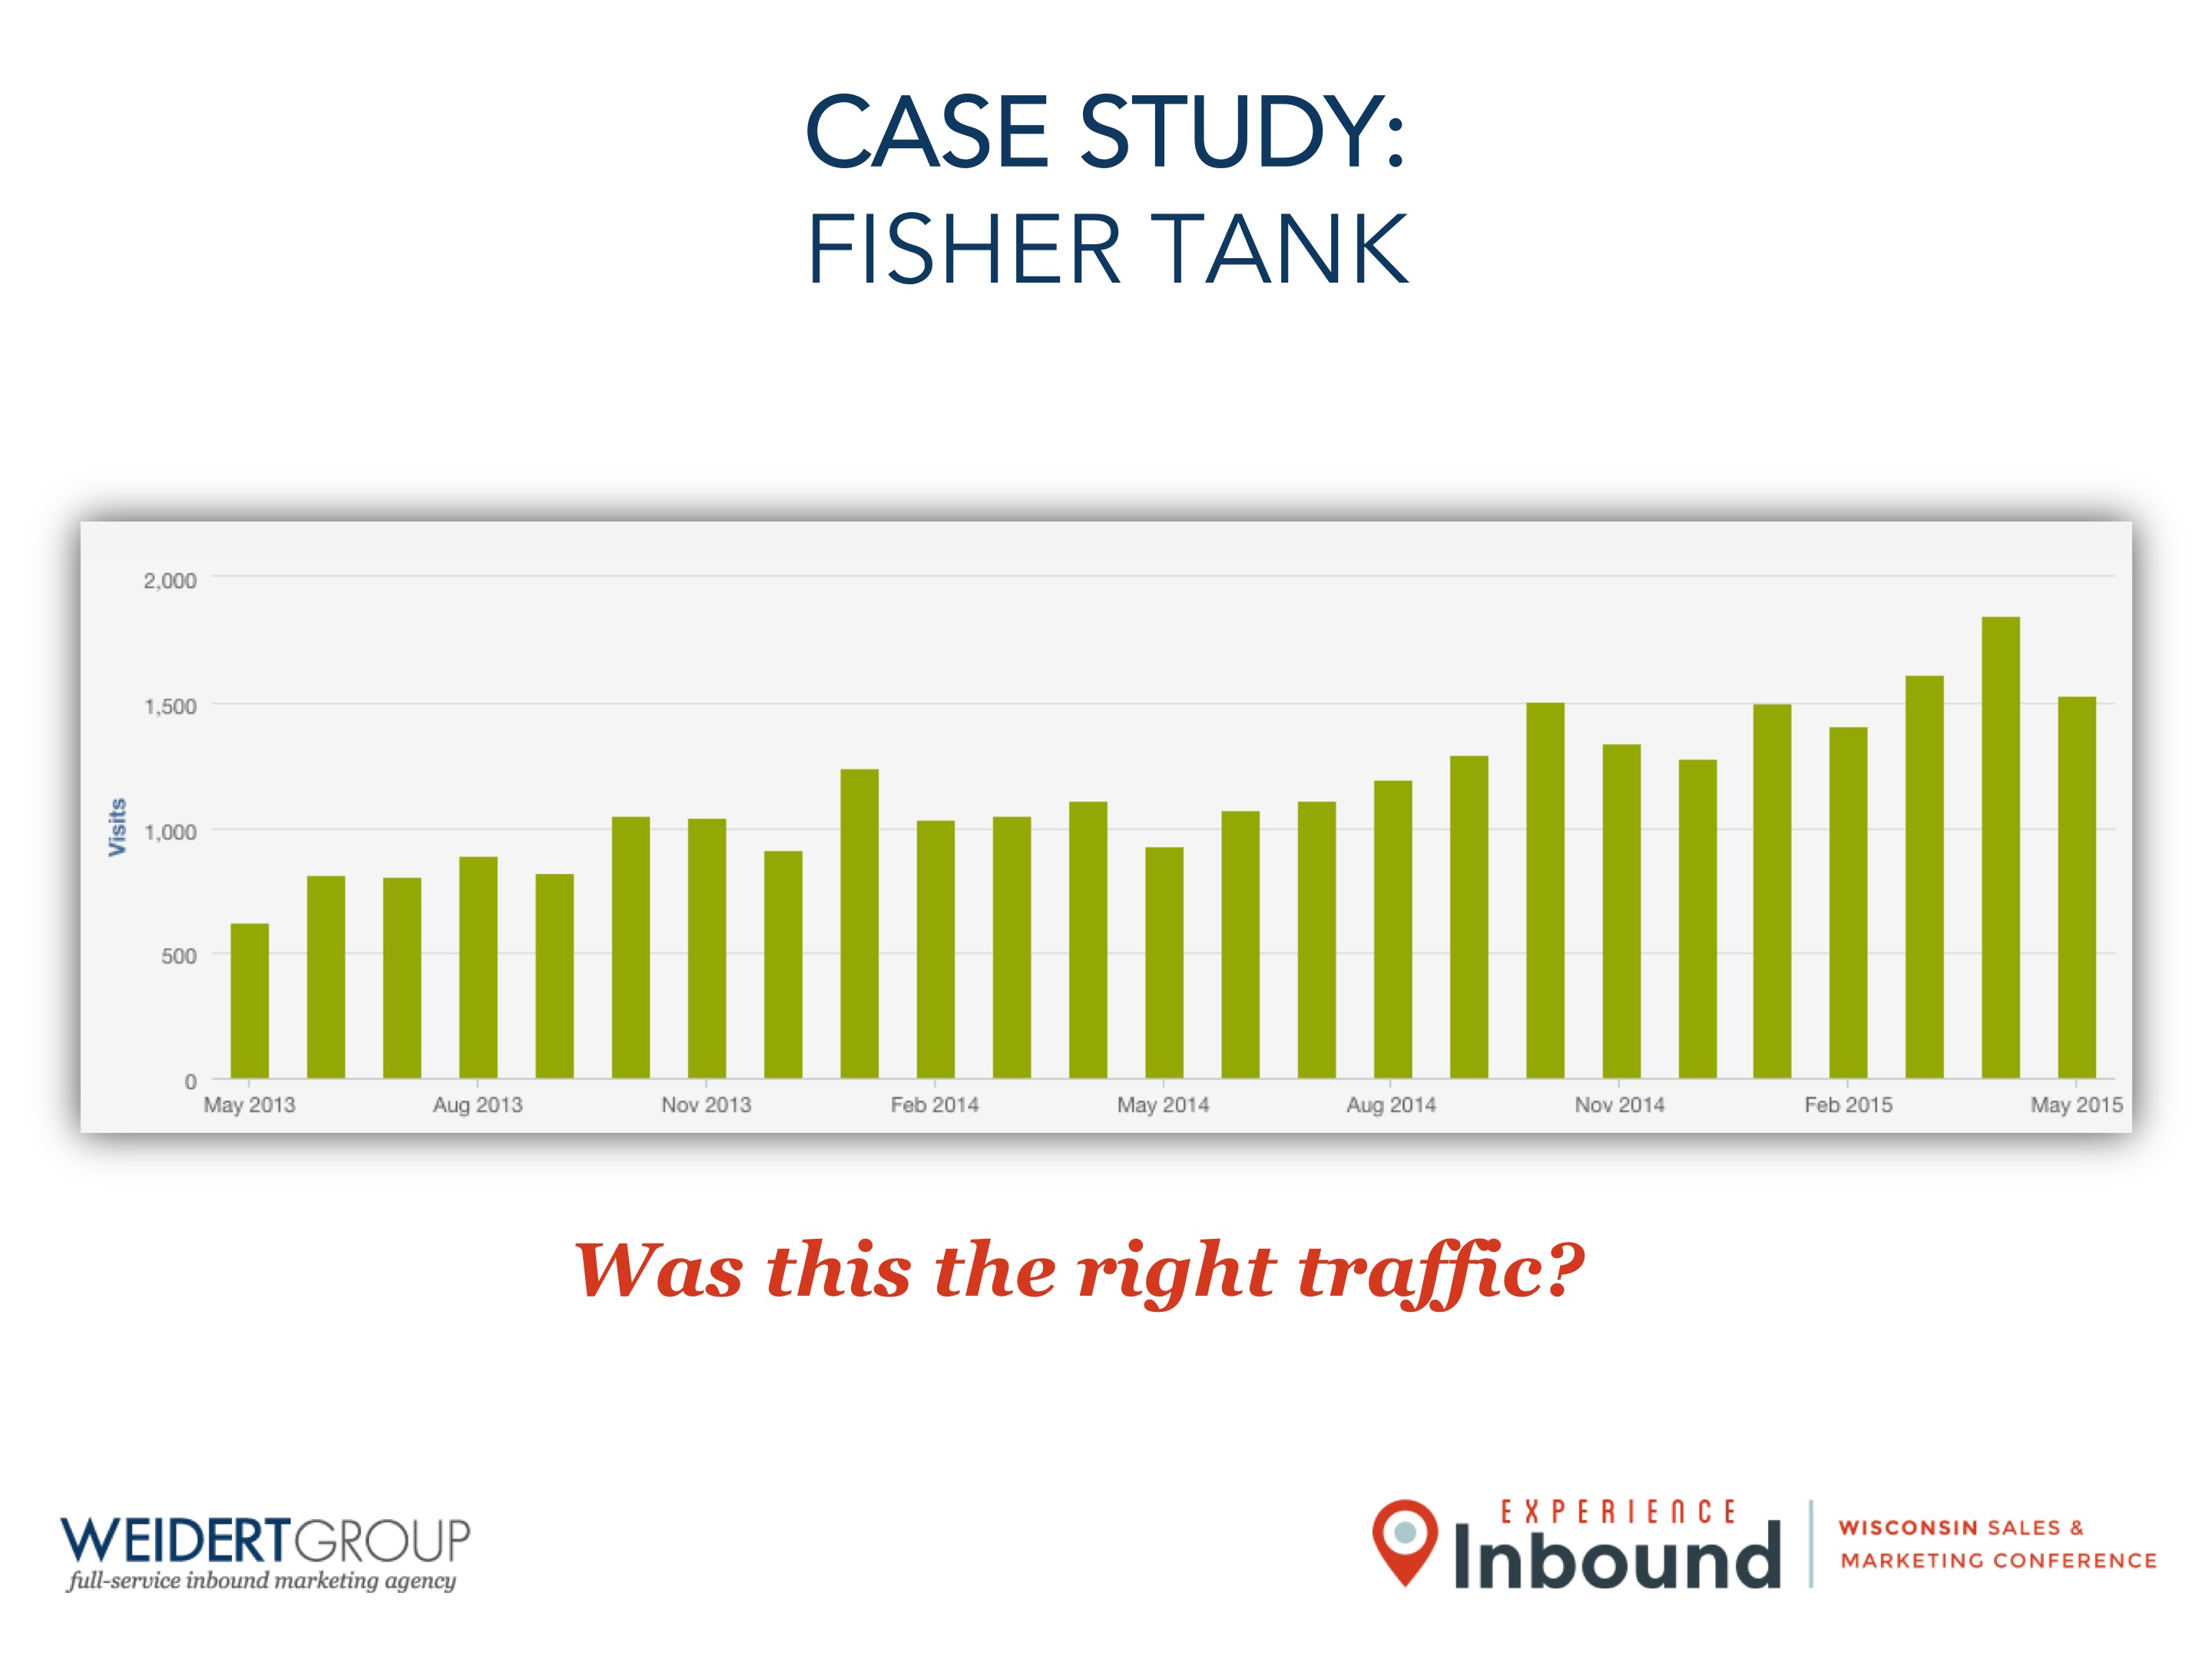
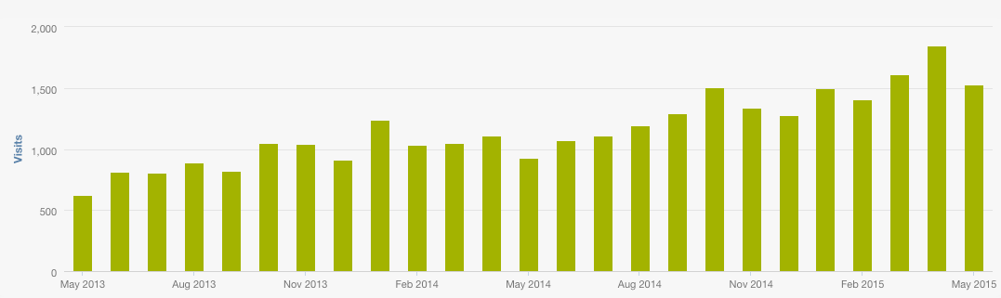
CASE STUDY:
FISHER TANK
Was this the right traffic?

Slide 27
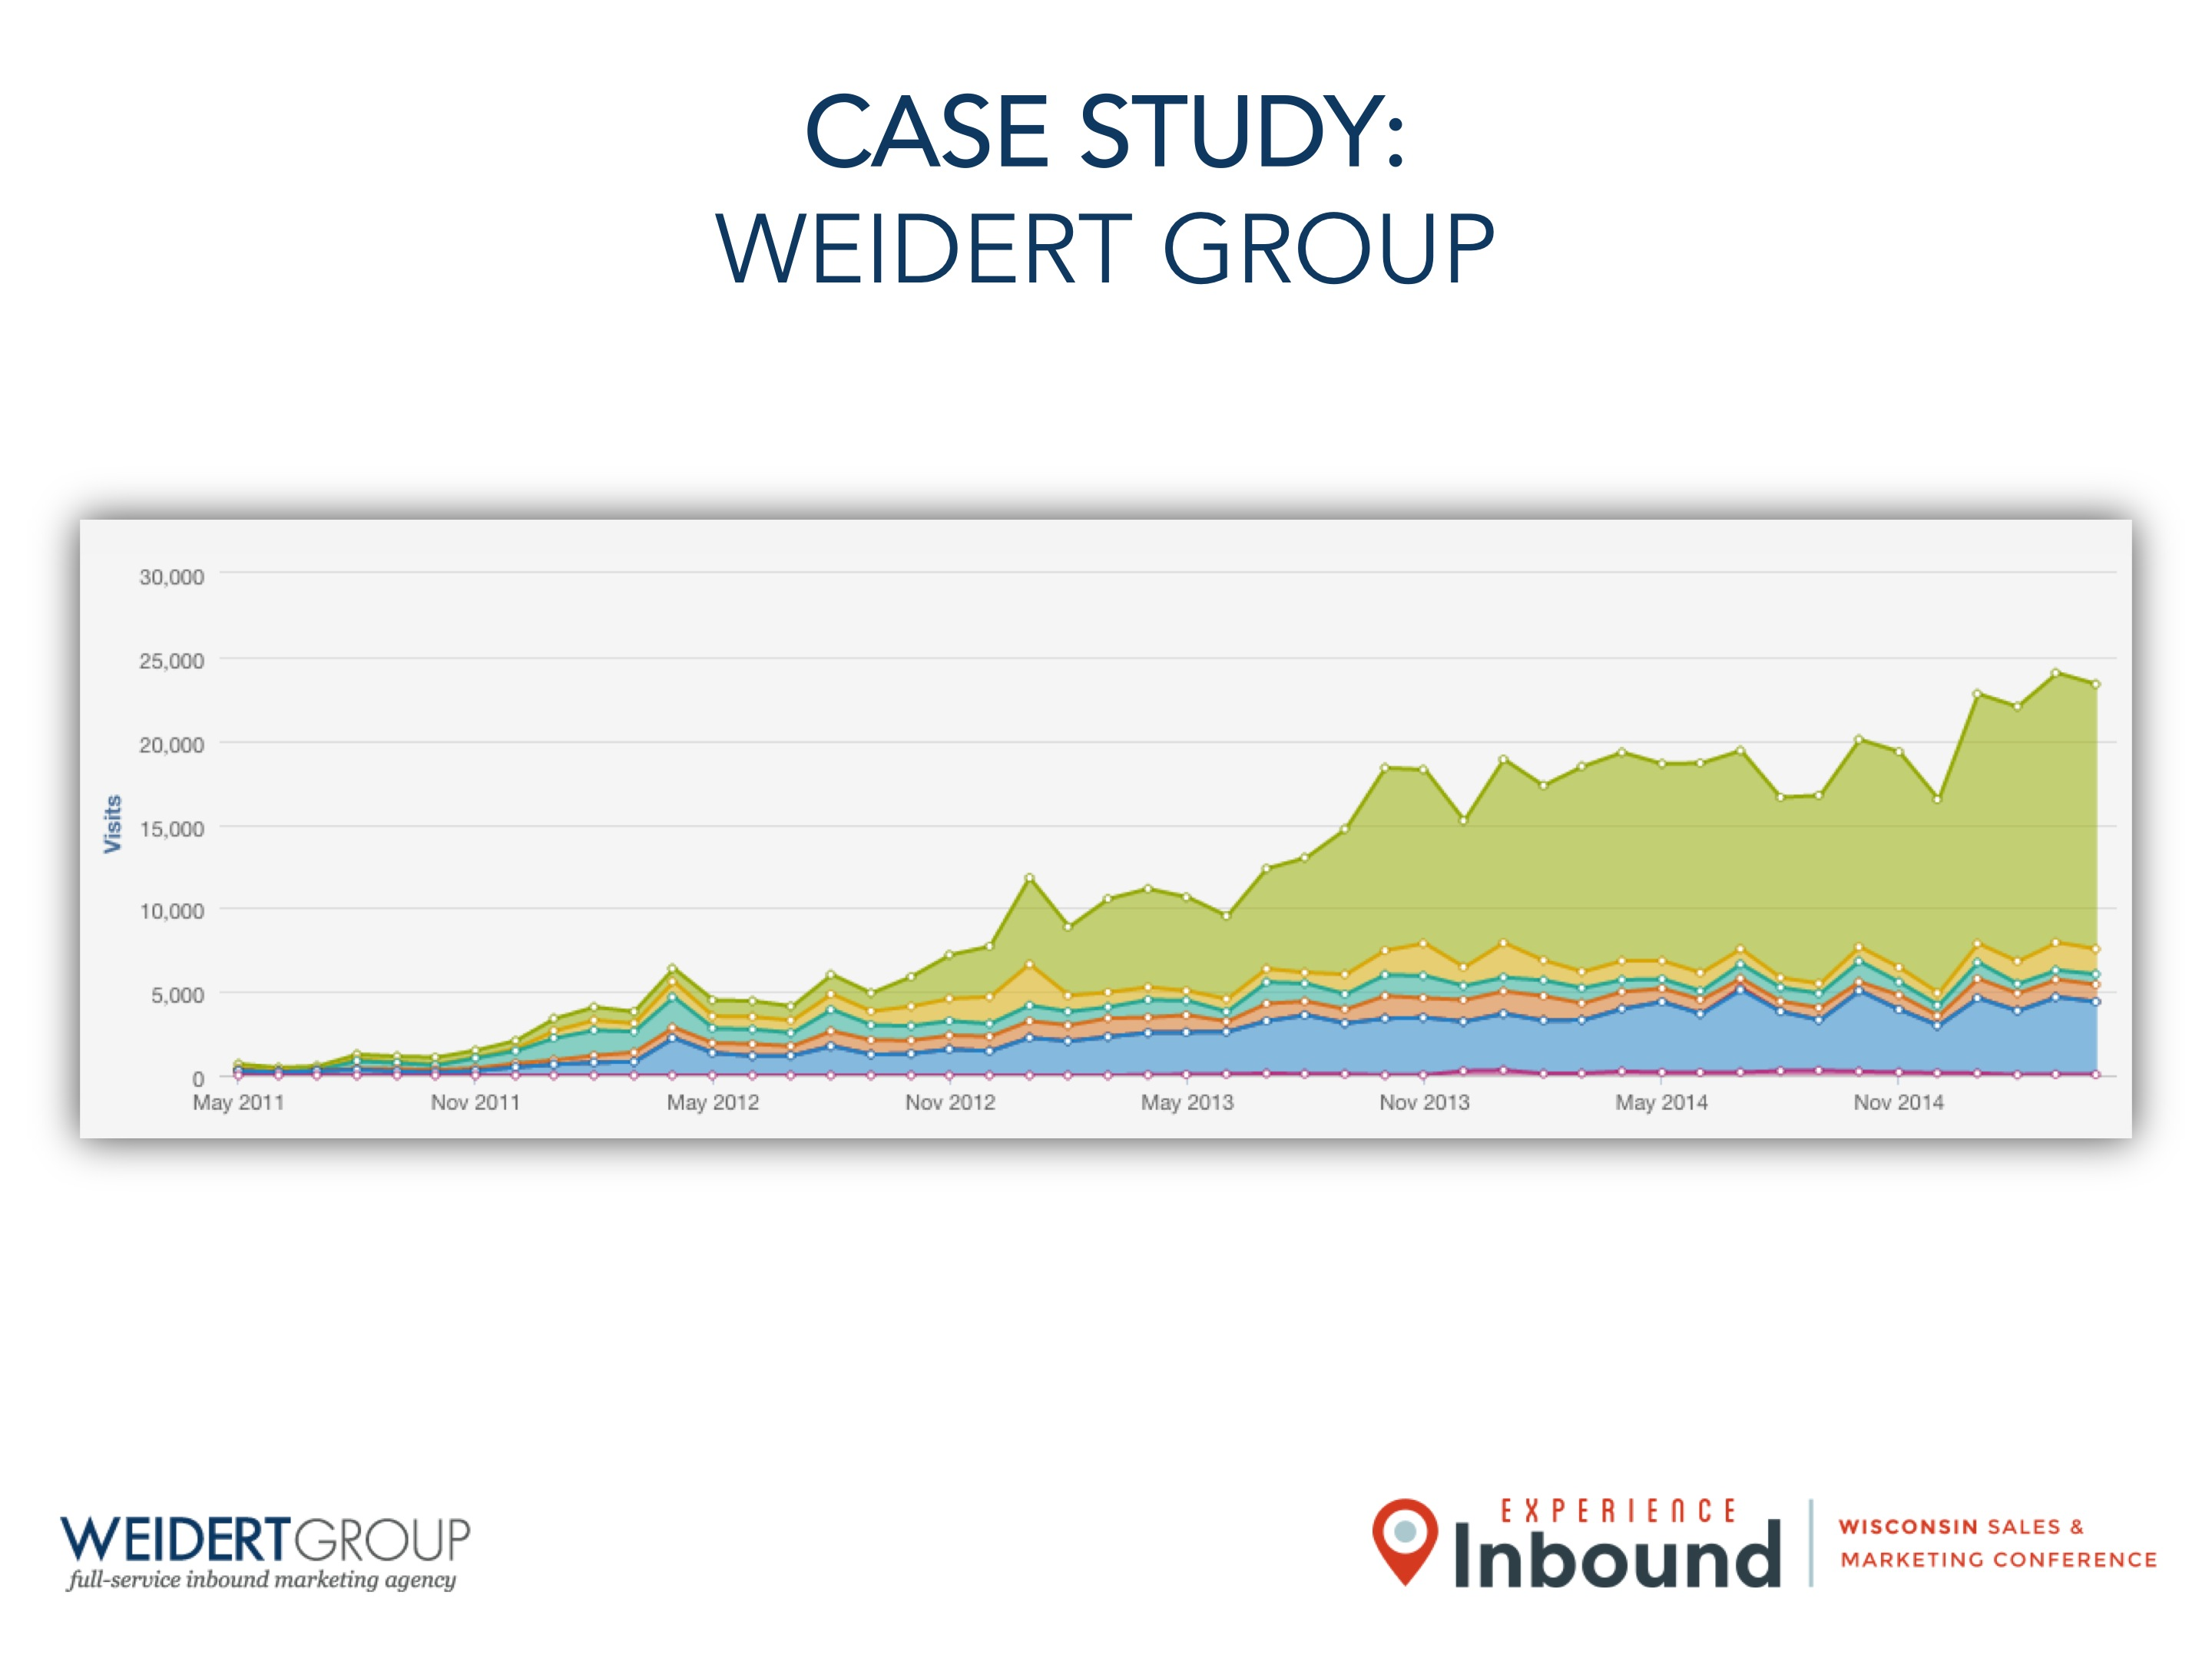
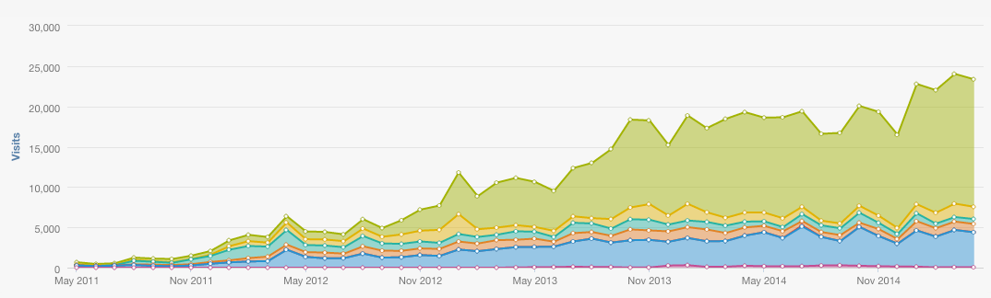
CASE STUDY:
WEIDERT GROUP

Slide 28
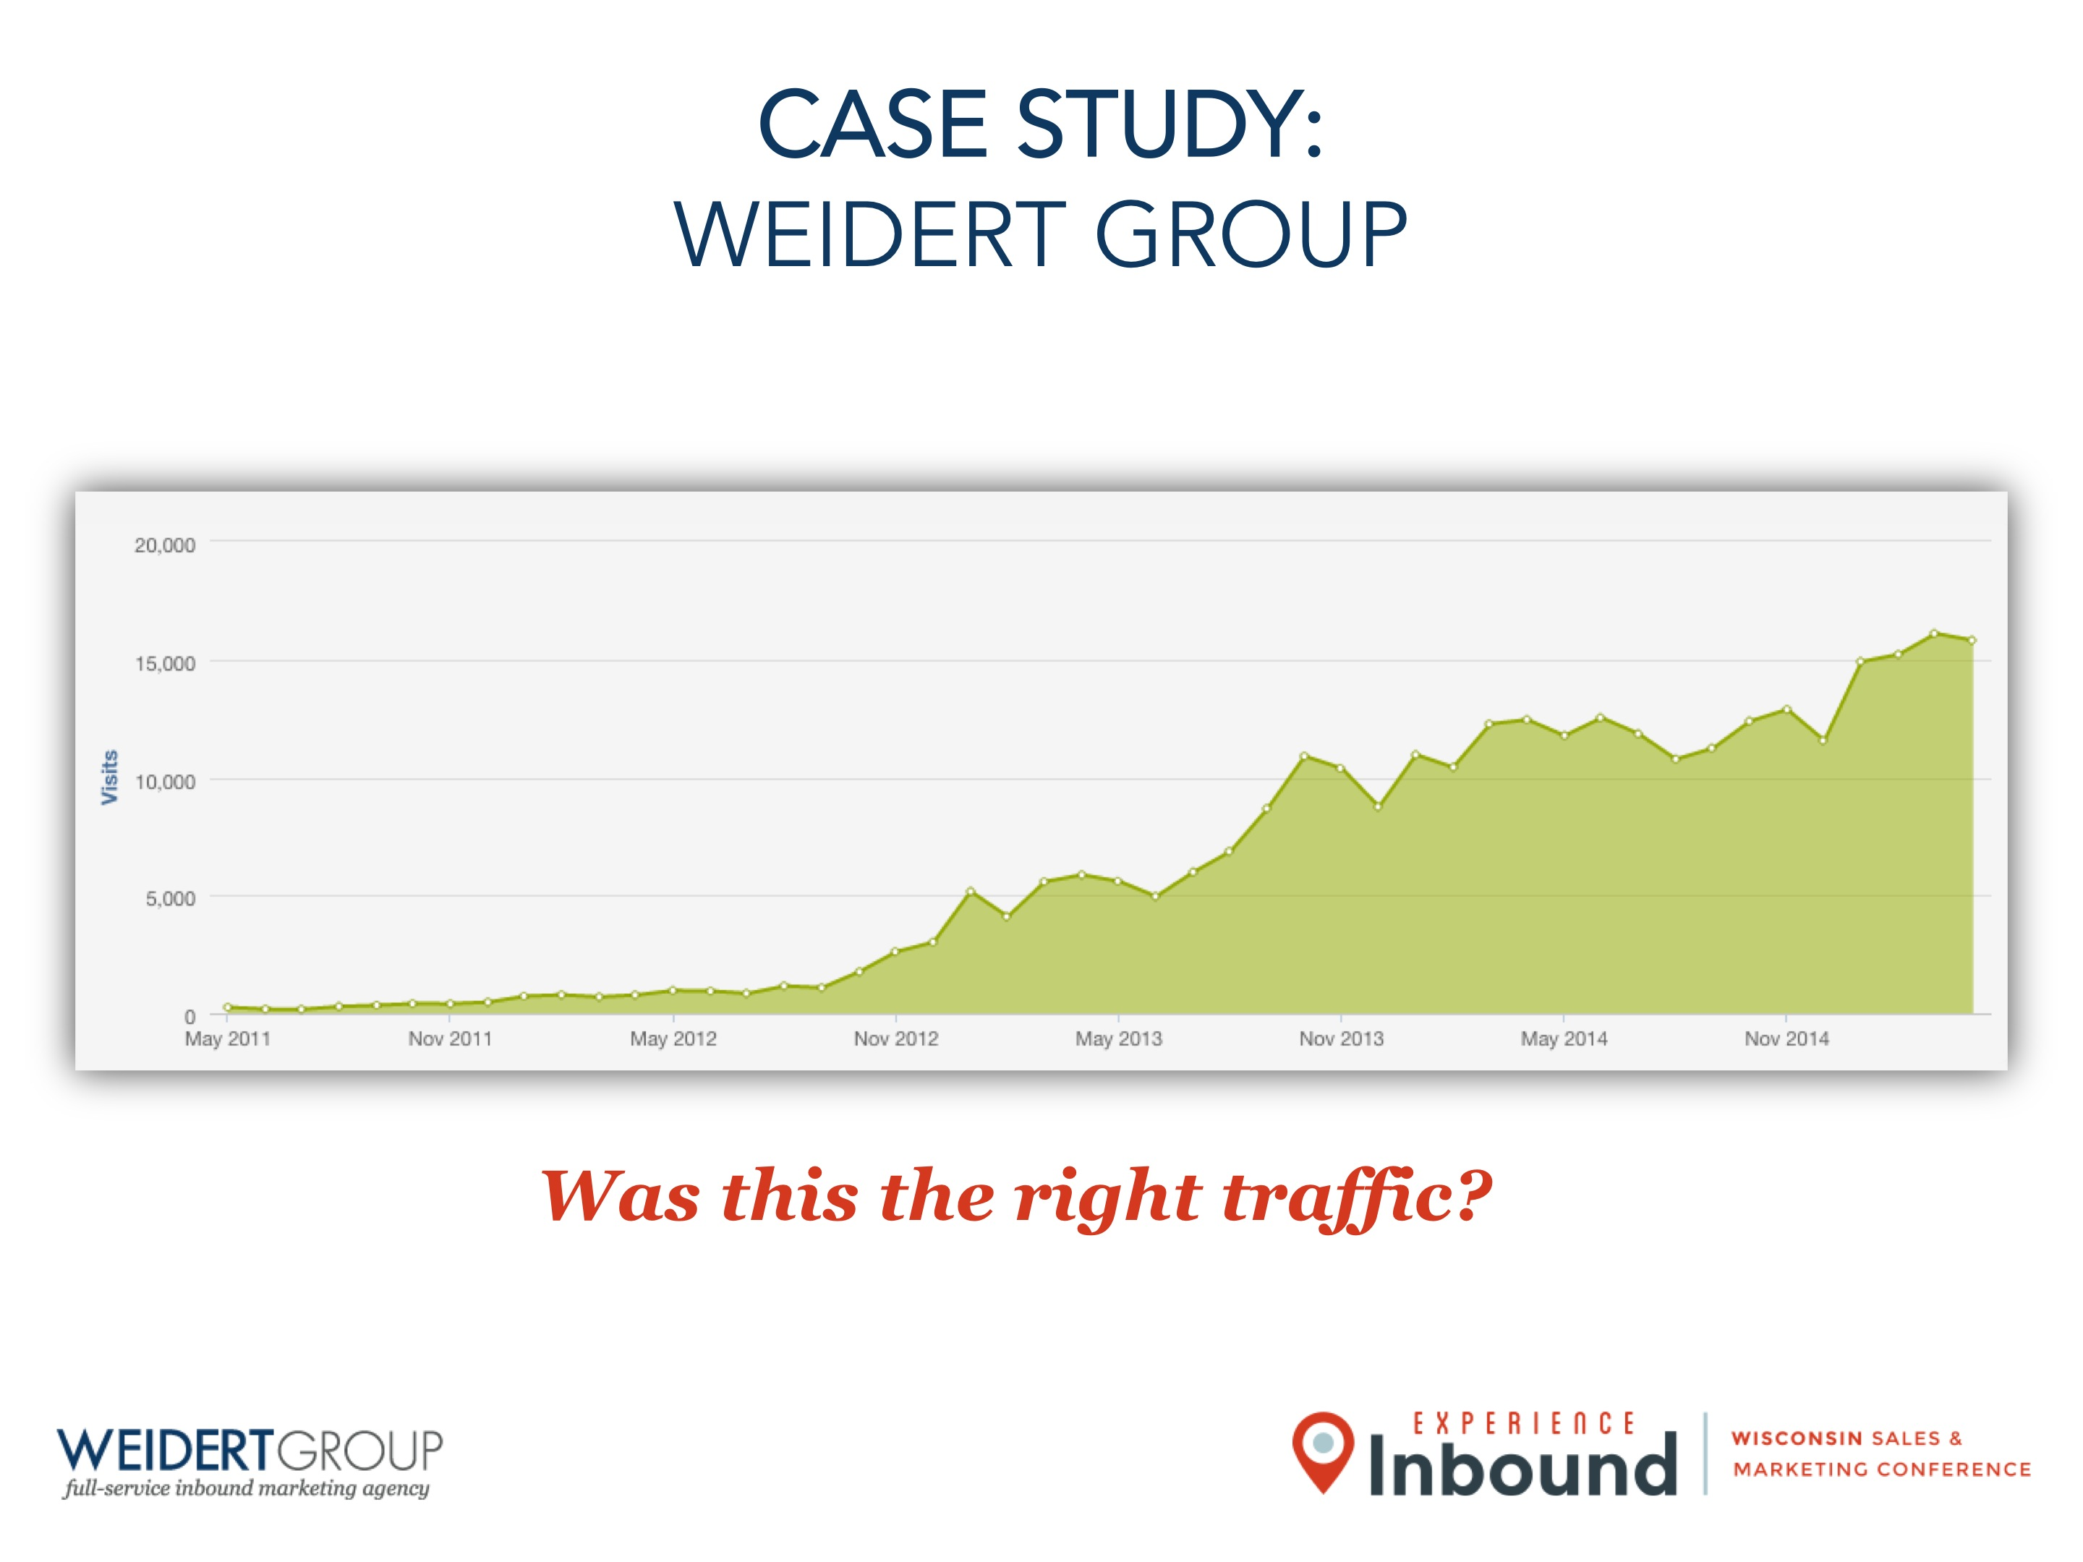
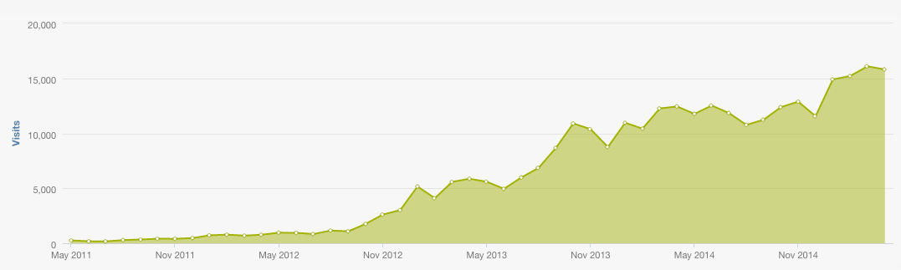
CASE STUDY:
WEIDERT GROUP
Was this the right traffic?

Slide 29
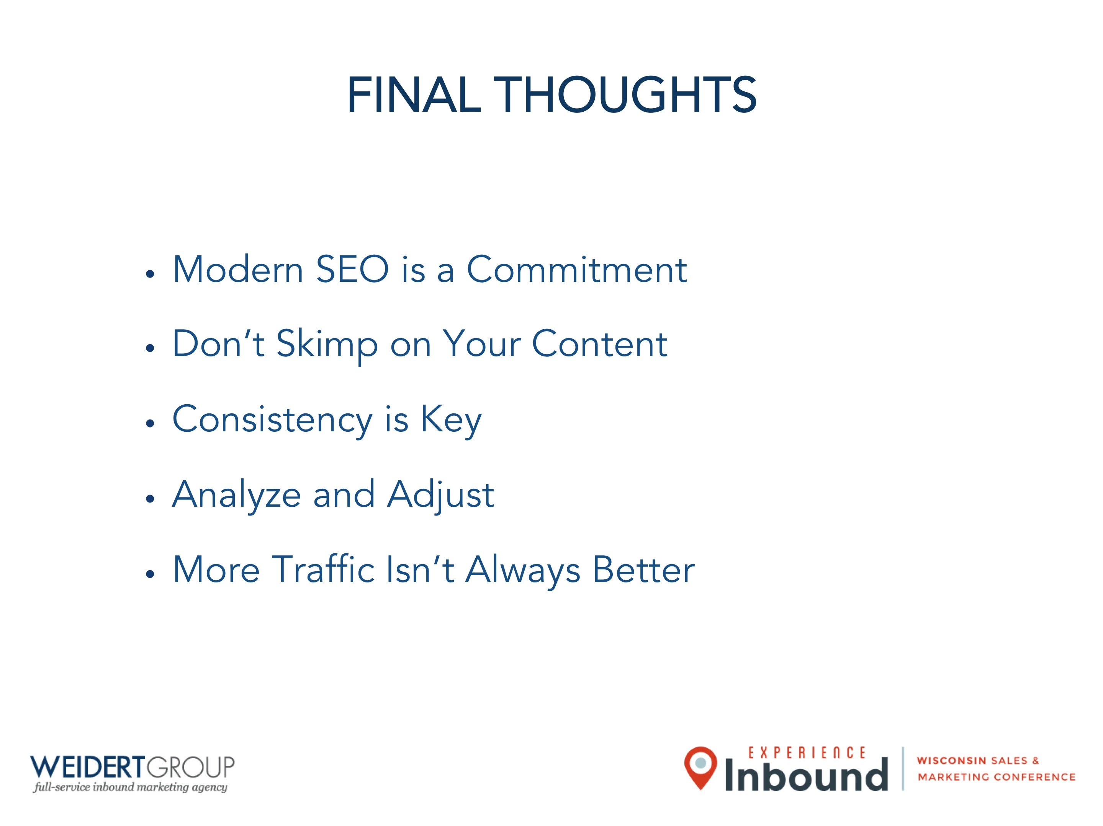
FINAL THOUGHTS
Modern SEO is a Commitment
Don’t Skimp on Your Content
Consistency is Key
Analyze and Adjust
More Traffic Isn’t Always Better

Slide 30

QUESTIONS?

