Slide 1


Slide 2
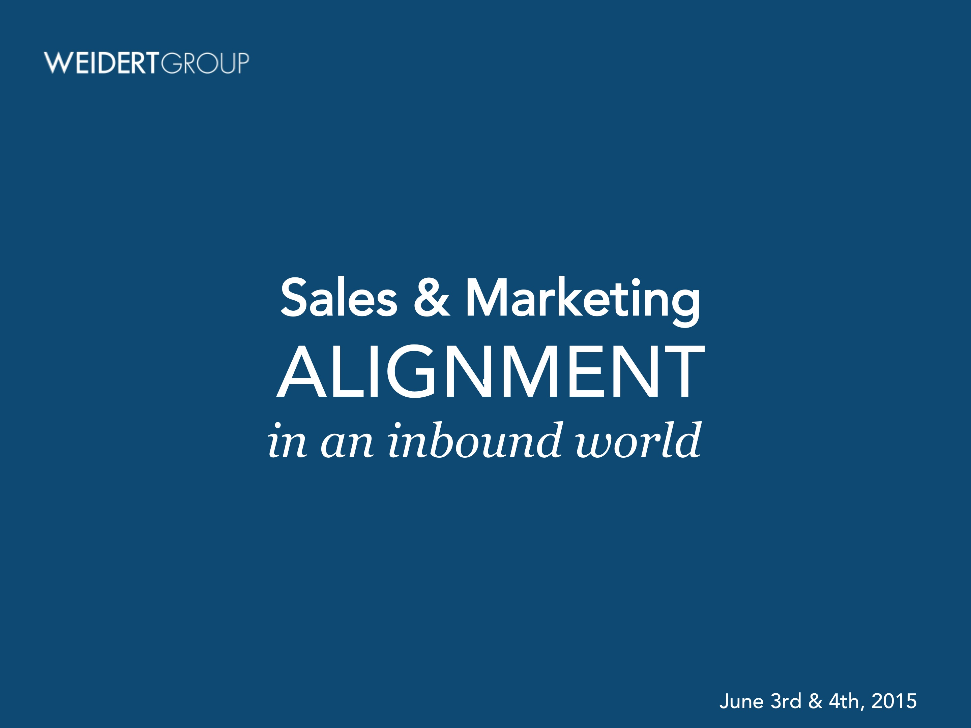

.
Sales & Marketing
ALIGNMENT
in an inbound world
June 3rd & 4th, 2015

Slide 3

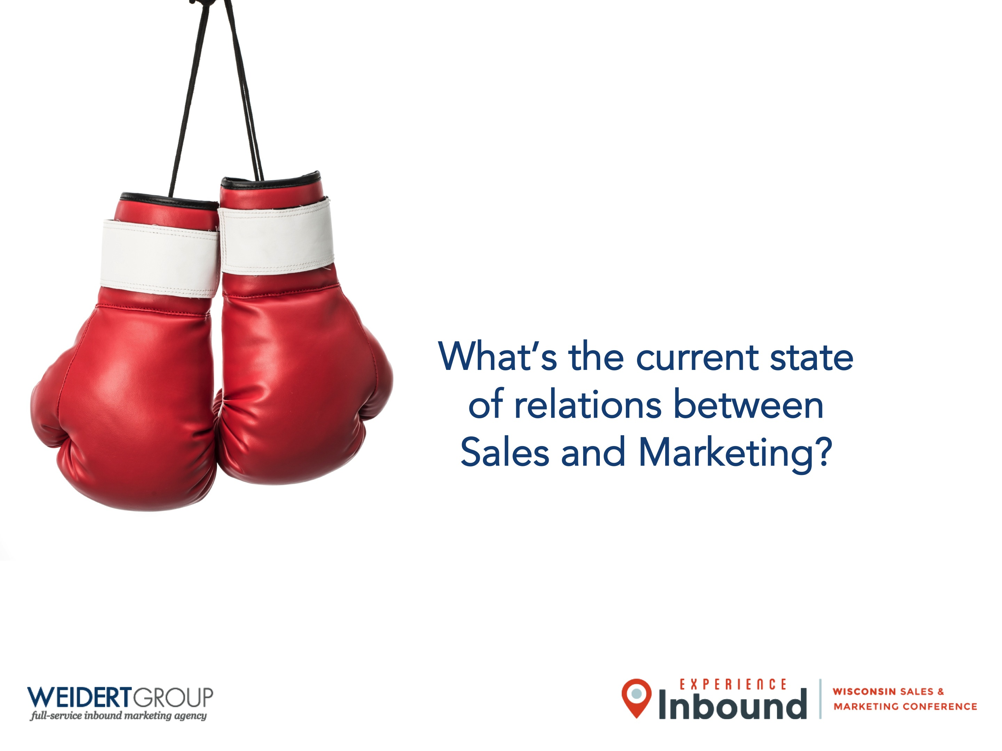


What’s the current state
of relations between
Sales and Marketing?

Slide 4

MARKETING
Is out of touch
(and dumb)
SALES
Is arrogant
(and dumb)
MARKETING
is arrogant,

Slide 5


Counseling, anyone?

Slide 6
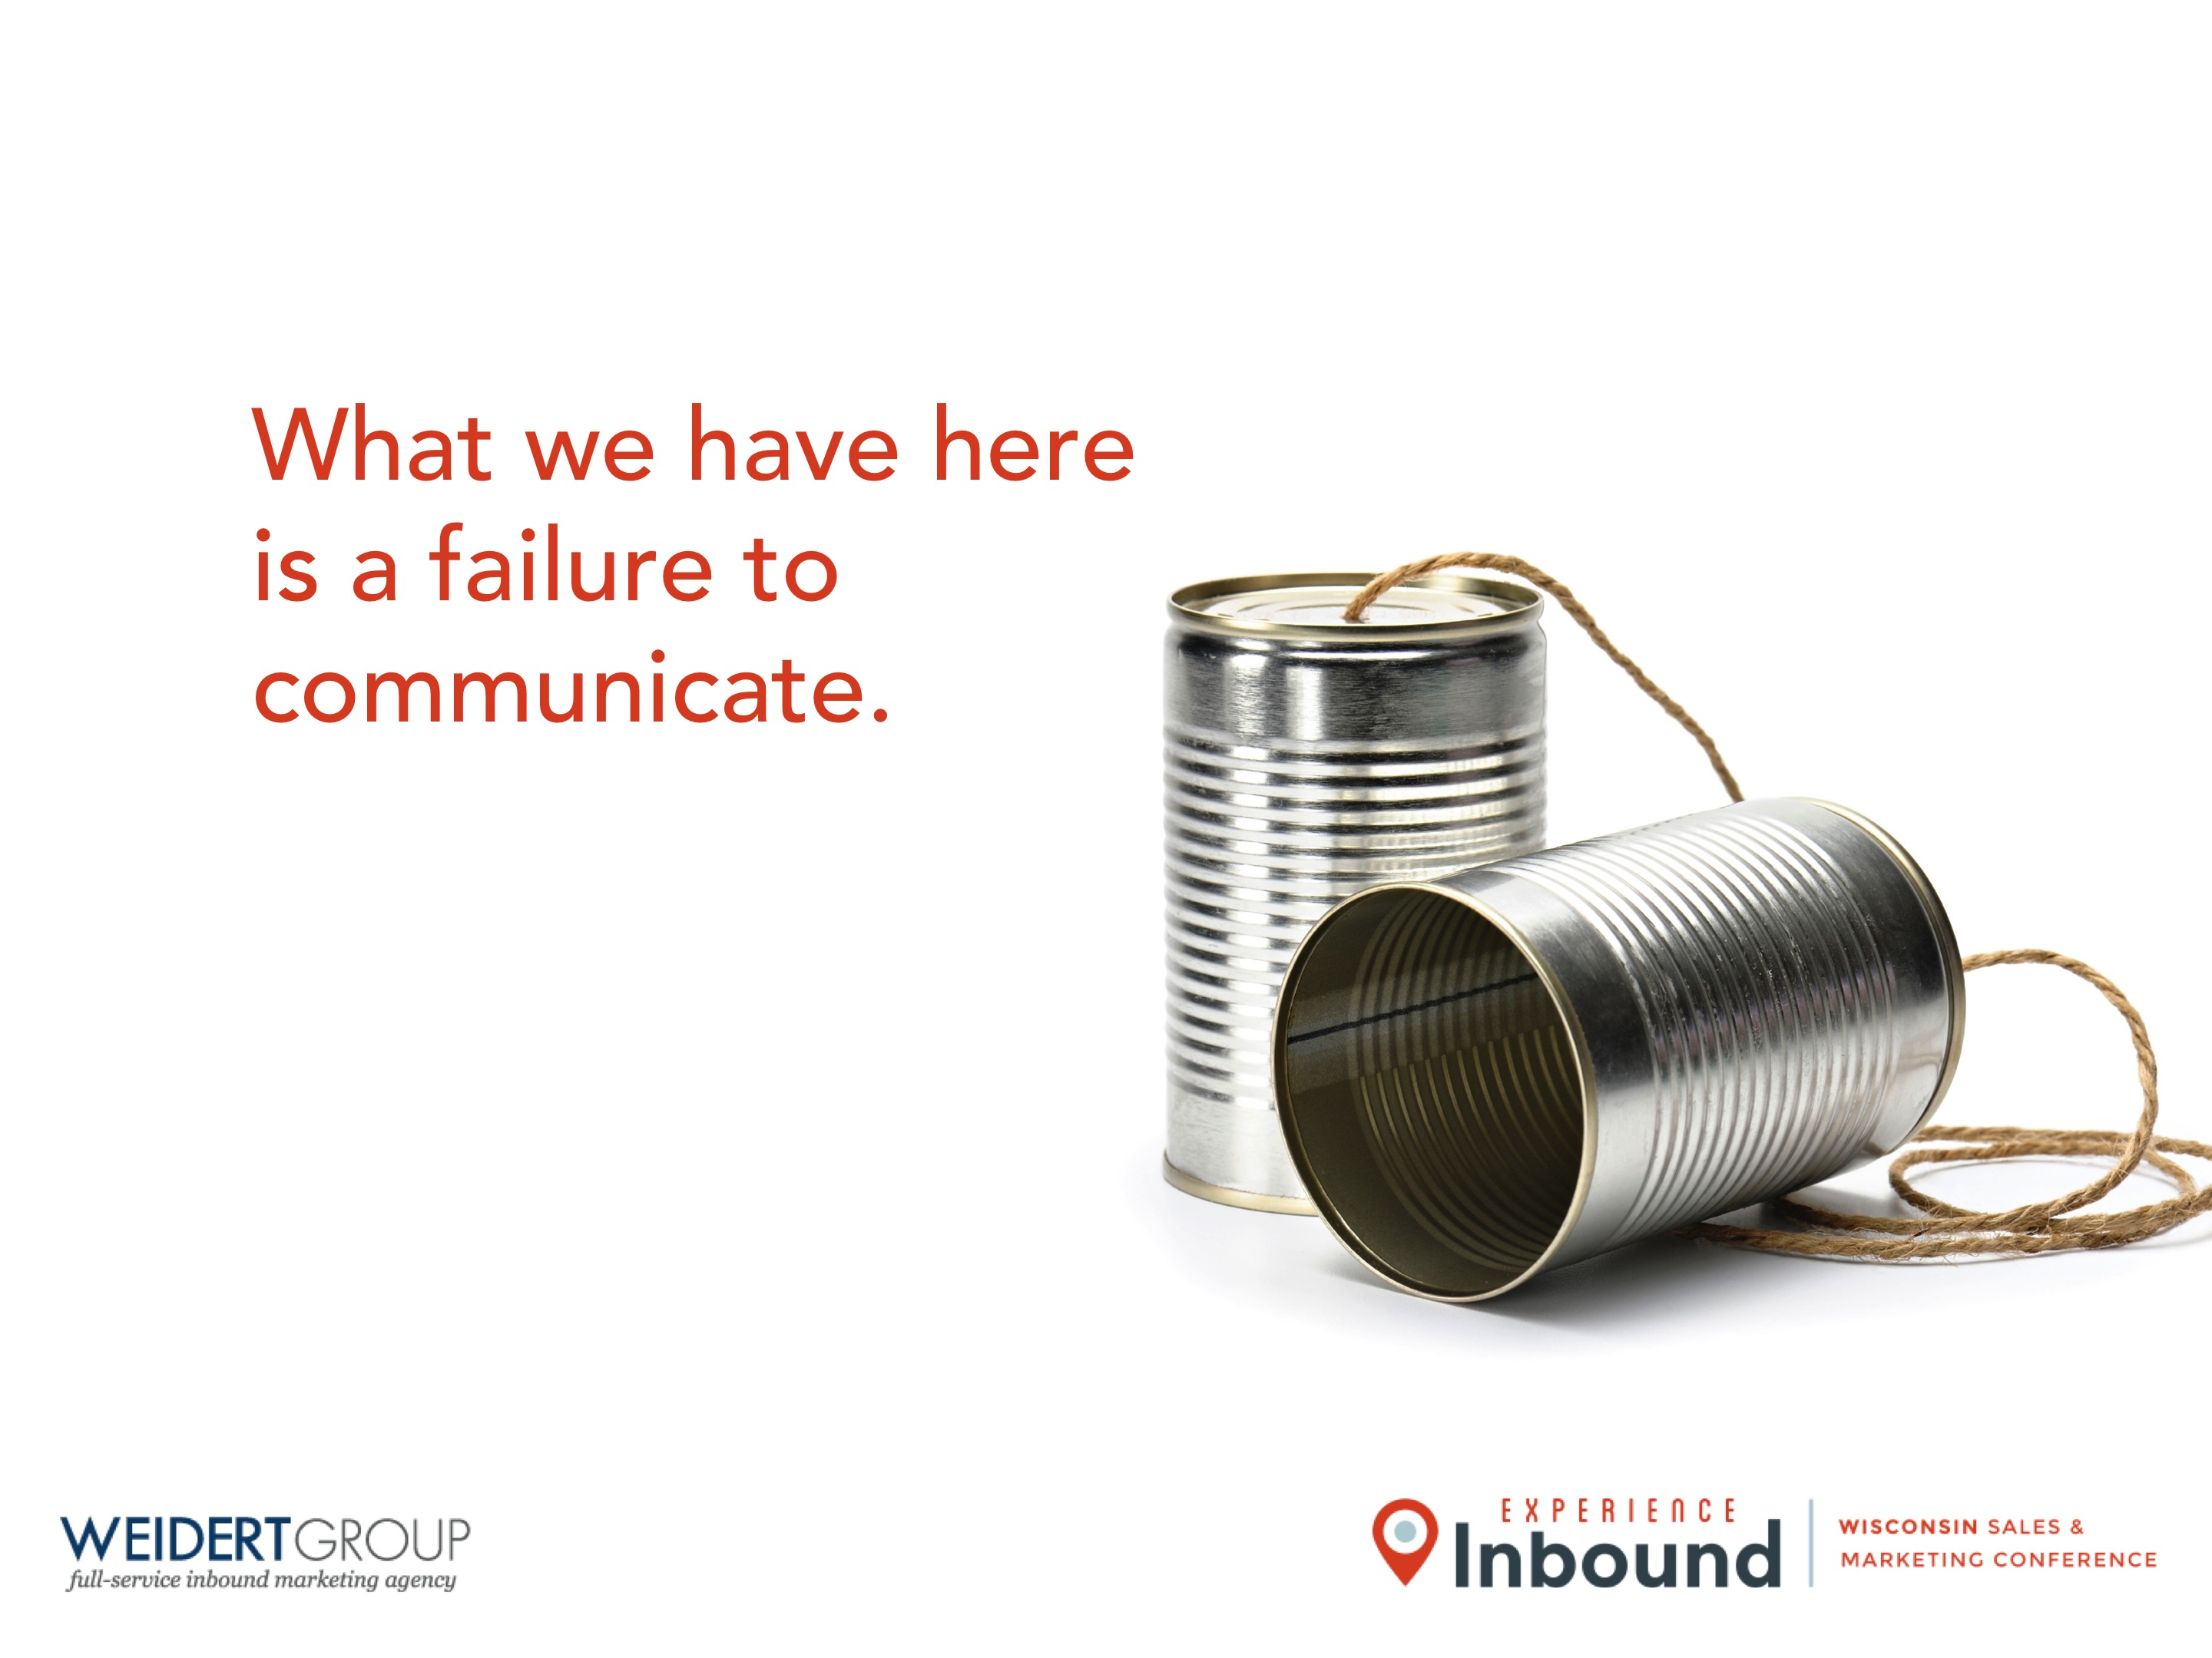

What we have here
is a failure to
communicate.

Slide 7
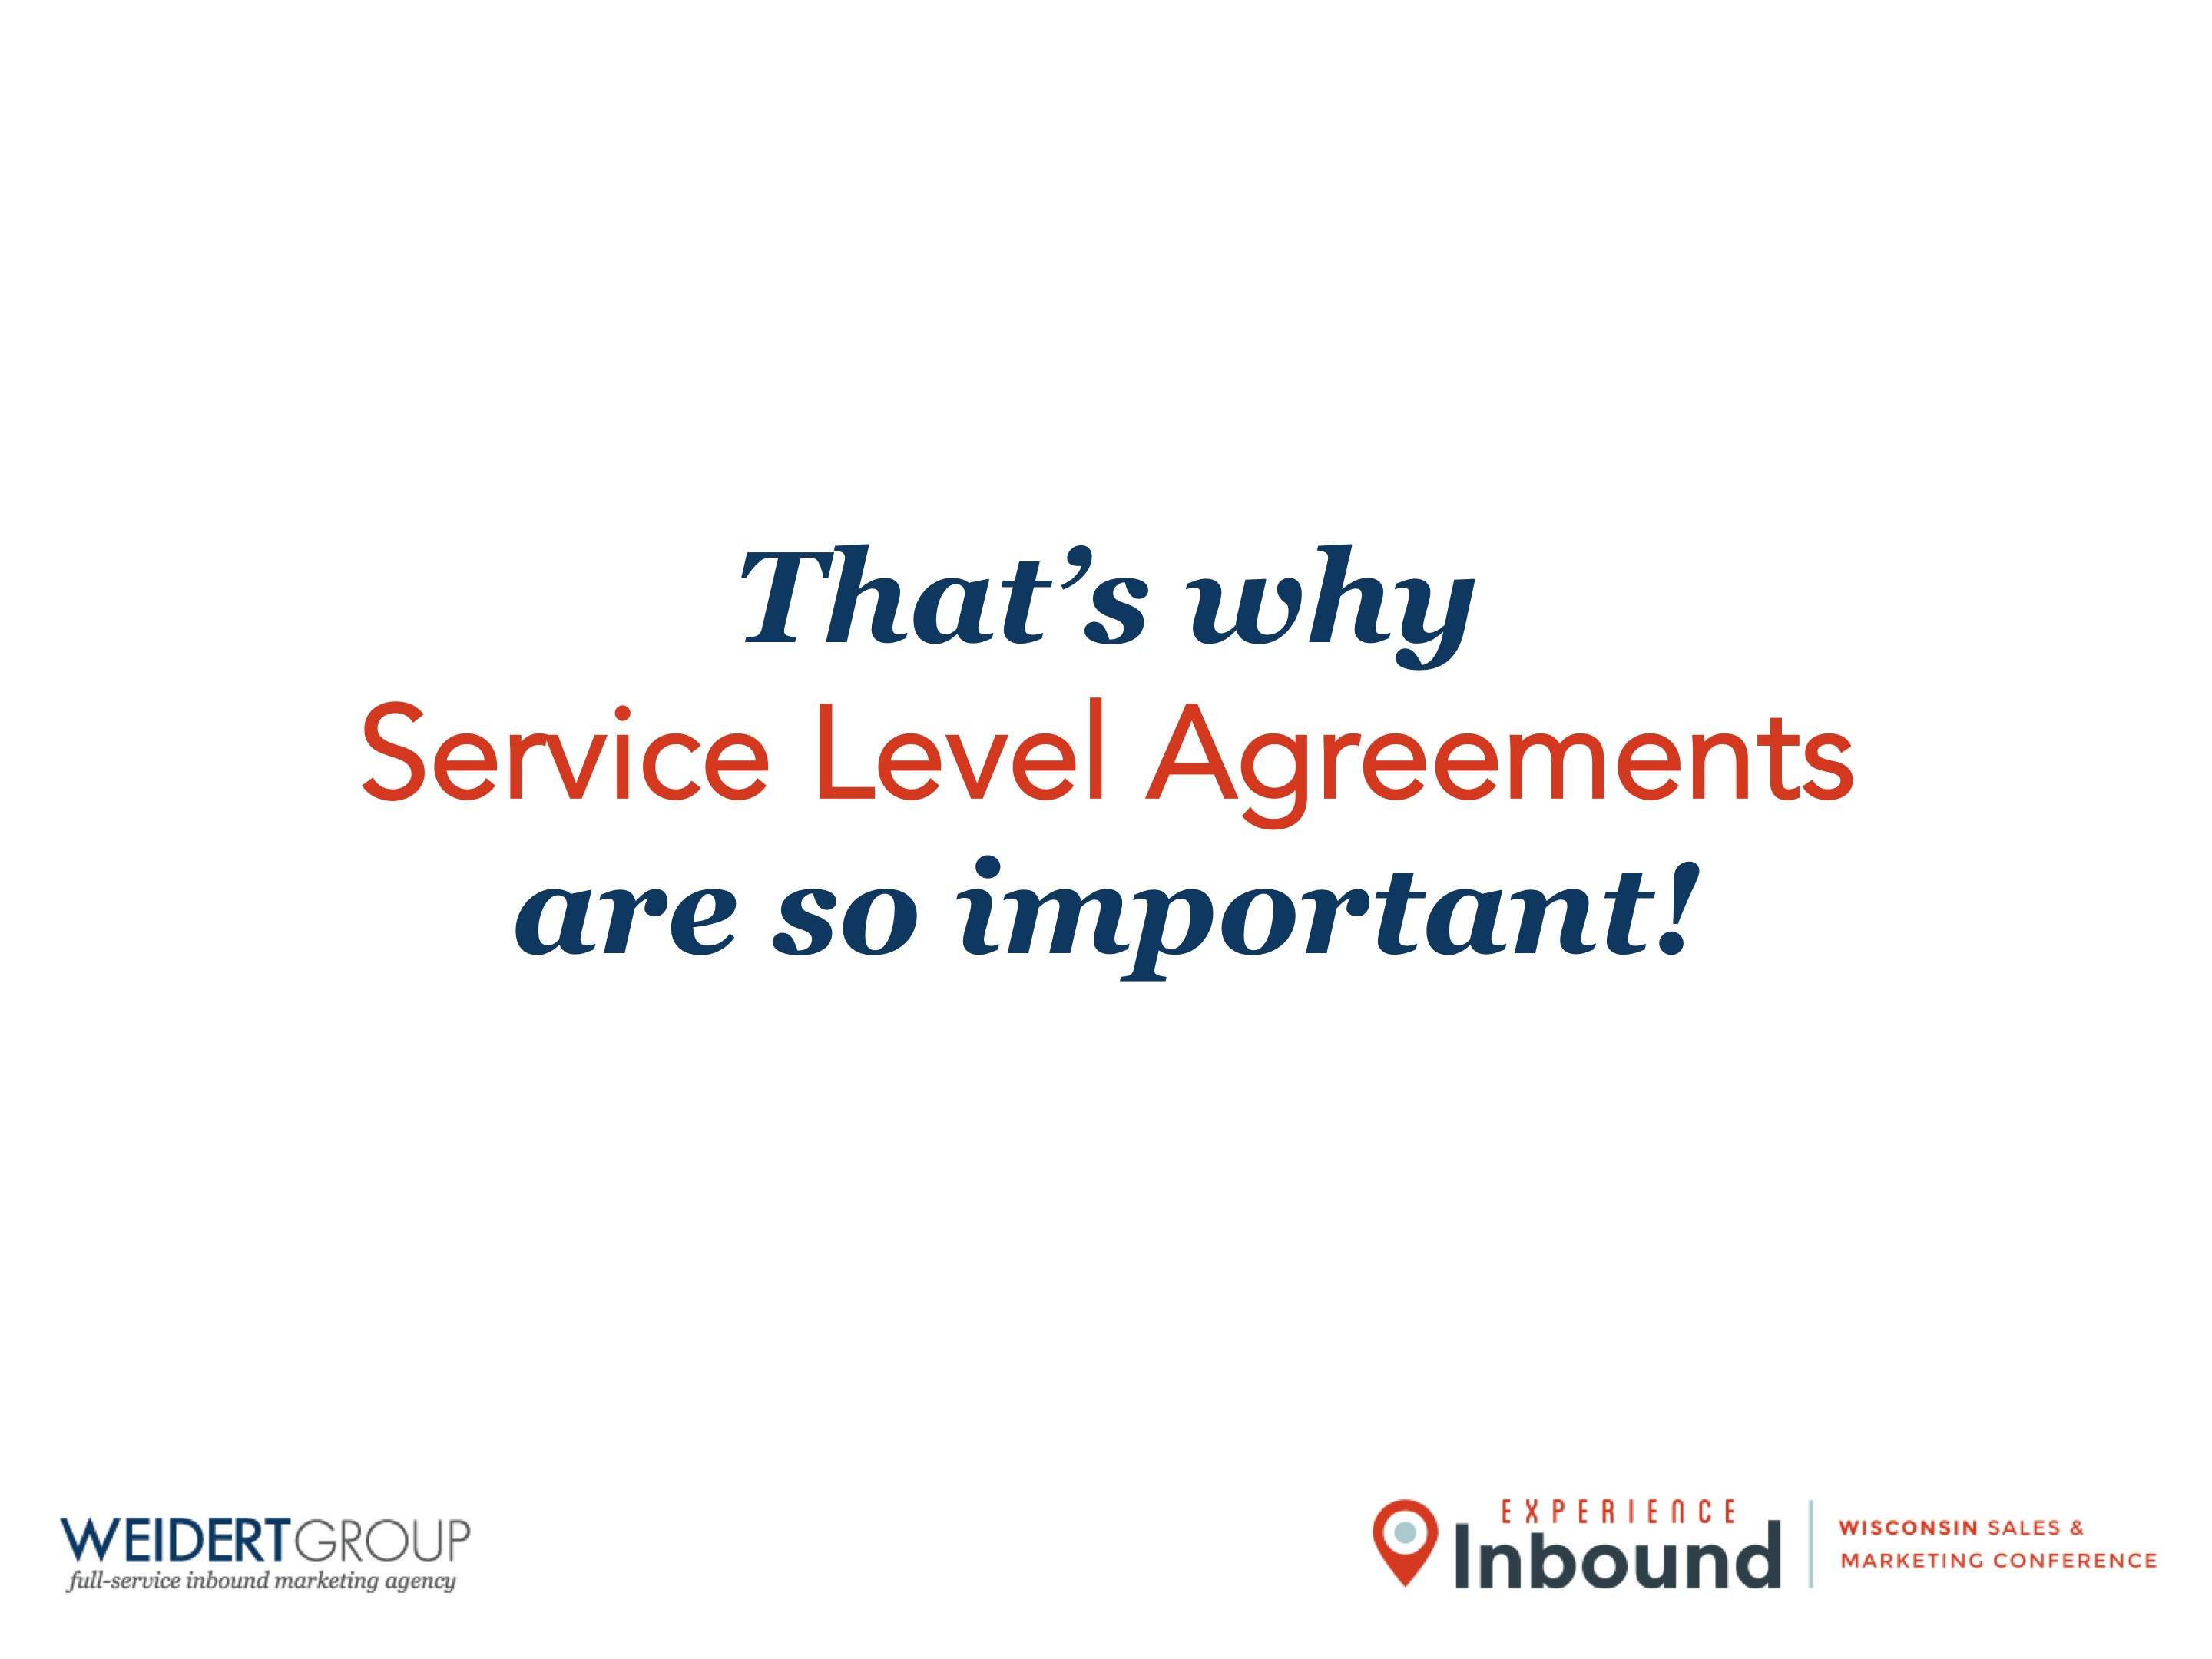
That’s why
Service Level Agreements
are so important!

Slide 8
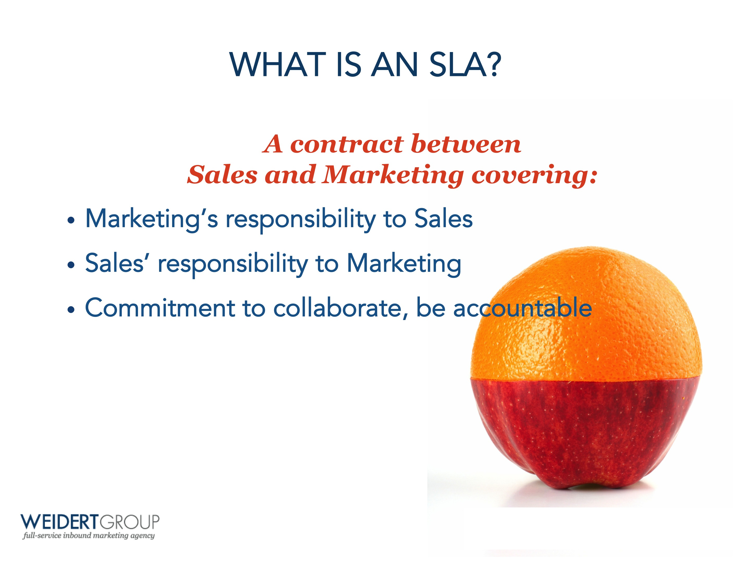

WHAT IS AN SLA?
A contract between
Sales and Marketing covering:
Marketing’s responsibility to Sales
Sales’ responsibility to Marketing
Commitment to collaborate, be accountable

Slide 9

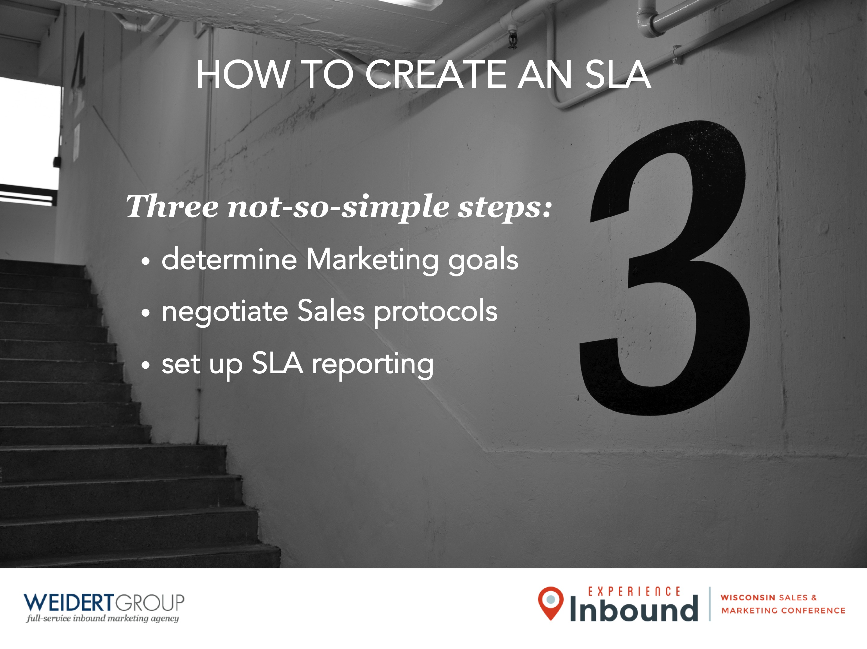
HOW TO CREATE AN SLA
Three not-so-simple steps:
determine Marketing goals
negotiate Sales protocols
set up SLA reporting

Slide 10
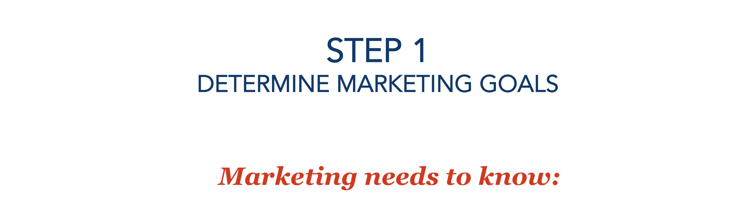

STEP 1
DETERMINE MARKETING GOALS
Marketing needs to know:
The definition of a qualified lead (SQL/MQL)
How much revenue expected from marketing leads?
What’s a new customer worth? Year 1 vs Lifetime?
What percentage of leads get closed?

Slide 11
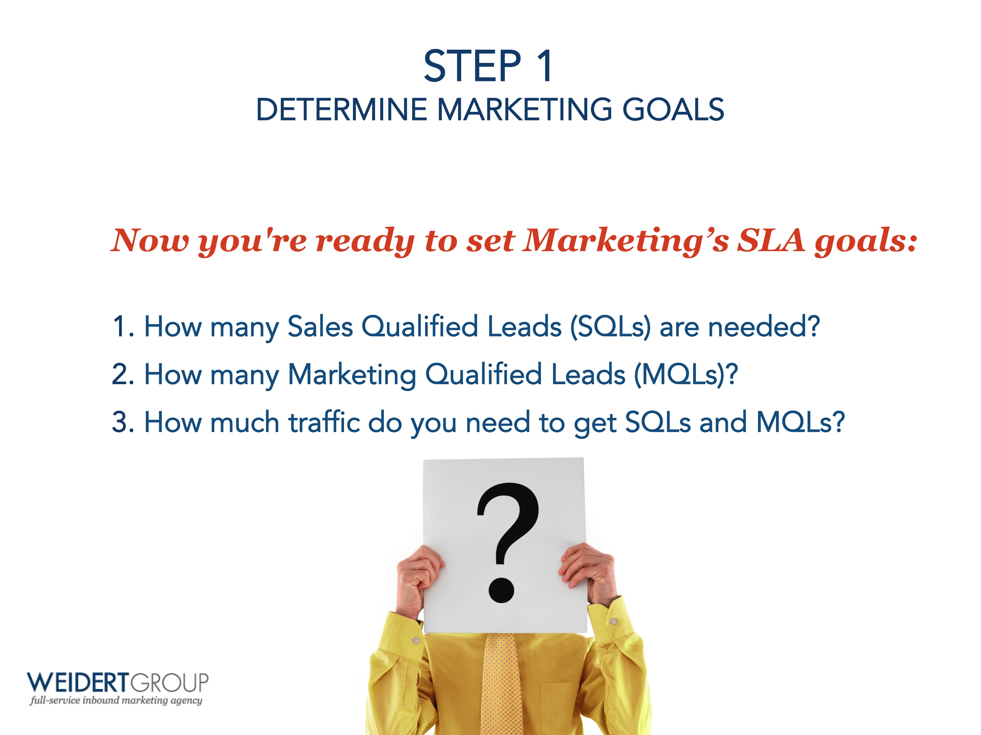

STEP 1
DETERMINE MARKETING GOALS
Now you're ready to set Marketing’s SLA goals:
How many Sales Qualified Leads (SQLs) are needed?
How many Marketing Qualified Leads (MQLs)?
How much traffic do you need to get SQLs and MQLs?

Slide 12
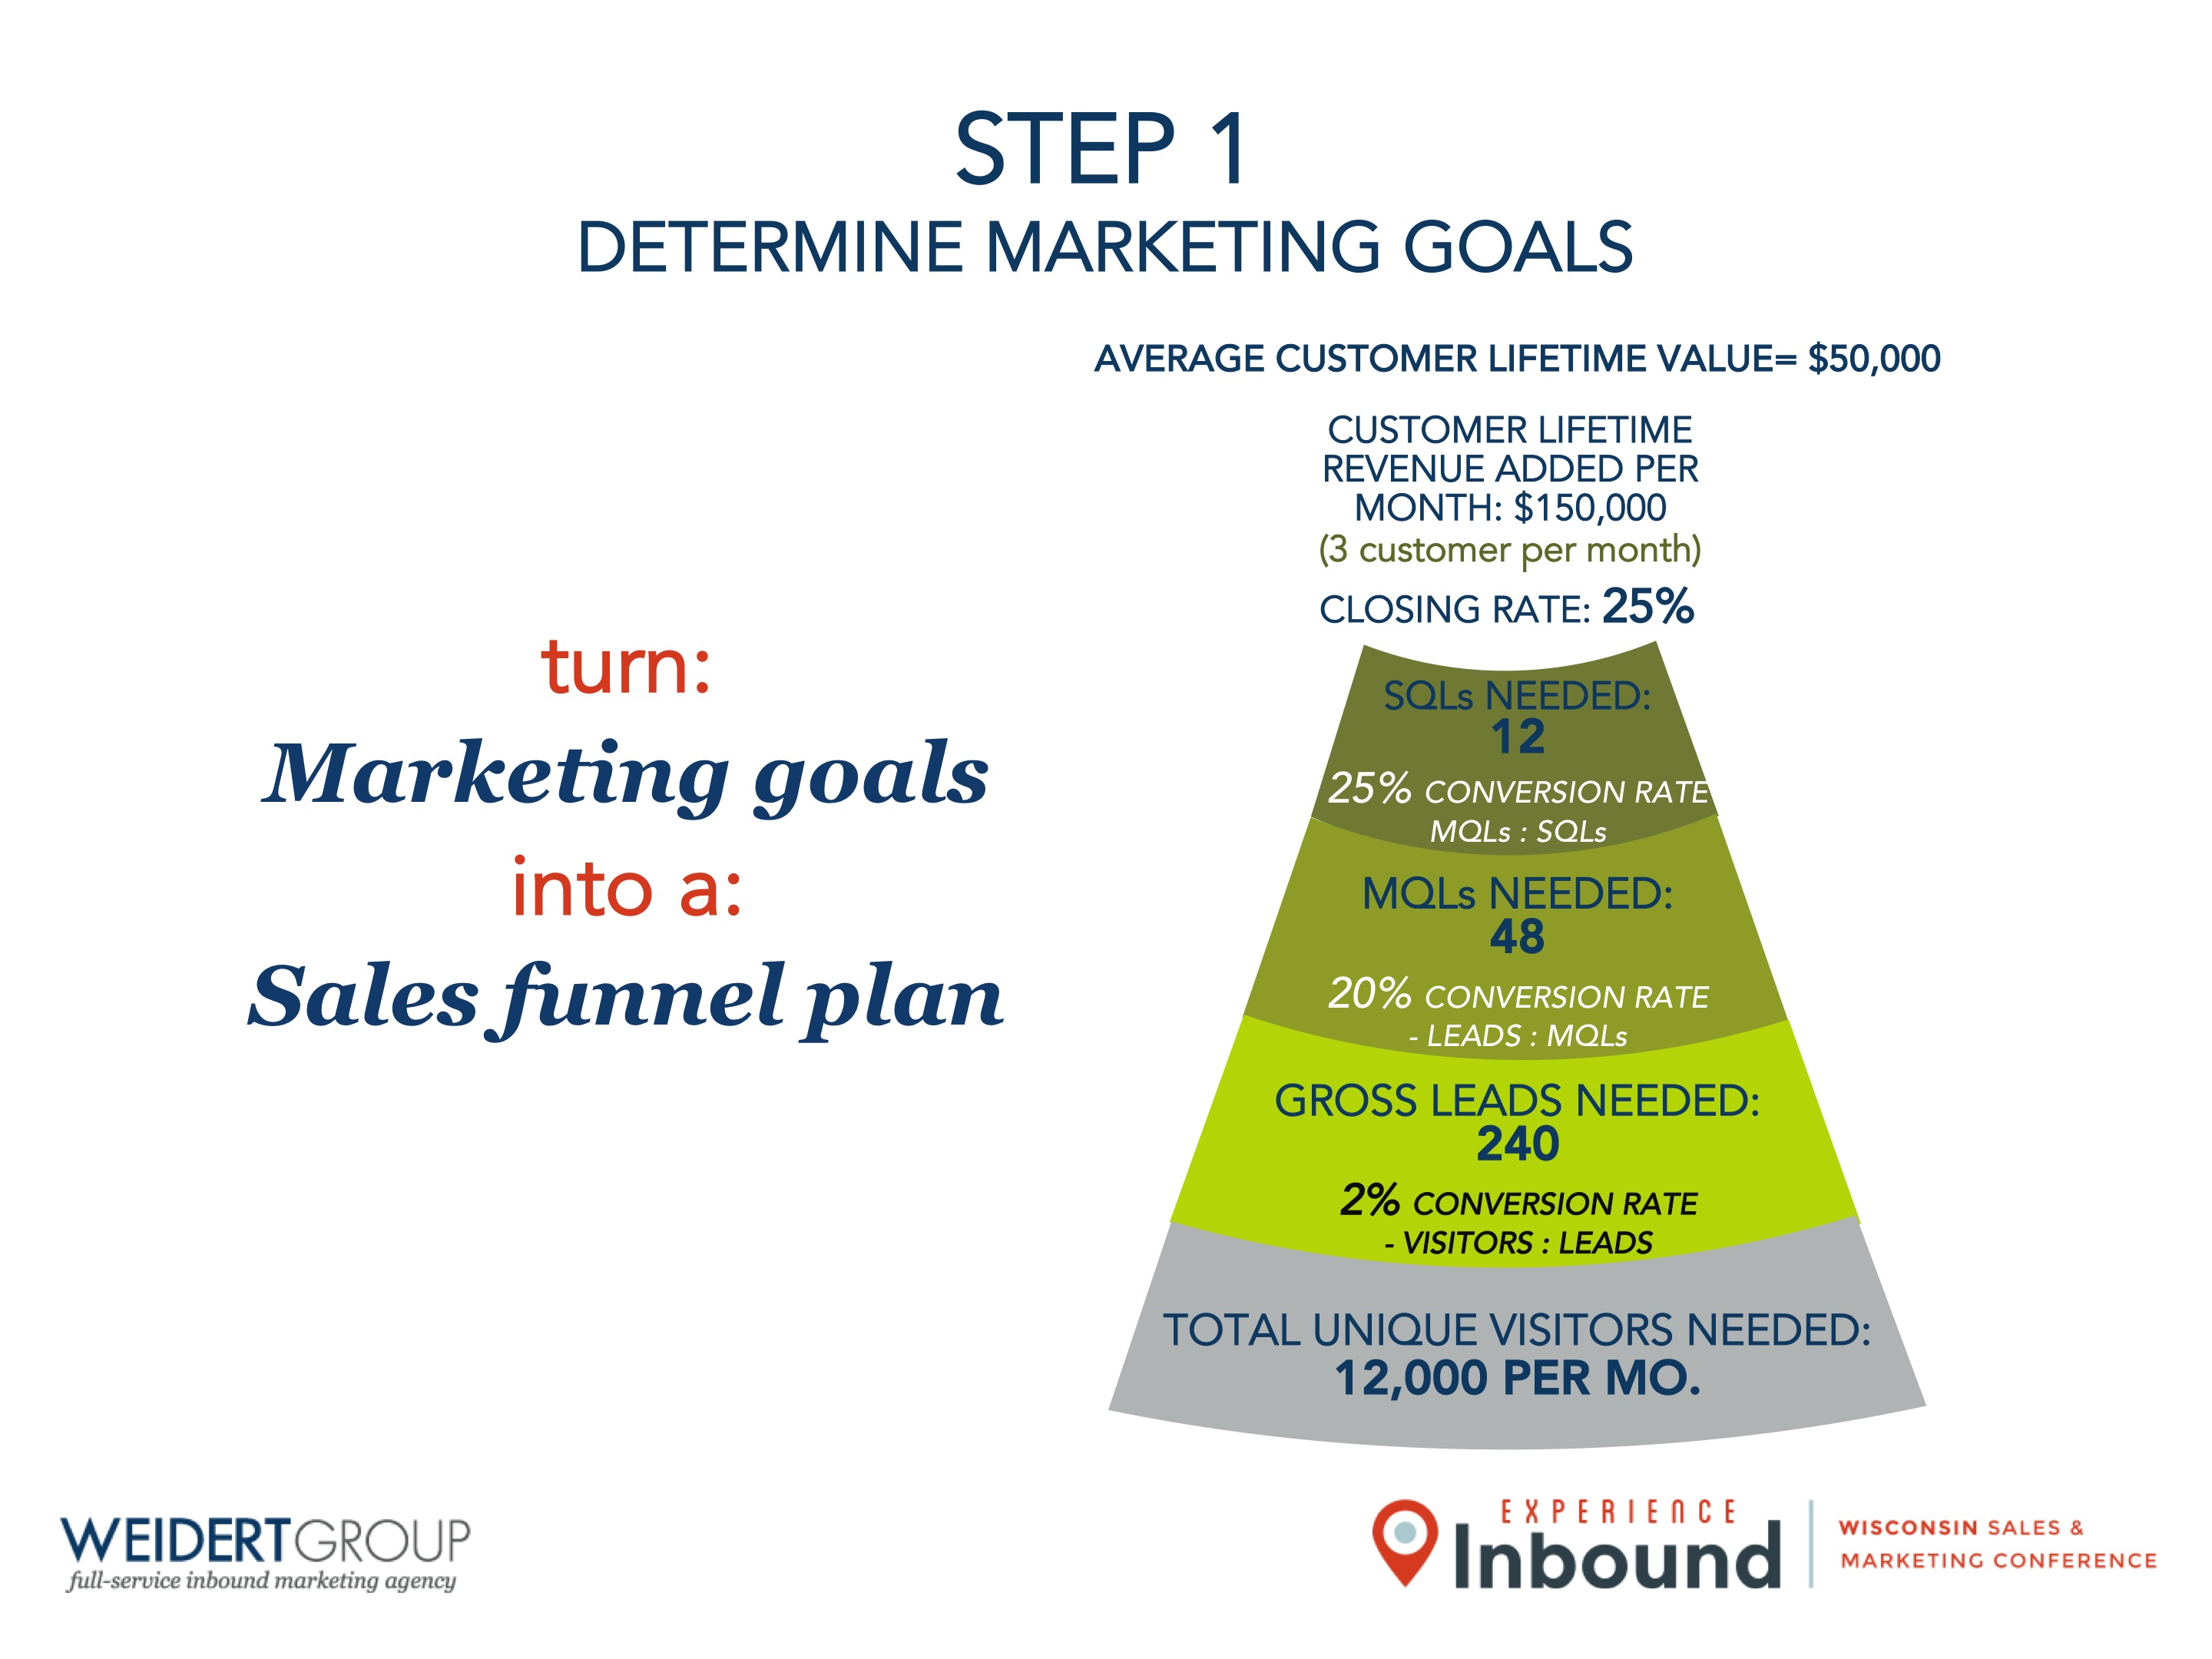
STEP 1
DETERMINE MARKETING GOALS
AVERAGE CUSTOMER LIFETIME VALUE= $50,000
CUSTOMER LIFETIME REVENUE ADDED PER MONTH: $150,000
(3 customer per month)
turn:
Marketing goals
into a:
Sales funnel plan
CLOSING RATE: 25%
SQLs NEEDED:
12
25% CONVERSION RATE
MQLs : SQLs
MQLs NEEDED:
48
20% CONVERSION RATE
- LEADS : MQLs
GROSS LEADS NEEDED:
240
1% CONVERSION RATE
- VISITORS : LEADS
2% CONVERSION RATE
- VISITORS : LEADS
TOTAL UNIQUE VISITORS NEEDED:
12,000 PER MO.

Slide 13

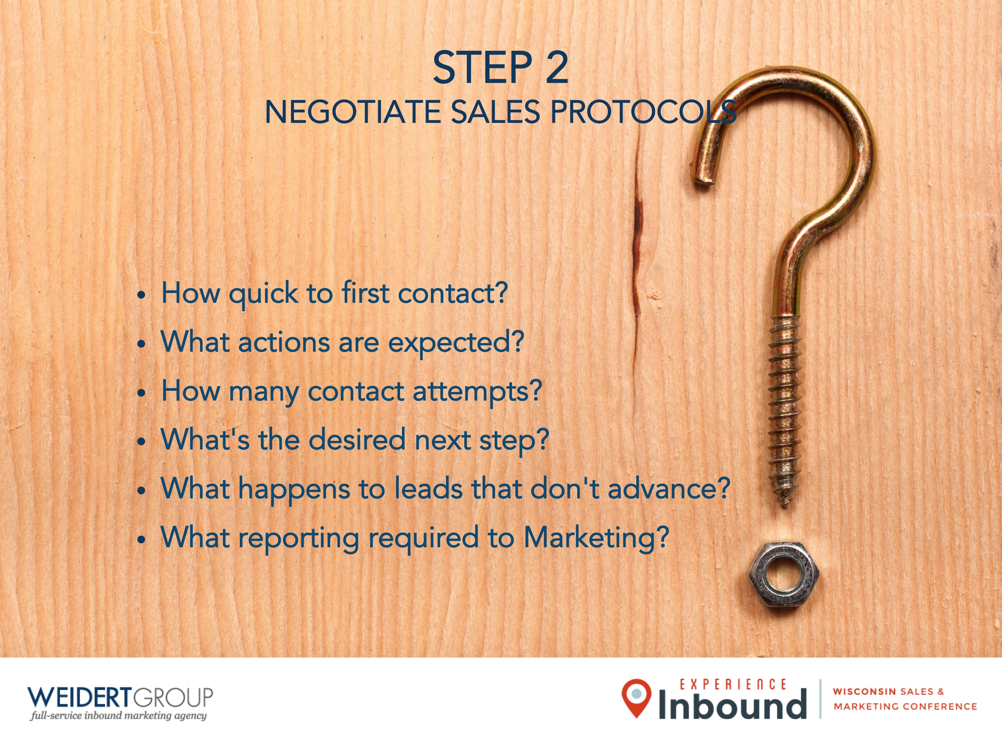
STEP 2
NEGOTIATE SALES PROTOCOLS
How quick to first contact?
What actions are expected?
How many contact attempts?
What's the desired next step?
What happens to leads that don't advance?
What reporting required to Marketing?

Slide 14
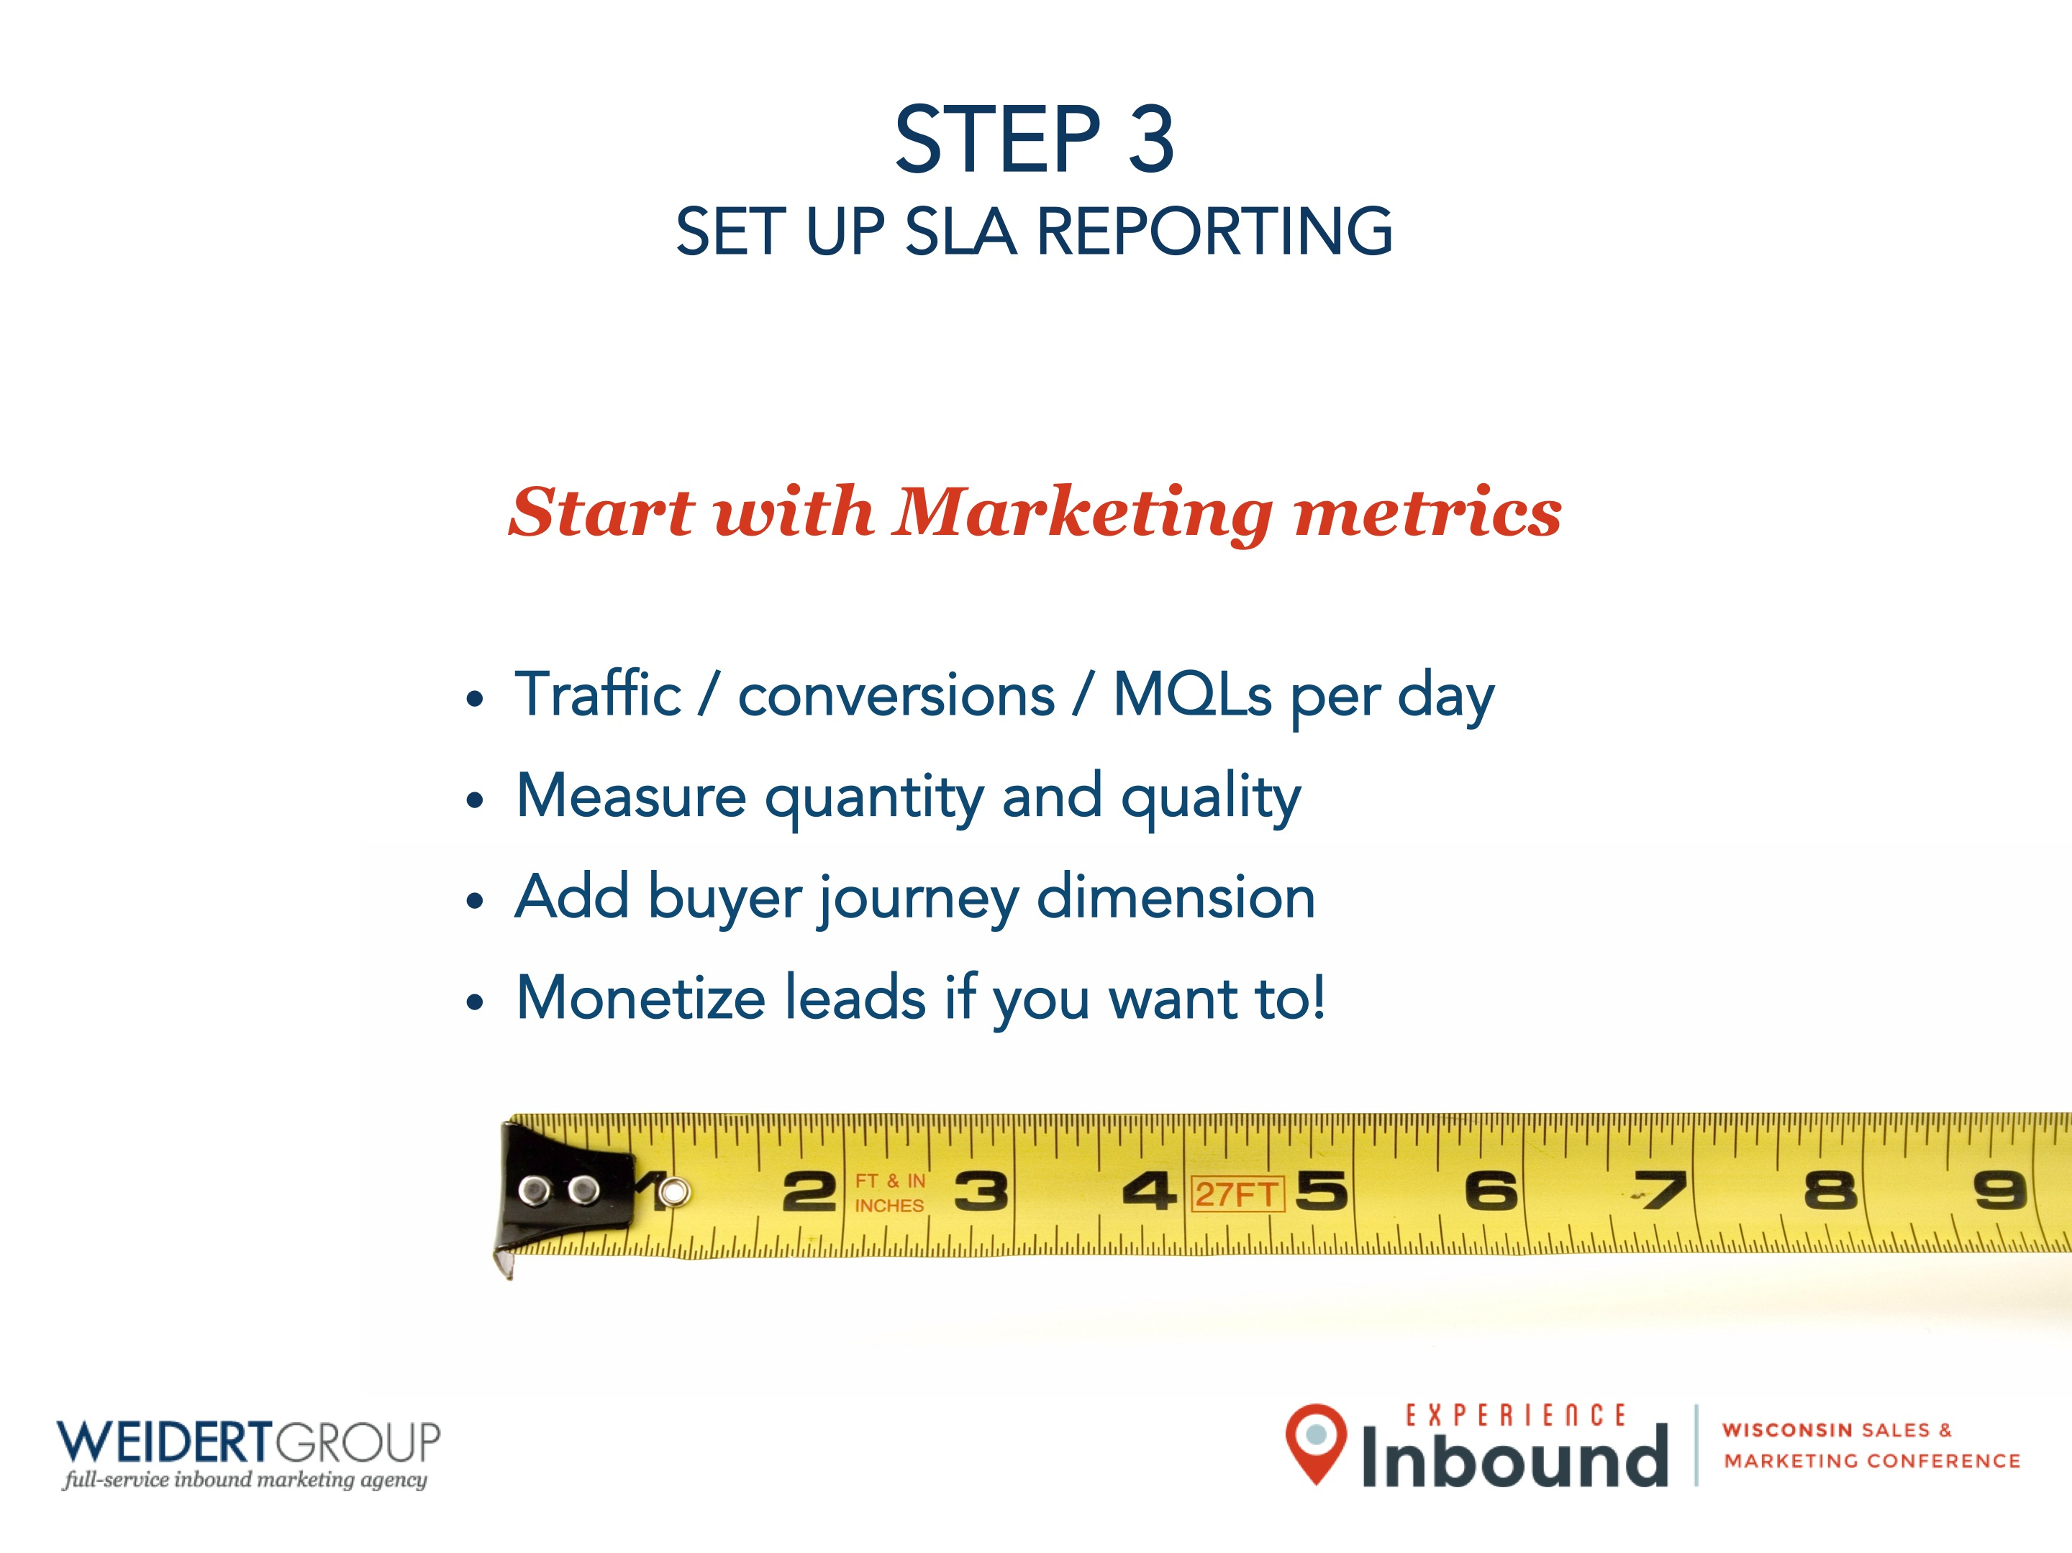

STEP 3
SET UP SLA REPORTING
Start with Marketing metrics
Traffic / conversions / MQLs per day
Measure quantity and quality
Add buyer journey dimension
Monetize leads if you want to!

Slide 15
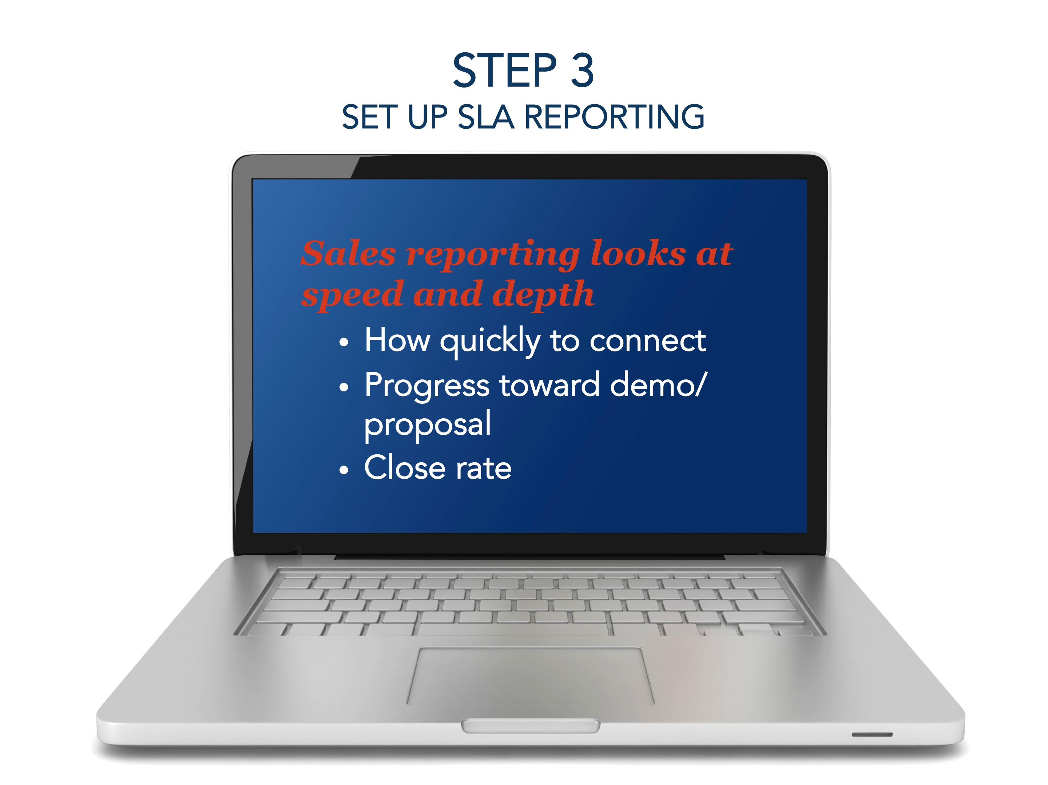

STEP 3
SET UP SLA REPORTING
Sales reporting looks at speed and depth
How quickly to connect
Progress toward demo/proposal
Close rate

Slide 16

QUESTIONS?

