Slide 1


Slide 2

The Sales Acceleration Formula
Using Data, Technology, and Inbound Selling to Go from $0 to $100M!
Mark Roberge
Chief Revenue Officer, HubSpot
@markroberge

Slide 3

My mission as a sales executive
MISSION
Predictable, scalable revenue growth
STRATEGY
If I can…
Hire the same type of successful sales person
Train the sales people in the same way
Provide each sales person with the same quantity and quality of leads
Have the sales people work the leads using the same process
…then I will achieve my goal.

Slide 4
#1: Hire the same type of successful sales person

Slide 5

What do you look for in a sales hire?

Slide 6
The ideal sales hiring formula is different for every company…
but the process to engineer the formula is the same.

Slide 7
Engineer Your Own Sales Hiring Formula

Slide 8
Which criteria scored highest for us?
INTELLIGENT or
COACHABLE or
CURIOUS

Slide 9

The HubSpot Sales Hiring Formula
Coach-ability
Curiosity
Intelligence
Work Ethic
Prior Success

Slide 10
#2: Train your sales people in the same way

Slide 11
A “ride-along” training strategy is neither scalable nor predictable.
Most top performing sales people succeed in their own unique way.

Slide 12

Components of Predictable,
Scalable Sales Training
The Sales Methodology
Buyer Journey
Sales Process
Qualifying Matrix
Use exams and certifications to measure quality and consistency coming out of training

Slide 13

Train Sales to “Live” in your Prospects’ World

Slide 14

Set Them Up to be Thought Leaders

Slide 15
#3: Provide sales people with the same quantity and quality of leads

Slide 16
How do you buy?
Cold Call?
Cold email?
Google?
Social Media?

Slide 17

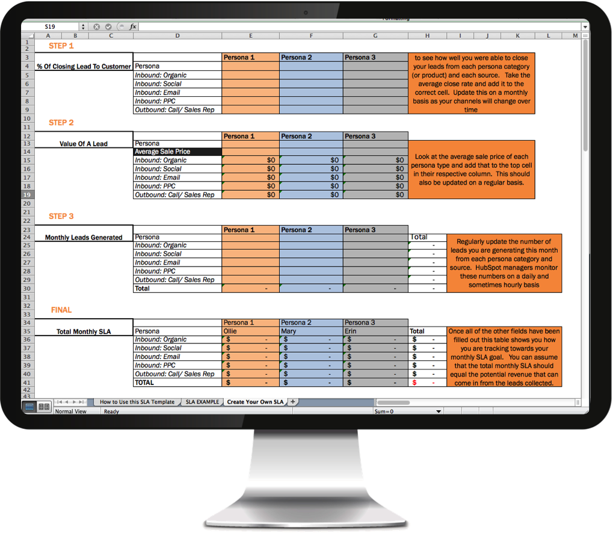
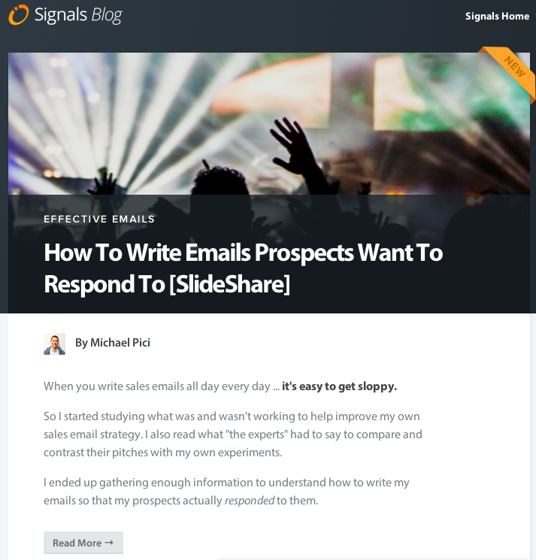
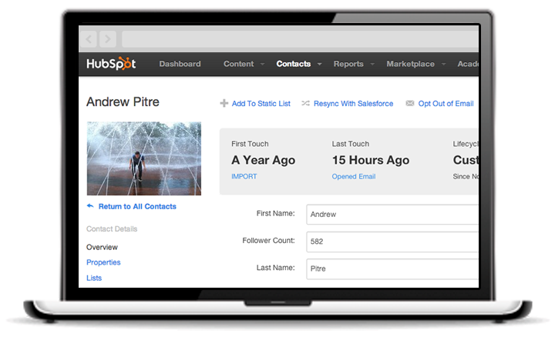
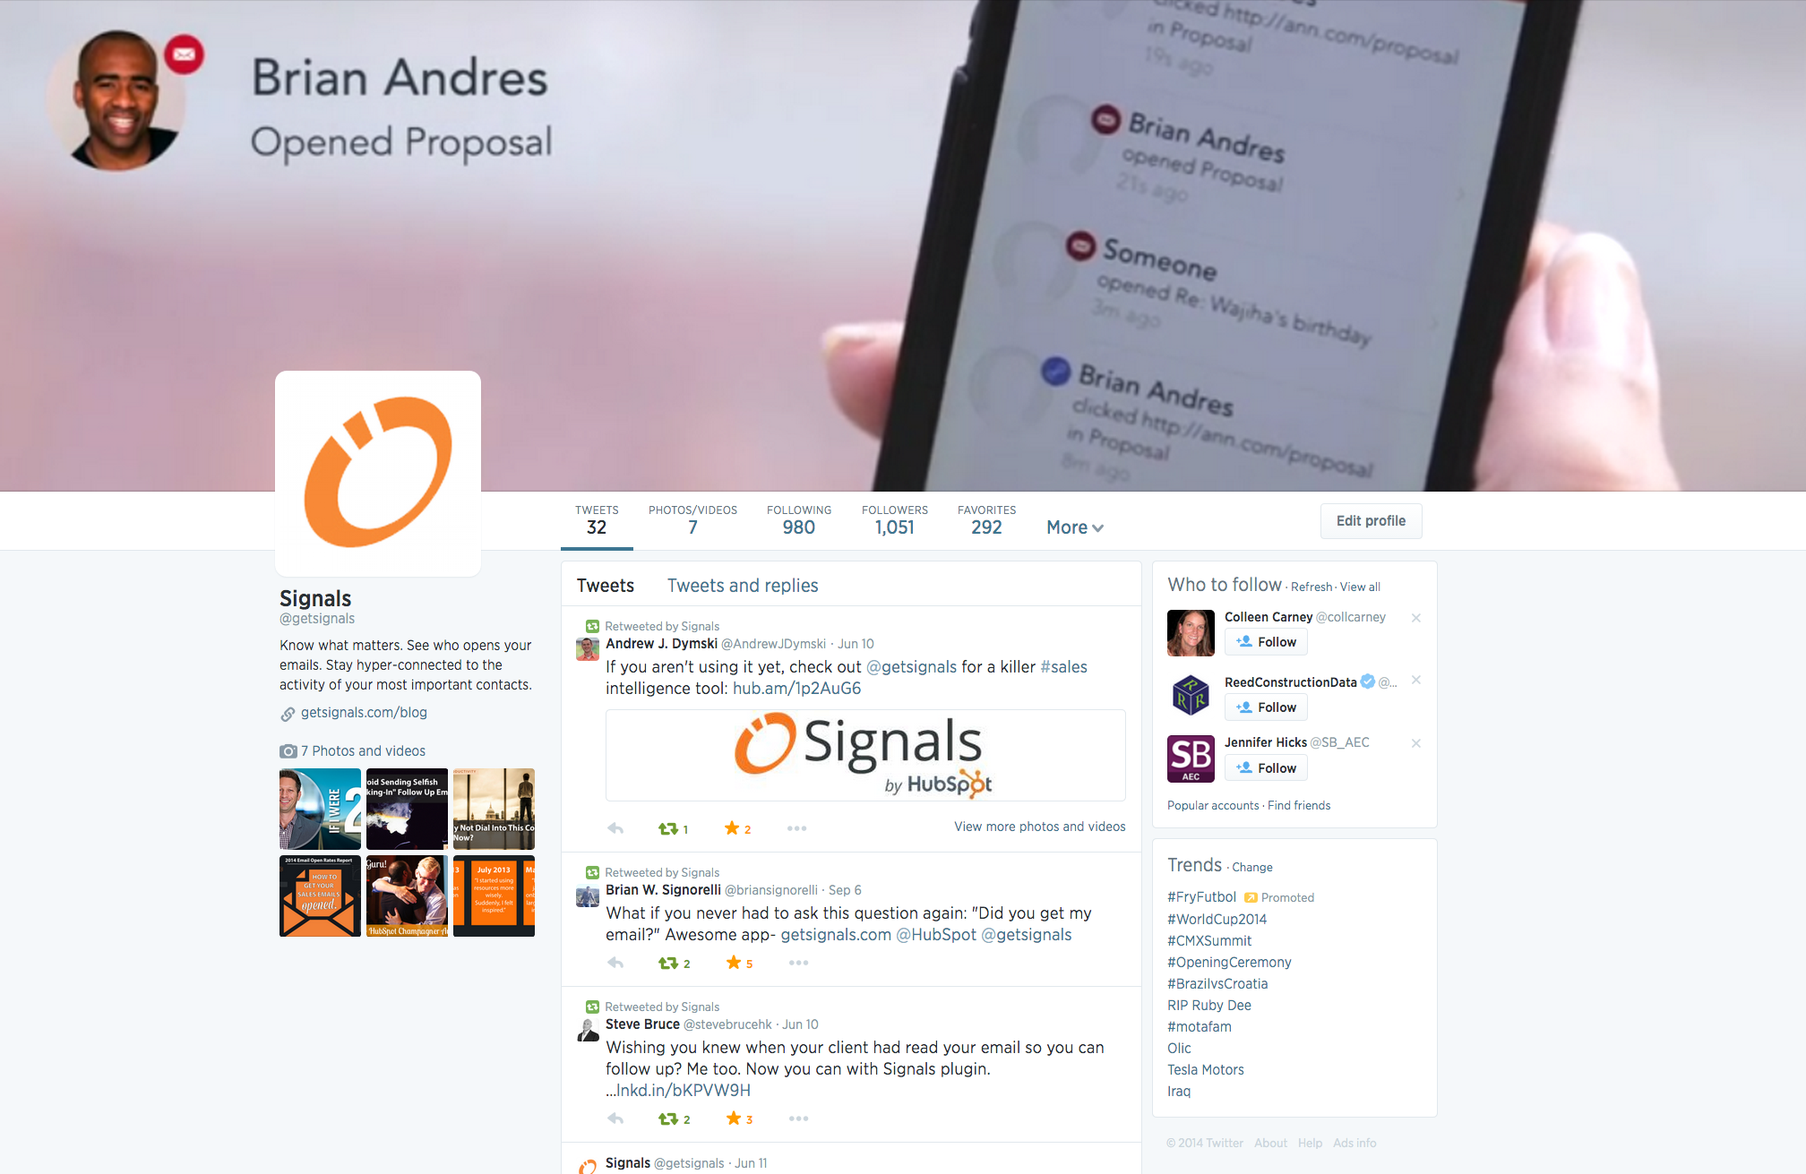

Modern Lead Generation:
Inbound Marketing
BLOG | SEO | SOCIAL MEDIA

Slide 18
“JOURNALISTS” hold the keys to the future of Demand Generation

Slide 19
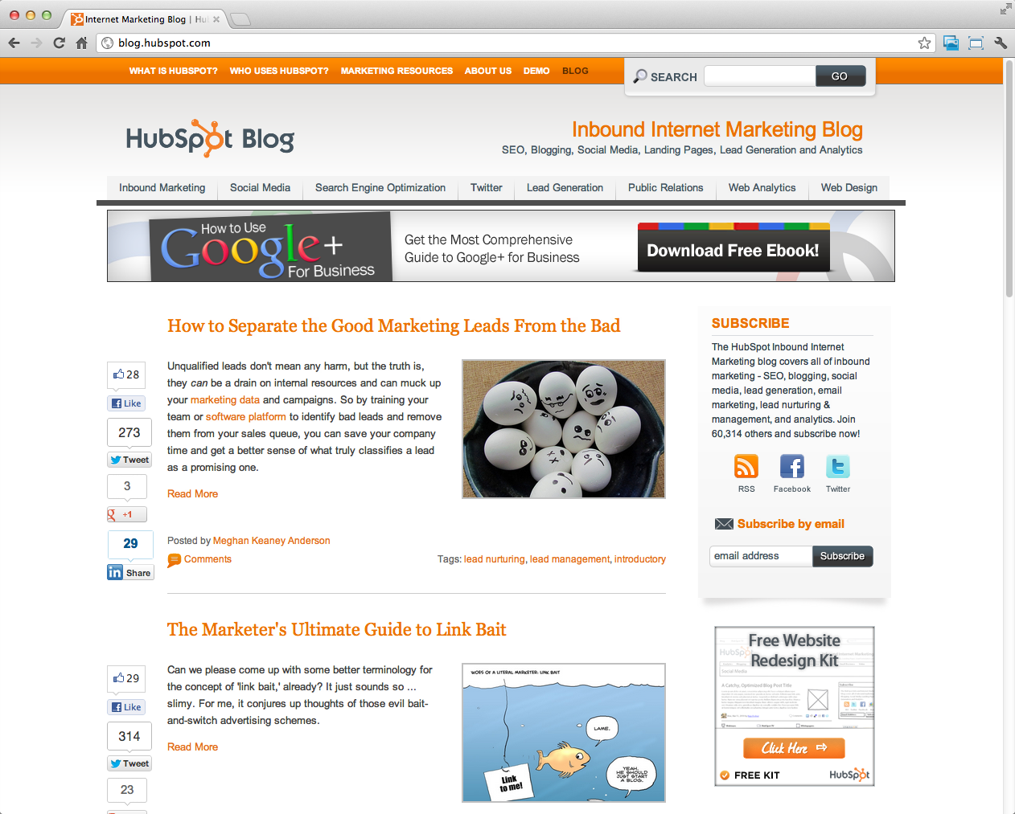
Create Your Content Engine

Slide 20


Create Your Content Calendar
1
eBook w/ LP / Month

Slide 21
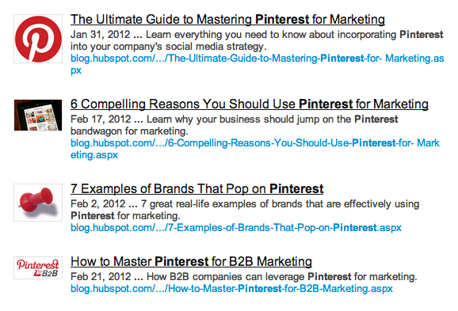

Create Your Content Calendar
1
eBook w/ LP / Month
4
Blog Posts / Month

Slide 22
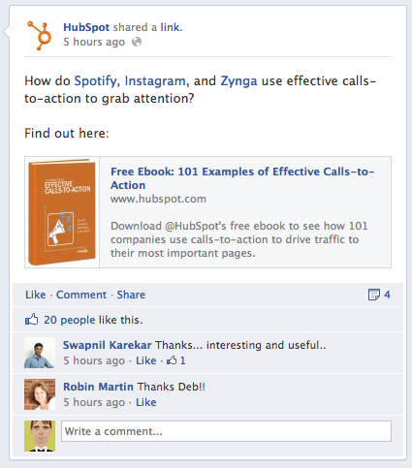

Create Your Content Calendar
1
eBook w/ LP / Month
4
Blog Posts / Month
8
FB Posts / Month

Slide 23
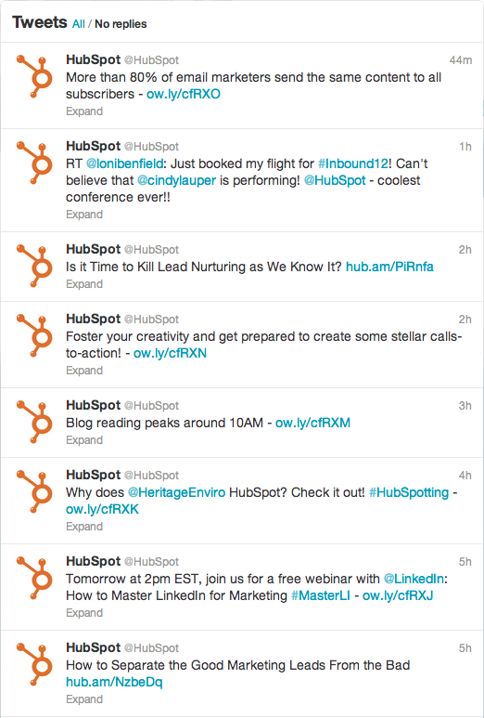

Create Your Content Calendar
1
eBook w/ LP / Month
4
Blog Posts / Month
8
FB Posts / Month
16
Tweets / month

Slide 24
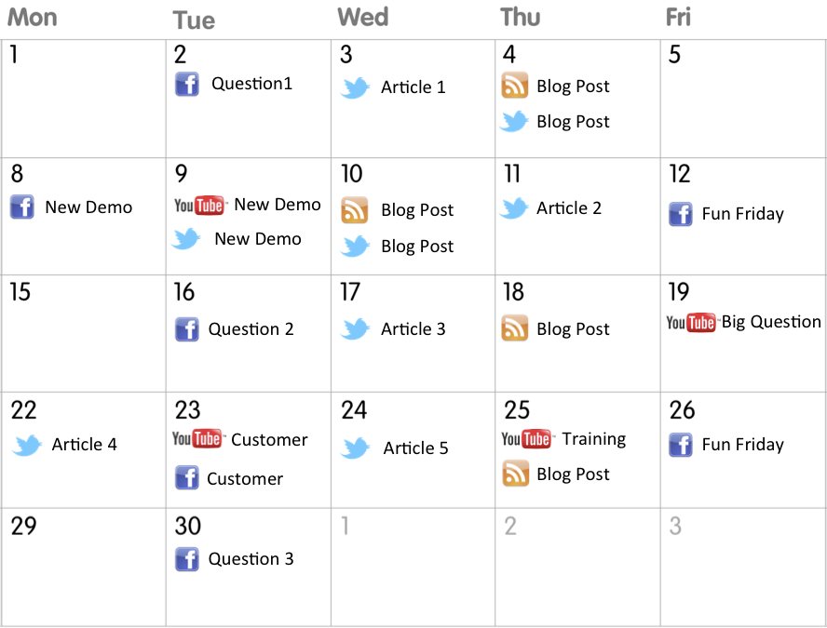
Create Your Content Calendar
1
eBook w/ LP / Month
4
Blog Posts / Month
8
FB Posts / month
16
Tweets / month

Slide 25
The Marketing SLA
Small Business Persona
Mid-Market Persona
Buyer Journey State | Customer Conversion % | Revenue per Customer | Lead Value
Problem Education | 1% | $40K | $400
Solution Research | 5% | $40K | $2K
Solution Selection | 20% | $40K | $8K
Buyer Journey State | Customer Conversion % | Revenue per Customer | Lead Value
Problem Education | 2% | $200K | $4K
Solution Research | 6% | $200K | $12K
Solution Selection | 25% | $200K | $50K
Enterprise Persona
Buyer Journey State | Customer Conversion % | Revenue per Customer | Lead Value
Problem Education | 3% | $700K | $21K
Solution Research | 10% | $700K | $70K
Solution Selection | 30% | $700K | $210K
* Data has been altered from actual HubSpot data for the purposes of this presentation

Slide 26
The Sales SLA
Calculate the ideal number of sales attempts for each type of lead
* Data has been altered from actual HubSpot data for the purposes of this presentation.

Slide 27
Daily Accountability for the SLA
Measure progress on the Marketing SLA each day
* Data has been altered from actual HubSpot data for the purposes of this presentation

Slide 28
#4: Have sales people work the leads with the same process

Slide 29
Coaching:
Golf vs. Sales

Slide 30
“Metrics-Driven Sales Coaching”
Use metrics to diagnose the skill deficiency. Customize a coaching plan.

Slide 31
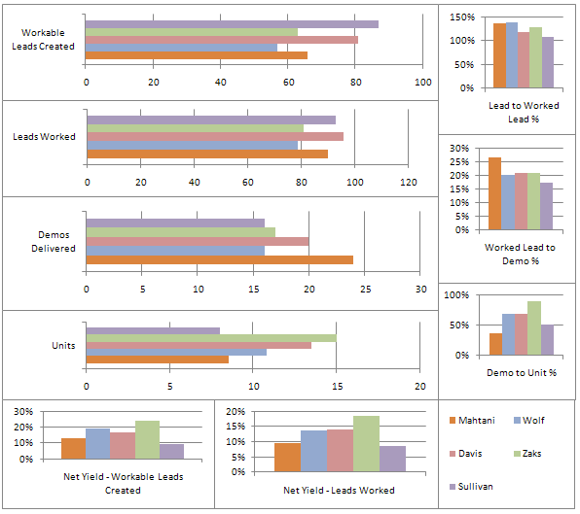
Implement a metrics-driven sales culture
Each Color Represents a Different Sales Rep
* Data has been altered from actual HubSpot data for the purposes of this presentation

Slide 32
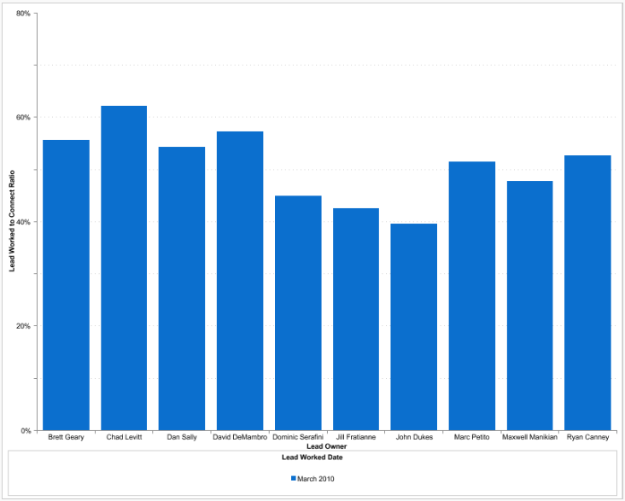
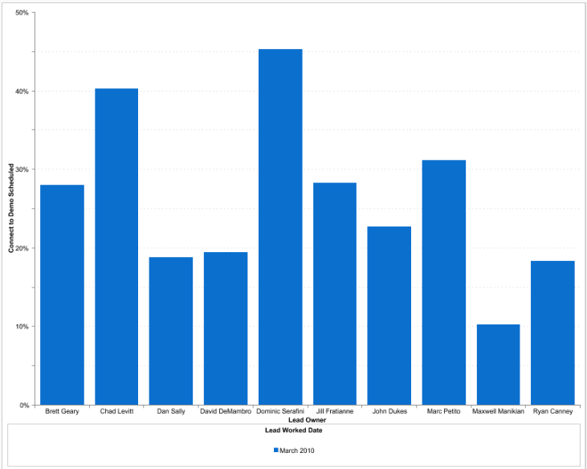
“Peel Back the Onion” for More Insight
Lead-Worked-to-Connect Ratio
Connect-to-Demo Ratio
* Data has been altered from actual HubSpot data for the purposes of this presentation

Slide 33

Implement a metrics-driven coaching culture
1st Day of Month
2nd Day of Month
Sales Person / Manager Independent Reviews
Think through qualitative performance
Review individual metrics
Think about Skill/Development Plan
Director Meets with Manager
Review Skill/Development Plans for each sales person
Morning
Manager Meets with Sales Person
Discuss qualitative performance
Review individual metrics
Co-Create Skill/Development Plan
VP Meets with Director
Review Skill/Development Plans for each sales person
Afternoon

Slide 34
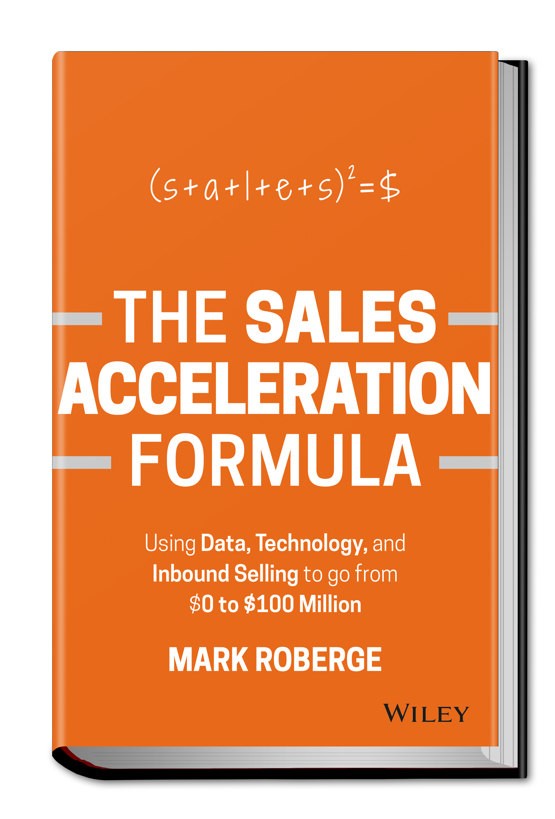

All proceeds go to

Slide 35
Questions?
Mark Roberge
Chief Revenue Officer, HubSpot
@markroberge

Slide 36

Take back your inbox with tools that make email better for everyone, including salespeople.
Say goodbye to manual tasks and confusing features. Say hello to HubSpot CRM.
www.hubspot.com/sales
www.getsidekick.com

