Slide 1
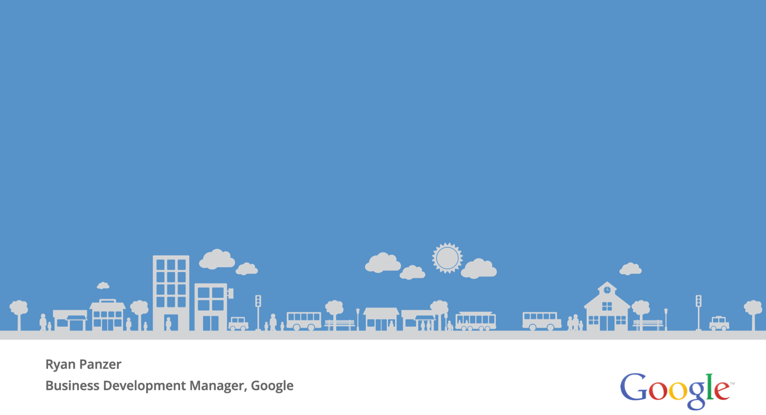
3 B2B Trends For Digital Marketing Success
Ryan Panzer
Business Development Manager, Google
Notes:
B2B is a broad category – but its remarkable how similar marketing strategies become when you create a simple distinction between companies that market to businesses versus those that market to consumers
Business Development Manager – every day, I help businesses to craft a strategy for online success. More often that not, these conversations are all about inbound marketing – generating leads through digital activity that the sales teams pursue and close.
We are going to talk through three trends that we’ve seen in the last year. Most of these trends are findings that Google discovered in partnership with Millward Brown.

Slide 2
Today’s Session:
1. The Path to Purchase is No Longer a Path.
2. Decisions Are Made on the Go
3. We Know What Customers Are Demanding.
4. Resources & Tools
How Do B2B Decision Makers Use the Web?
How Has the Dominance of the Smartphone Changed B2B Marketing?
What Insights Should You, as a Marketer, Be Aware Of?
Places to Research, Discover, and Grow Your Online Identity
Notes:
This presentation covers three areas:
The B2B path to purchase – how do companies find business partners online?
The surprisingly mobile world of B2B marketing
Google data at your fingertips
Let’s get started!

Slide 3
Trend #1: The Path to Purchase is No Longer a Path
Notes:
What do I mean by “extension”?

Slide 4
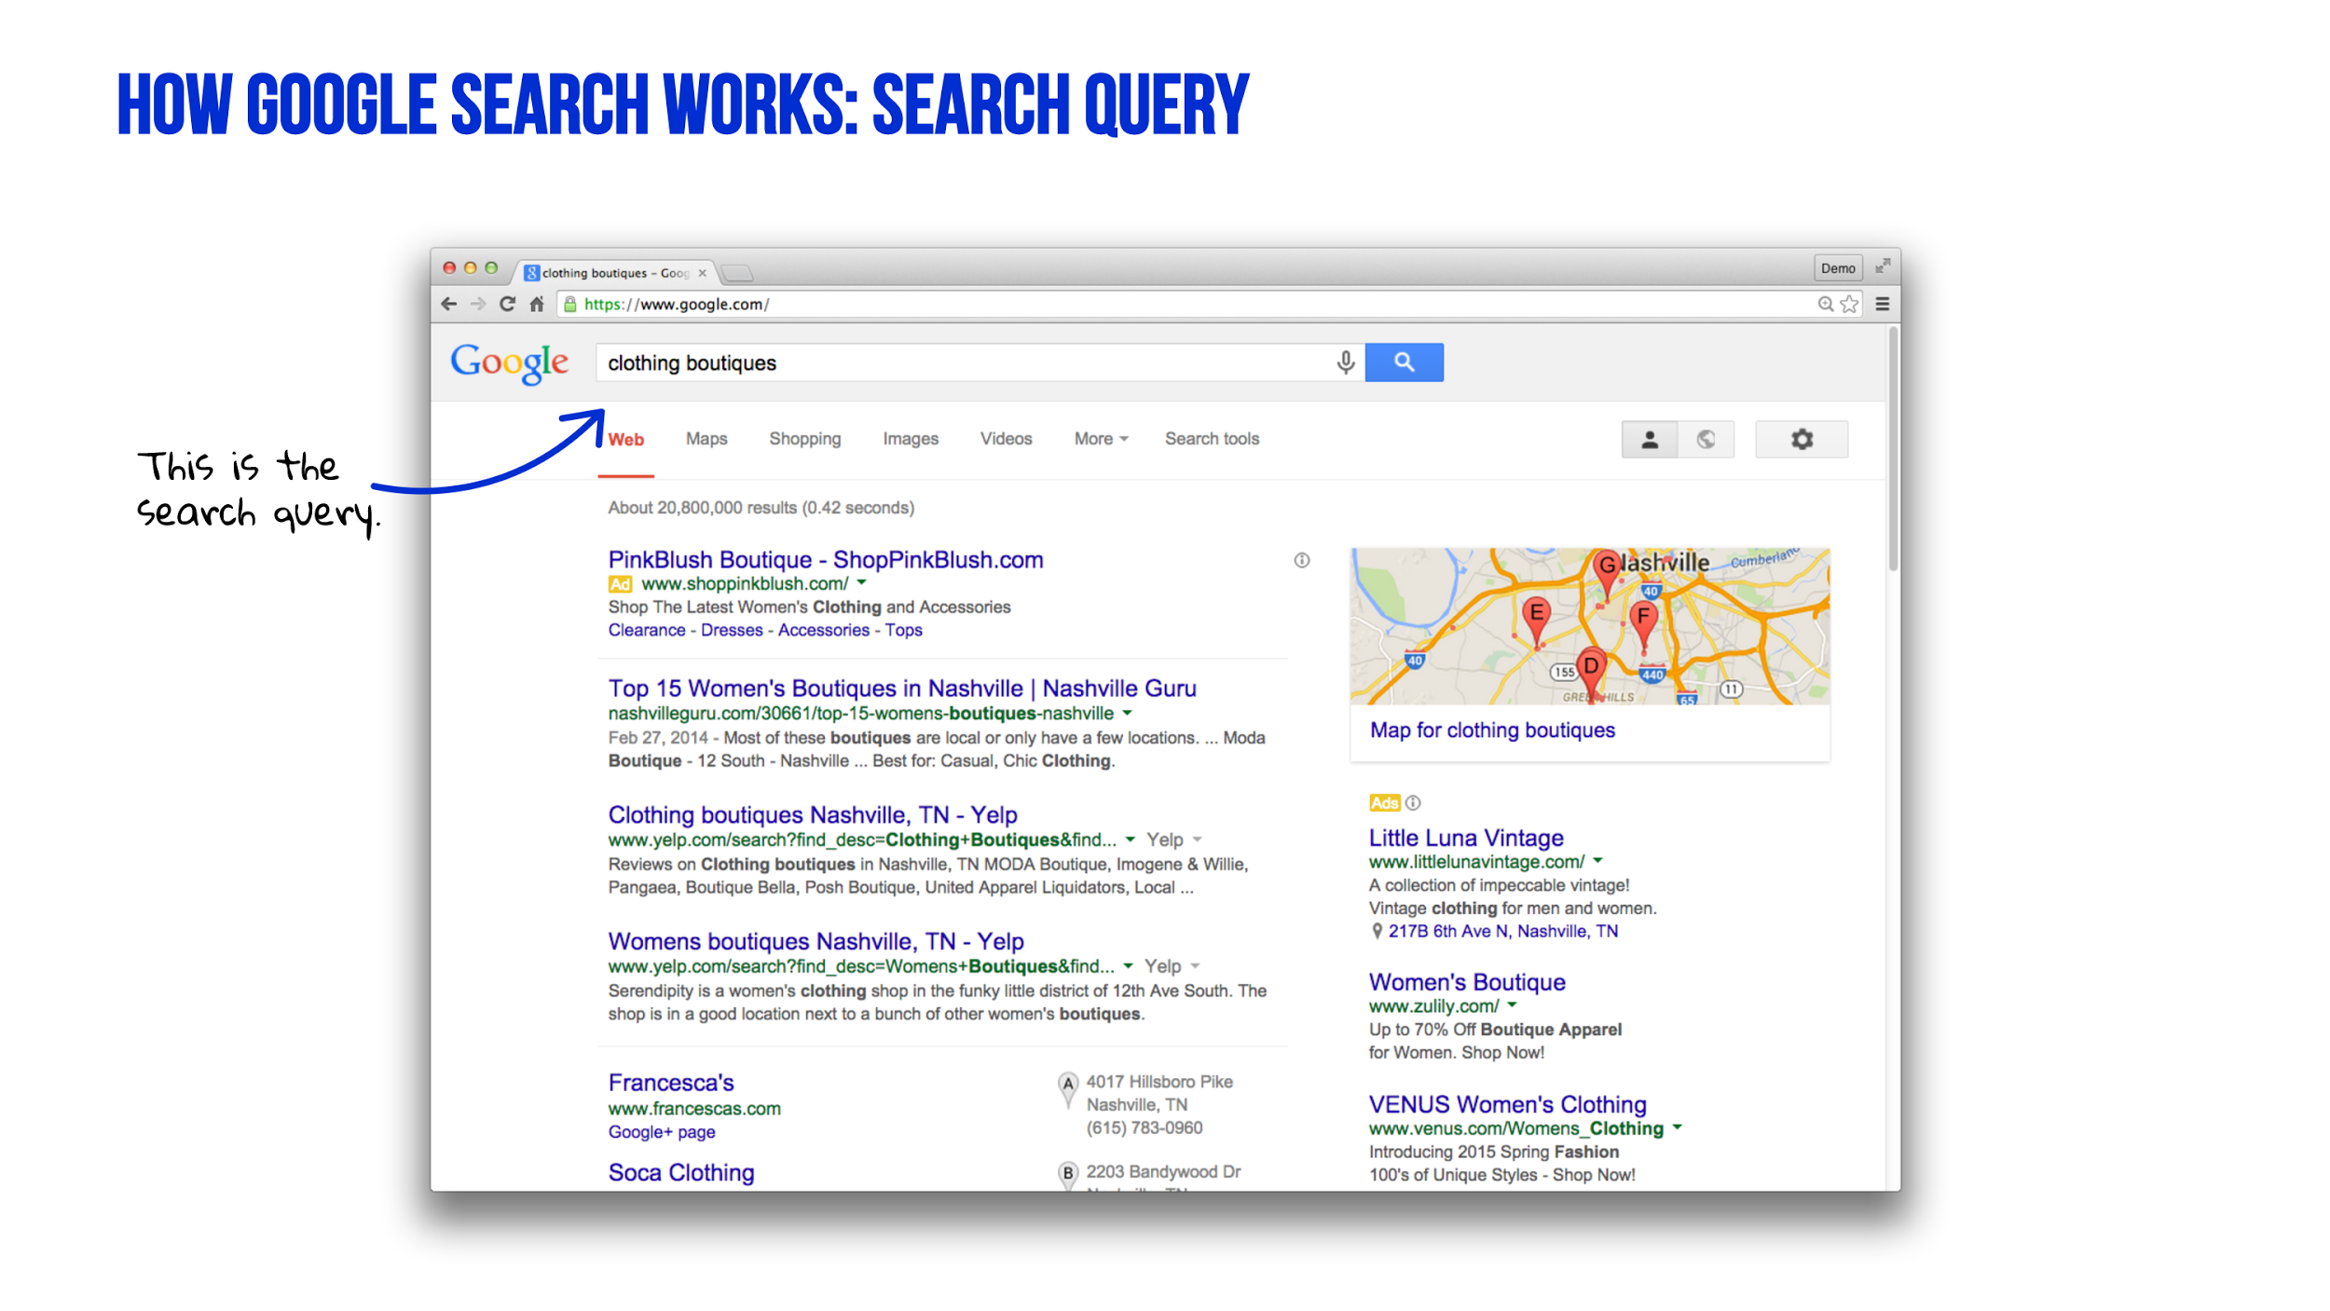
Notes:
Let’s look at the various ways your business can appear on Google.
Before we can strategize about ways to get found online, it’s helpful to understand how a search engine results page is organized.
Take a look at this search results page on Google.com.
You see that the searcher typed in the phrase “clothing boutiques.”
This is called a search query. Searchers type in words and phrases to find websites that match their queries.
Google displays the most relevant results it can find, based on the search query and any information it has about the searcher.

Slide 5
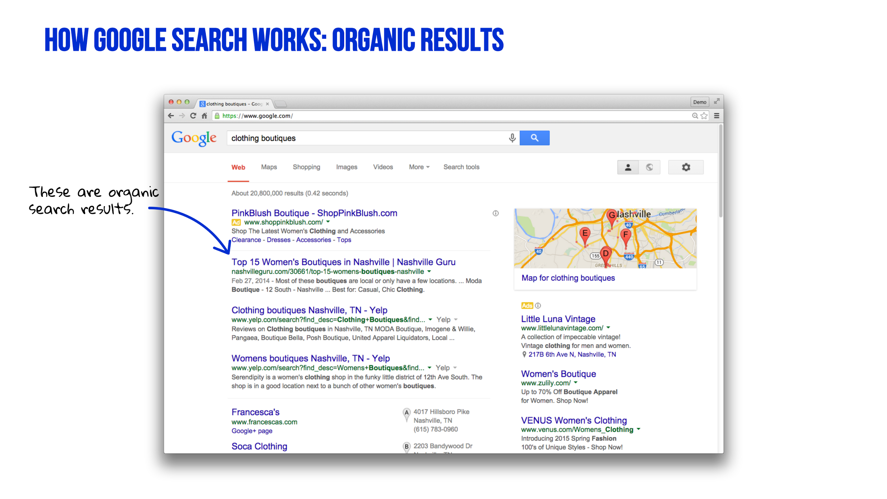
Notes:
In this example, we see the “natural” or “organic” results on a Google Search Results Page (sometimes called a SERP, for short).
Every time someone searches, Google generates a page with a list of the most relevant results for that searcher, in that location, at that moment in time. So, these pages may show different results for different searchers. A person in California may see different results than a searcher in Florida or Maine.
You cannot pay Google for higher placement in the organic results, and clicks on these links do NOT cost the owners of the websites any money.

Slide 6
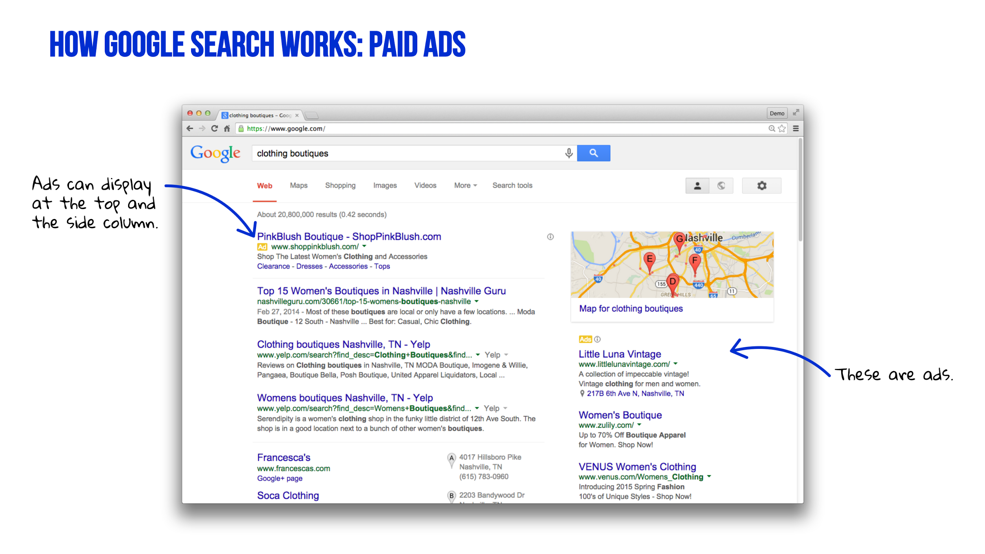
Notes:
If you look directly above the organic search results or on right side of the page, you may see ads, served by Google’s advertising programs: AdWords and AdWords Express.
These are paid placements. Advertisers compete against each other for ad spots on the page.
Advertisers are NOT charged when ads appear. They pay only if searchers CLICK the ads.
Advertising with Google does not have any impact on a website’s organic results - these are two entirely separate algorithms.

Slide 7
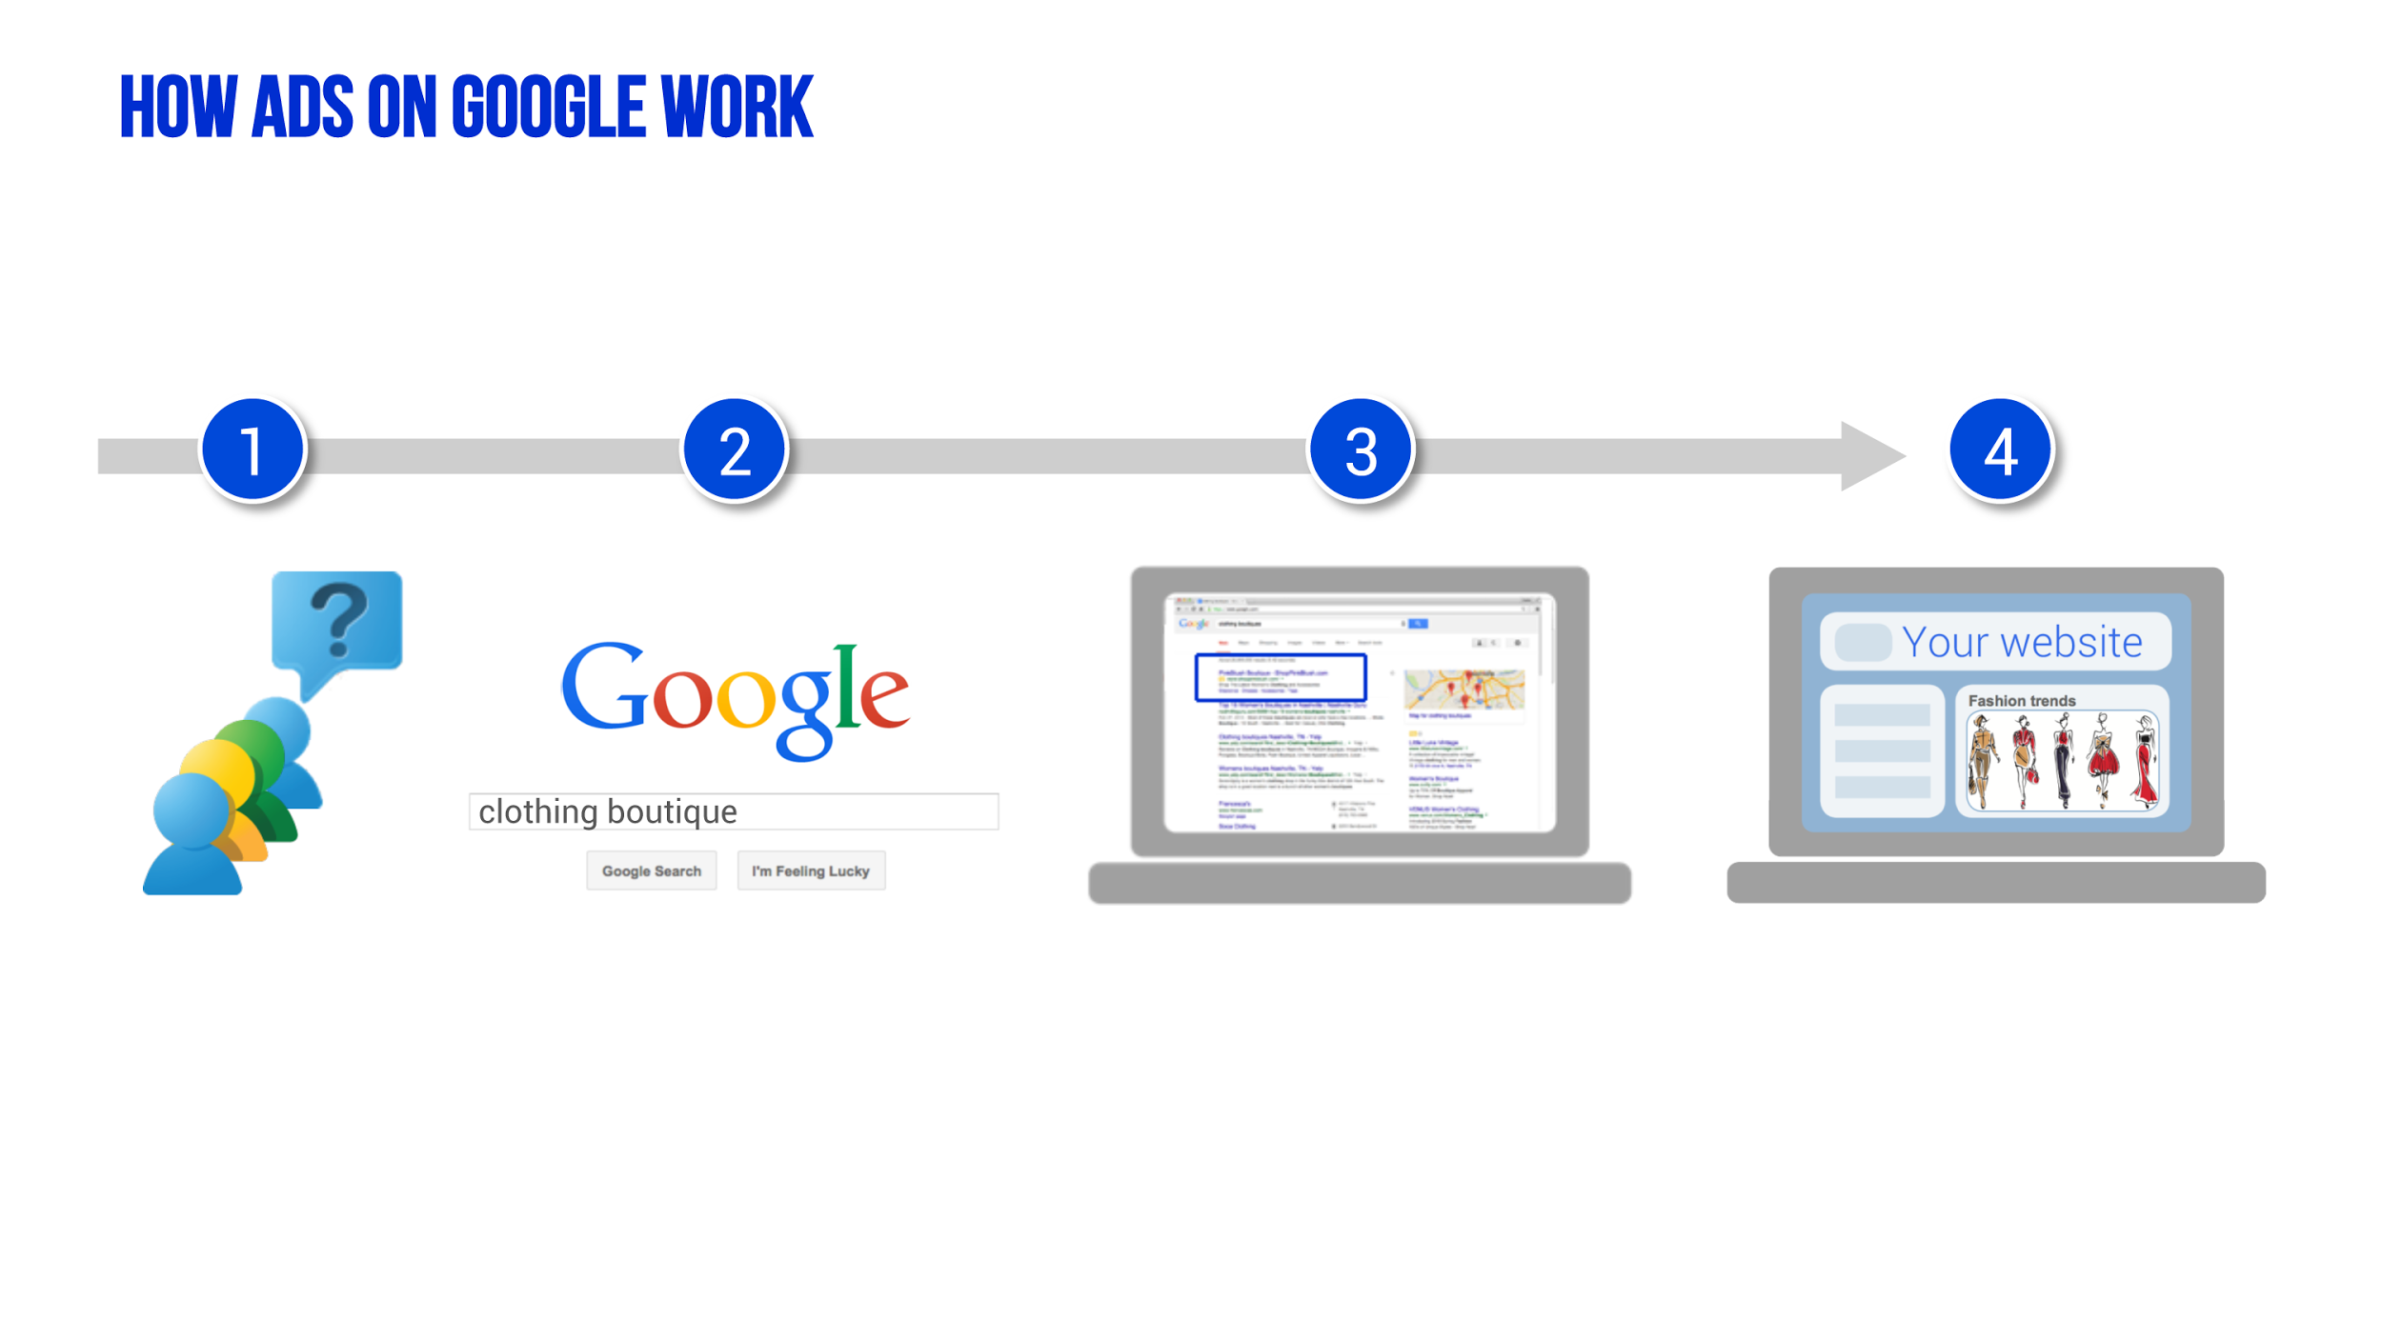
Notes:
Let’s take a look at how ads are displayed on Google.
Someone wants to find something - in this case, a clothing boutique.
The searcher types in words or phrases describing what they want to find– called the search query – into Google.
Now, Google displays a page of results to help that searcher find relevant websites. Advertisers can show ads when people search for words and phrases relevant to their products and services.
When a searcher sees an ad and wants to learn more, a click sends that searcher to the advertiser’s website.
THE PROBLEM - The Path to purchase is much more complex than AdWords, especially search!

Slide 8
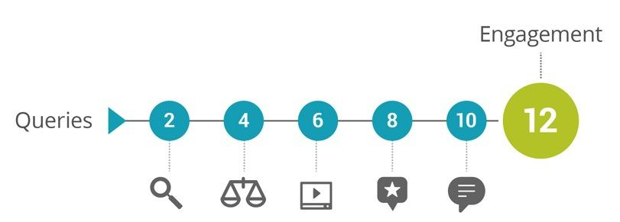
Number of Actions Prior to Contacting a Business
Source: Google/Millward Brown 2014 Study – The Changing Face of B2B Marketing
Notes:
2014 Study conducted by Google and Millward Brown
Surveyed over 3,000 B2B researchers over the course of 13 months
12 search queries before an engagement with your company - very long path to purchase
As a marketer, take advantage by:
Dividing keywords based on position in marketing funnel
Utilizing re-engagement strategies, including video and remarketing
Leveraging display advertising

Slide 9
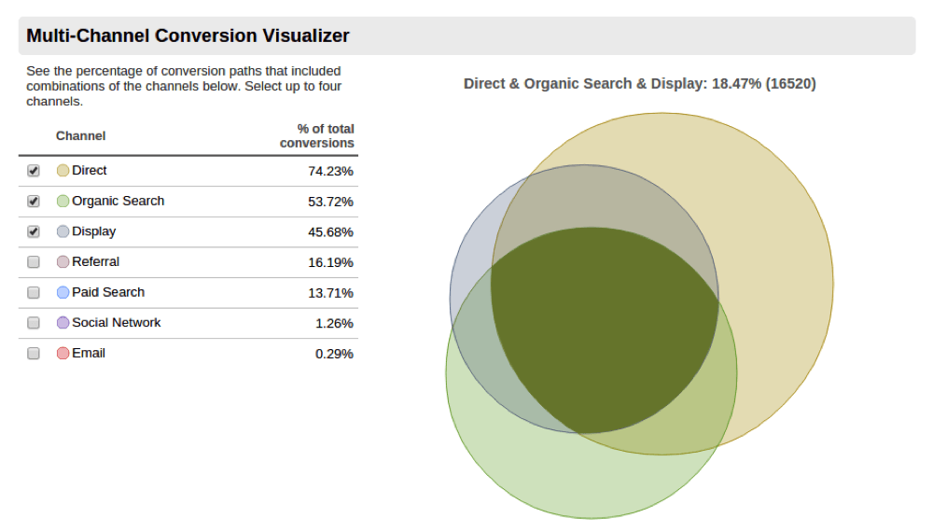
Notes:
Google Analytics – Free online data analysis tool, available to any business with a website. Code implementation required.
Multi-Channel Funnels Report
Measures Goal Completion by Source
Find Your Sweet Spot. In this instance, most non-direct leads are coming the combination of Paid Search, Organic Search, and Direct traffic (three engagements prior to conversion).
Find Where Most of Your Leads are Coming From
Optimize
This is the nature of B2B marketing and the path to purchase.

Slide 10
Trend #2: Decisions Are Made on Mobile Devices
Notes:
Basic marketers think about mobile. Saavy marketers think mobile-first in everything they do.

Slide 11
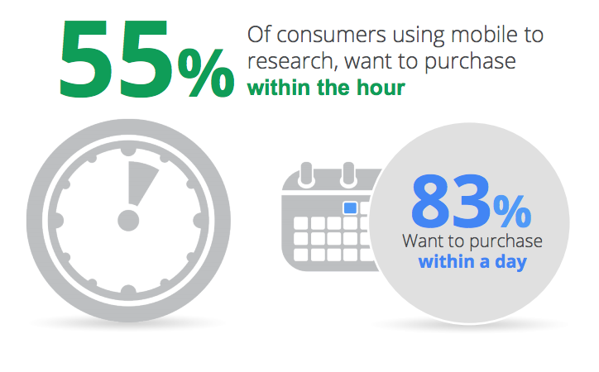

Notes:
Those that find you on mobile are your best shot for success.

Slide 12
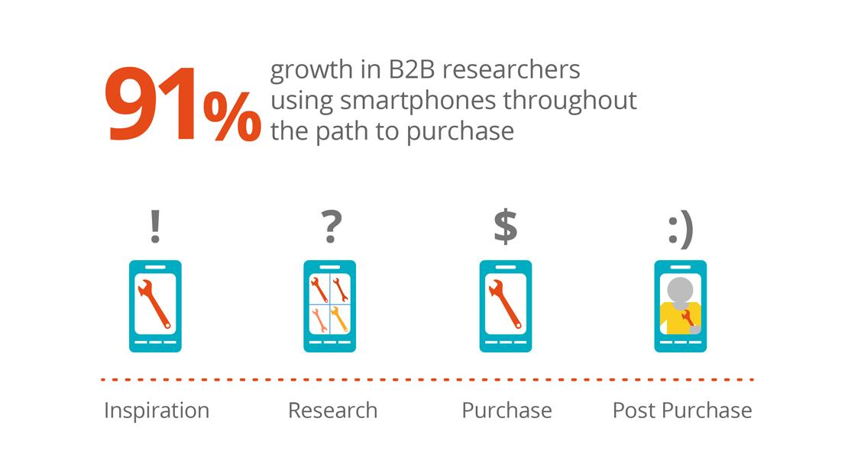
Source: Google/Millward Brown 2014 Study – The Changing Face of B2B Marketing
Notes:
Not surprisingly, this trend doesn’t just hold true for B2C customers – B2B is everything mobile.

Slide 13
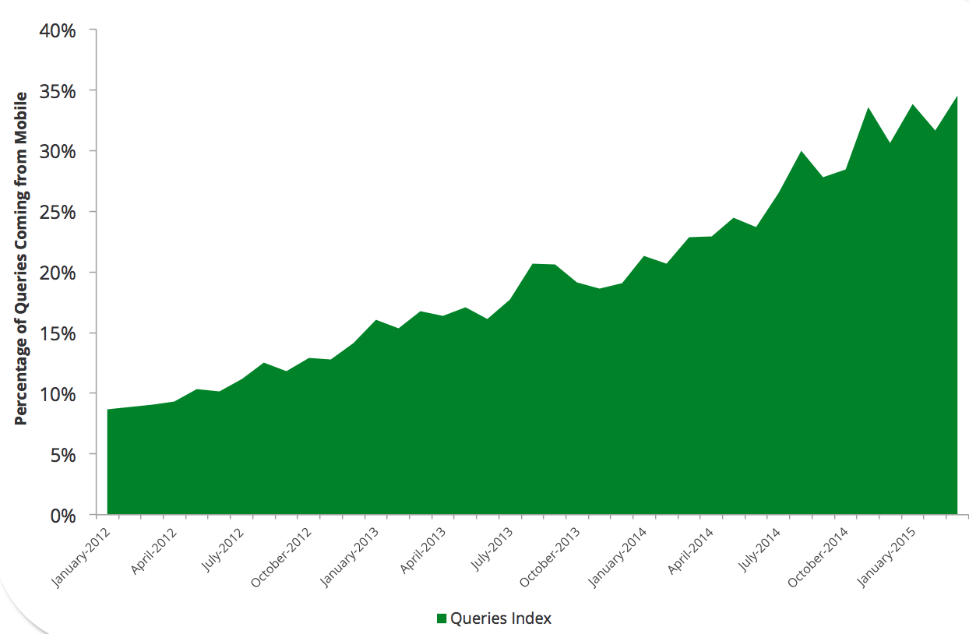
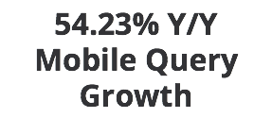
Paper Industry Search Data
Notes:
Paper industry search data

Slide 14
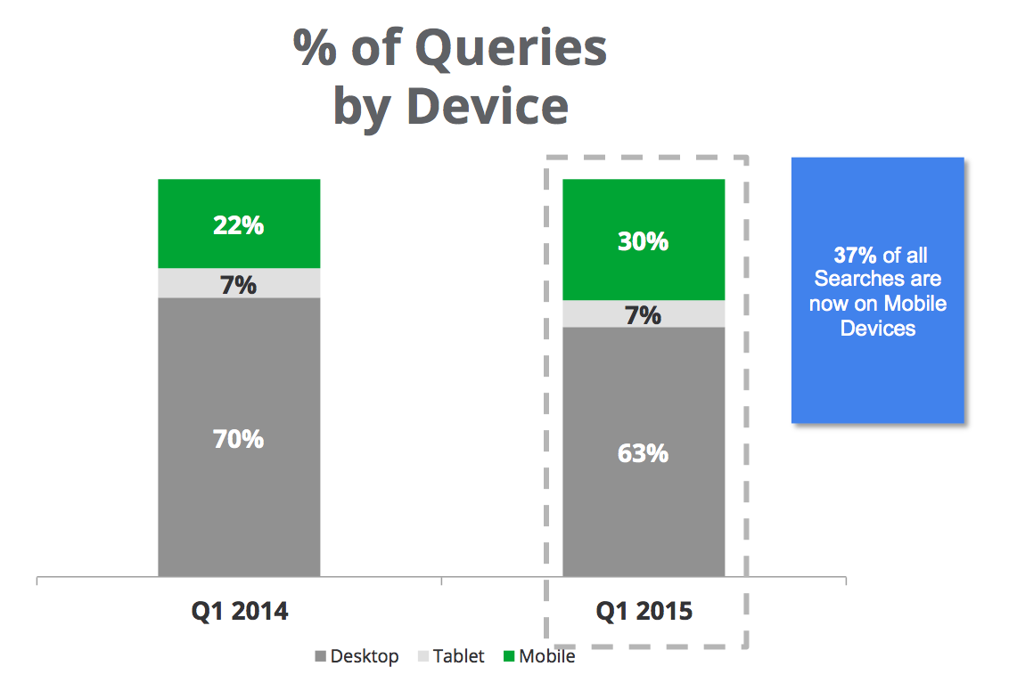
Notes:
Paper industry search data

Slide 15
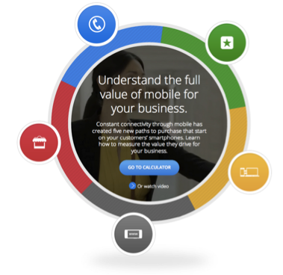
Phone Calls
App Installs
Store Visits
Cross Device Conversions
Mobile Web Conversions

Slide 16
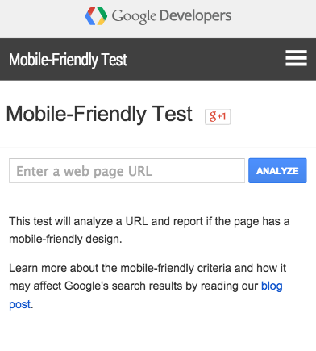
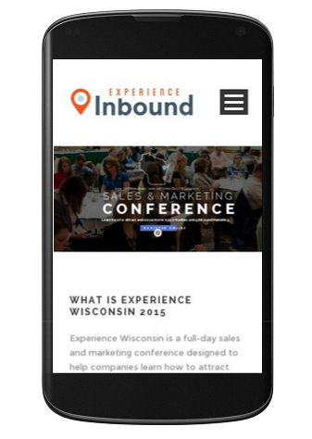

Slide 17
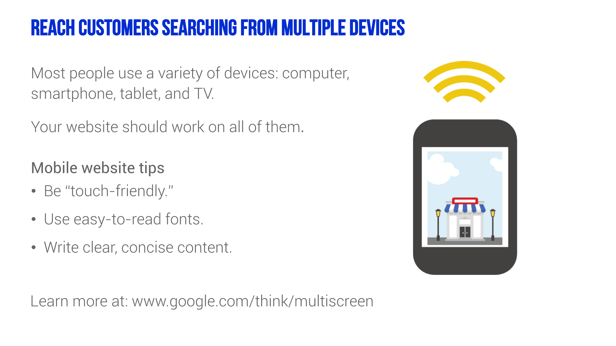
Notes:
Now that we’ve covered SEO and SEM, let’s talk about ore more important topic that applies to both: getting found on mobile devices.
4 in 5 consumers use search engines to find local information nearby like store address, business hours, product availability and directions.
More and more people, are turning to their smartphones to access the Internet
They’re using mobile devices and search engine listings to find the businesses that offer those goods and services.
Using mobile devices to find things locally
56% of smartphone searches done on the go have local intent
89% of local consumers prefer to use either a maps app or an mobile internet browser when looking for a local business on their mobile
From smartphones and tablets to laptops and television, 90% of all media interactions today are on a screen, and businesses that allow users to interact with their brand across all platforms and on all devices are able to generate more engagement.
So what is a mobile website, exactly? In a nutshell:
Designed for small screens
Thumb friendly
Easy to navigate from a mobile device.
Key Takeaway: mobile users tend to be very goal-oriented - they expect to be able to get what they need from a mobile site easily, immediately, and on their own terms. Ensure success by designing with their context and needs in mind without sacrificing richness of content.
******
Useful whitepaper: http://static.googleusercontent.com/media/www.google.com/en/us/intl/ALL_ALL/think/multiscreen/pdf/multi-screen-moblie-whitepaper_research-studies.pdf

Slide 18
Trend #3: We Know What Customers Are Demanding
Notes:
Google is not just a search engine. It’s the world’s greatest index of consumer demand – for a product, for a service, or for your company.

Slide 19
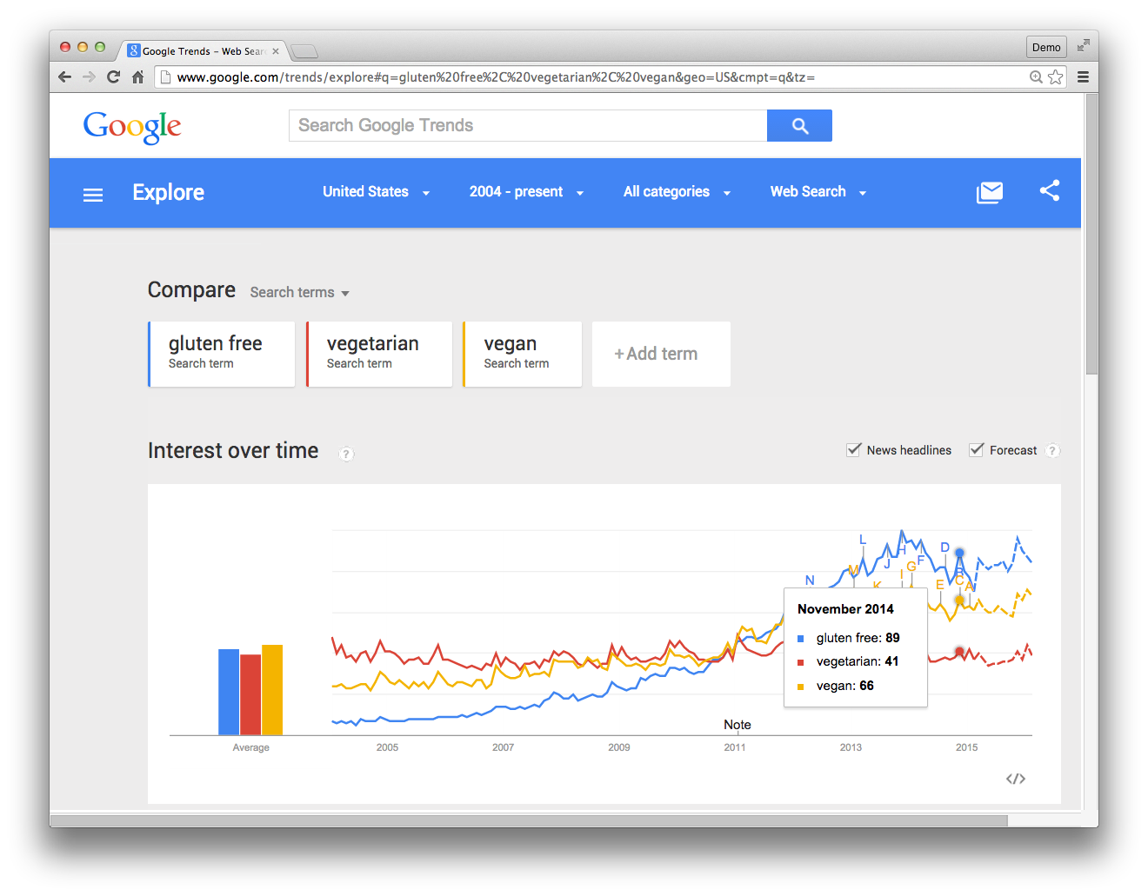
Google Trends: Know the Direction of Your Industry, Your Brand, Your Competition
www.google.com/trends
Notes:
Let’s look at another tool that can help you grow your business online called Google Trends: at www.google.com/trends
Free, web-based tool
Google Trends shows the relative popularity of different keywords searched on Google, over time.
Data is presented in a graph, on a scale of 0-100. One hundred represents the peak search volume.
If it has enough data, Trends can show related news headlines from peak periods, a forecast of search volume, related popular searches, and “rising searches” - searches experiencing significant growth.
GIVE AN EXAMPLE, OR POINT OUT THE RISE OF GLUTEN FREE

Slide 20
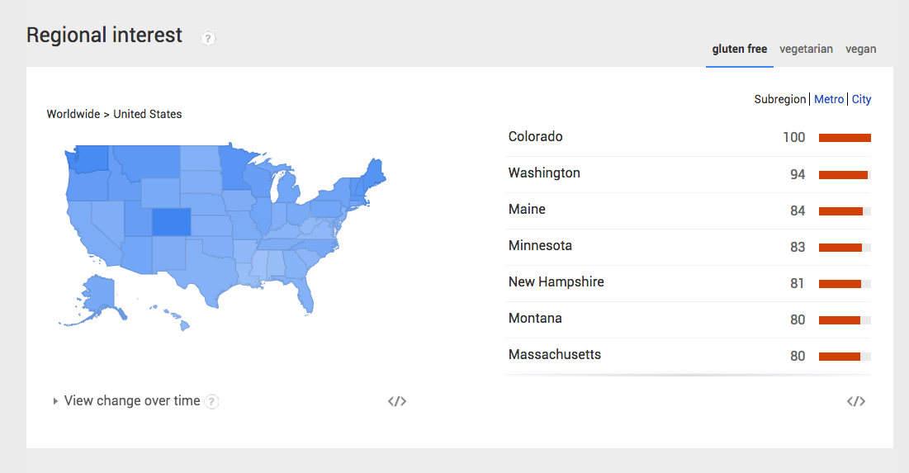
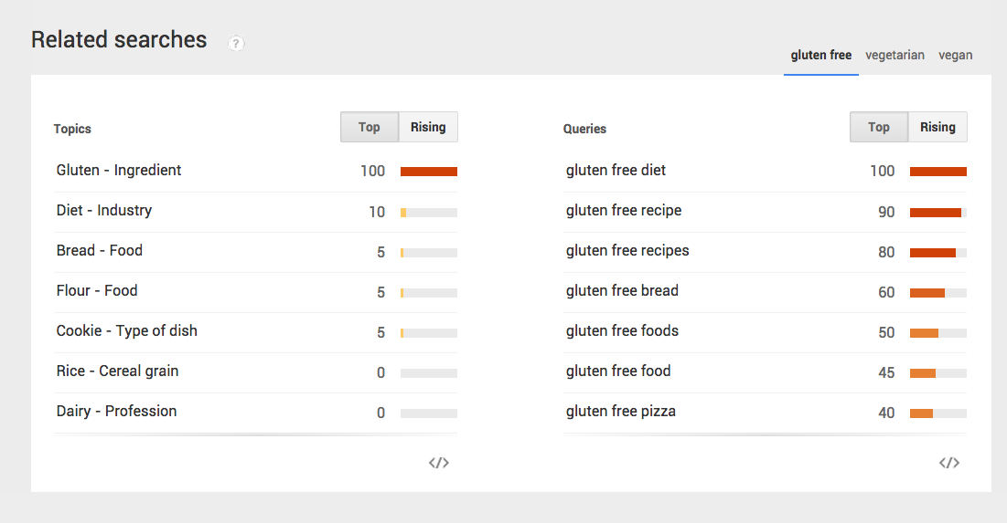
See Regional Interest, Related Searches
Notes:
So how can use use Google Trends? Lots of ways!
You can use it to refine marketing messages by comparing the popularity of different words and phrases.
You can use Trends to determine seasonality of different searches. With data going back to 2004, you can see when people are searching for different words and phrases and how that changes over the course of the year.
The reports show where searches happen, geographically. You can see where search terms are more and less popular in a given area.
POINT OF REGIONAL INTEREST AND RELATED SEARCHES

Slide 21
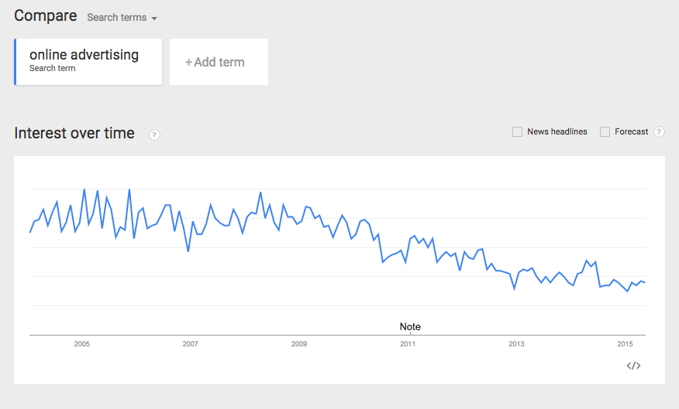

Slide 22
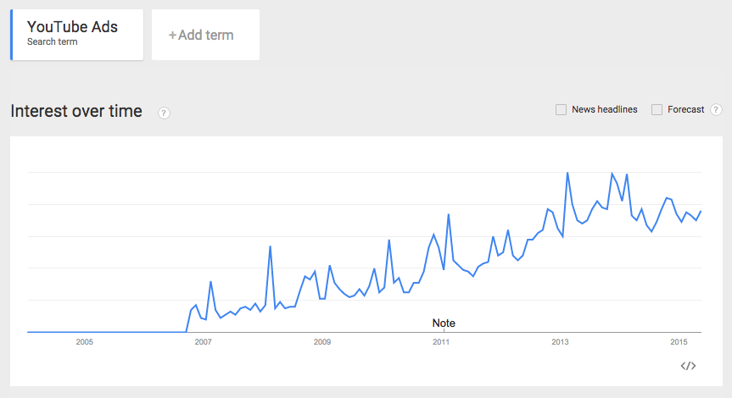

Slide 23
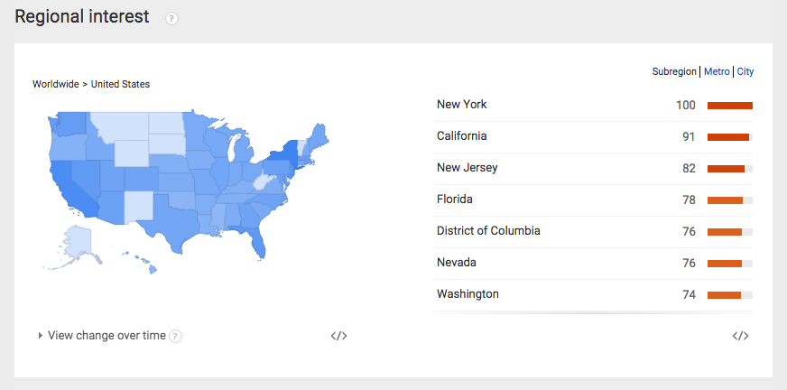

Slide 24
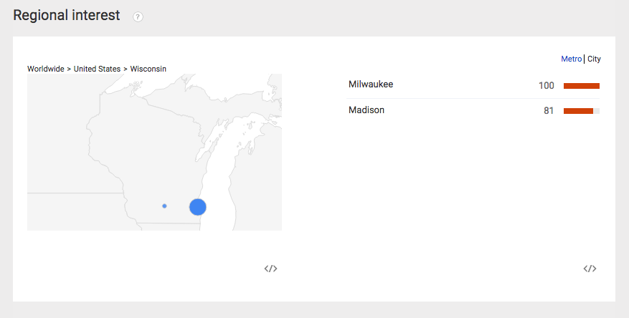

Slide 25
Resources
Notes:
Google is not just a search engine. It’s the world’s greatest index of consumer demand – for a product, for a service, or for your company.

Slide 26
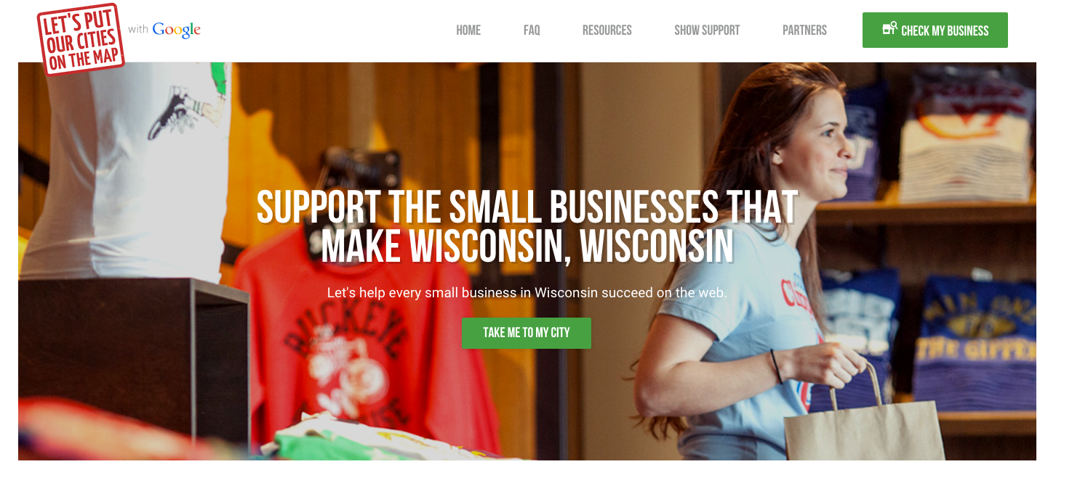
www.GYBO.com/WI

Slide 27
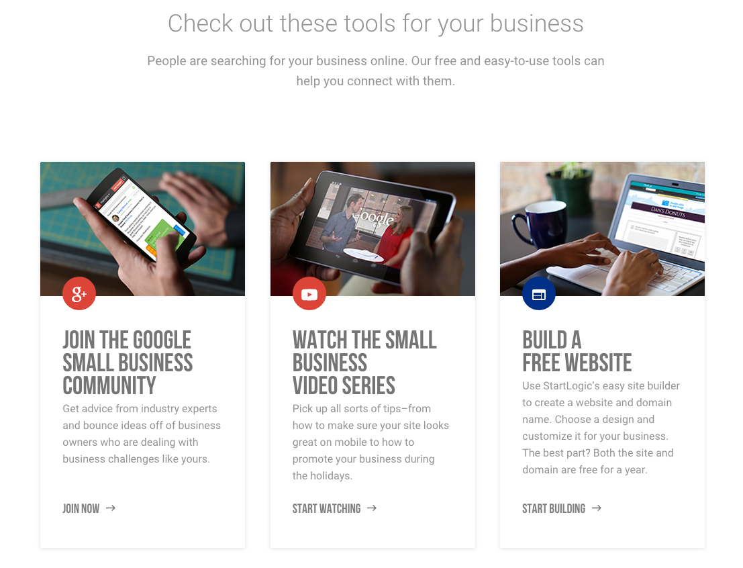
www.GYBO.com/WI

Slide 28
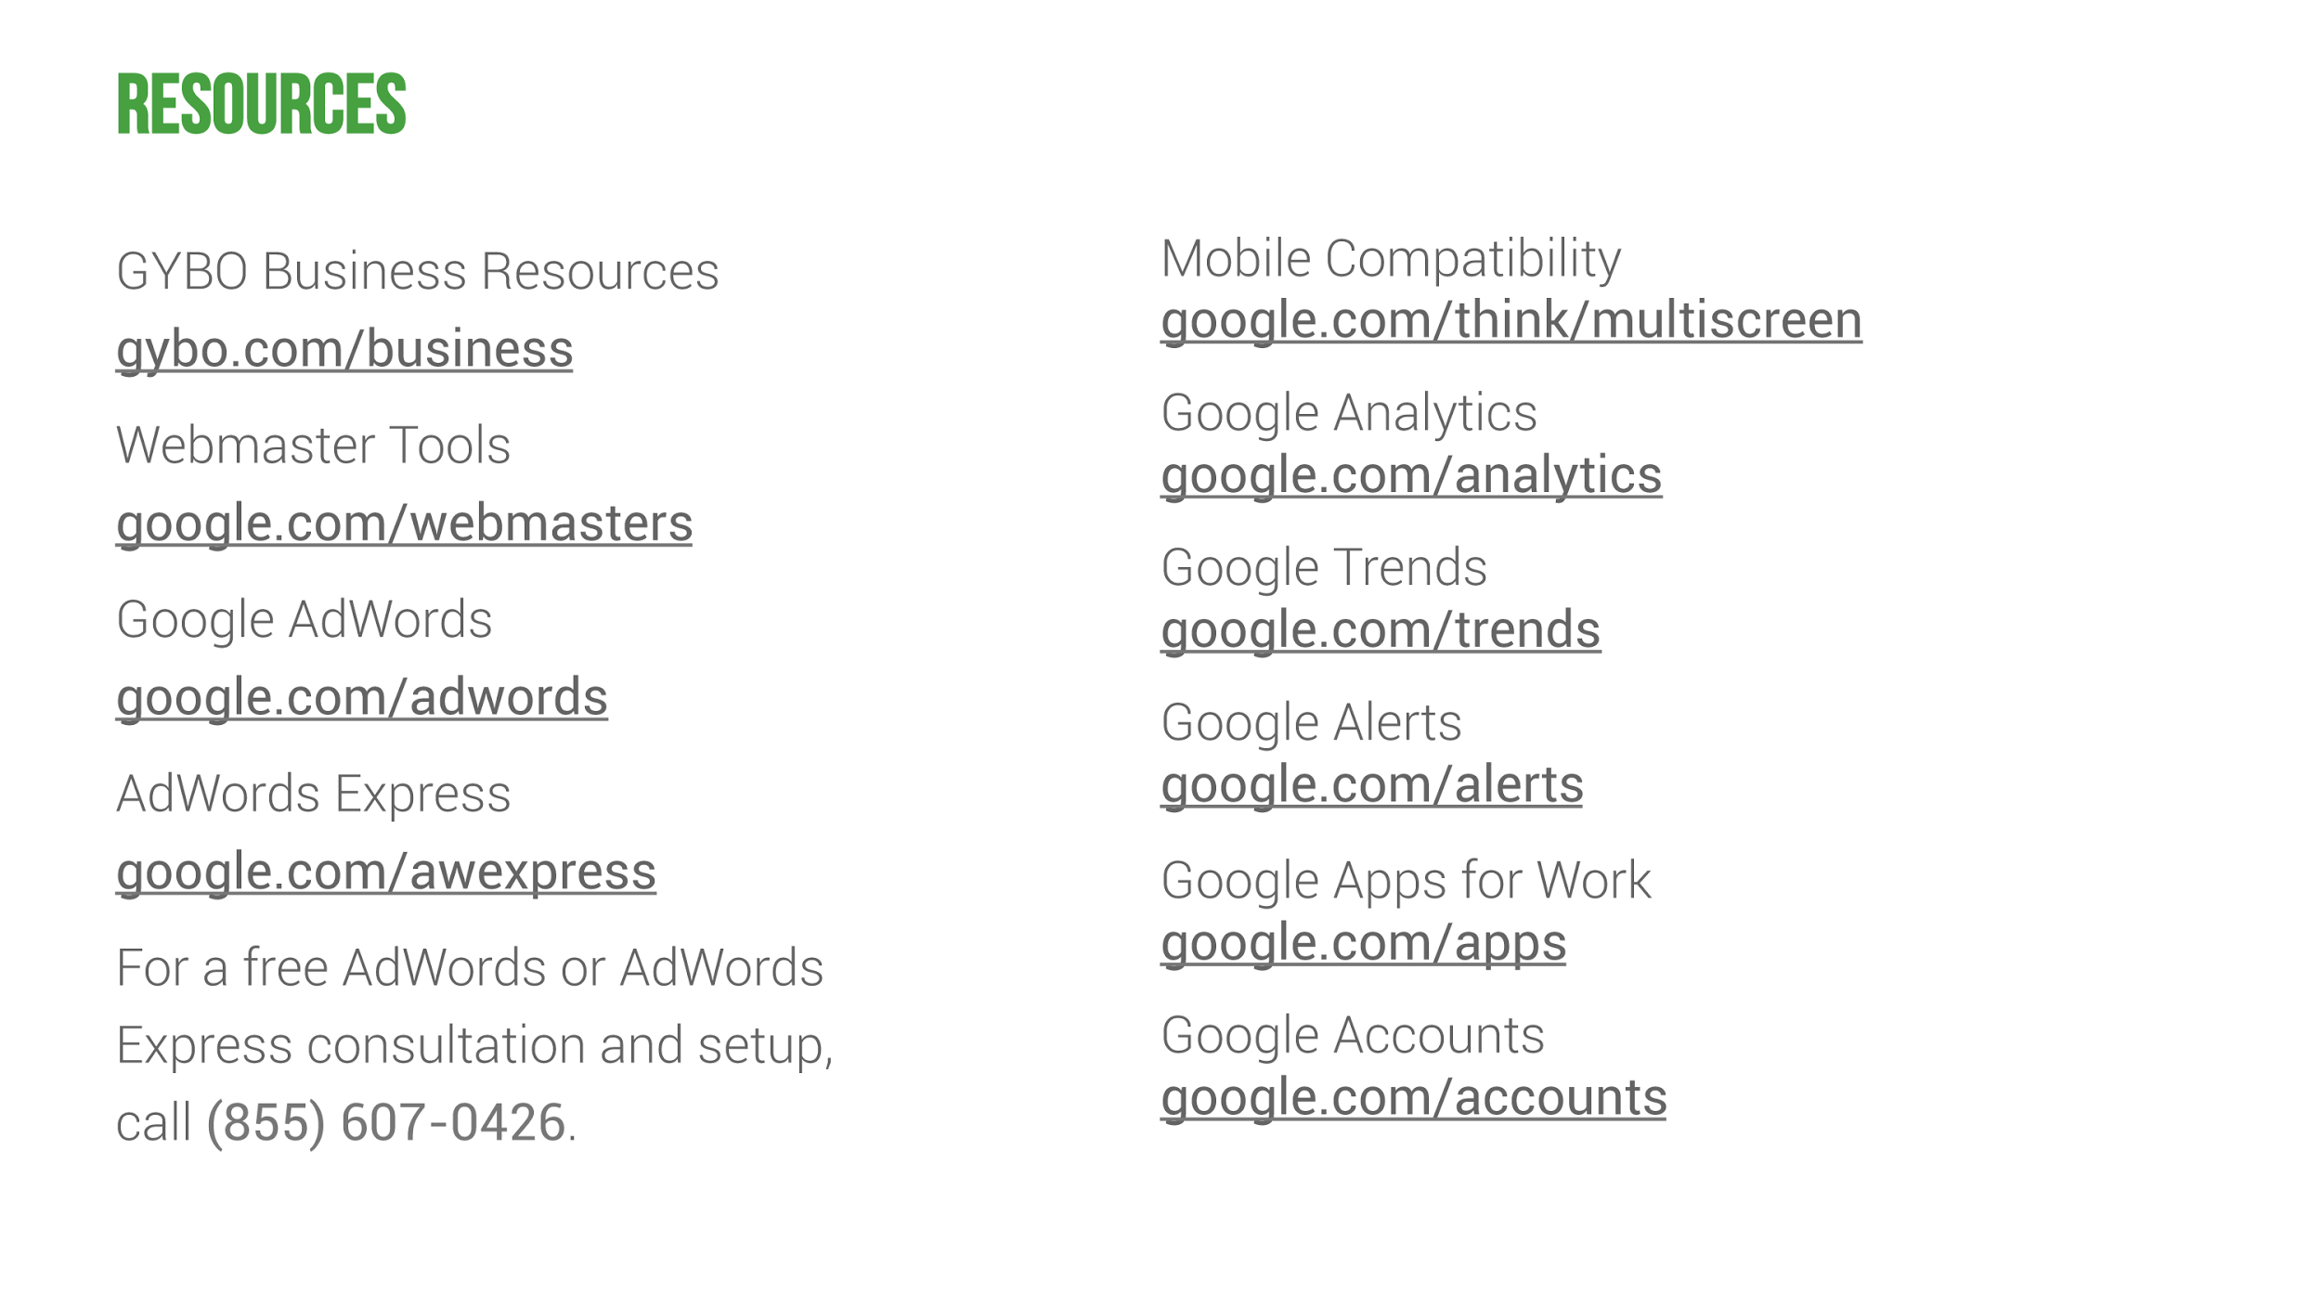

Slide 29
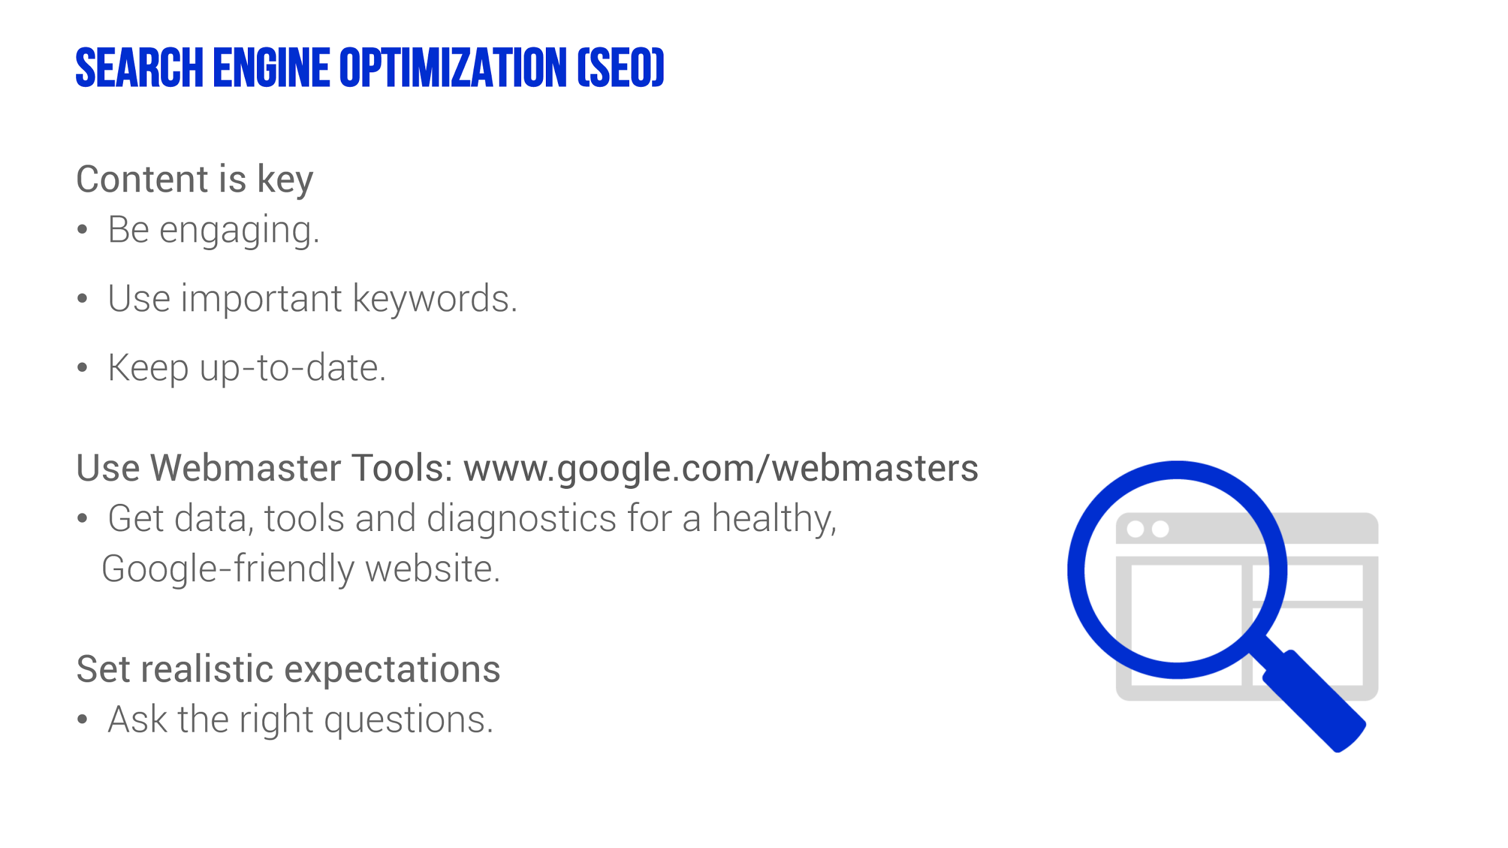
Notes:
Many of you have heard of SEO, which stands for Search Engine Optimization.
SEO is the process of making a website more visible and more relevant to search engines, with the goal of appearing more prominently in the search results pages.
Google has more than 200 signals to determine how a page ranks. Lets talk about some of the most important aspects of an SEO program.
Content is the key to search engine optimization. Your goal is to include information on your website that helps Google understand what your business is about.
You can help by including keyword-focused content, relevant to the theme of your website. But remember, you’re still writing for humans!
Keep your site up-to-date. One easy way is to incorporate a blog into your site. A website with interesting, up-to-date content is a resource worth sharing. As people learn about your site and find interesting information, they will recommend it to others.
OK, let’s talk about our first tool from Google, called Webmaster Tools.
It’s free, found at www.Google.com/webmasters
Provides reports about your website’s visibility on Google.
You can use it to send feedback and report issues.
Includes diagnostic tools to help you understand and fix potential problems.
You can use Webmaster Tools to submit a Sitemap. Sitemaps are a way to tell Google about pages on your site it might not otherwise discover. This is not a file visible for humans - it’s specifically for search engines.
Finally, don’t rush it! SEO is a slow, incremental process and you should see improvement over time.
Don’t try to speed up the process by trying sneaky techniques, like “stuffing” your web pages with keywords.

Slide 30
Today’s Session:
The B2B Path to Purchase
Our Mobile Planet
The Database of Intentions
Resources & Tools
How Do B2B Purchasers Use the Web?
How Has the Dominance of the Smartphone Changed B2B Marketing?
What Insights Should You, as a Marketer, Be Aware Of?
Places to Research, Discover, and Grow Your Online Identity
Notes:
This presentation covers three areas:
Being found on Google and your website’s compatibility with mobile devices
Using Google’s tools to get insight into search behavior, visitor behavior on your website and your online reputation.
And using Google Apps to for Work increase your office productivity and save money
Let’s get started!

Slide 31
3 B2B Trends For Digital Marketing Success
Ryan Panzer
Business Development Manager, Google
ryanpanzer@google.com | (734) 619-4013
Notes:
Let’s talk about another way to get found on Google, by creating a free Google+ page for your business. A plus page is a profile page with interactive features.
You can create pages for these categories:
Local Business or Place
Product or brand
Company, institution or organization
Arts, entertainment or sports
Or, other
If you’re creating a Google+ page for a local business with a storefront and want to appear on Google Maps, choose the Local Business category.
If you have a Google Places for Business page, that information now appears on a Google+ Local.

