Slide 1
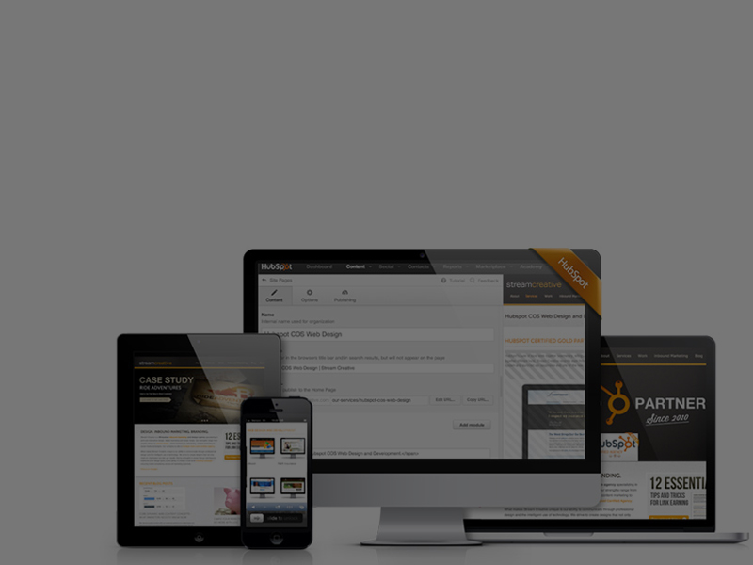
EVERYTHING YOU NEED TO KNOW FOR YOUR NEXT WEBSITE REDESIGN
STEVE JAMES
Partner, Stream Creative

Slide 2
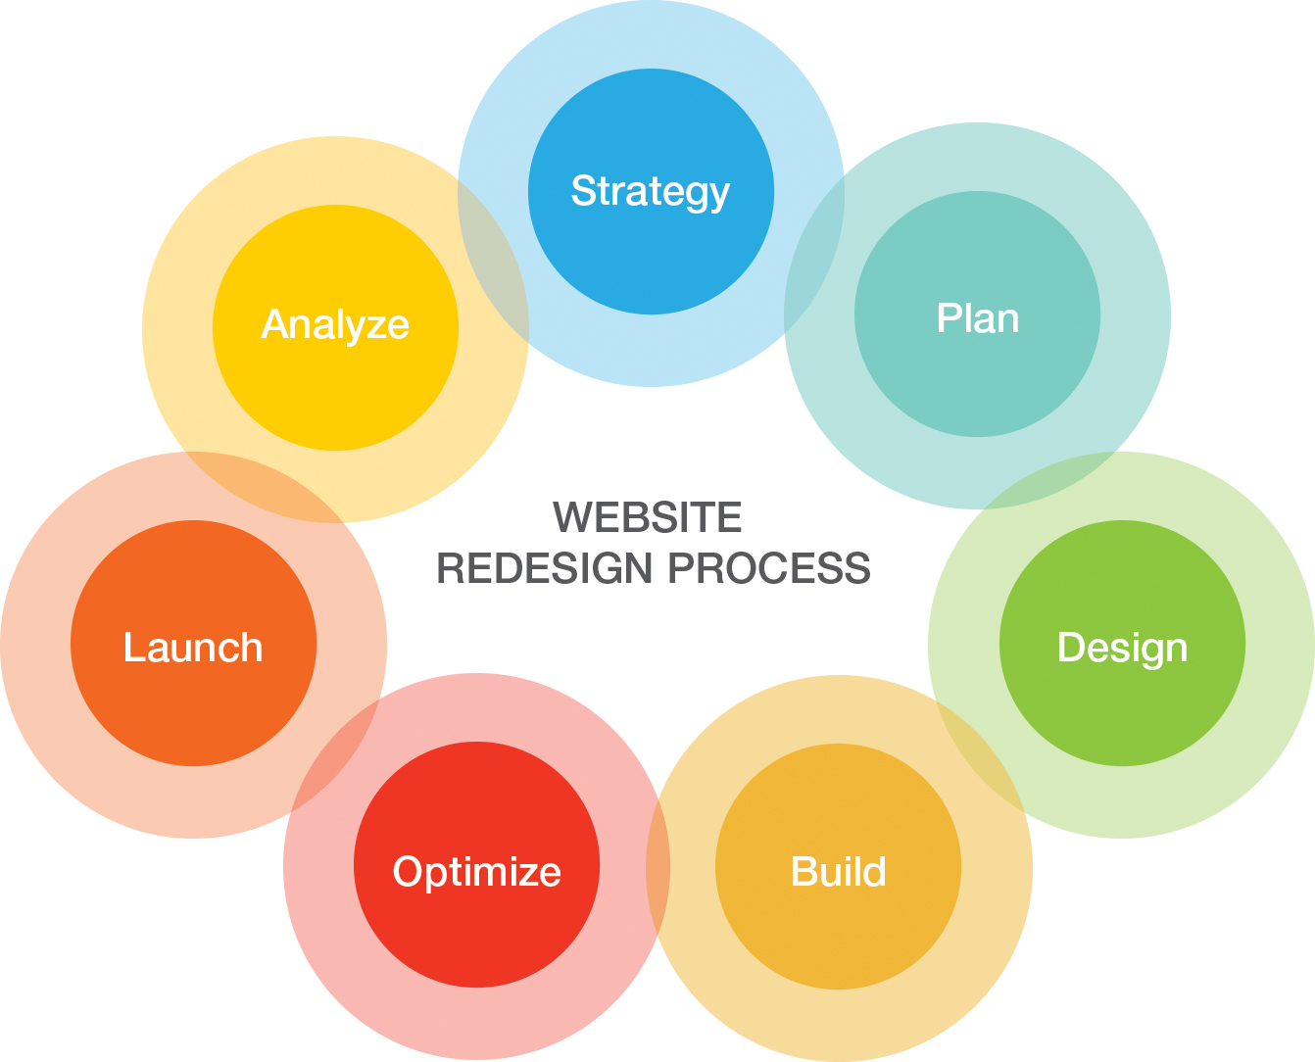
Notes:
http://offers.hubspot.com/redesigning-your-website

Slide 3
Strategy

Slide 4




Strategy
Benchmark Your Current Metrics.
Determine Your Goal.
Define Your Brand.
Define Your Buyer Persona.
Notes:
Benchmark Your Current Metrics. Number of visits/Bounce rate/Time on site, Top performing keywords, etc.
--
Determine Your Goal. Why are you doing the redesign?
Define Your Brand. What is your business’s message/unique value proposition. Has this changed over the past couple years?
Define Your Buyer Persona. Do you have a clearly defined target audience. Is this audience changing as part of the redesign. Does your current branding/content aligned with that audience?
Analyze the Competition. Do you like their sites? Top 3 most competitive keywords in your industry. Top-ranked competitors.

Slide 5
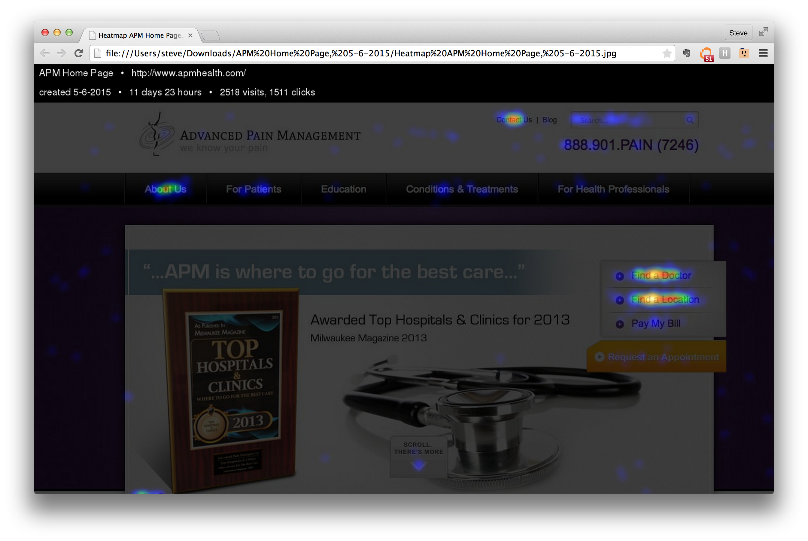
Notes:
Crazyegg
HotJar

Slide 6
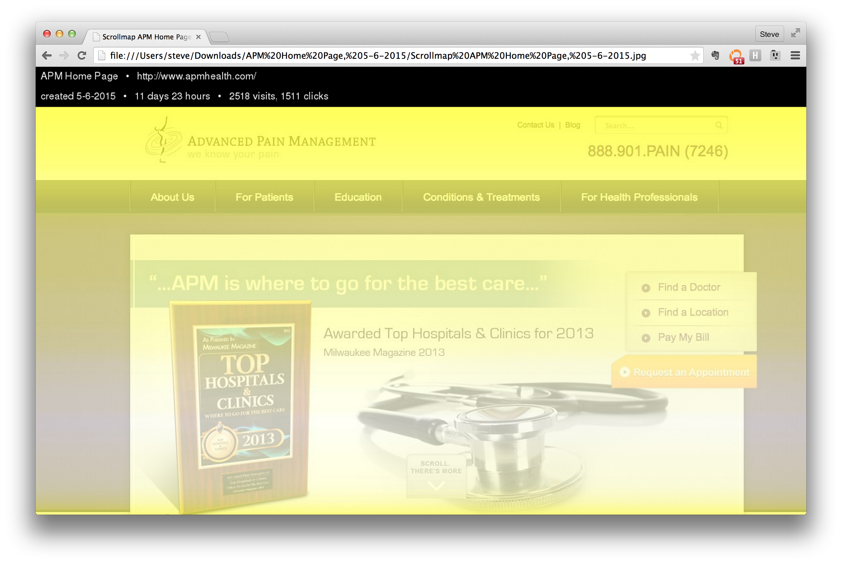
Notes:
Crazyegg
HotJar

Slide 7
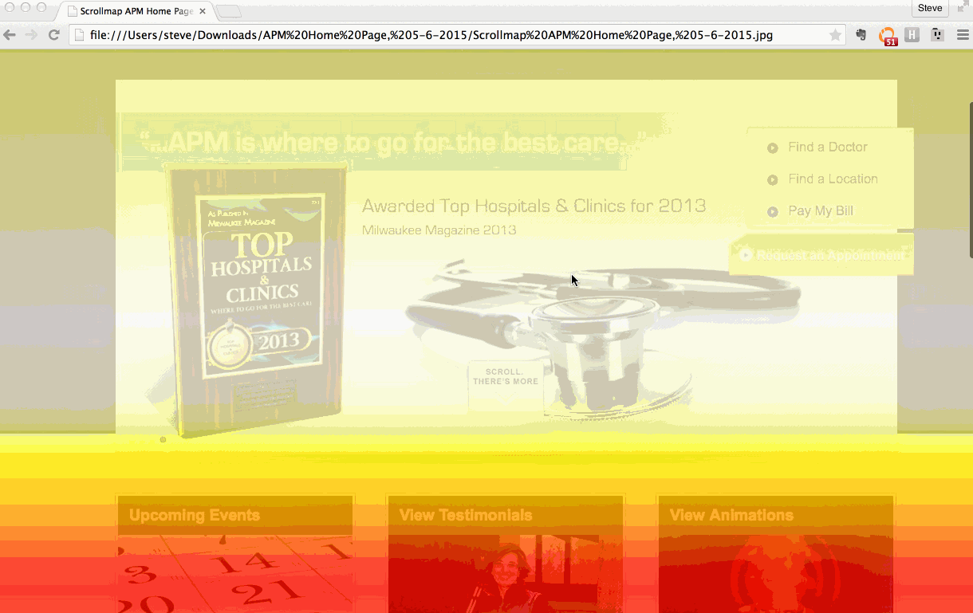
Notes:
Crazyegg and HotJar

Slide 8

Strategy
Benchmark Your Current Metrics.
Determine Your Goal.
Define Your Brand.
Define Your Buyer Persona.
Notes:
Benchmark Your Current Metrics. Number of visits/Bounce rate/Time on site, Top performing keywords, etc.
--
Determine Your Goal. Why are you doing the redesign?
Define Your Brand. What is your business’s message/unique value proposition. Has this changed over the past couple years?
Define Your Buyer Persona. Do you have a clearly defined target audience. Is this audience changing as part of the redesign. Does your current branding/content aligned with that audience?
Analyze the Competition. Do you like their sites? Top 3 most competitive keywords in your industry. Top-ranked competitors.

Slide 9
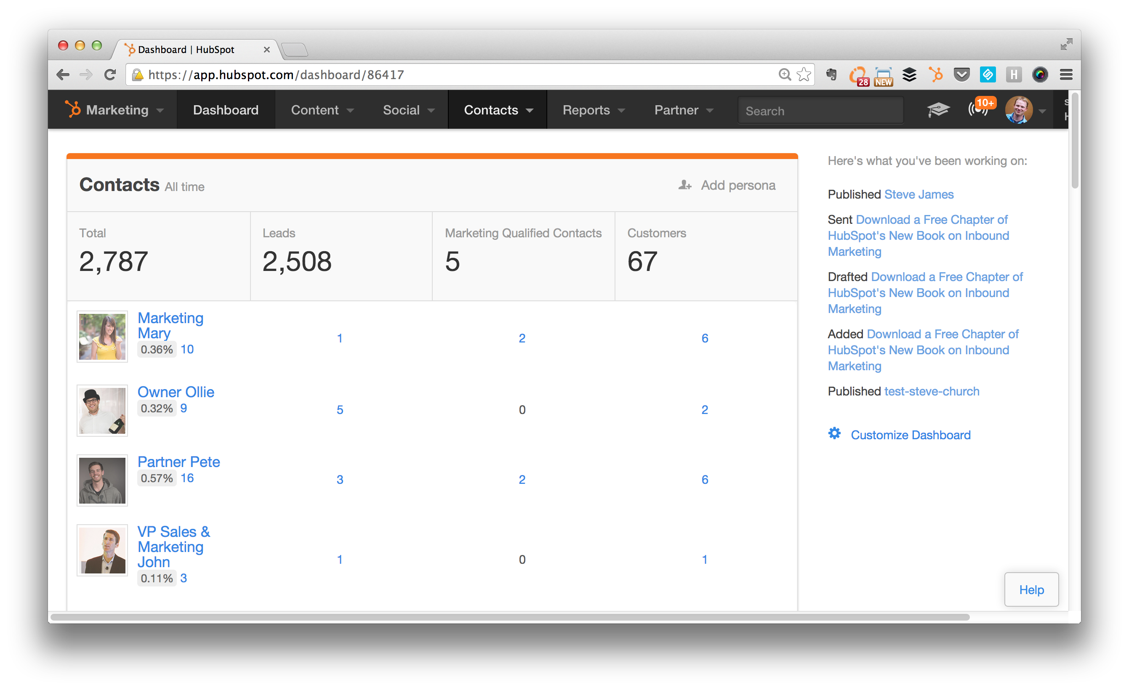
Notes:
http://knowledge.hubspot.com/contacts-user-guide/how-to-create-personas

Slide 10
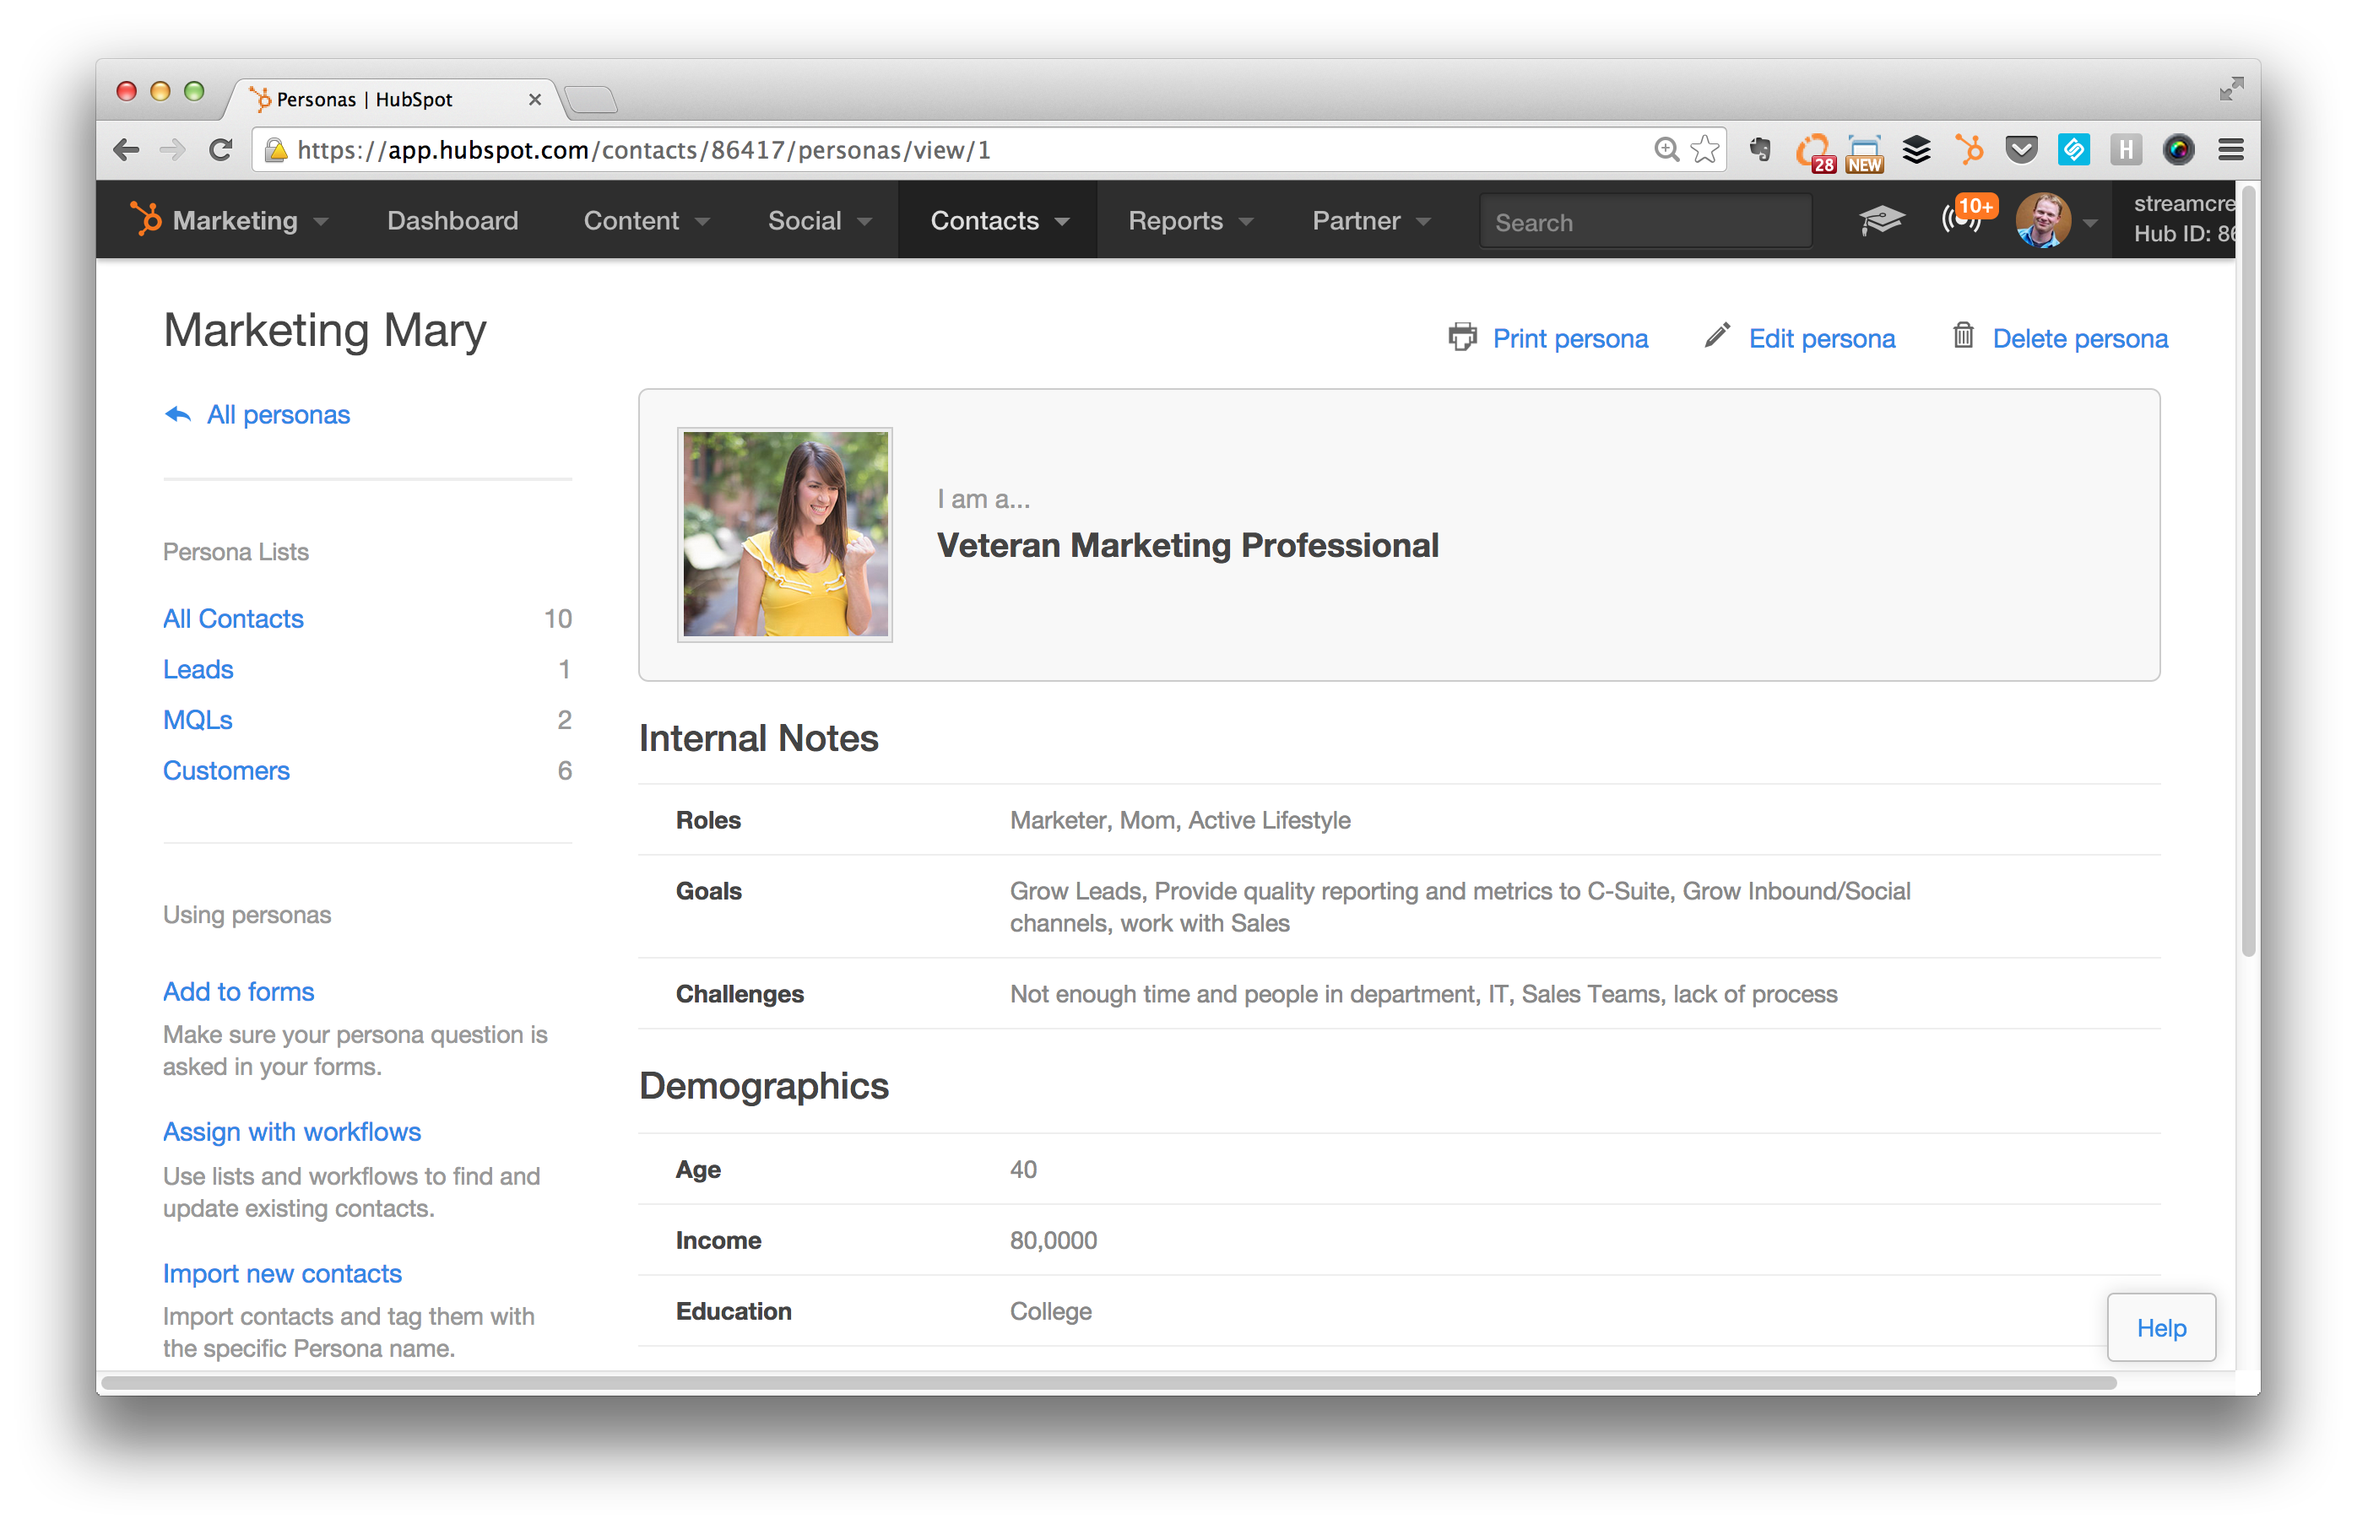
Notes:
Define Your Buyer Persona. Do you have a clearly defined target audience. Is this audience changing as part of the redesign. Does your current branding/content aligned with that audience? Are you asking the right questions on your web site to help segment your personas?

Slide 11
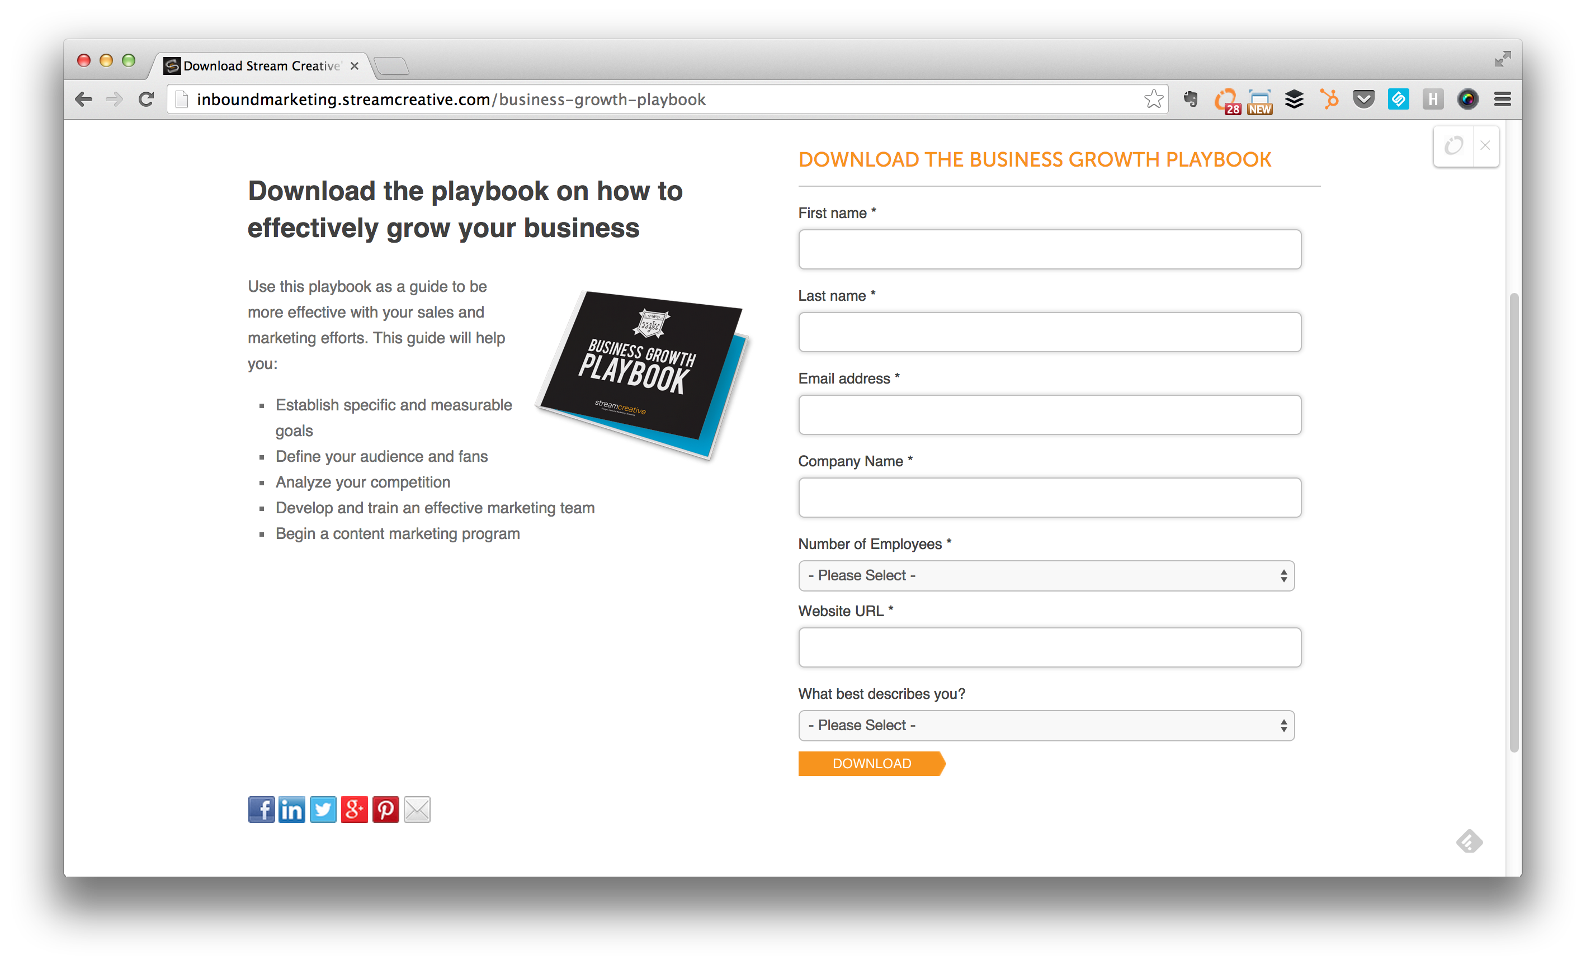
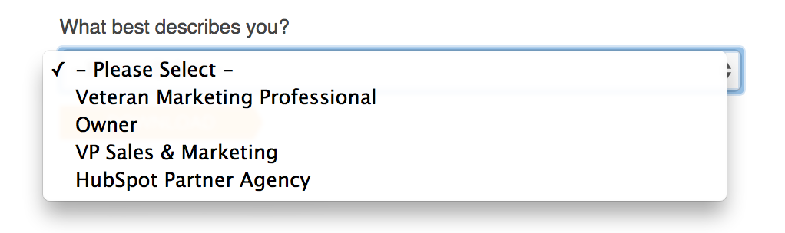

Slide 12
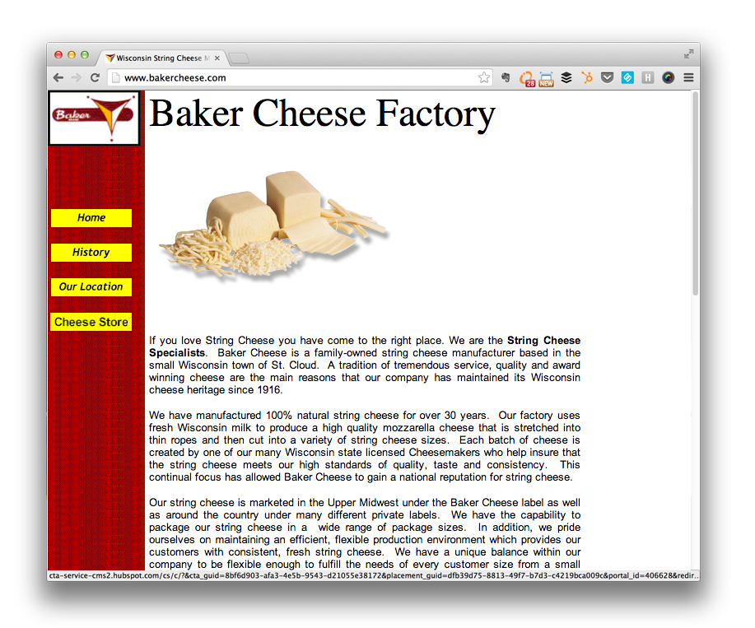
Buyer Personas
Large Cheese Producers
Small Market/Boutique
Grocery Stores
End Consumer
Notes:
http://offers.hubspot.com/free-template-creating-buyer-personas

Slide 13
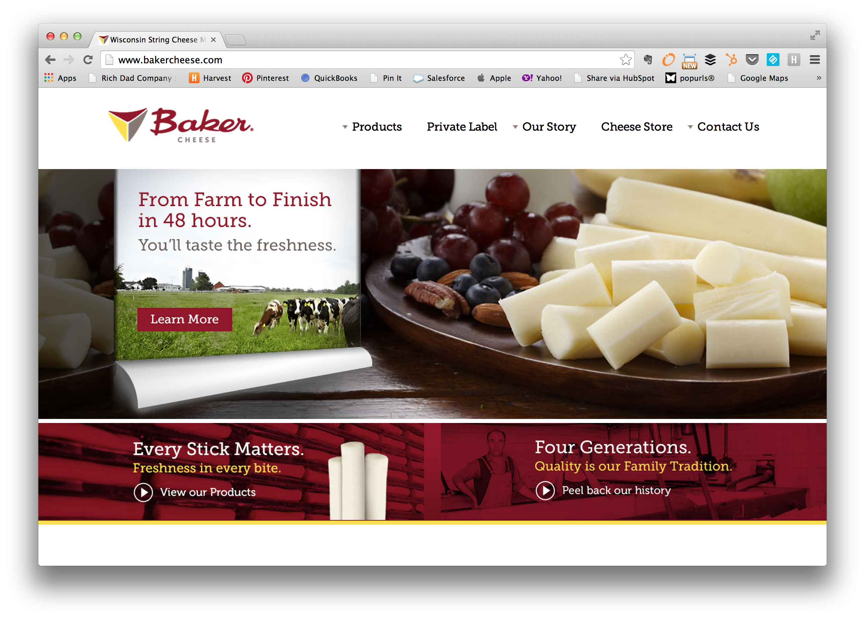

Slide 14
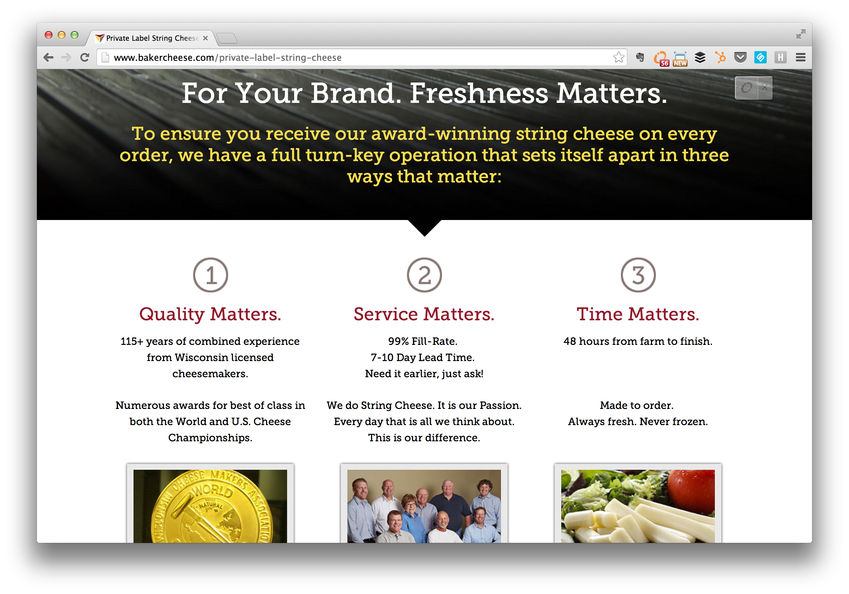

Slide 15
Takeaway
Define & document at least 3 customer types your company currently services.
Notes:
http://offers.hubspot.com/free-template-creating-buyer-personas

Slide 16
2
Plan

Slide 17
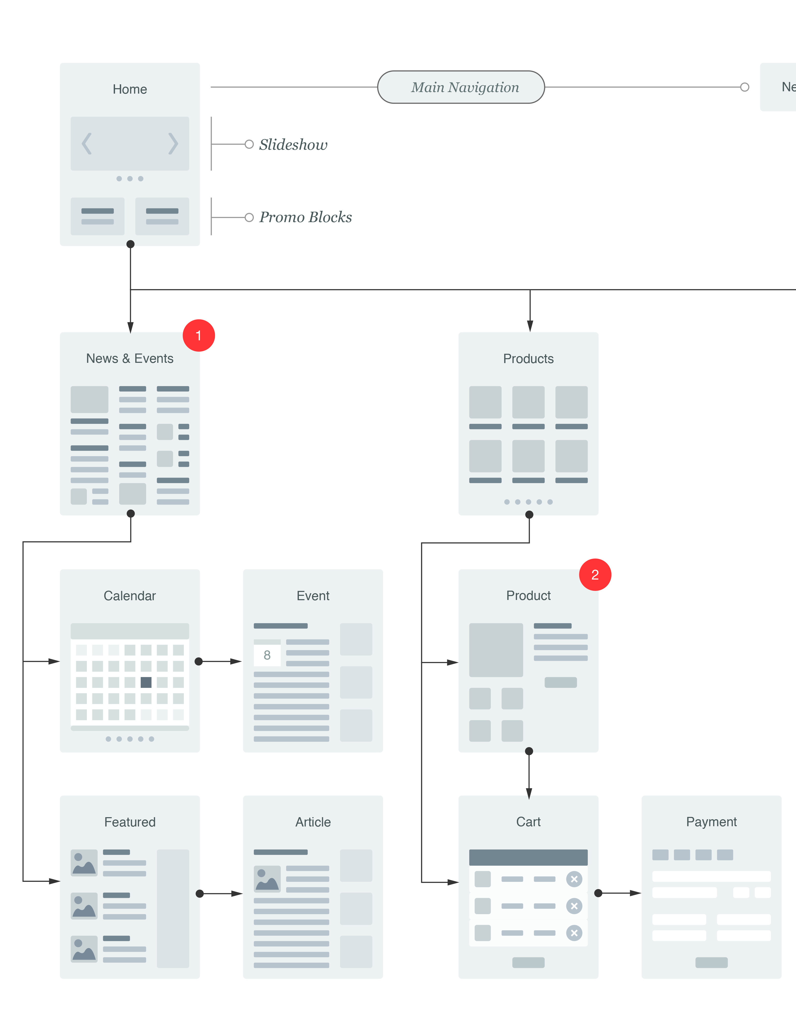
Plan
Define Your Team.
Platform Considerations.
Review and outline current assets.
Outline Site Architecture/Site Map.
Plan out your URL Mapping/301 Redirects.
Define Your Content Plan.

Slide 18
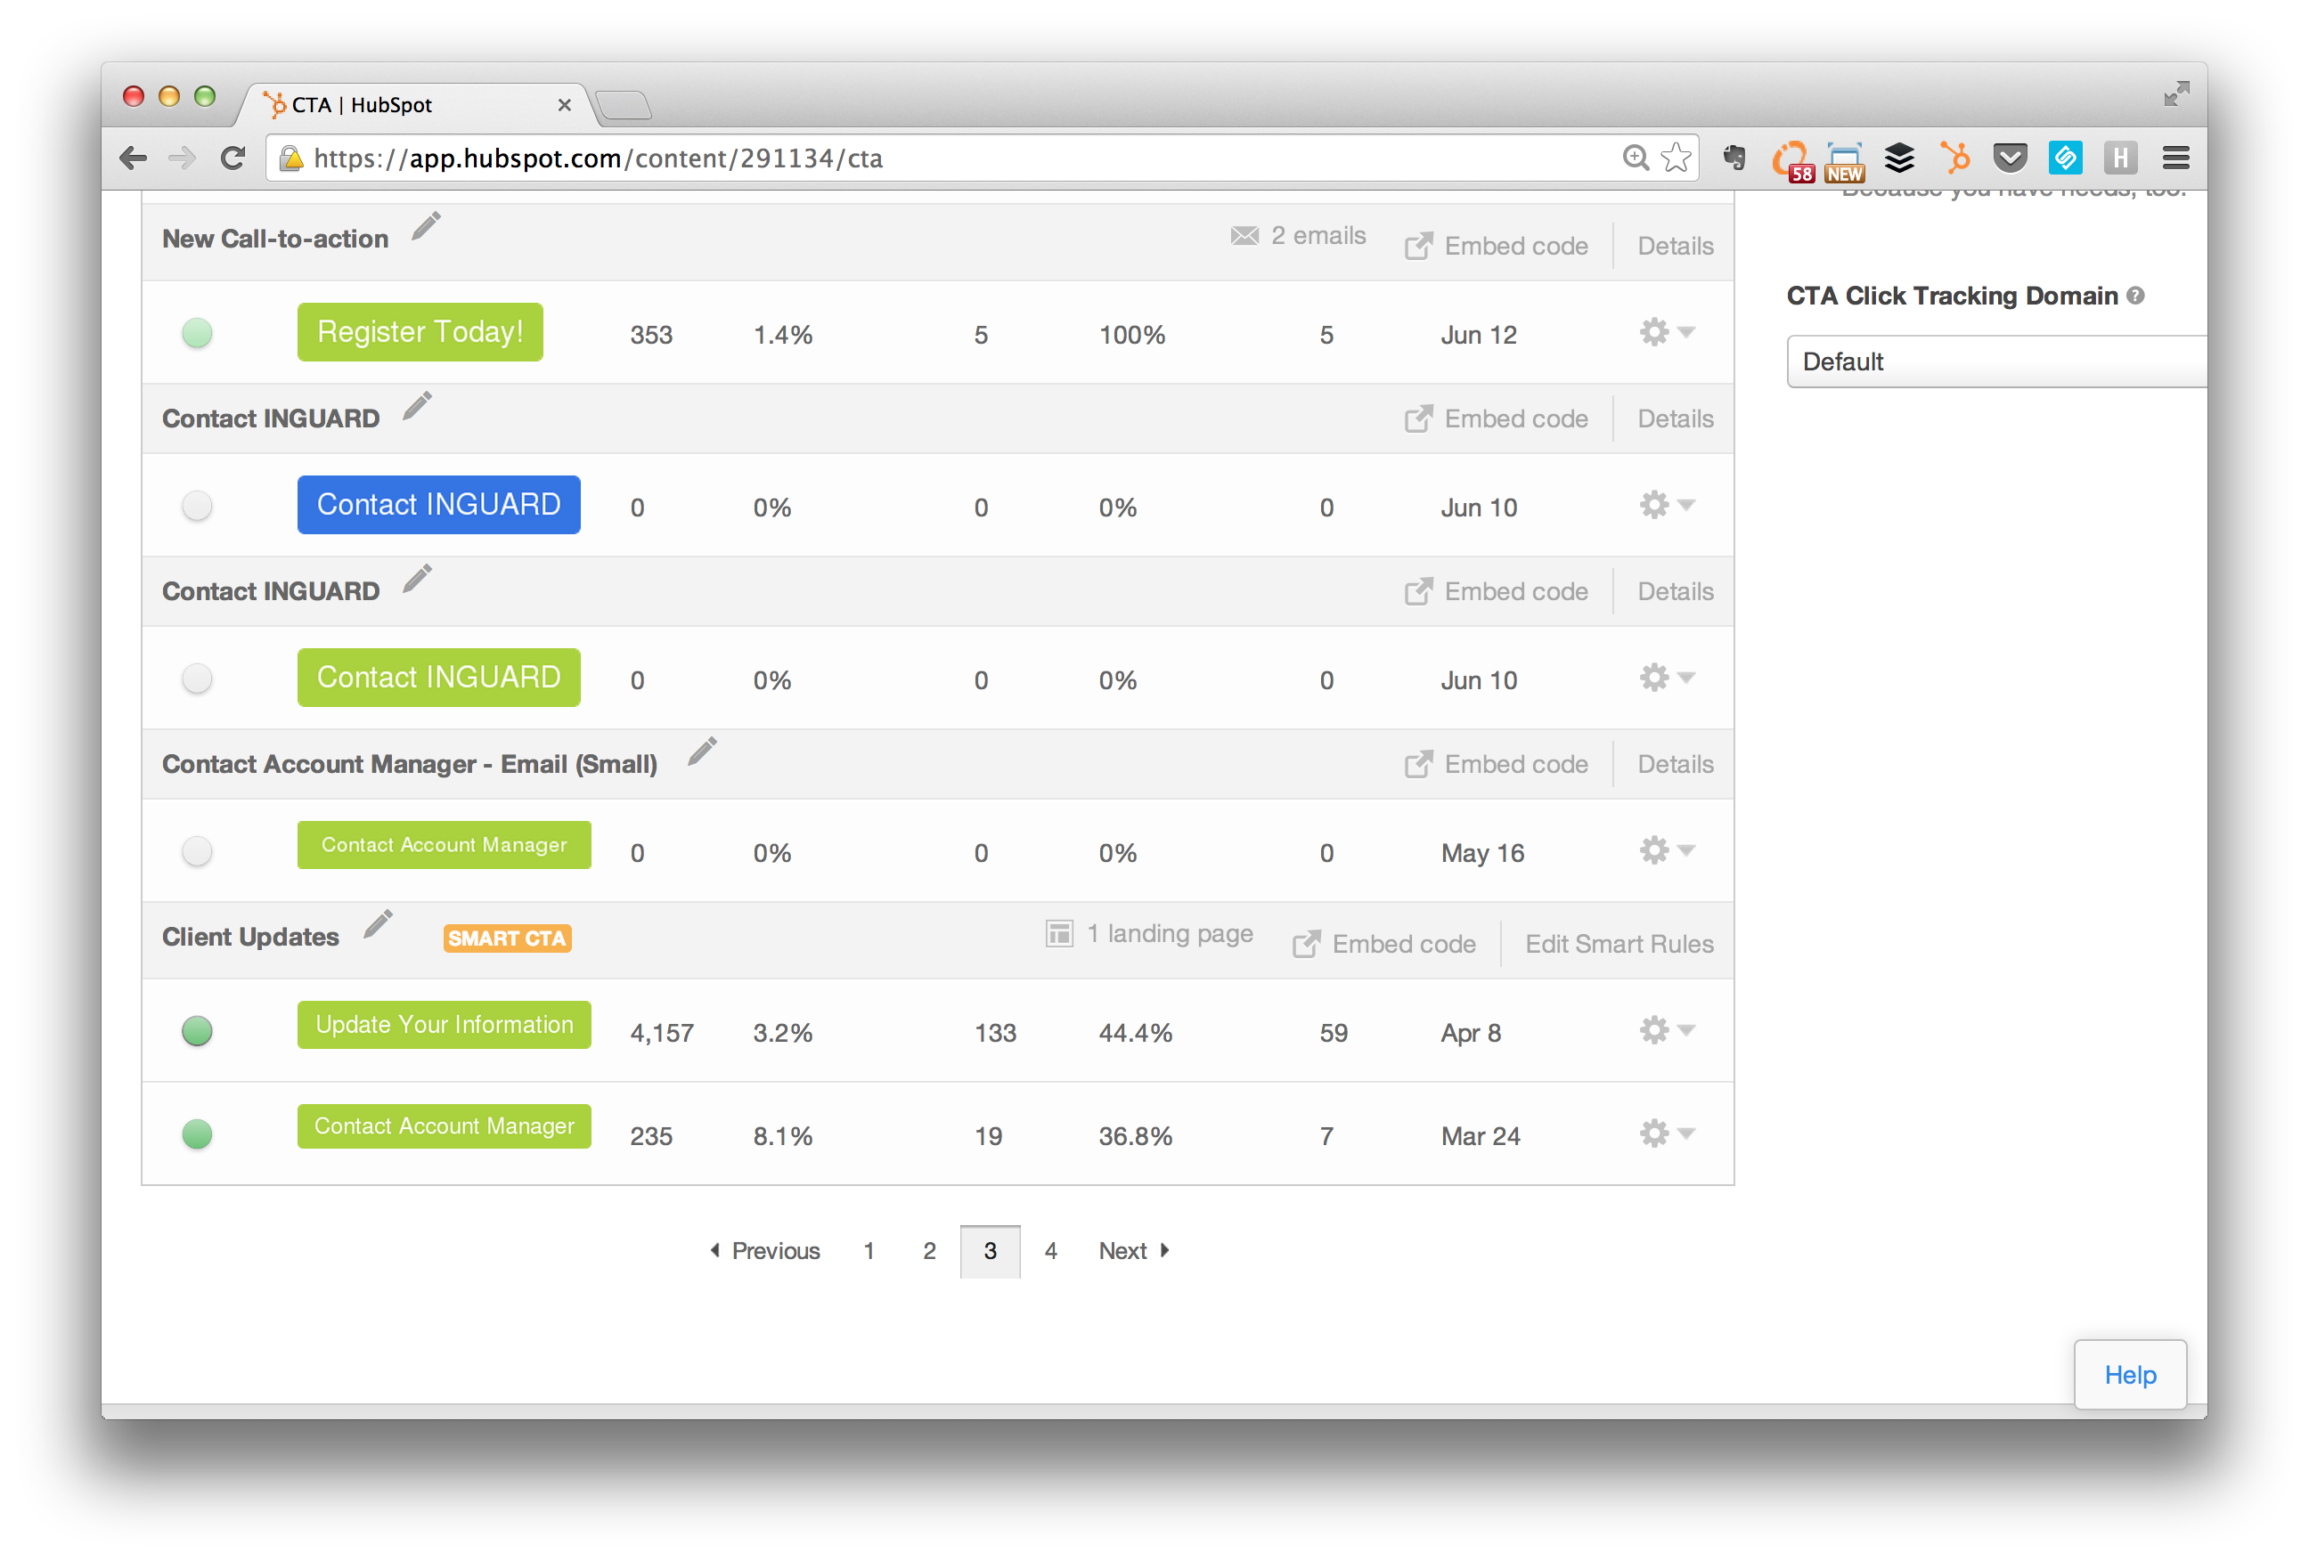
Notes:
http://knowledge.hubspot.com/site-pages-user-guide/how-to-use-smart-content
http://blog.hubspot.com/insiders/what-is-a-cos
Good Article:
http://www.cmsmyth.com/2013/09/the-content-personalization-myth/
http://contentmarketinginstitute.com/2010/06/a-quick-and-dirty-way-to-segment-your-b2b-content-marketing/

Slide 19
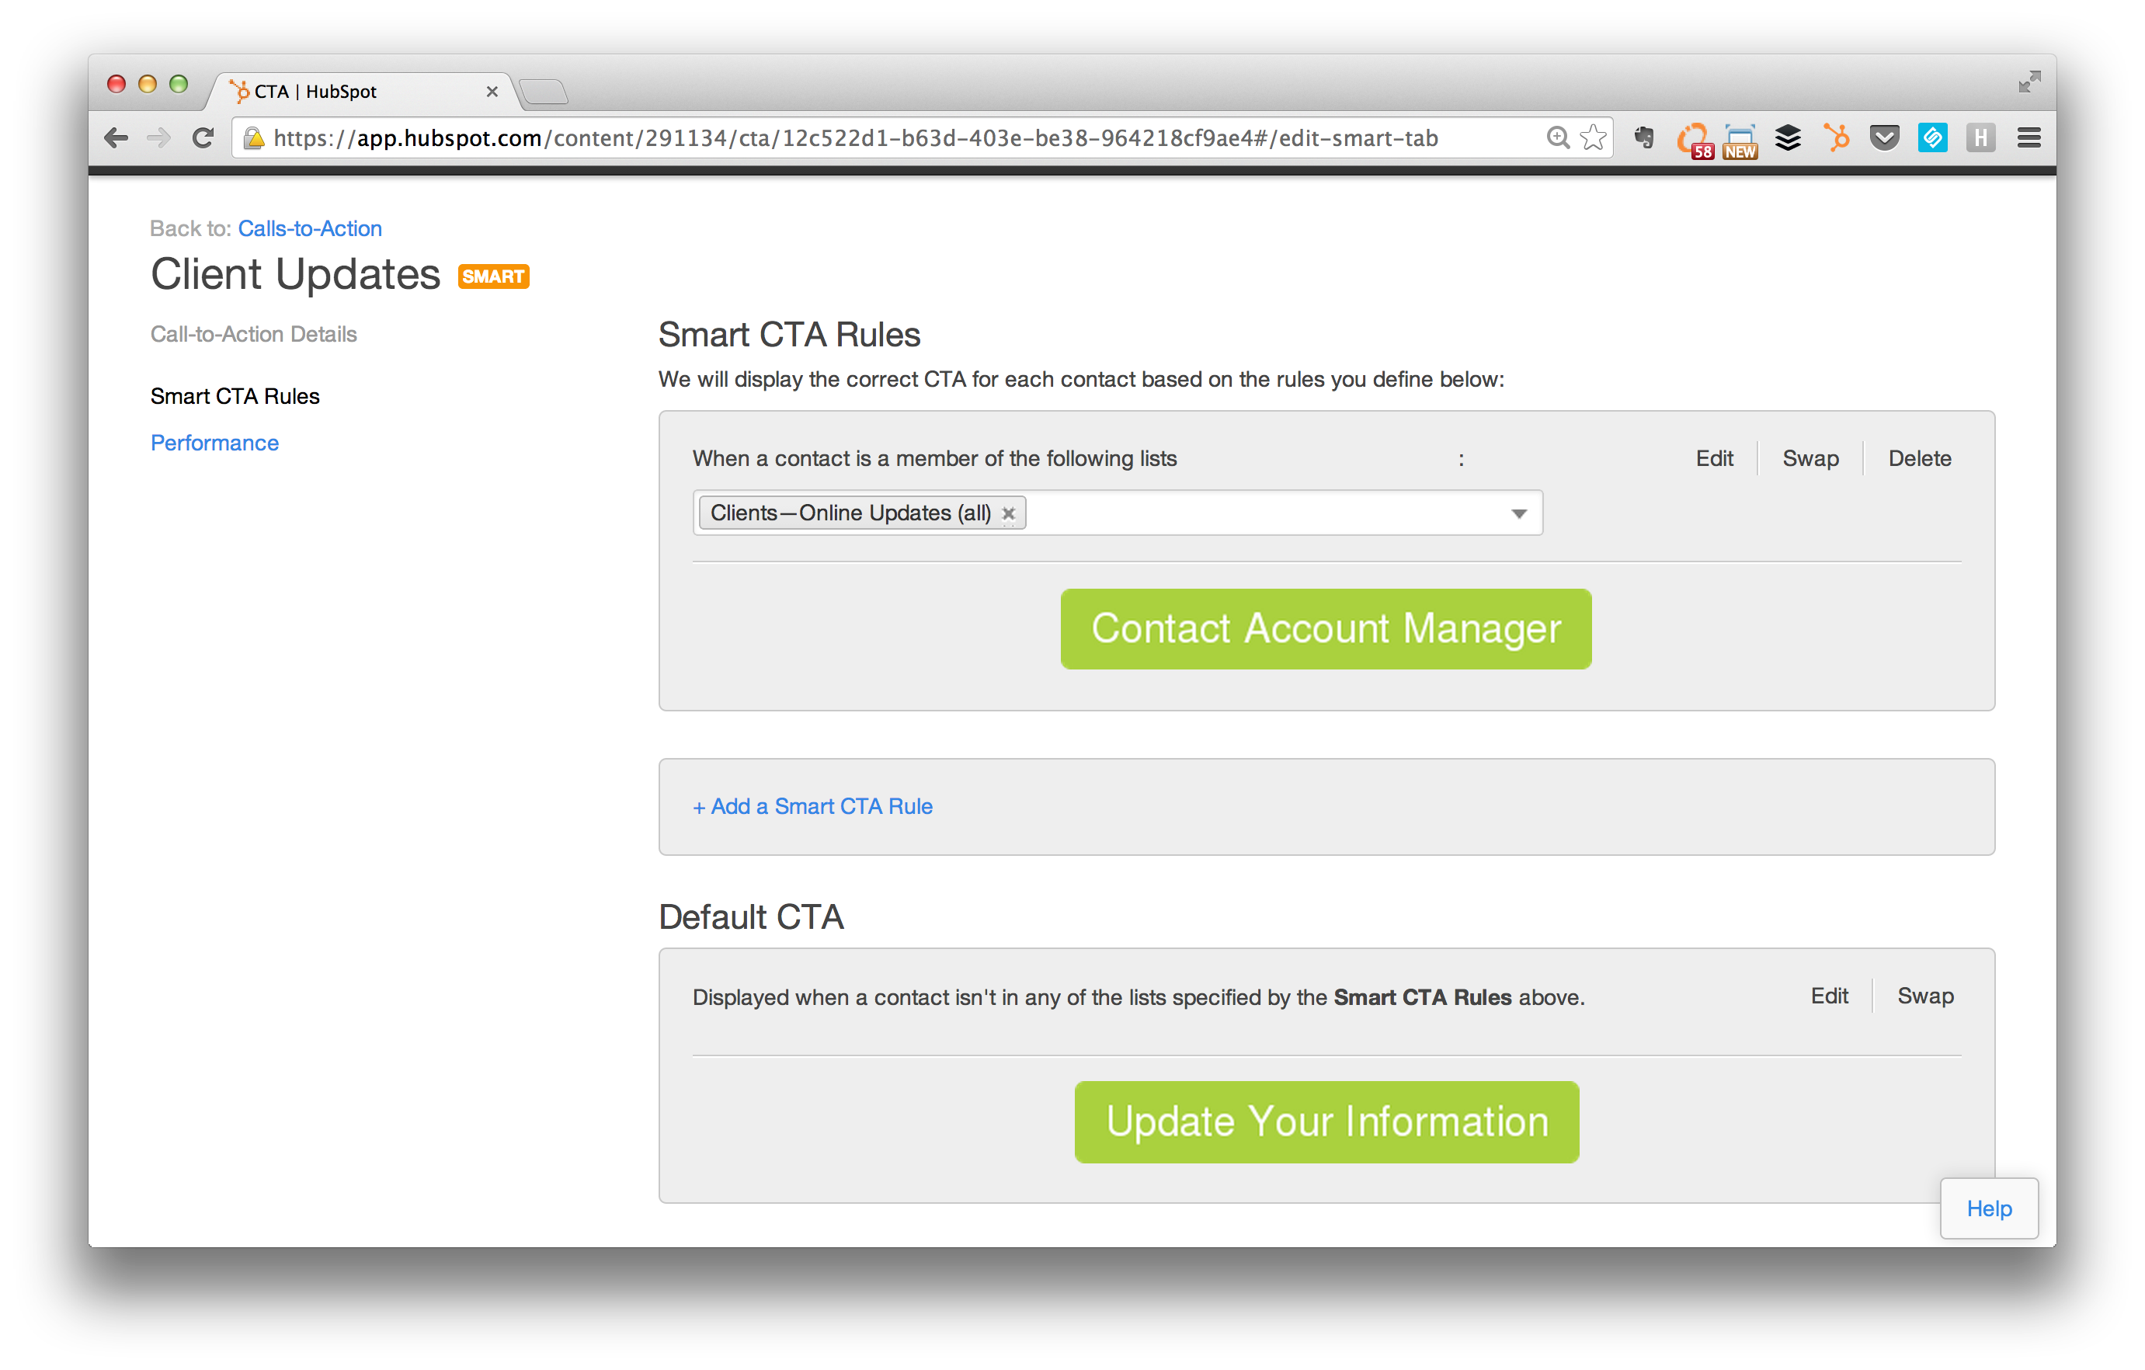

Slide 20
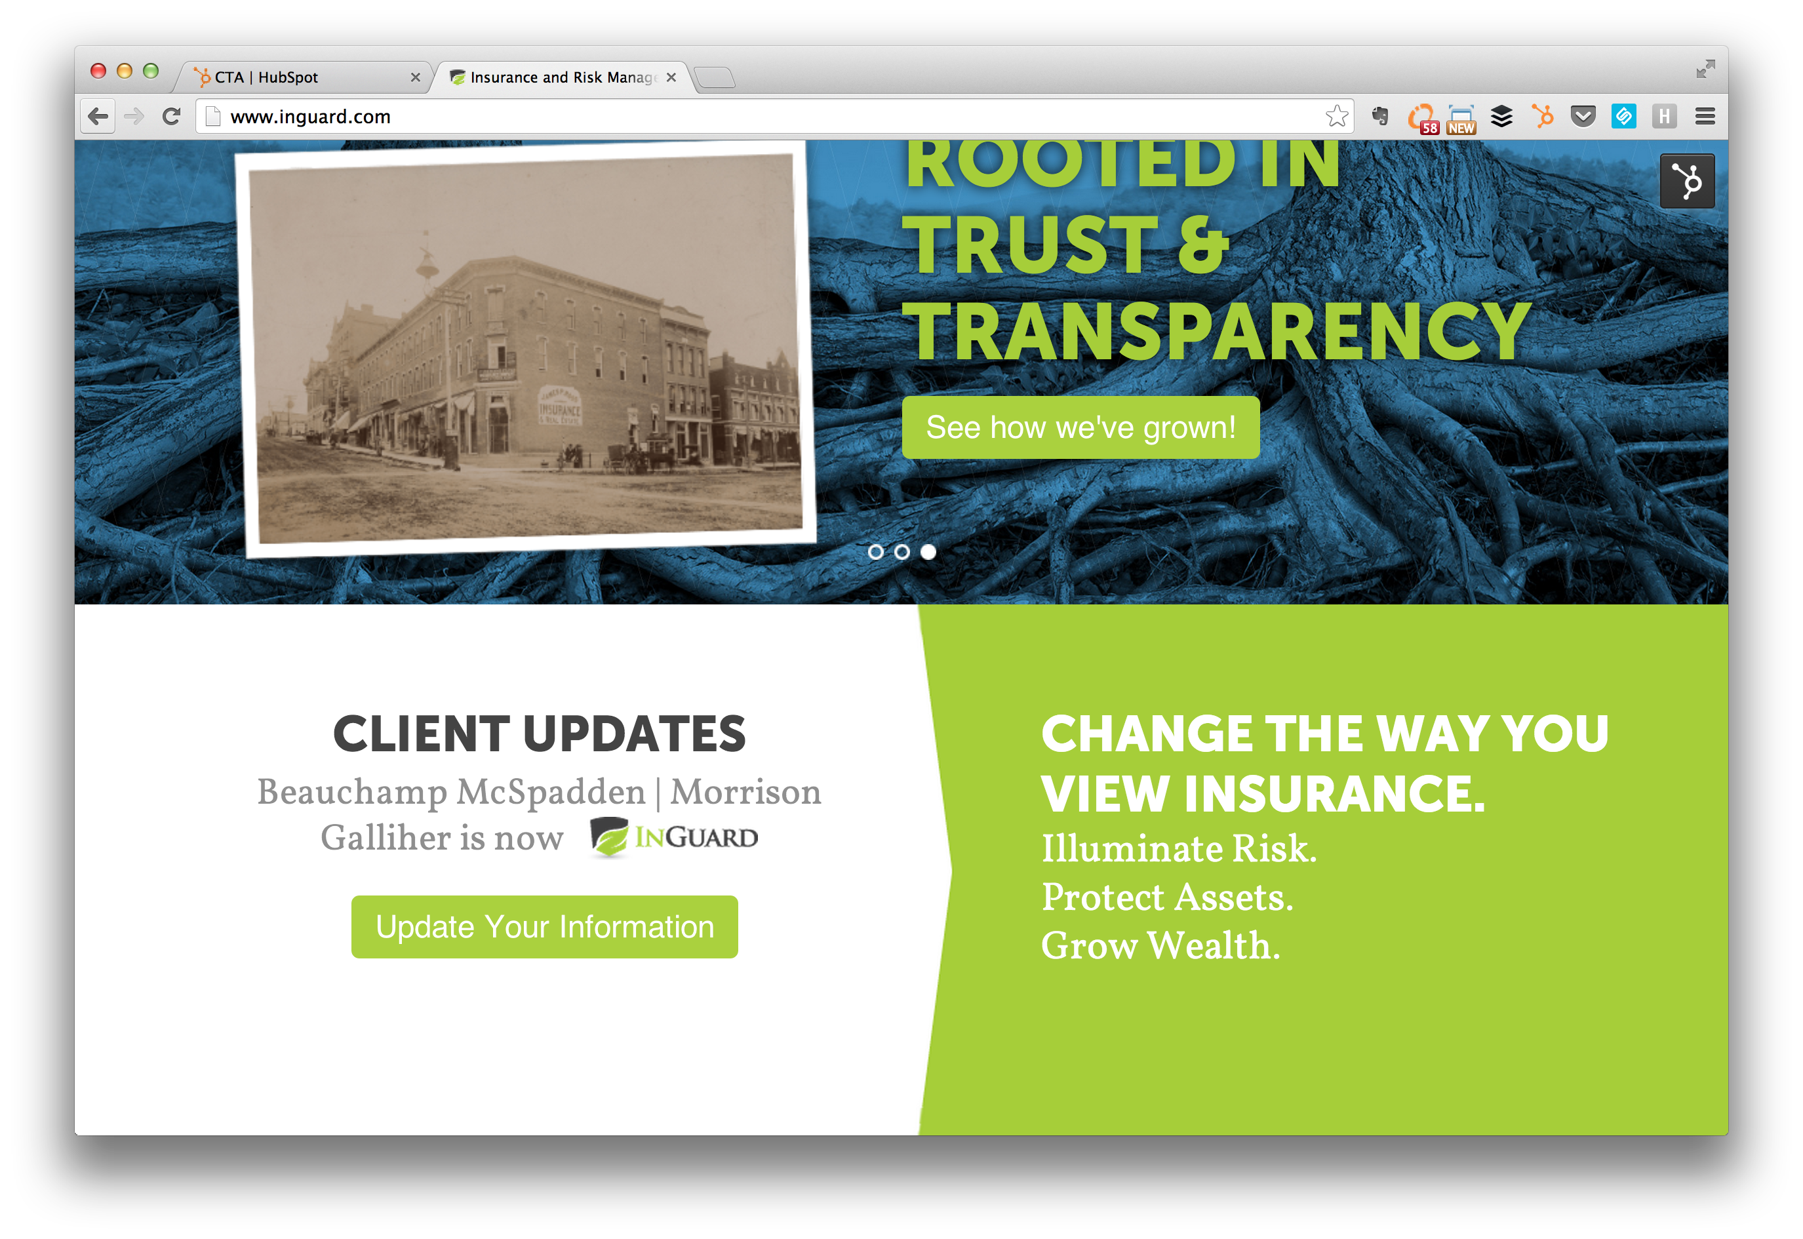
Notes:
http://www.inguard.com/
Here are a few example rules-based scenarios for an auto insurance company:
If a user in a specific region of the United States visits the site, show them regionally specific rates and agent information.
If a user has shown a specific interest in a vehicle, show images and offers that include that vehicle.
If a user is an existing customer (as identified through specific site actions or e-mail campaigns) feature tools and content that help them maintain their relationship with you.
If a user has already subscribed to the newsletter, replace the subscribe to newsletter callout with a different offer or high value piece of content.

Slide 21
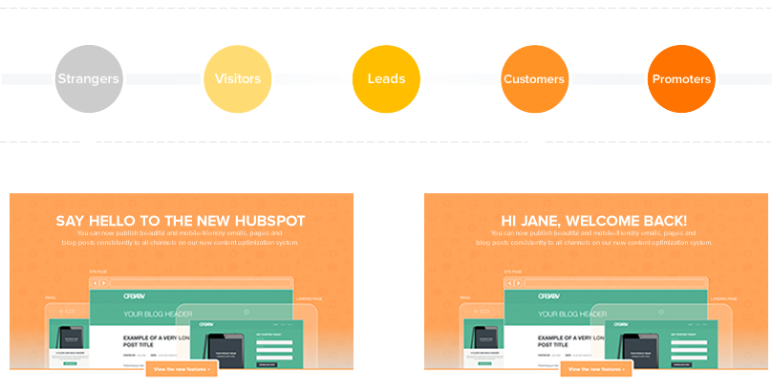
HubSpot looked at the data for more than 93,000 calls to action created using HubSpot over a 12 month period.
Calls-to-action targeted to the user performed 42% better than calls to action that were generic.

Slide 22
Takeaway
Plan. Purpose. Personalize.

Slide 23
3
Design

Slide 24
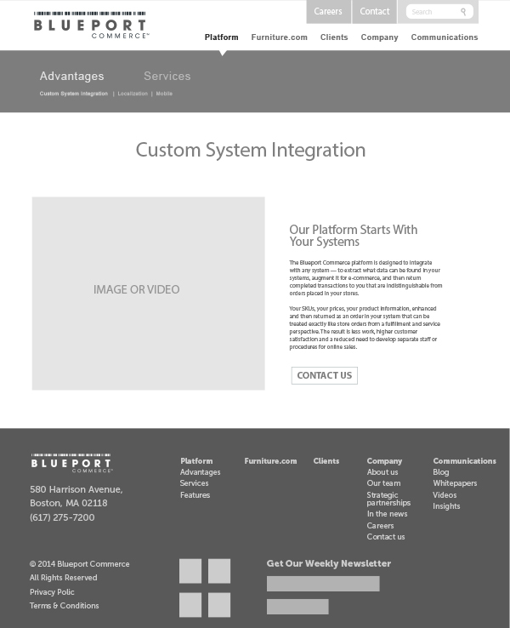
Design
Website Creative Brief
Wireframes
Review Colors and Images
Full Color Mock-ups

Slide 25
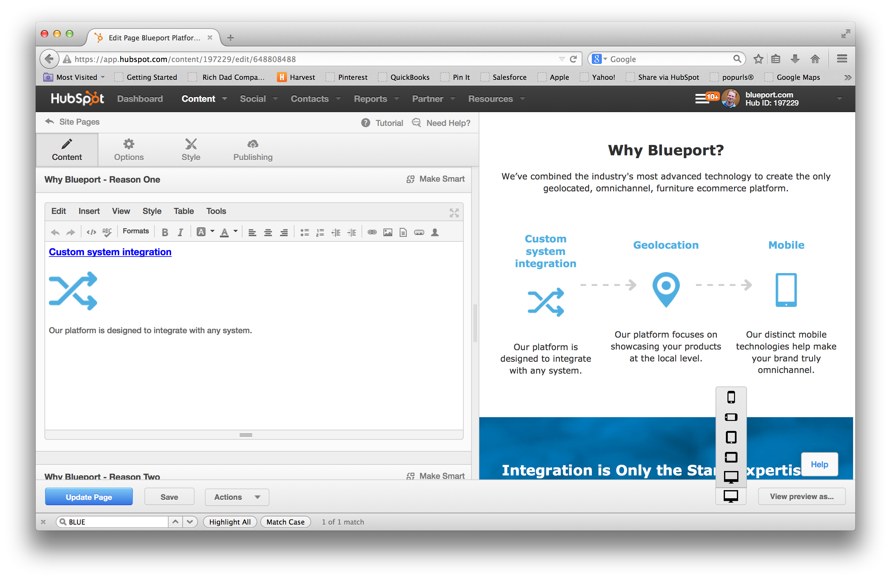
Notes:
HubSpot COS Tool Example:
The tool helps you visualize/preview within HubSpot, you can see what the design looks like on all platforms. Think mobile. It also is super flexible in the templates. This allows us to start thinking about how the web content is going to be built in HubSpot to allow for ease of editing by the customer, and also how actual content breaks down on tablet and mobile. This is an example of how we are building components of a PR 20/20 (or BLUEPORT?) page that we started thinking about in the wireframe stage.
Benefits a Marketer as they add their own content pages. They can quickly test tablet, mobile, desktop.

Slide 26
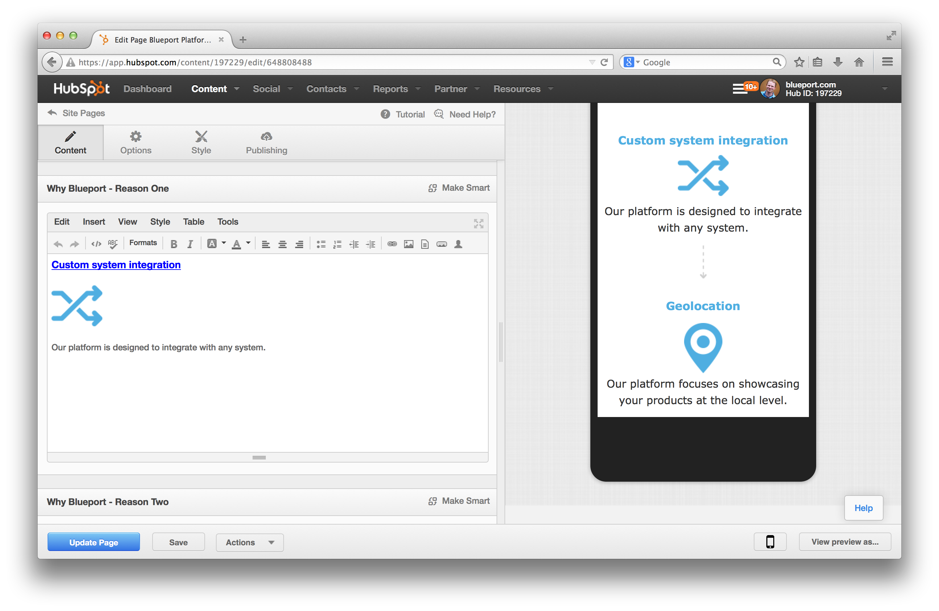
Notes:
HubSpot COS Tool Example:
The tool helps you visualize/preview within HubSpot, you can see what the design looks like on all platforms. Think mobile. It also is super flexible in the templates. This allows us to start thinking about how the web content is going to be built in HubSpot to allow for ease of editing by the customer, and also how actual content breaks down on tablet and mobile. This is an example of how we are building components of a PR 20/20 (or BLUEPORT?) page that we started thinking about in the wireframe stage.
Customer Example:
Use Blueport as an example of very visual, strong messaging and very visual

Slide 27
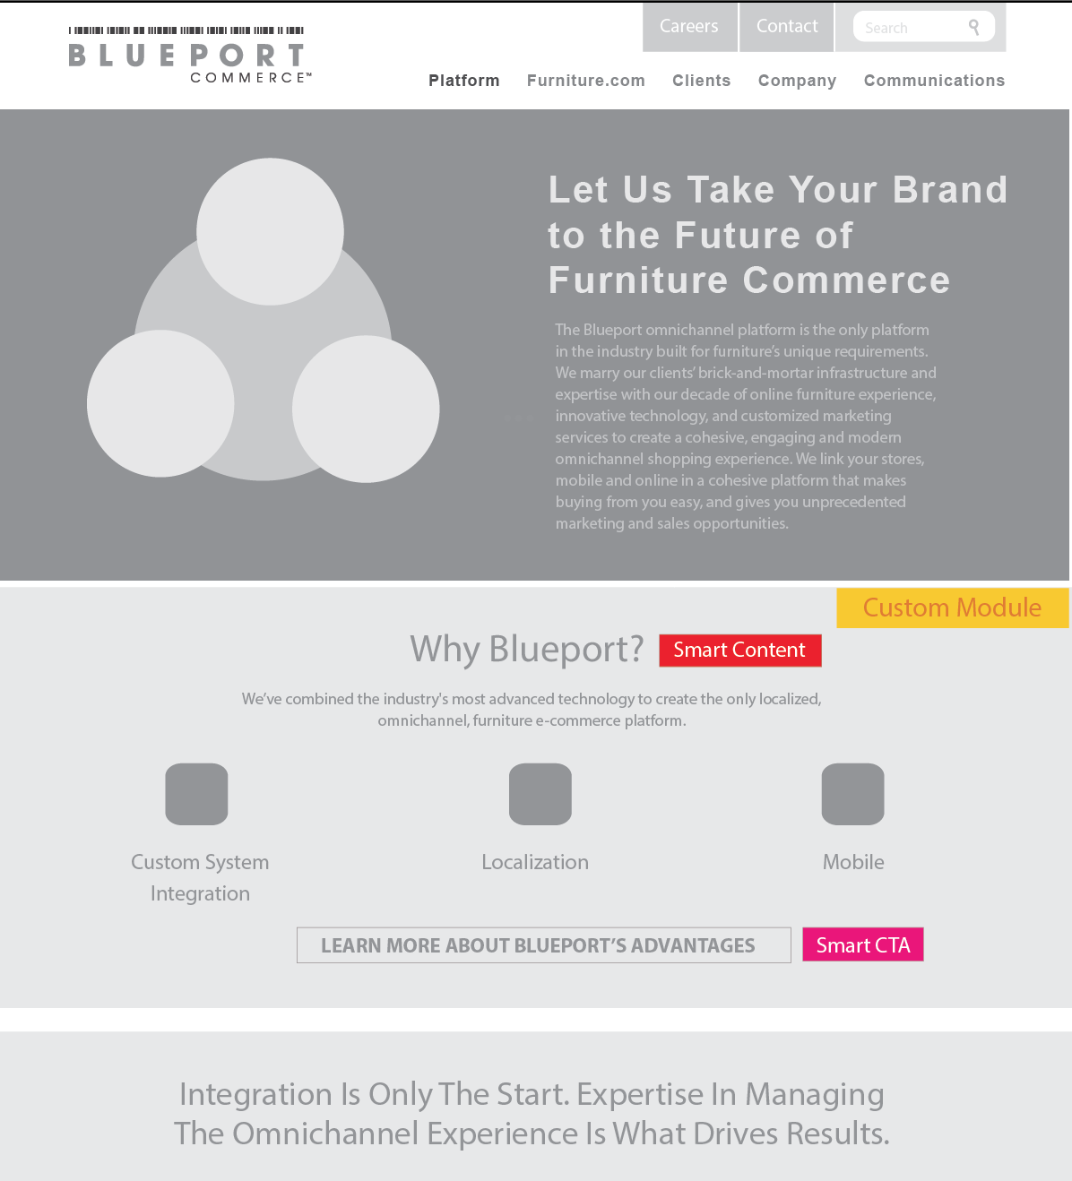

Slide 28
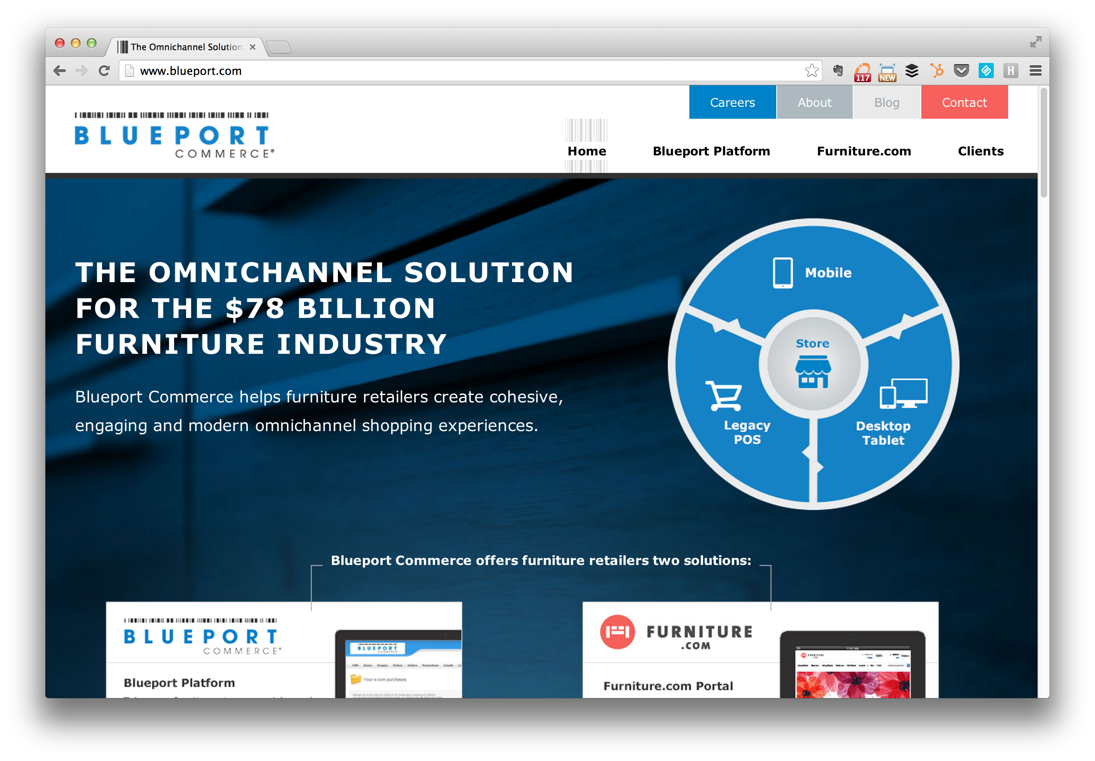

Slide 29
Takeaway
Simple, Purposeful and Responsive.

Slide 30
4
Build

Slide 31







Build
Platform
Templates
Finalize Content
Testing and Review

Slide 32
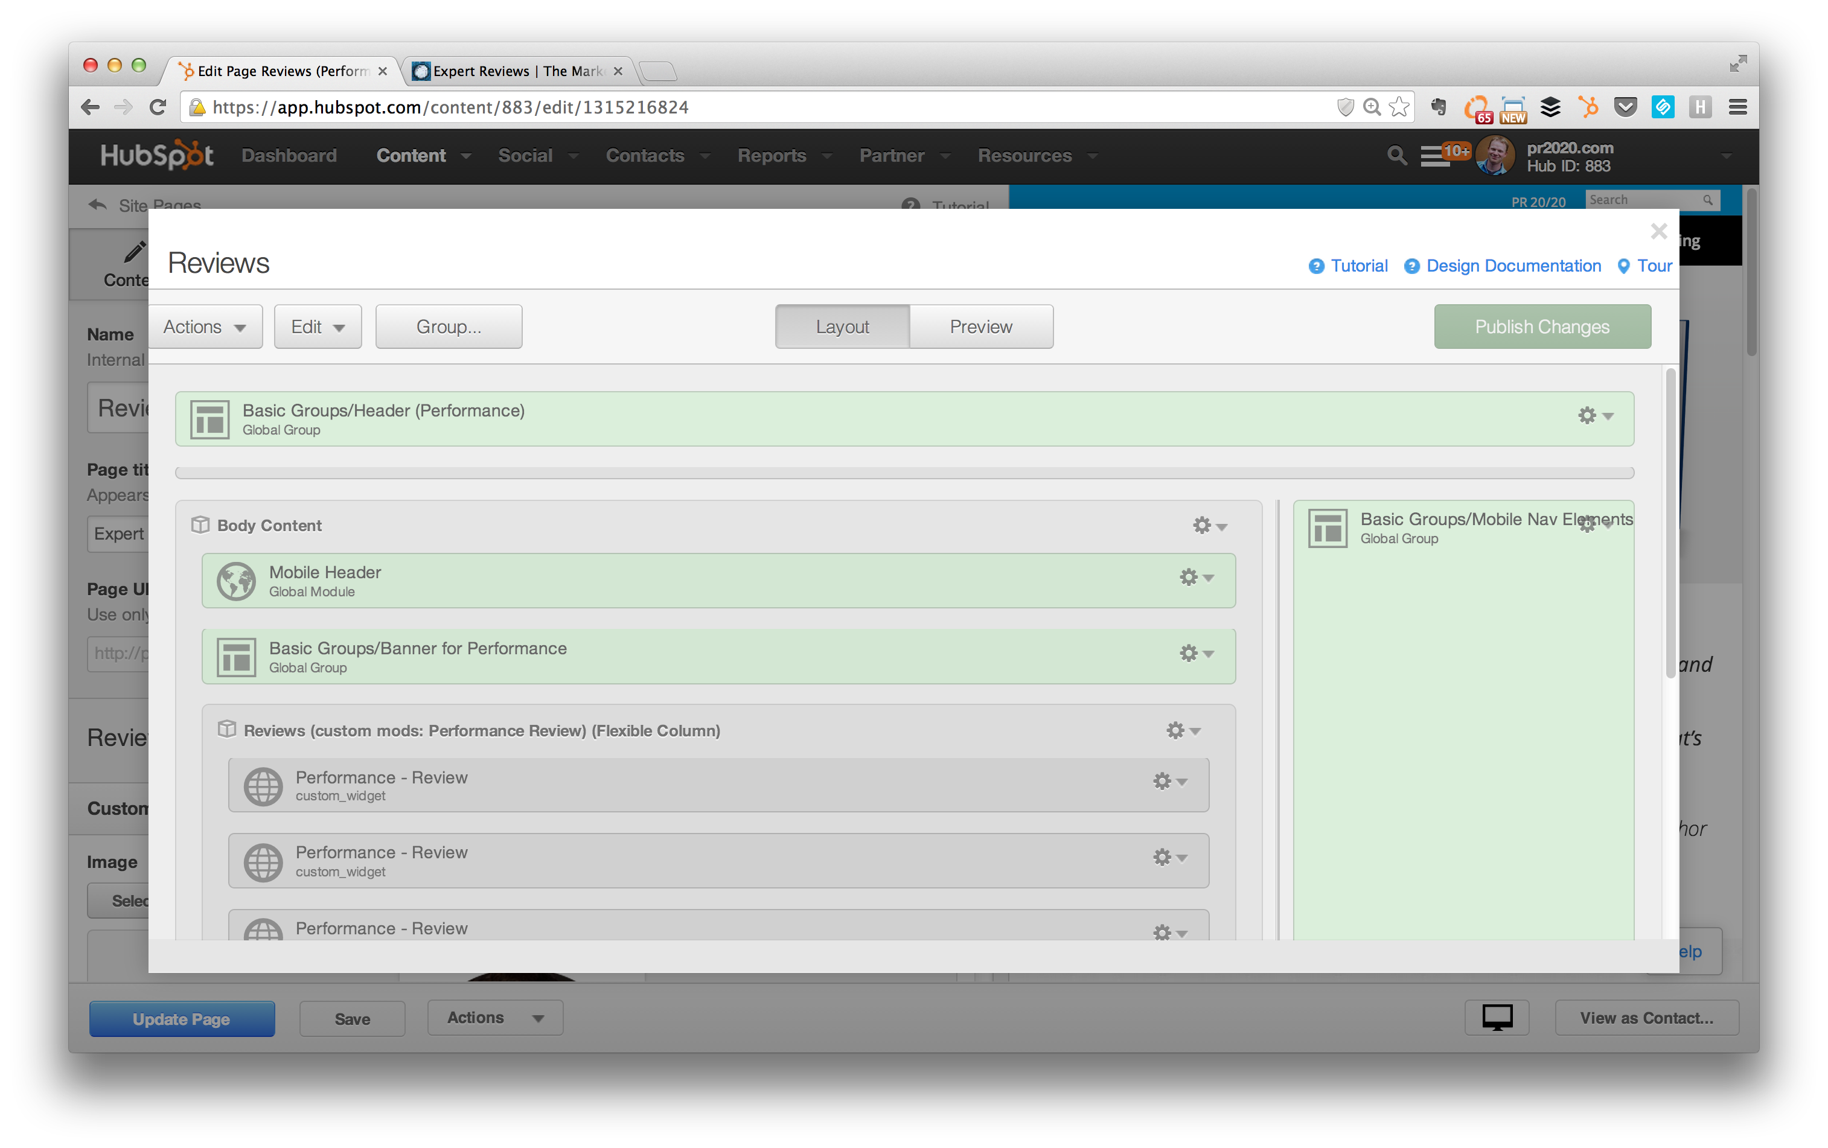

Slide 33
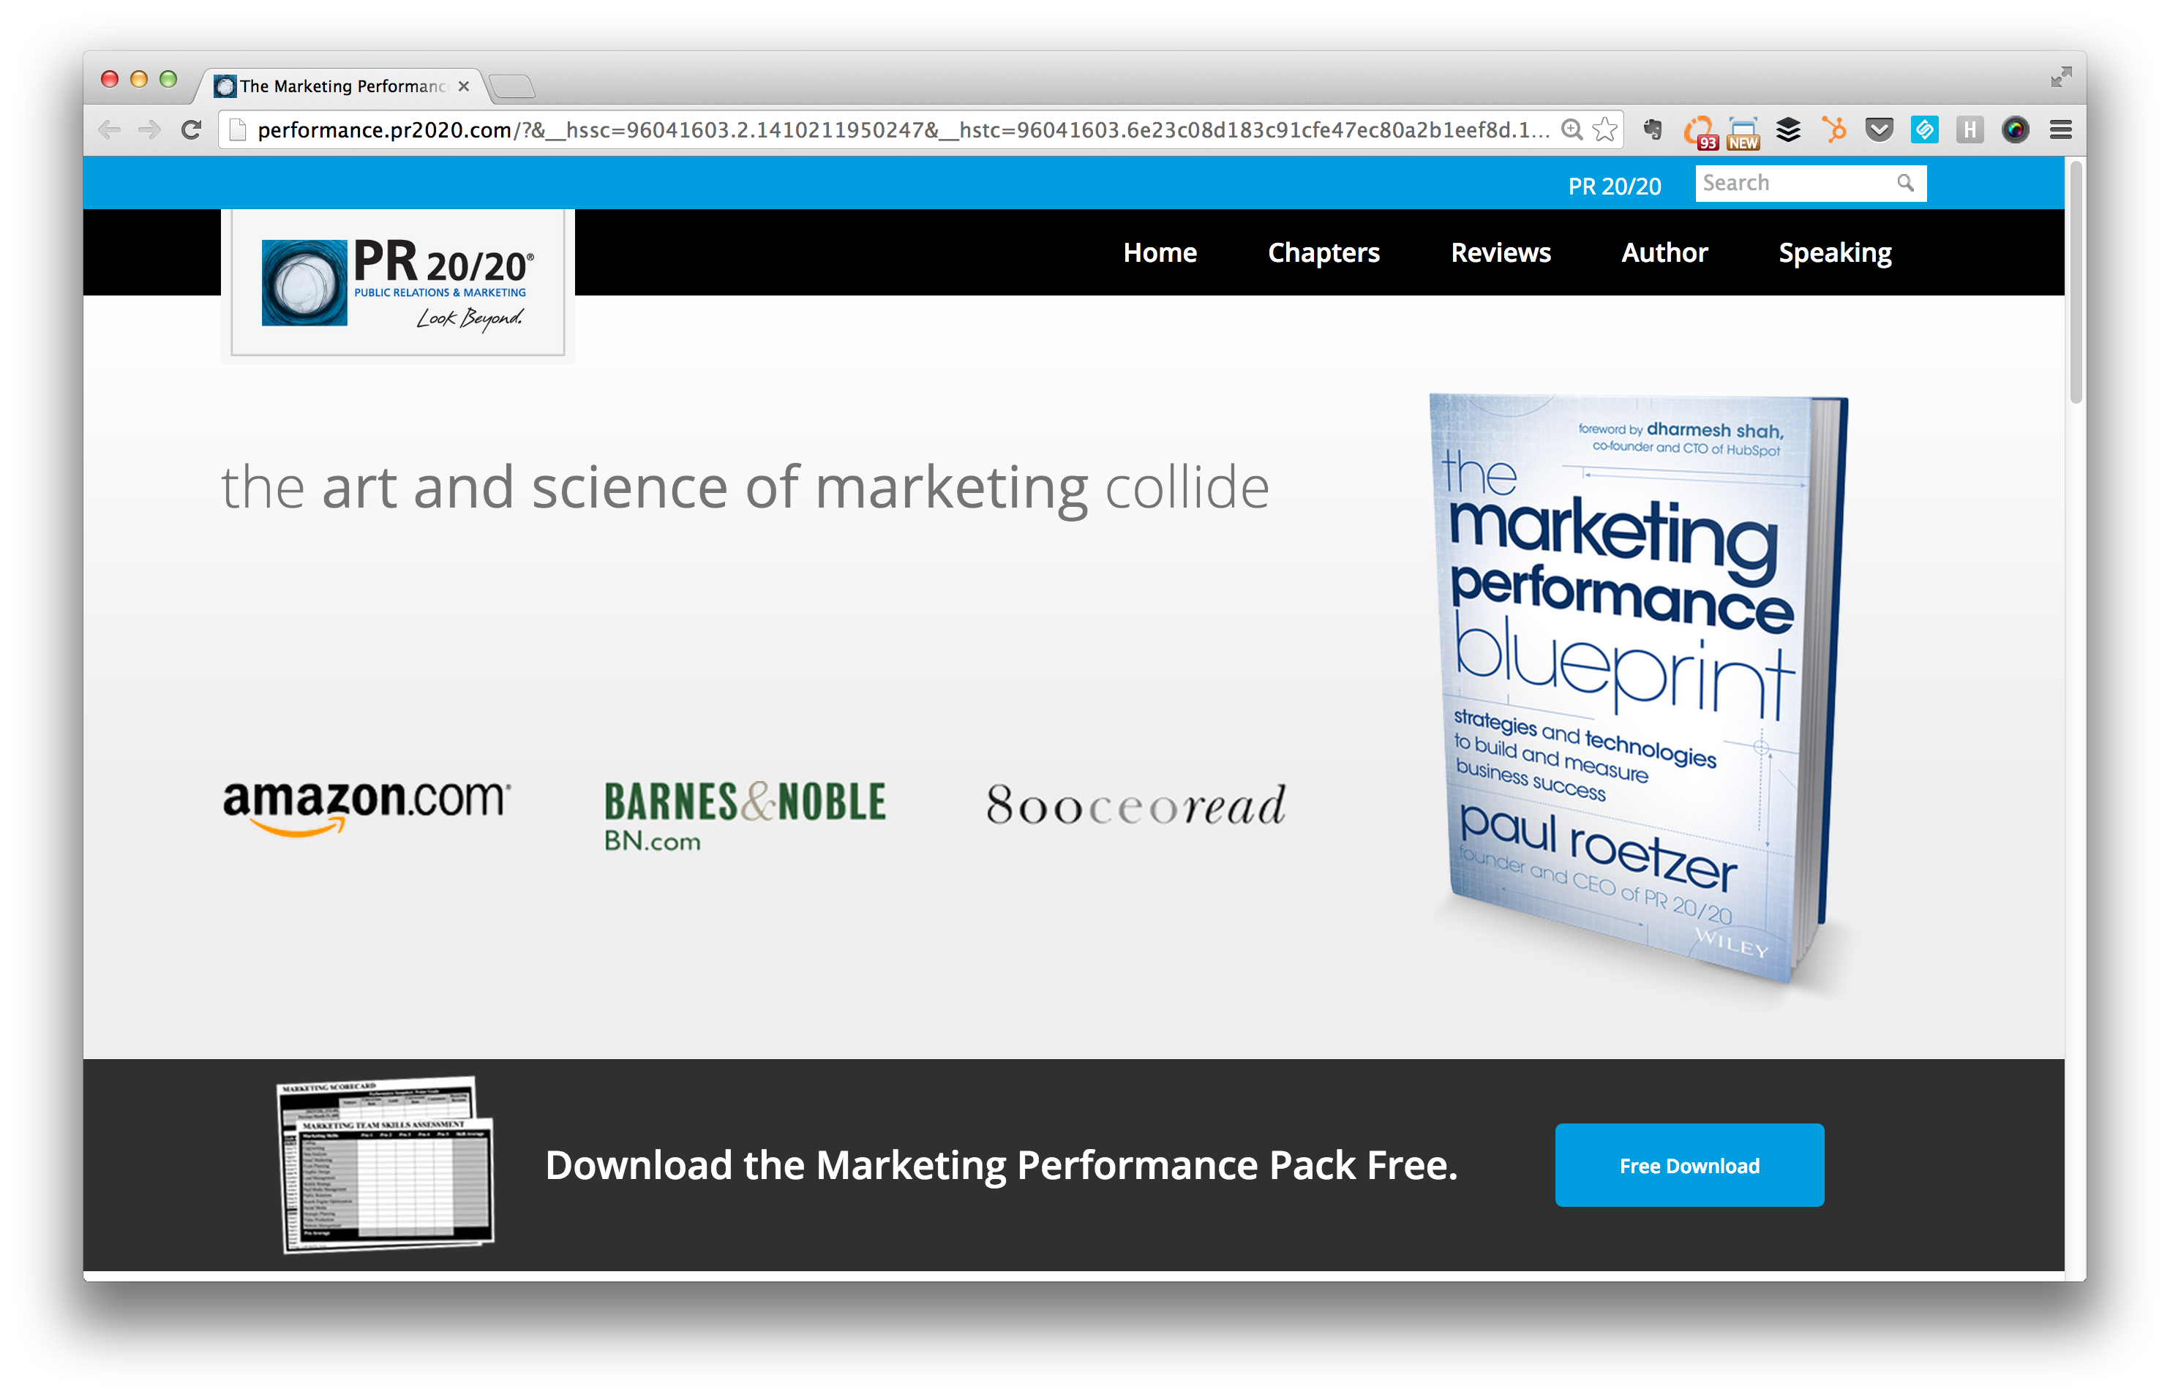

Slide 34
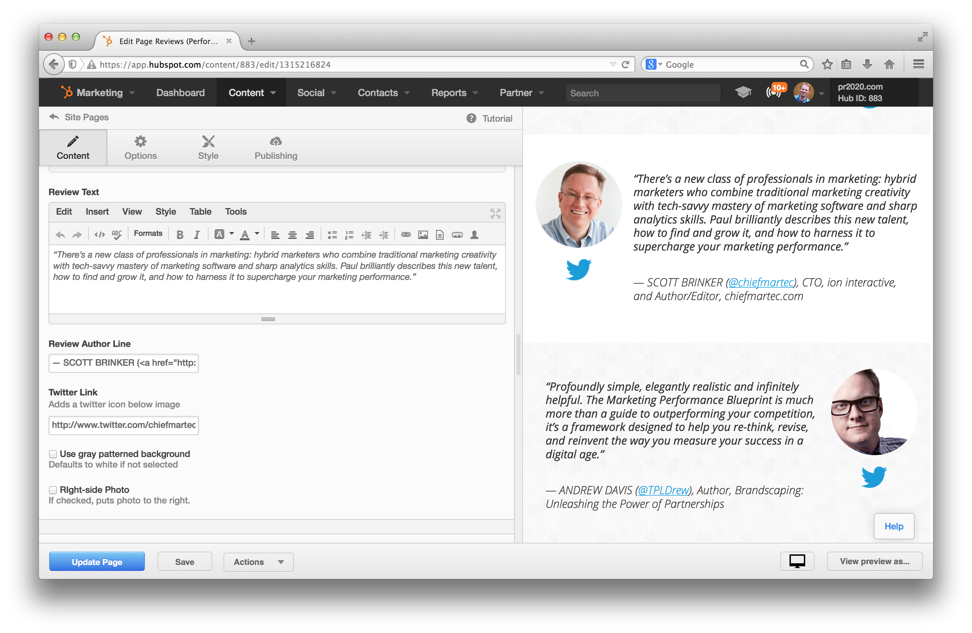
Notes:
http://designers.hubspot.com/docs/tutorials/custom-modules

Slide 35
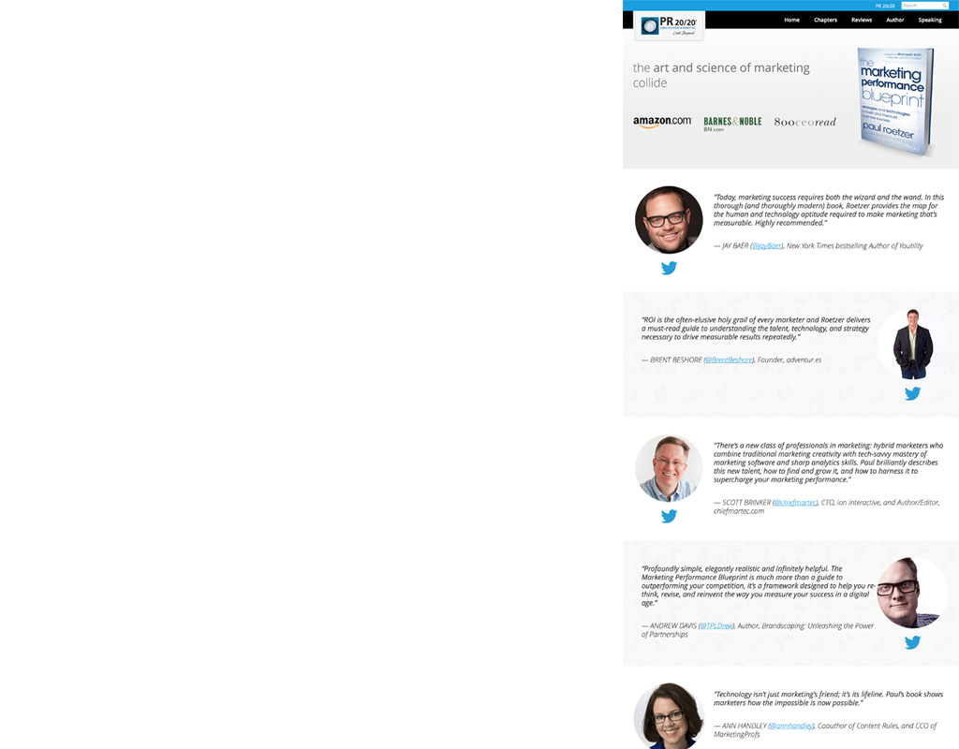
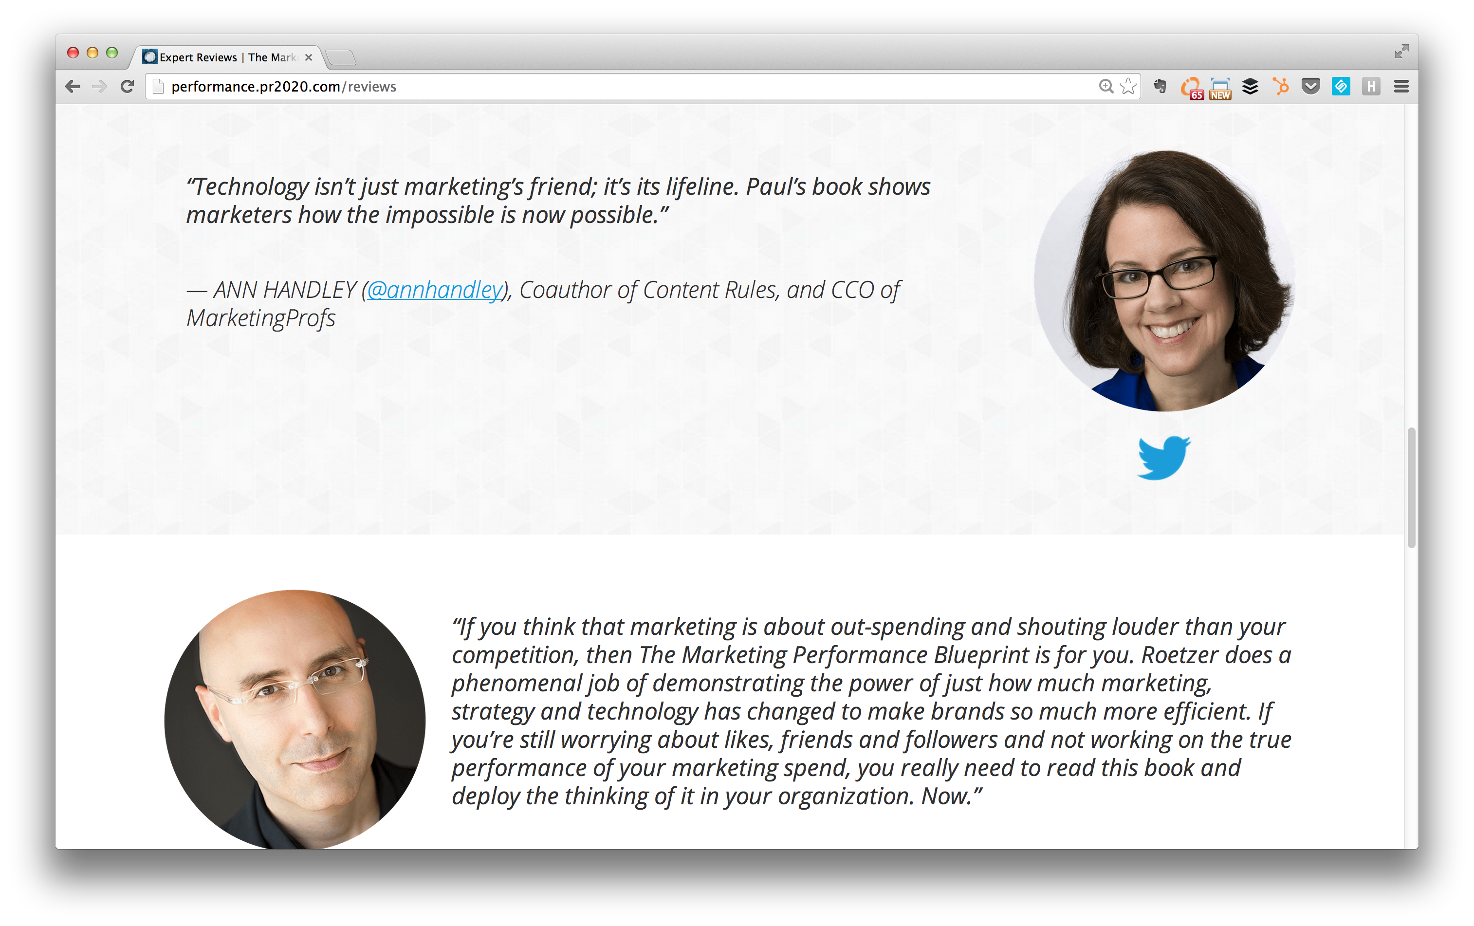
Notes:
performance.pr2020.com
Microsite ability is extremely easy to do in the portal. Different templates can be created for a unique look or just a slight difference in navigation like Paul’s book vs the PR 20/20 web site.
While in the launch process the microsite was live before we launched the main PR 20/20 web site.

Slide 36
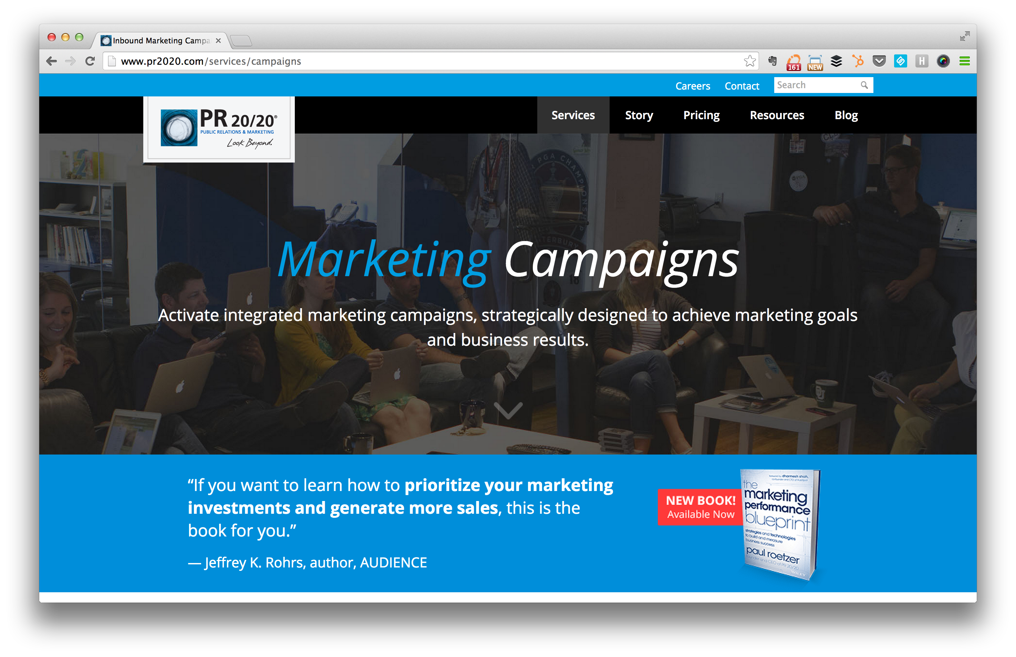

Slide 37
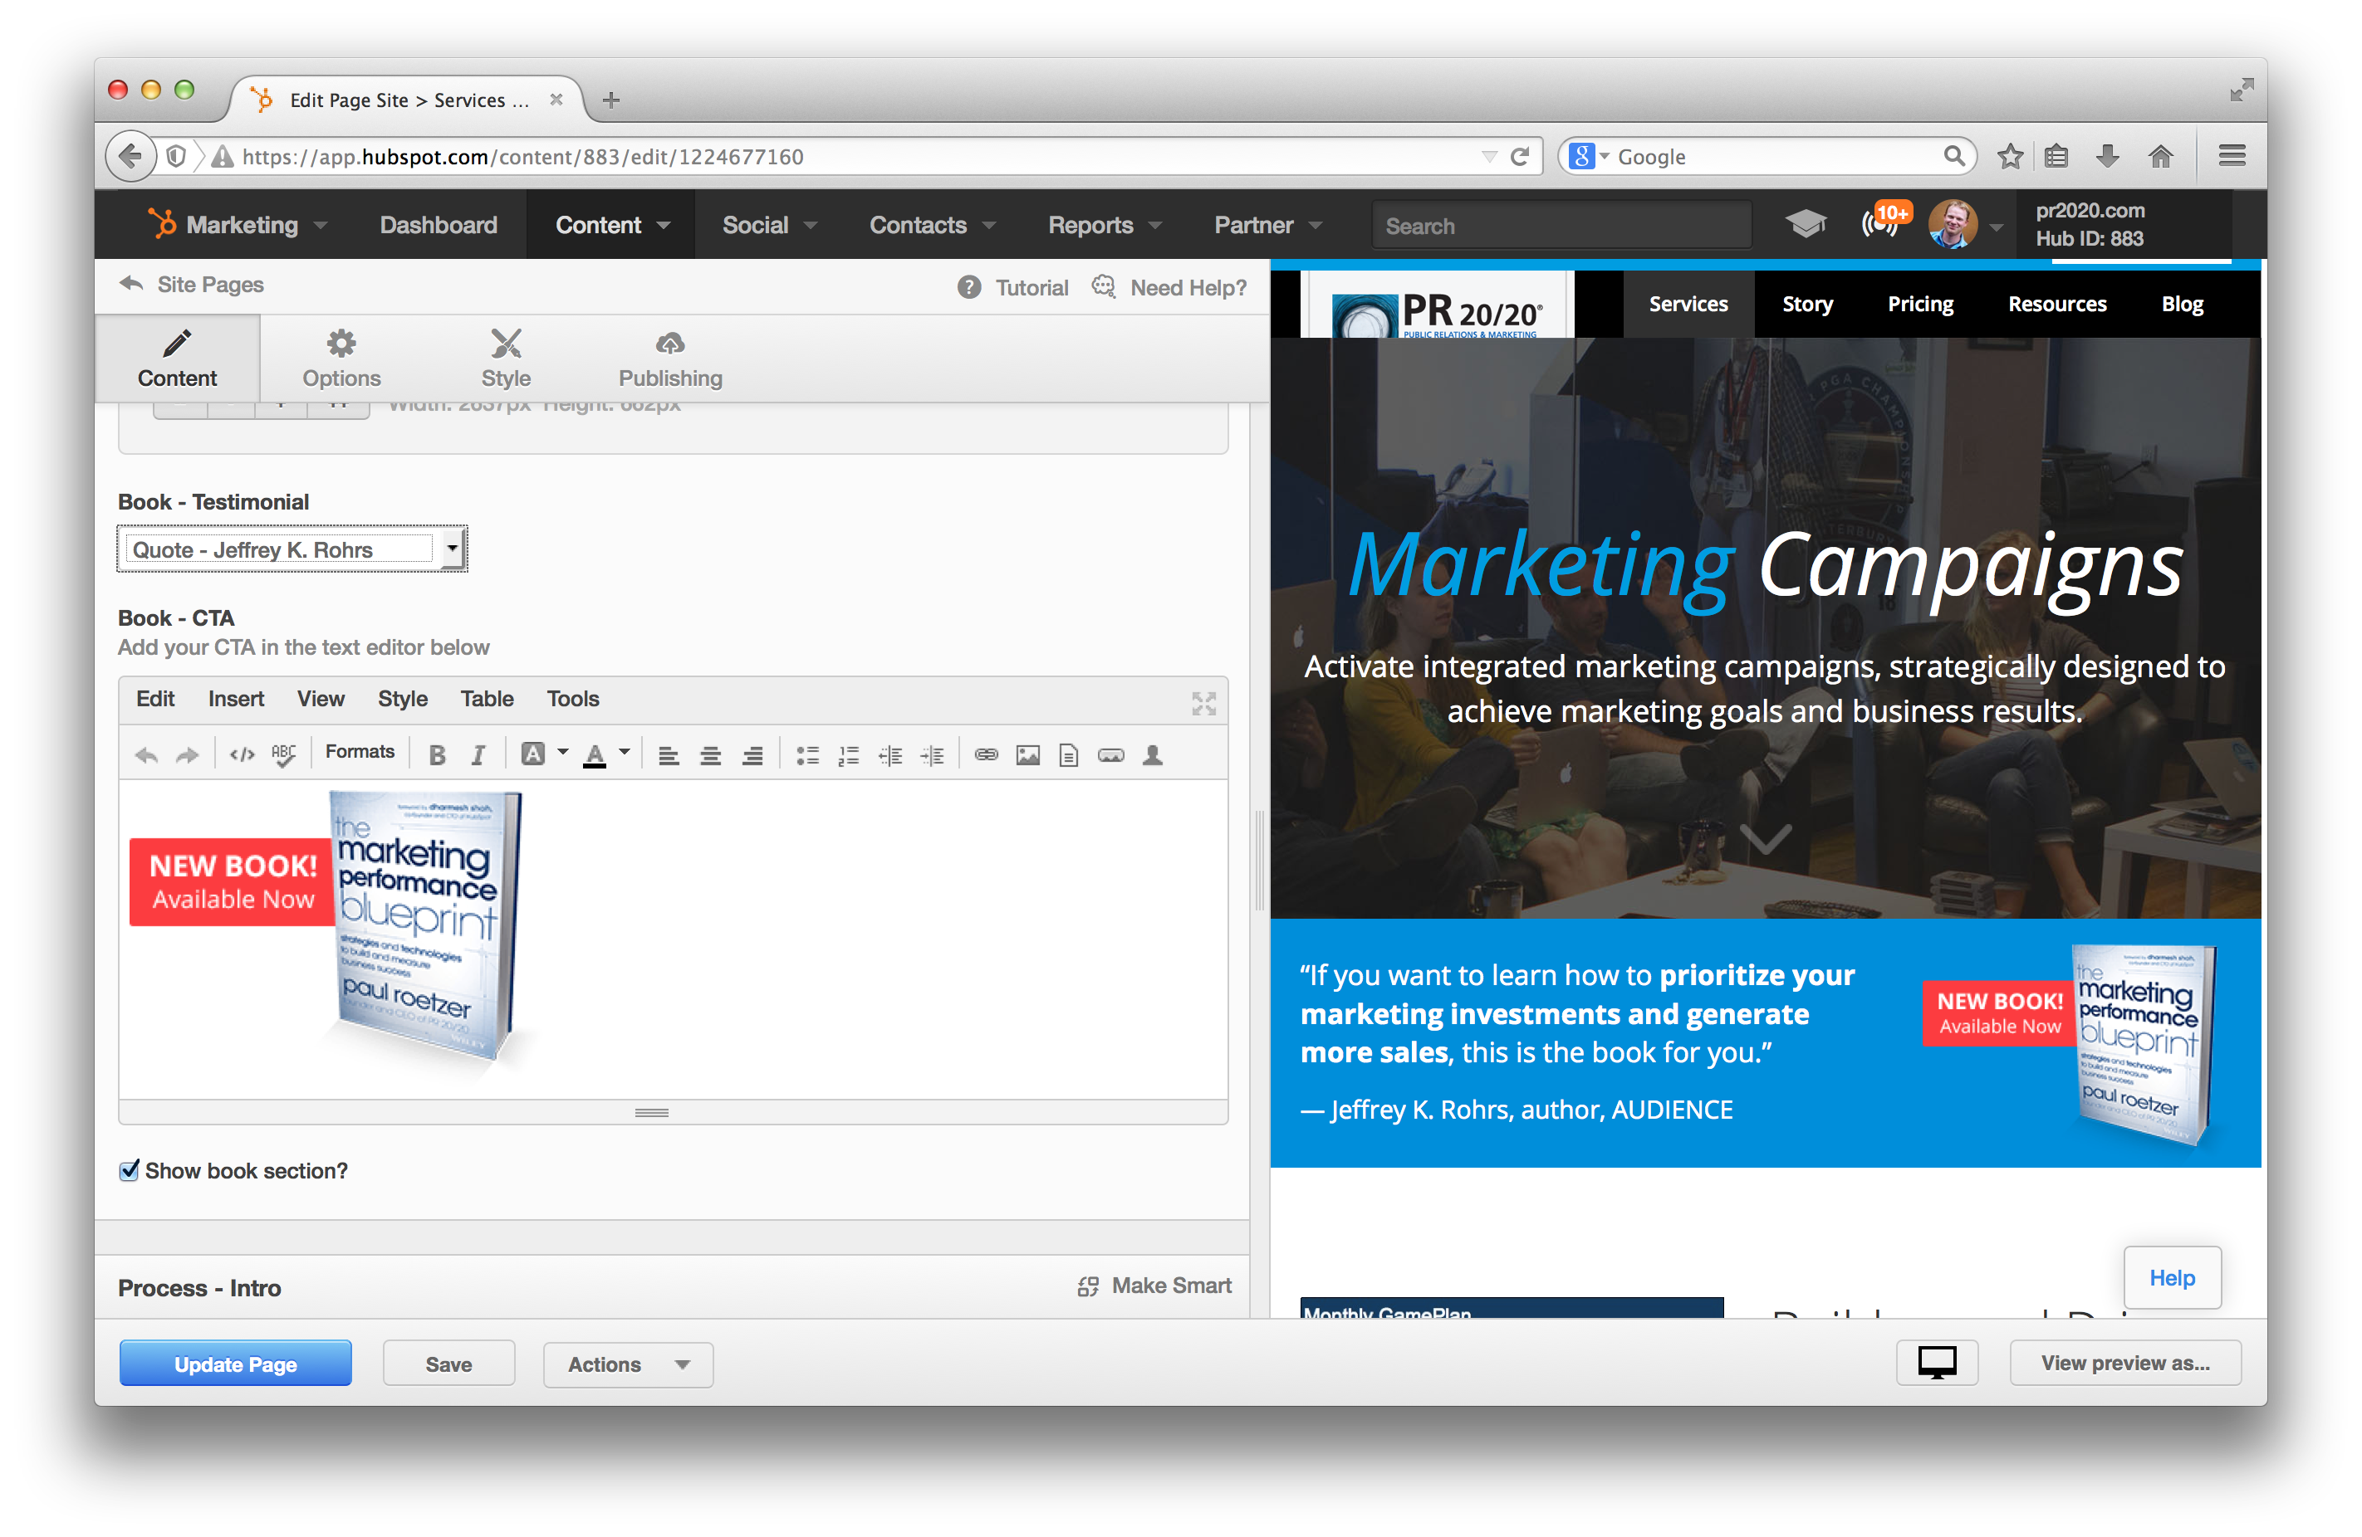

Slide 38
Takeaway
Find a platform that allows marketers to focus on marketing.

Slide 39
5
Optimize

Slide 40




Optimize
Basics
Shareability
Analytics
Keywords
Redirects
Mobile

Slide 41
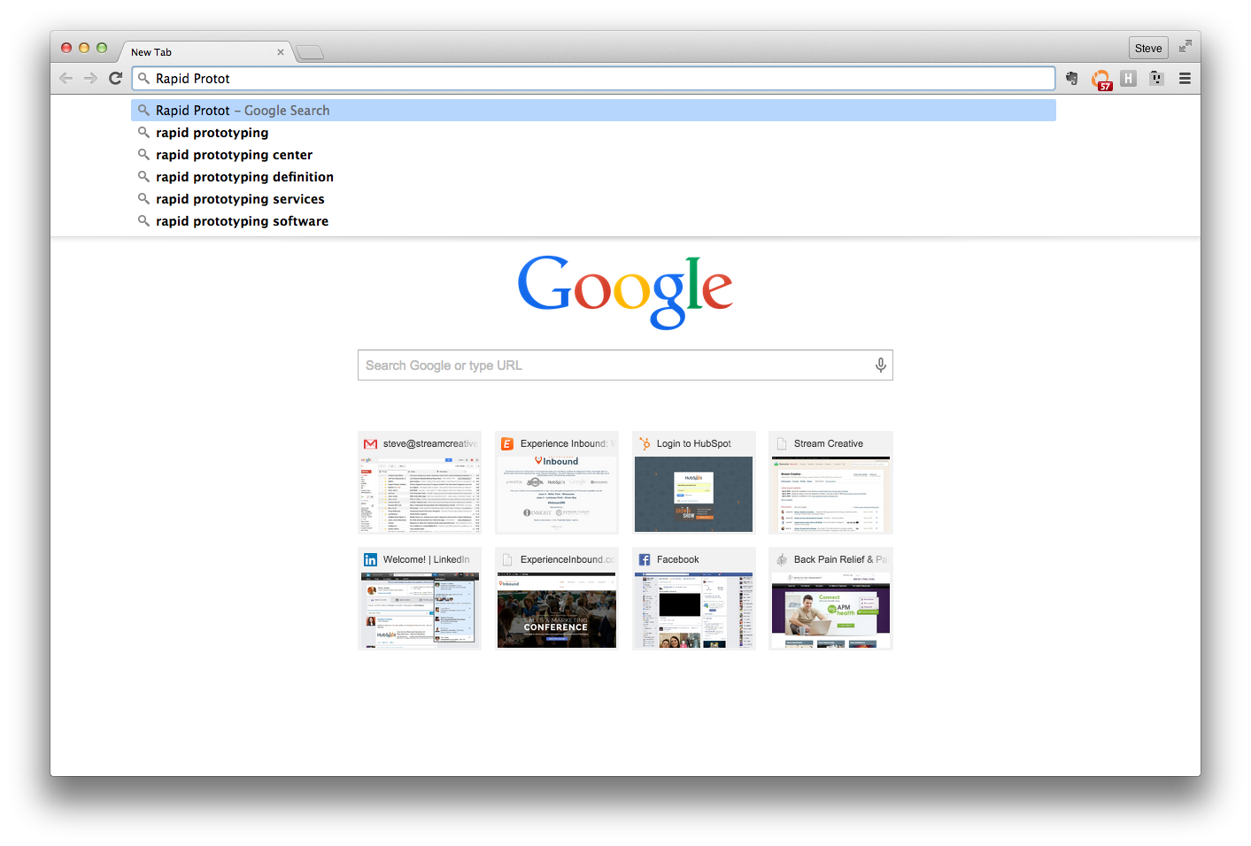
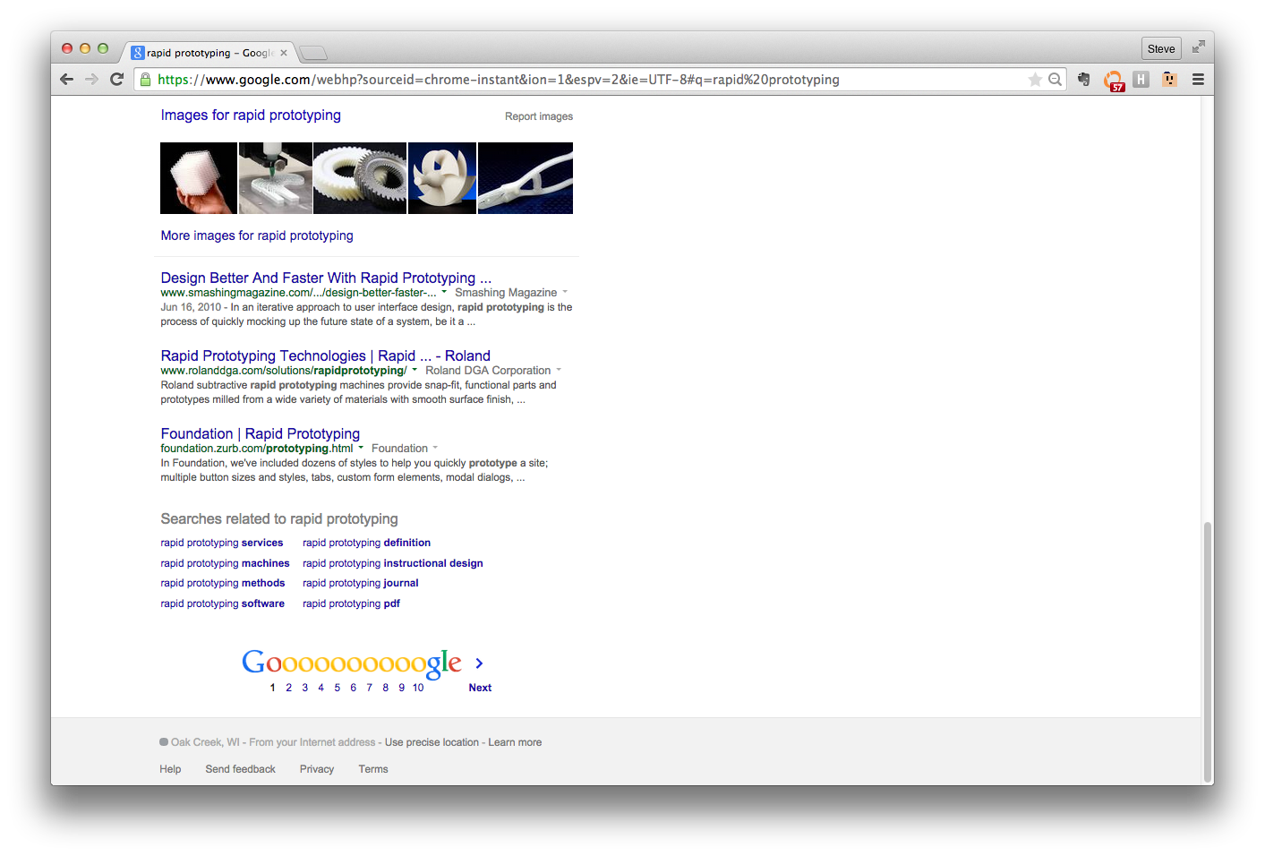

Slide 42
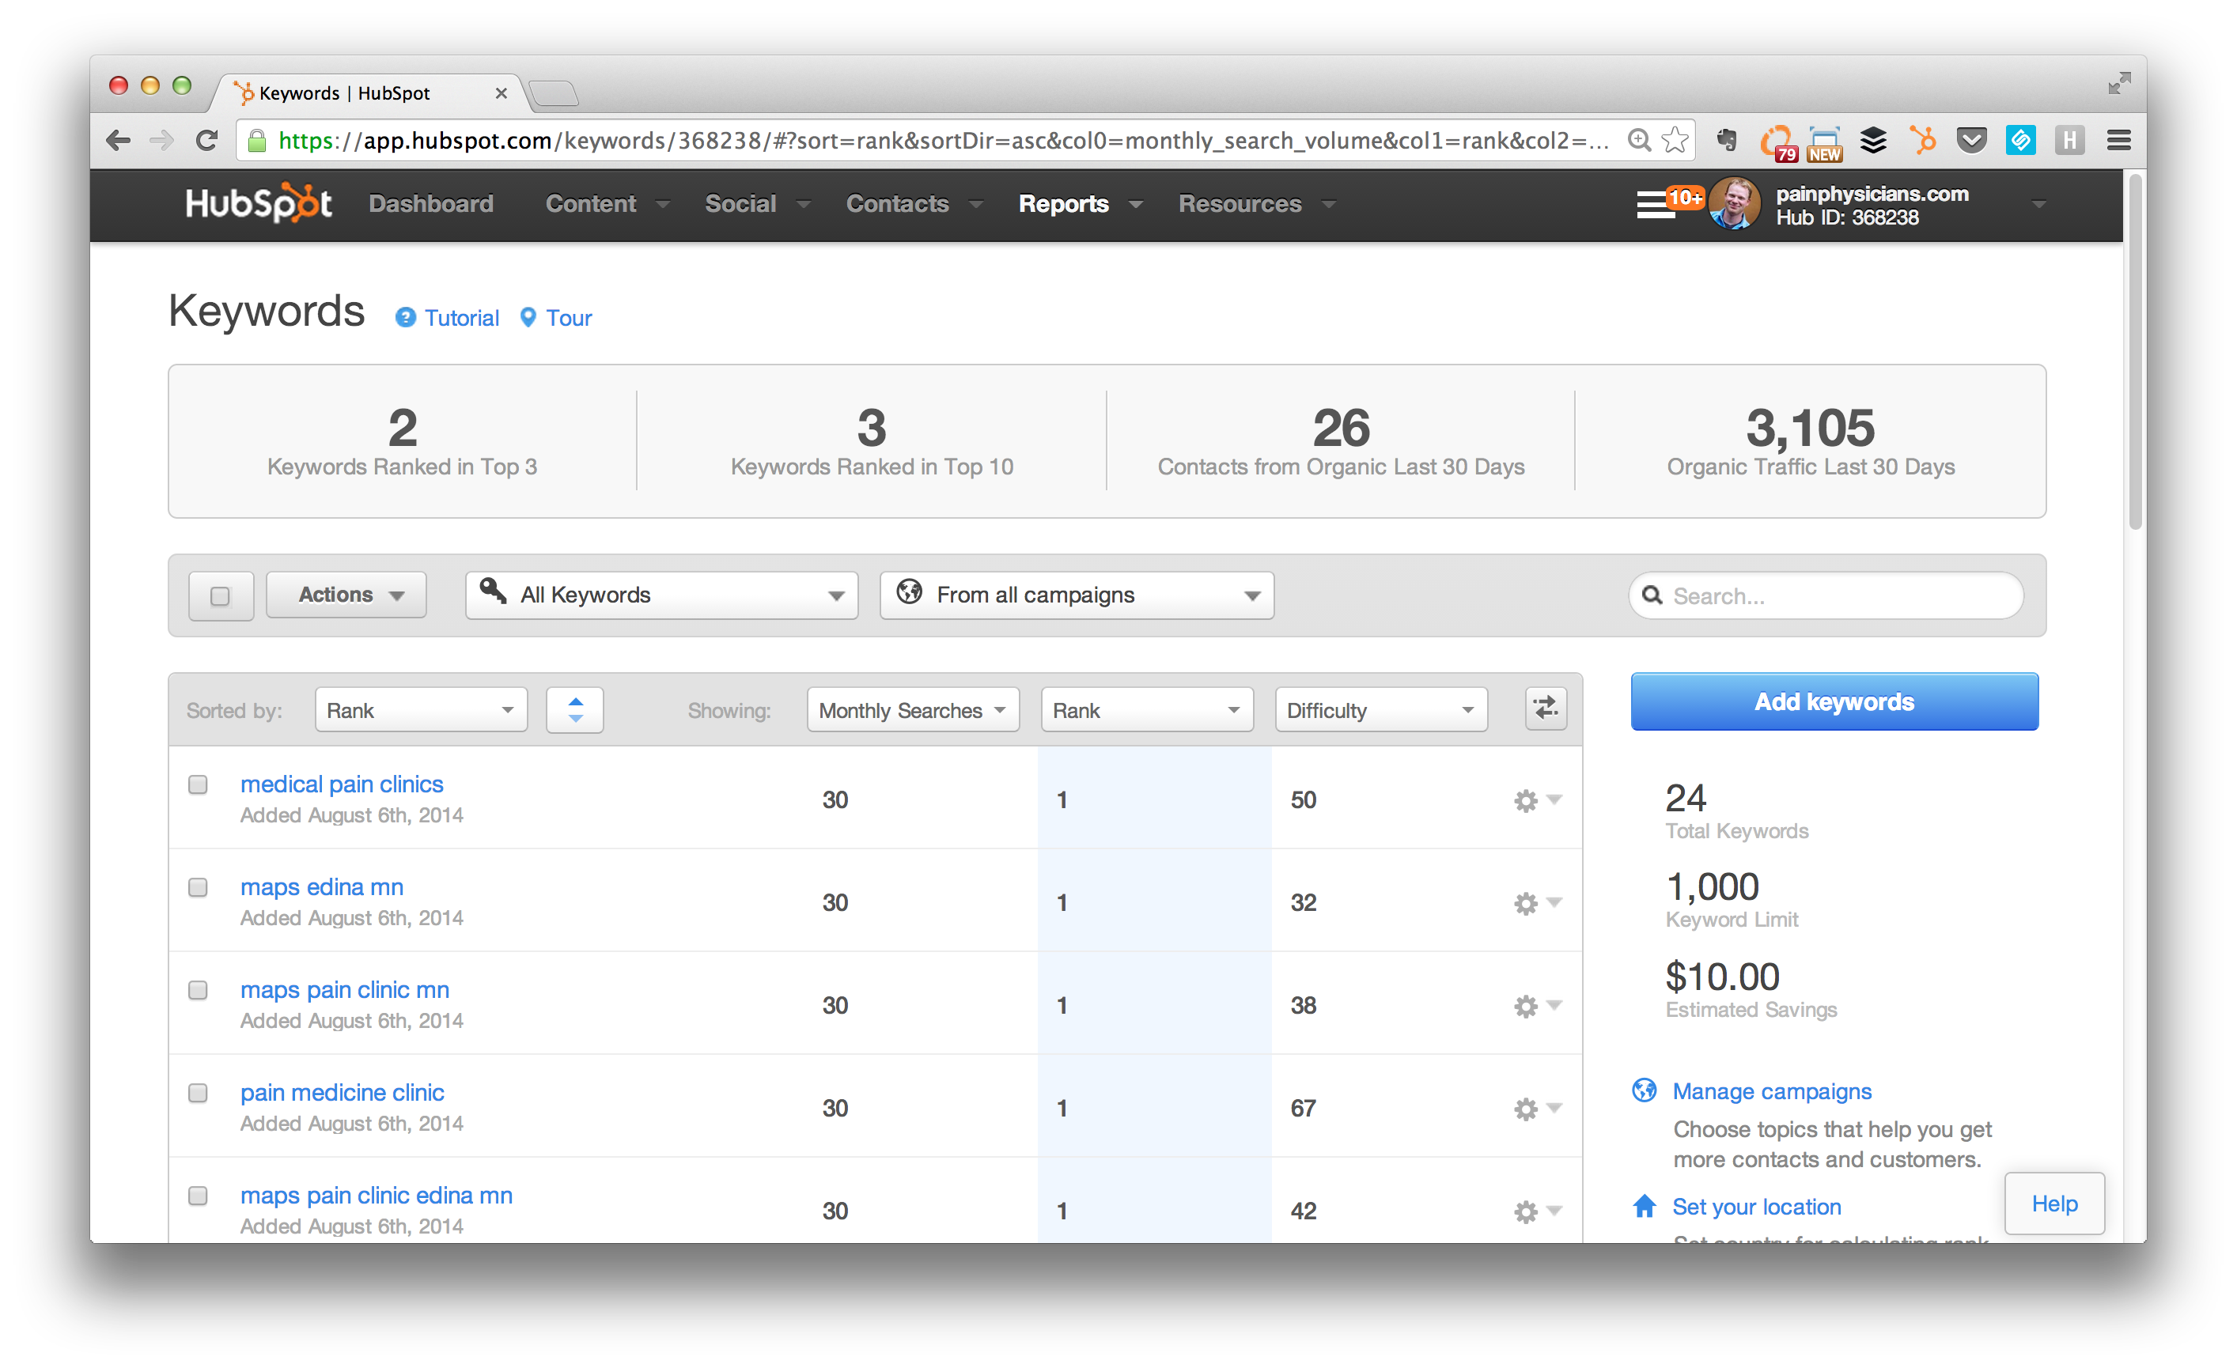

Slide 43
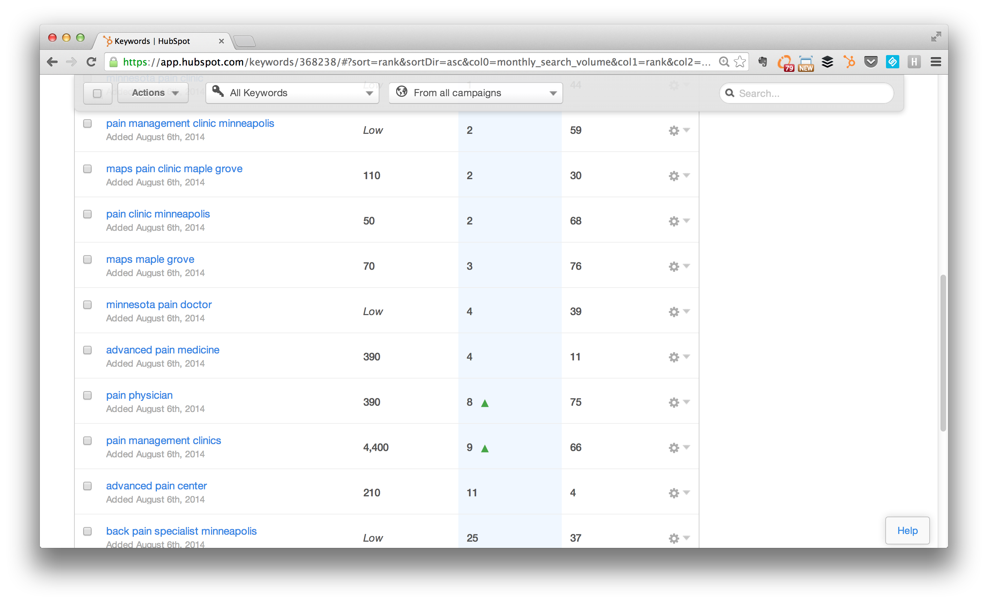

Slide 44
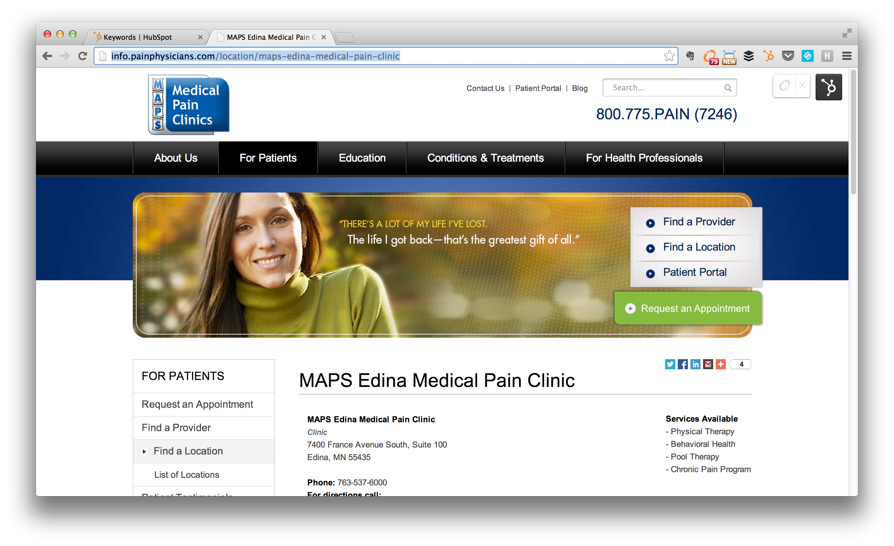

Slide 45
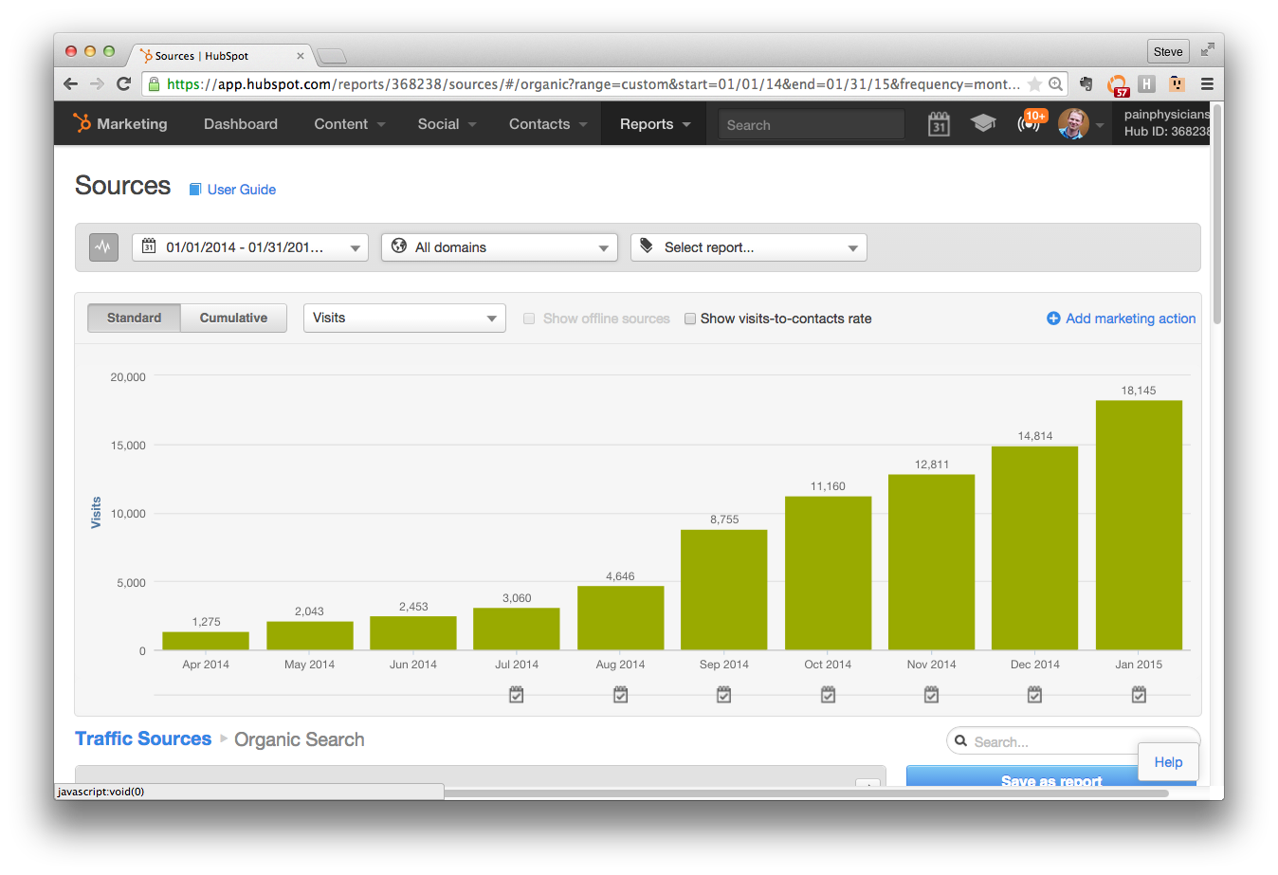

Slide 46

Optimize
Basics
Shareability
Analytics
Keywords
Redirects
Mobile

Slide 47
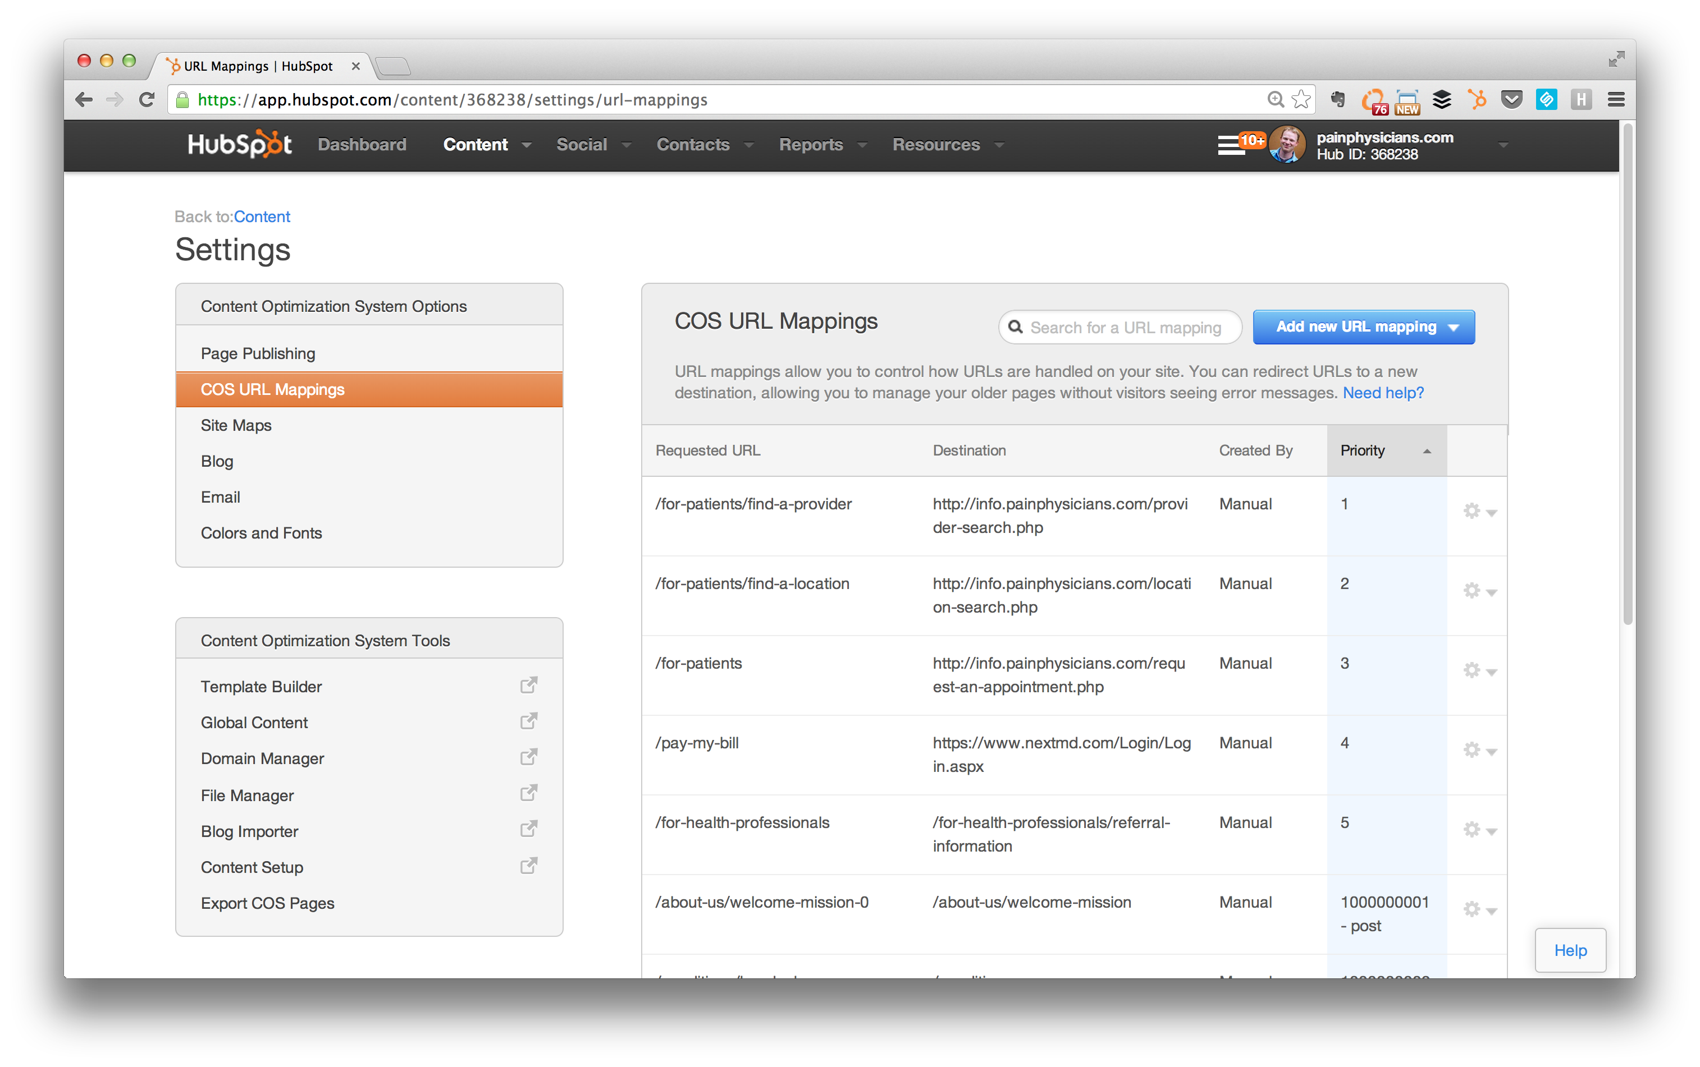

Slide 48
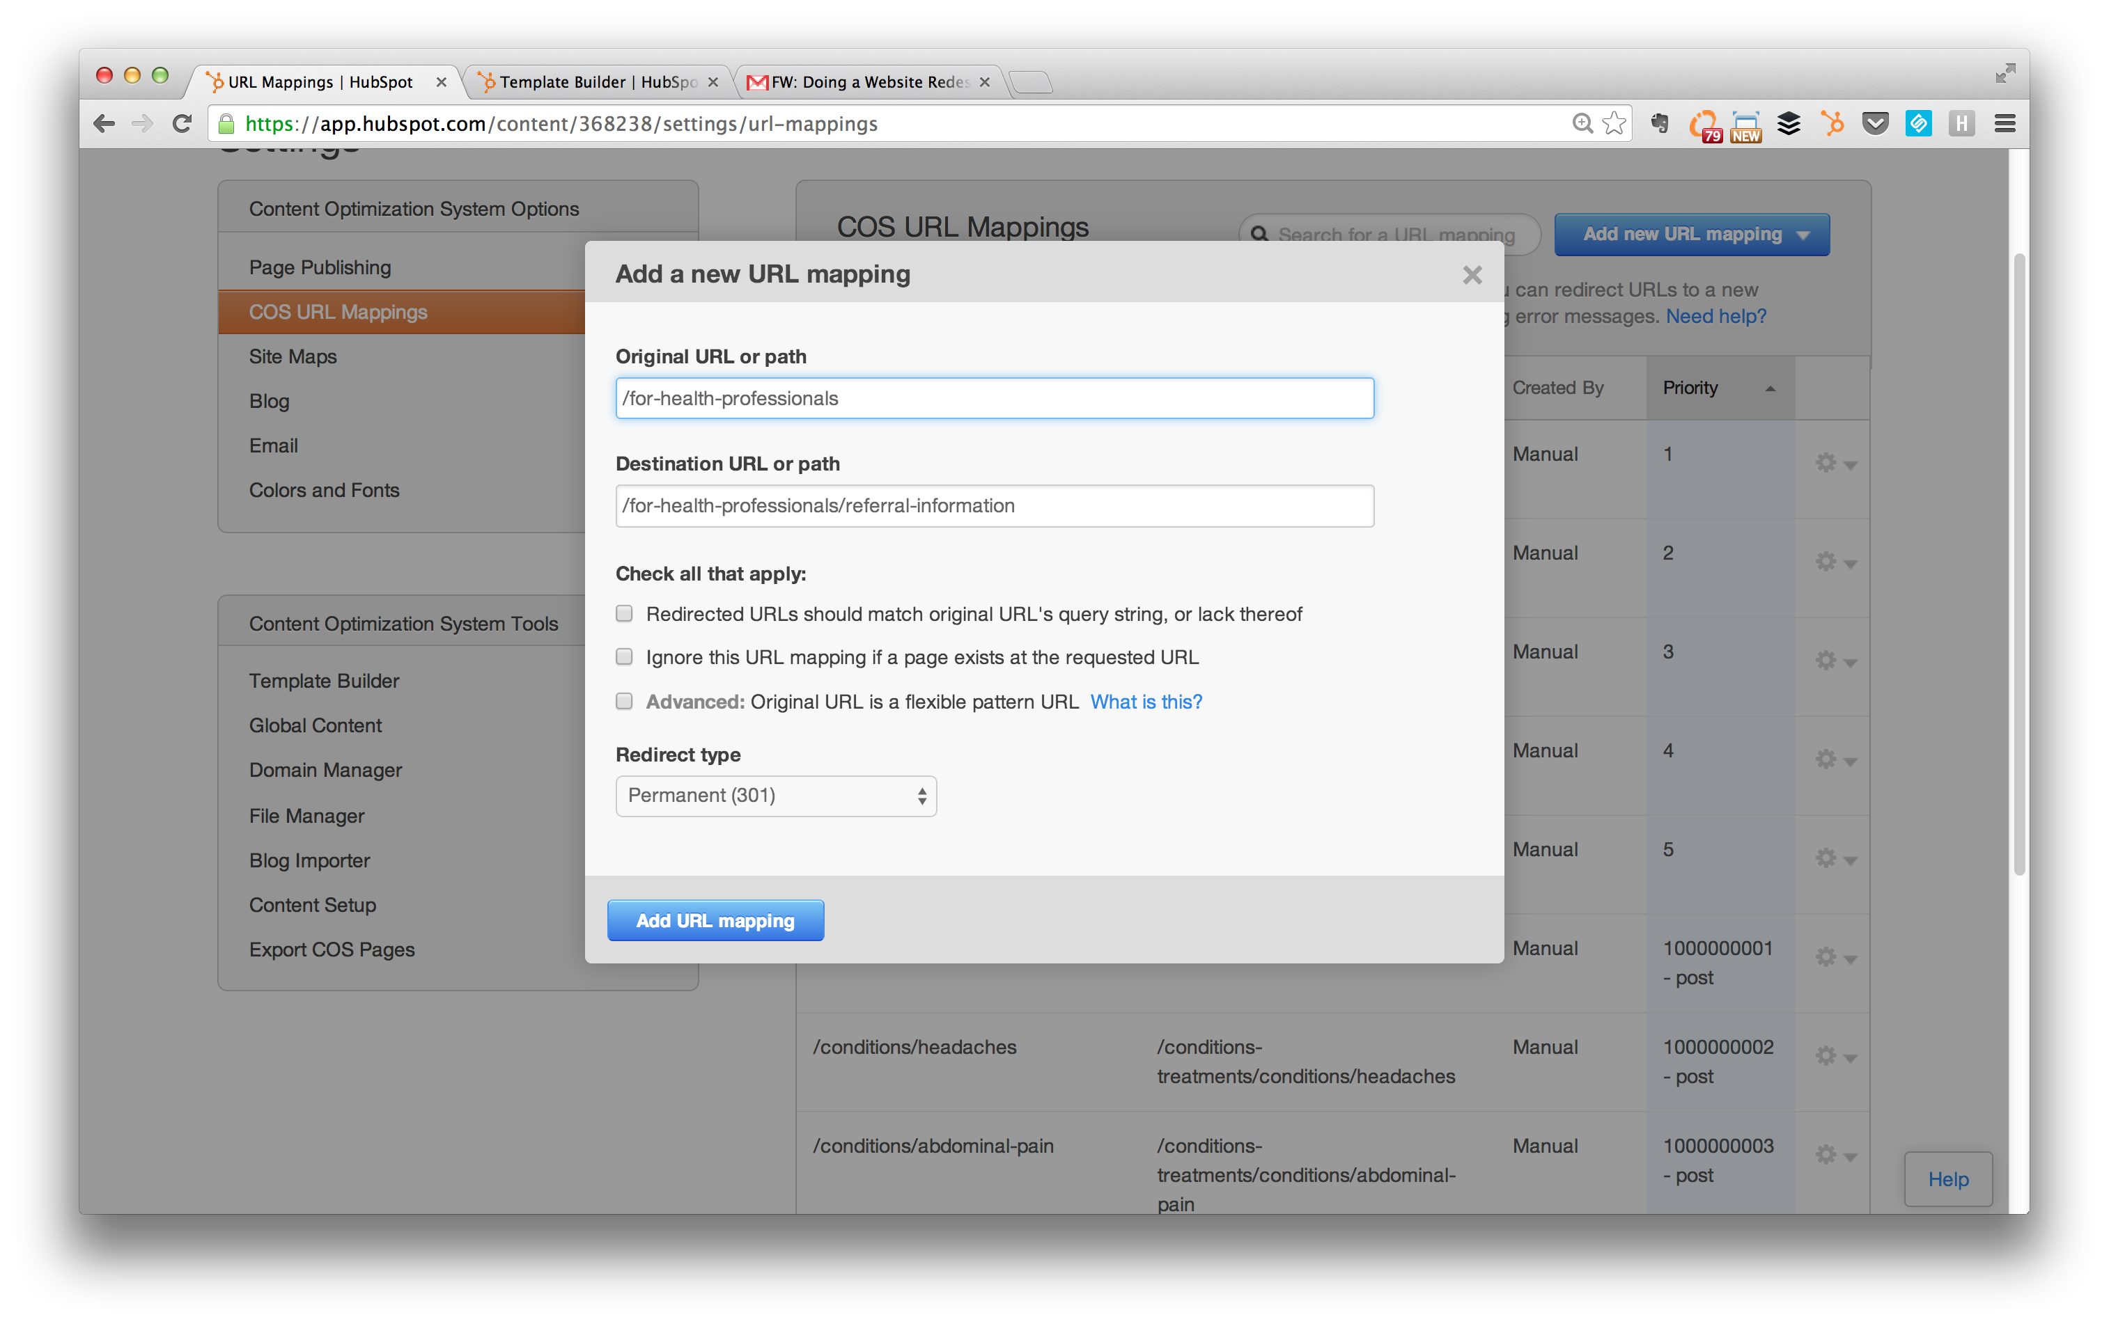

Slide 49
Takeaway
Please do not forget your redirects!

Slide 50
6
Launch

Slide 51
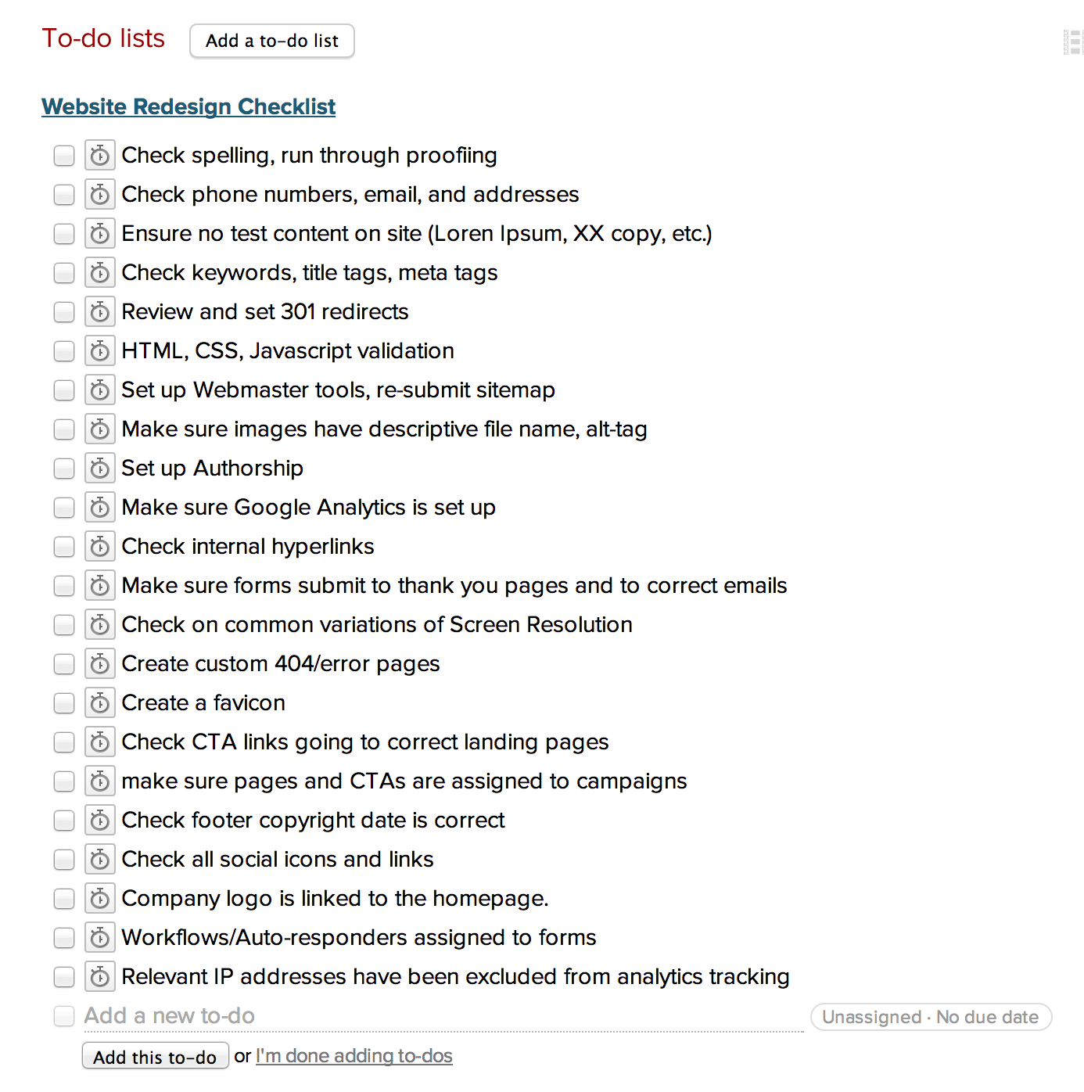
Launch
Prepare
Checklist
Announce
Kick off content strategy

Slide 52
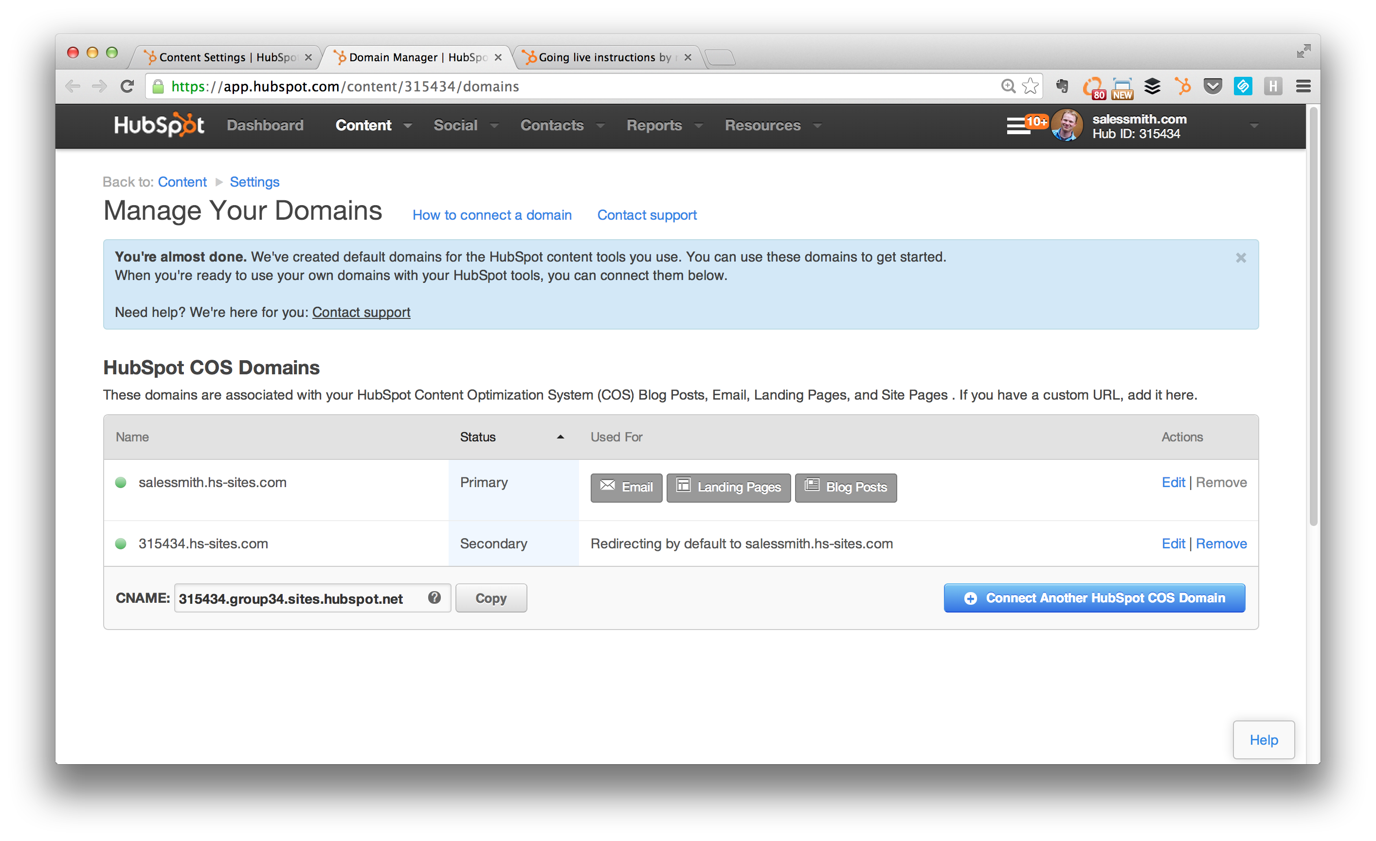

Slide 53
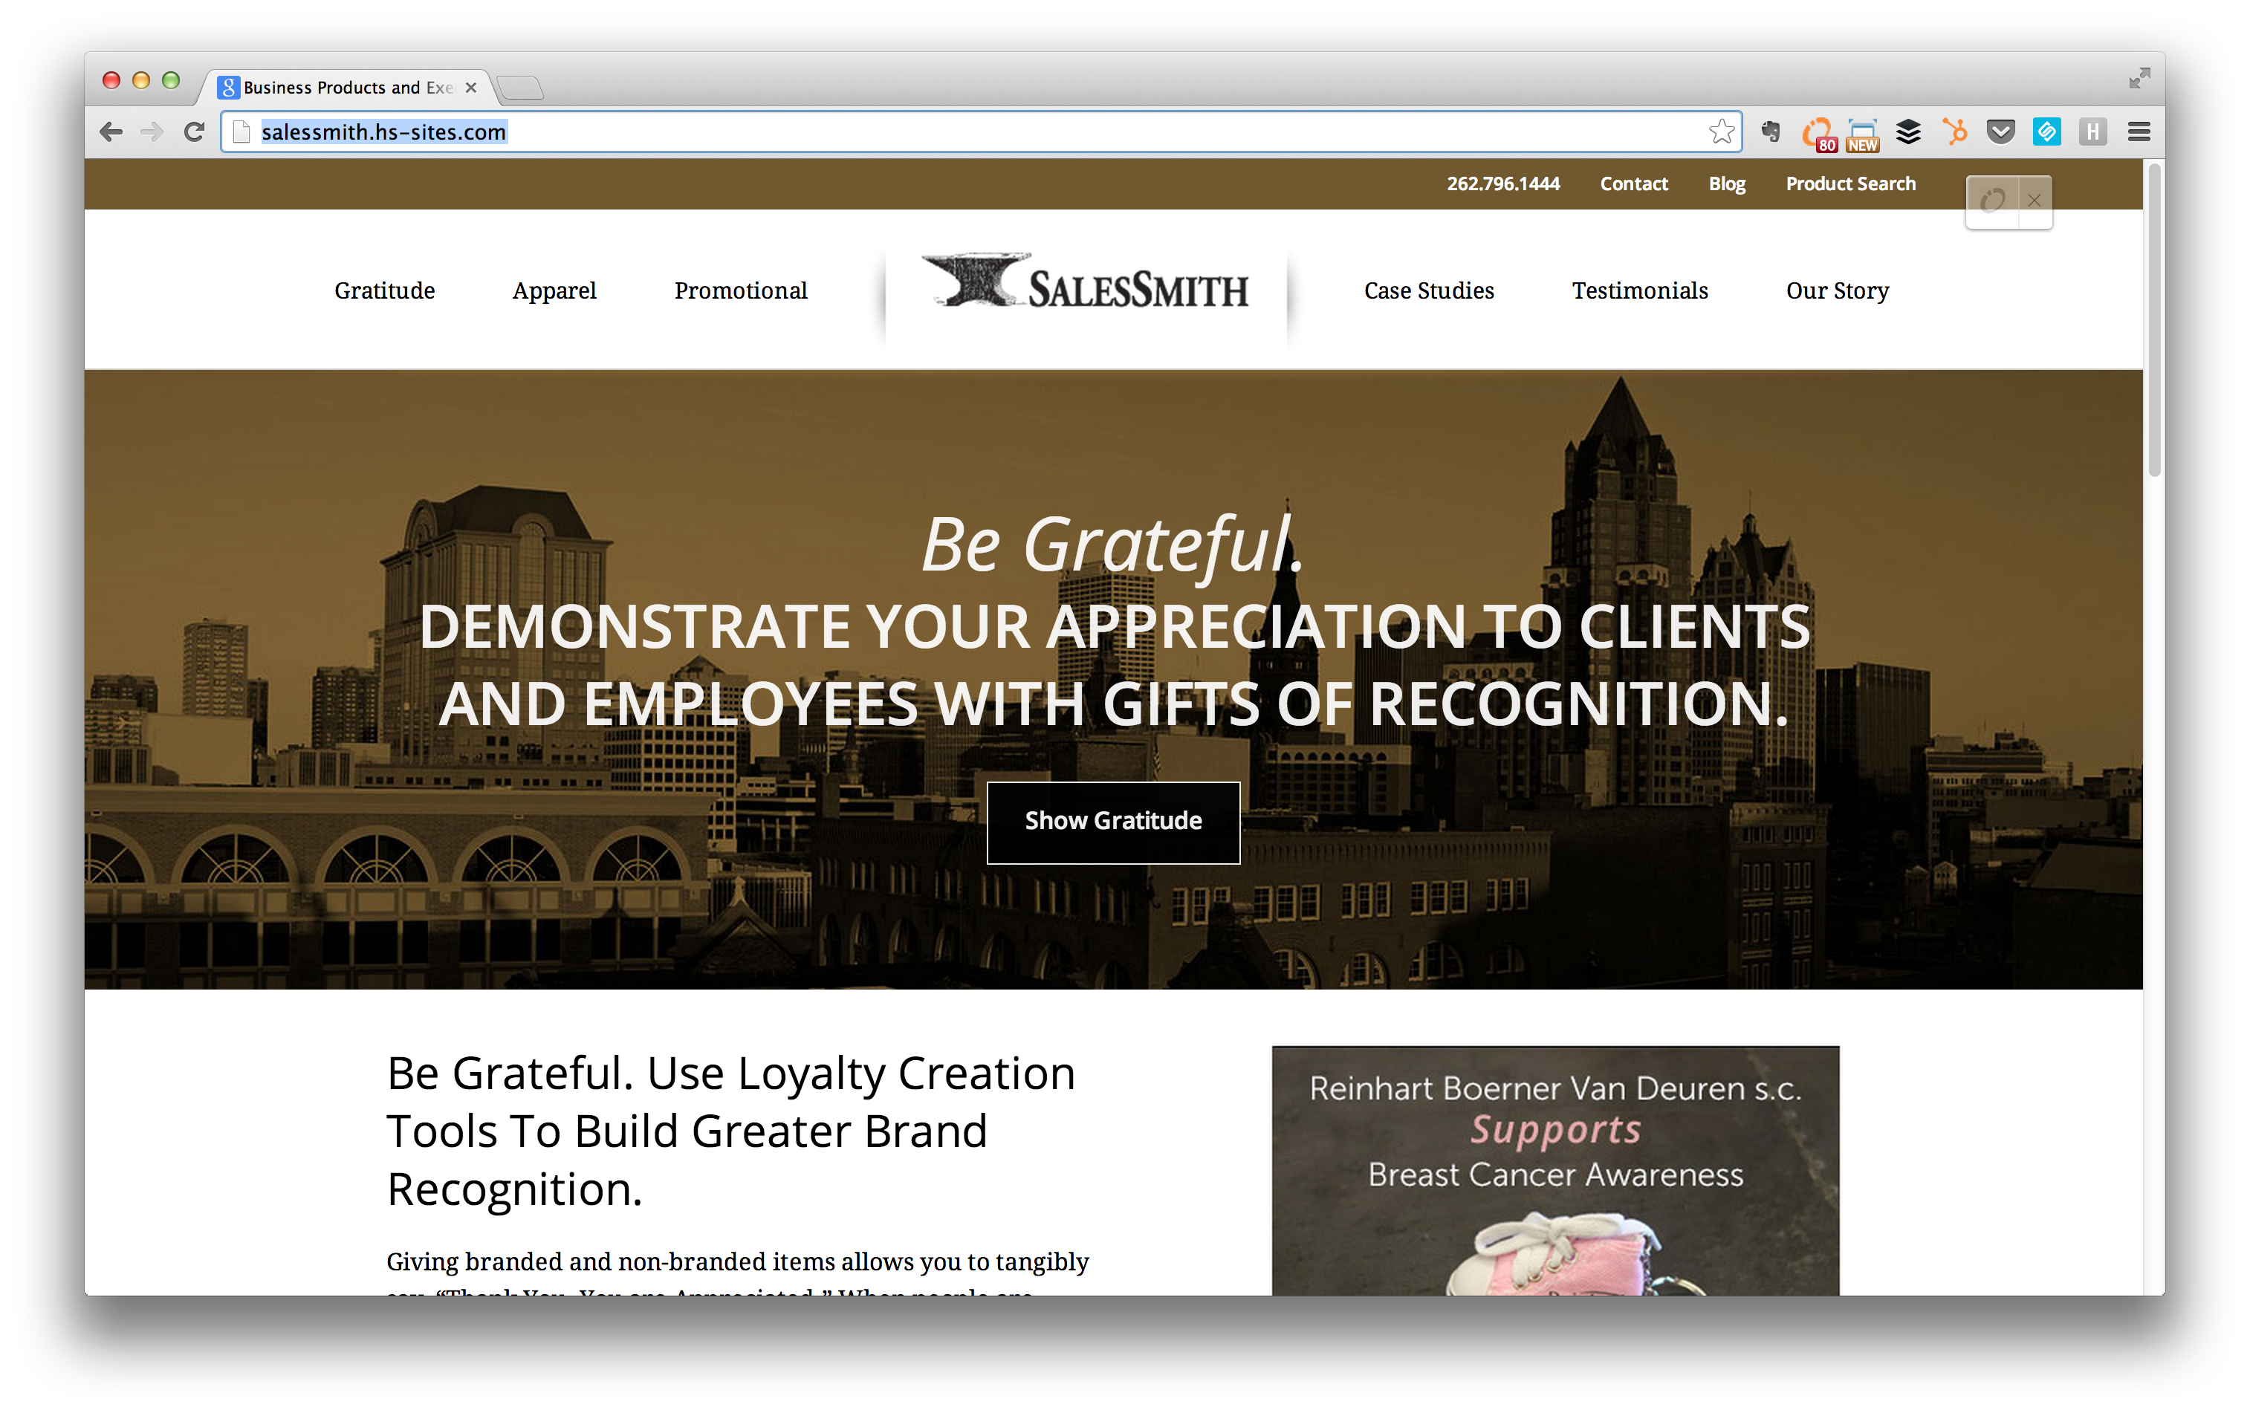
Notes:
Client example of Sub-Domain issue, working with IT – Working with IT helps with Launch and makes your life easier.
Two quick Stories:
Adaptive IT didn’t communicate with Customer Service and accidentally turned off a subdomain
Baker Cheese third party company wasn’t available on a Friday because the customer didn’t set early expectations on launch date and waited till last minute
Marketing at Catholic Financial Life didn’t follow up with IT on subdomain for blog and still is using blog incorrectly
TLHA internal IP address set and although the public can see new site, no one internally could see it.
Planning, Purpose, Process. Plan for launch day. Have people on stand by (developers, content integrator, IT or IT company), prepare for off hours, do it on a weekend or best day for your business. Manage Expectations.
Use HubSpot to make primary domains and turn things on. Catholic financial blog with H-S.Sites isn’t redirecting.
- Pop up window for InGuard example with cookies that only show up once
- Scheduling your Posts for announcement
The real work happens next to do social/content marketing strategy. Make sure everything is set up in tracking.
Remember the purpose of the redesign is to drive traffic and convert leads. The end goal shouldn’t be the launch, but how to facilitate your campaigns and lead gen, blogging.

Slide 54
Takeaway
Manage expectations on
launch day.

Slide 55
7
Analyze

Slide 56
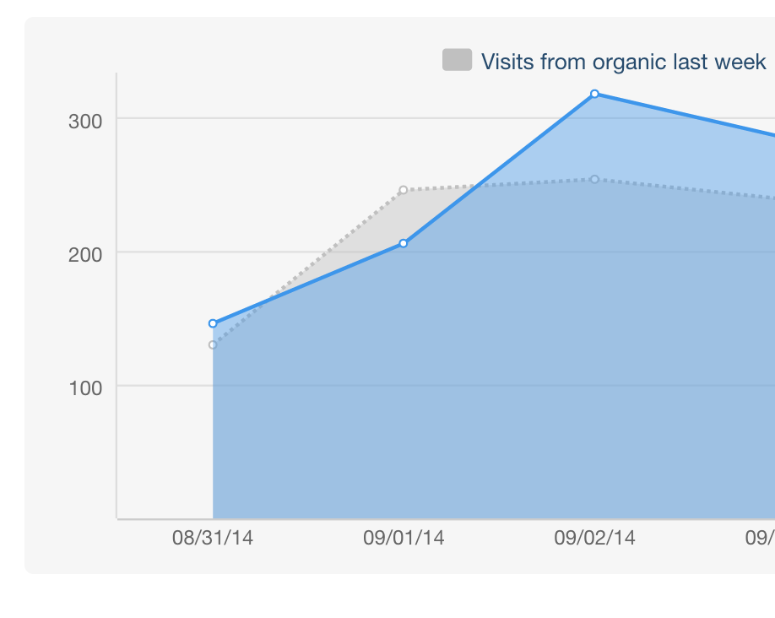
Analyze
Are pages indexed
Post-launch checklist
Benchmark metrics
Kick off content strategy
Update/test/measure

Slide 57
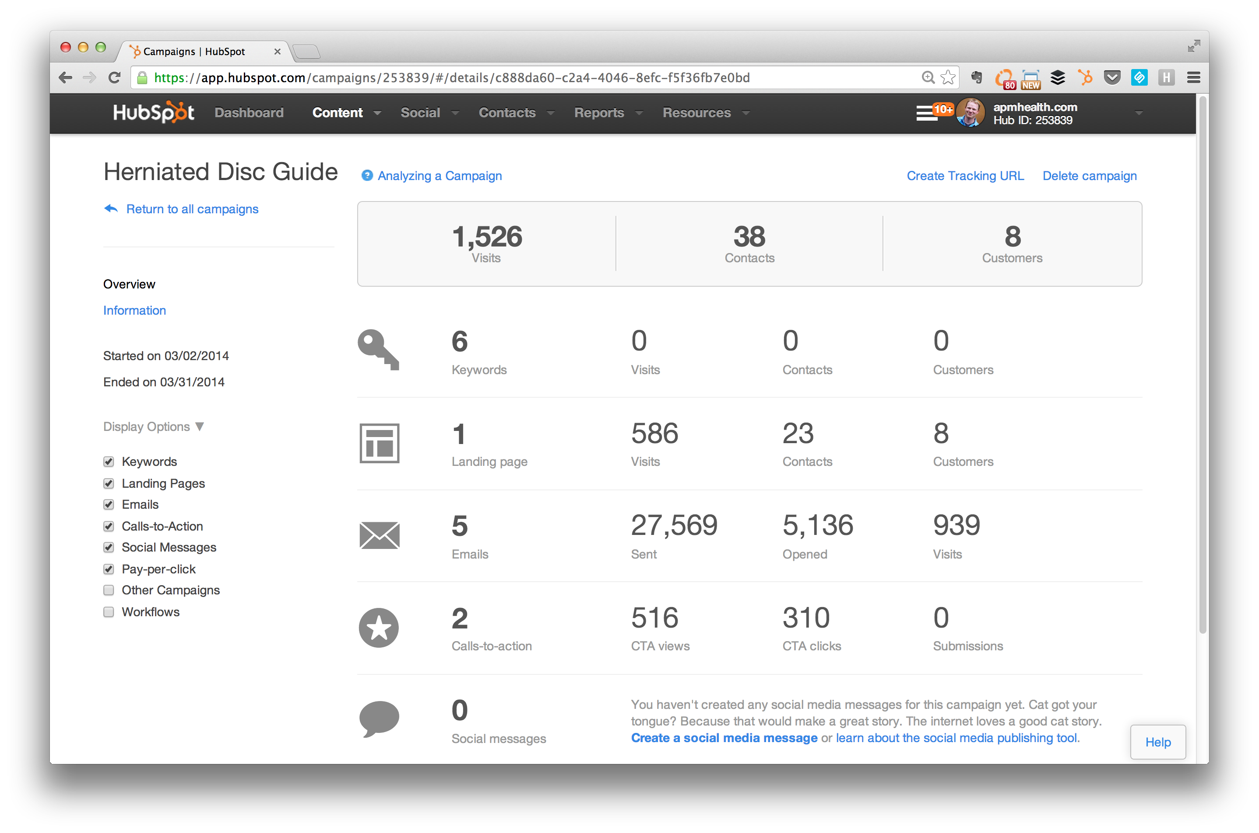
Notes:
http://knowledge.hubspot.com/campaigns-user-guide/how-to-analyze-a-campaign-in-hubspot

Slide 58
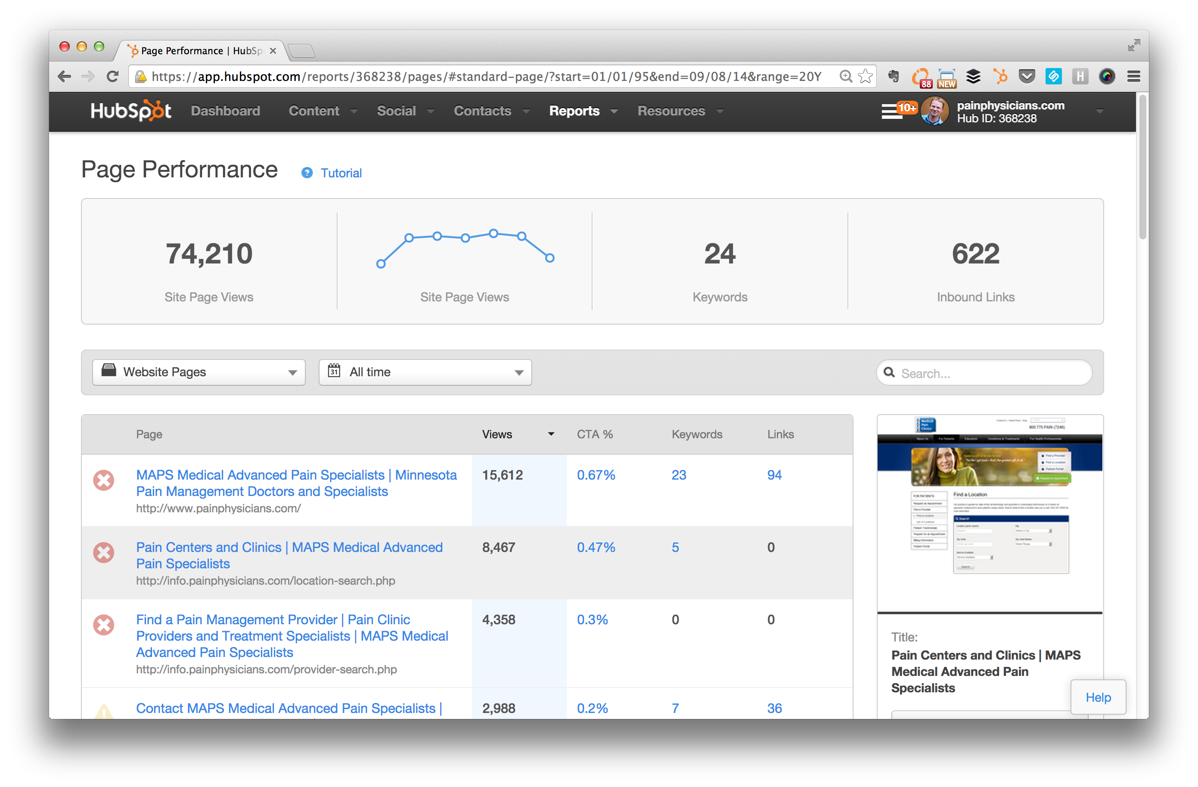
Notes:
HubSpot COS ties everything together. Make sure you set campaigns up to properly measure how keywords are doing, landing pages, emails, etc are working and converting on your site.
http://knowledge.hubspot.com/page-performance-user-guide/how-to-analyze-pages-in-page-performance

Slide 59
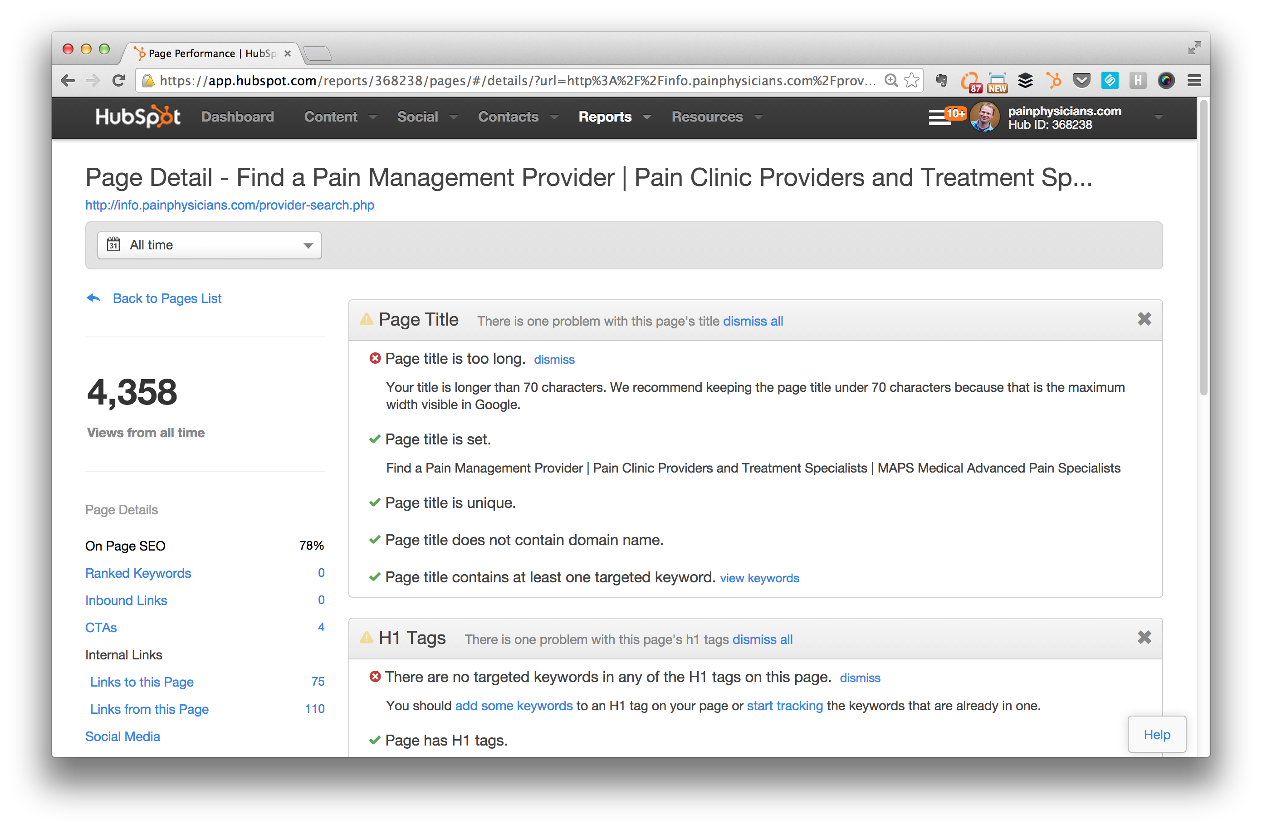
Notes:
HubSpot COS ties everything together. Make sure you set campaigns up to properly measure how keywords are doing, landing pages, emails, etc are working and converting on your site.
http://knowledge.hubspot.com/page-performance-user-guide/how-to-analyze-pages-in-page-performance

Slide 60
Takeaway
Set Quarterly review times to see how your web site design is performing. Make frequent updates.

Slide 61
Resources
10-Step Checklist
http://bit.ly/sc-checklist
Buyer Personas
http://bit.ly/hubspot-template
http://bit.ly/sc-persona

Slide 62

QUESTIONS ?

Slide 63
THANK YOU!

